Slide 1
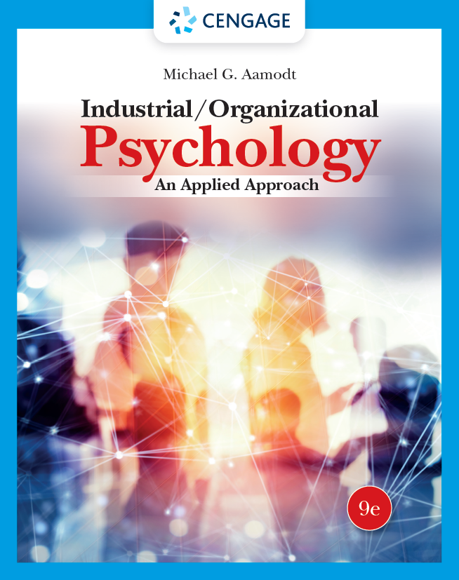
Industrial/Organizational Psychology: An Applied Approach, 9e
Chapter 6: Evaluating Selection Techniques and Decisions
Michael G. Aamodt, Industrial/Organizational Psychology: An Applied Approach, 9th Edition. © 2023 Cengage. All Rights Reserved. May not be scanned, copied or duplicated, or posted to a publicly accessible website, in whole or in part.

Slide 2
Icebreaker
Break into pairs of students.
Discuss any legal issues you have either experienced or heard about (through media, friends, etc.) during an interview process.
Share your discussions with the class.

Slide 3
Learning Objectives
06-01 Determine the reliability of a test and understand the factors that affect test reliability
06-02 Recognize the five ways to validate a test
06-03 Find information about tests
06-04 Determine the utility of a selection test
06-05 Evaluate a test for potential legal problems
06-06 Use test scores to make personnel selection decisions

Slide 4
Characteristics of Effective Selection Techniques

Slide 5
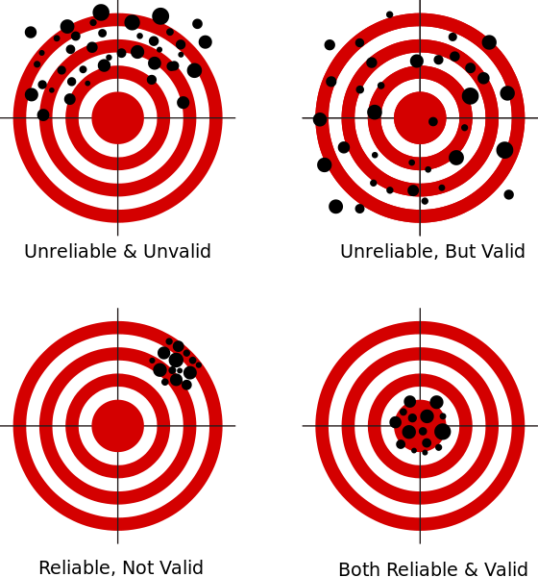
Optimal Employee Selection Systems
Are Reliable
Are Valid
Based on a job analysis (content validity)
Predict work-related behavior (criterion validity)
Are Cost Effective
Cost to purchase/create
Cost to administer
Cost to score
Are Fair
Reduce the Chance of a Legal Challenge
Face valid
Don’t invade privacy
Don’t intentionally discriminate
Minimize adverse impact

Slide 6
Reliability
The extent to which a score from a test is consistent and free from errors of measurement
Methods of determining reliability
Test-retest (temporal stability)
Alternate forms (form stability)
Internal reliability (item stability)
Scorer reliability

Slide 7
Test-Retest Reliability
Measures temporal stability
Administration
Same applicants
Same test
Two testing periods
Scores at time one are correlated with scores at time two
Typical test-retest reliability correlation used by organizations is 0.86 (Hood, 2001)

Slide 8
Test-Retest Reliability Problems
Sources of measurement errors
Characteristic or attribute being measured may change over time
Reactivity
Carry over effects
Practical problems
Time consuming
Expensive
Inappropriate for some types of tests

Slide 9
Alternate Forms Reliability Administration
Two forms of the same test are developed, and to the highest degree possible, are equivalent in terms of content, response process, and statistical characteristics
One form is administered to examinees, and at some later date, the same examinees take the second form

Slide 10
Alternate Forms Reliability Scoring
Scores from the first form of test are correlated with scores from the second form
If the scores are highly correlated, the test has form stability

Slide 11
Internal Reliability
Defines measurement error strictly in terms of consistency or inconsistency in the content of the test
Used when it is impractical to administer two separate forms of a test
With this form of reliability, the test is administered only once and measures item stability

Slide 12
Determining Internal Reliability
Split-half method (most common)
Test items are divided into two equal parts
Scores for the two parts are correlated to get a measure of internal reliability
Kuder-Richardson formula 20 (K-R 20)
Dichotomous items
Spearman-Brown prophecy formula:
(2 × split half reliability) ÷ (1 + split-half reliability)

Slide 13
Spearman-Brown Formula Example
(2 × split-half correlation)
(1 + split-half correlation)
If we have a split-half correlation of 0.60, the corrected reliability would be:
(2 × 0.60) ÷ (1 + 0.60) = 1.2 ÷ 1.6 = 0.75

Slide 14
Common Methods: Correlating Split-Half
Cronbach’s Coefficient Alpha
Used with ratio or interval data
Kuder-Richardson 20 Formula
Used for test with dichotomous items (yes-no true-false)

Slide 15
Scorer Reliability
Used when human judgment of performance is involved in the selection process
Refers to the degree of agreement between 2 or more raters

Slide 16
Reliability: Conclusions
The higher the reliability of a selection test the better
Reliability can be affected by many factors
Factors when evaluating reliability:
Magnitude of reliability coefficient
People that are taking the test

Slide 17
Validity
Definition: The degree to which inferences from scores on tests or assessments are justified by the evidence
Common ways to measure
Content validity
Criterion validity
Construct validity
Known-group validity
Face validity

Slide 18
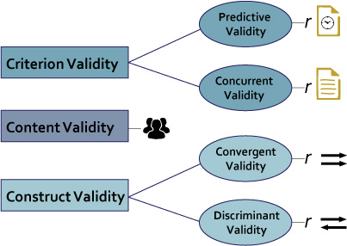
Content Validity
The extent to which test items sample the content that they are supposed to measure
In industry the appropriate content of a test or test battery is determined by a job analysis

Slide 19
Criterion Validity
Criterion validity refers to the extent to which a test score is related to some measure of job performance called a criterion
Established using one of the following research designs:
Concurrent validity
Predictive validity
Validity generalization

Slide 20
Concurrent Validity
Uses current employees
Correlated with a measure of employee performance
Range restriction can be a problem

Slide 21
Predictive Validity
Correlates test scores with future behavior
Reduces the problem of range restriction
May not be practical

Slide 22
Validity Generalization
The extent to which a test found valid for a job in one location is valid for the same job in a different location
The key to establishing validity generalization is meta-analysis and job analysis
Synthetic validity

Slide 23
Construct Validity
The extent to which a test actually measures the construct that it purports to measure
Is concerned with inferences about test scores
Determined by correlating scores on a test with scores from other tests
Known group validity

Slide 24

Face Validity
The extent to which a test appears to be job related
Reduces the chance of legal challenge
Increasing face validity

Slide 25
Workbook Exercise 6.1 Locating Test Information

Slide 26
Finding Reliability and Validity Information
Twenty-First Mental Measurements Yearbook (MMY)
Tests in Print IX

Slide 27
Cost Efficiency
Wonderlic Personnel Test vs. Wechsler Adult Intelligence Scale (WAIS)
Unproctored Internet-based testing (UIT)
Computer adaptive testing (CAT)

Slide 28
Establishing the Usefulness of a Selection Device

Slide 29
Utility
The degree to which a selection device improves the quality of a personnel system, above and beyond what would have occurred had the instrument not been used.

Slide 30
Selection Works Best When...
You have many job openings
You have many more applicants than openings
You have a valid test
The job in question has a high salary
The job is not easily performed or easily trained

Slide 31
Common Utility Methods
Taylor-Russell tables
Proportion of correct decisions
Lawshe tables
Expectancy charts
Brogden-Cronbach-Gleser utility formula

Slide 32
Utility Analysis: Taylor-Russell Tables
Estimates the percentage of future employees that will be successful
Three components
Validity
Base rate (successful employees ÷ total employees)
Selection ratio (hired ÷ applicants)

Slide 33
Taylor-Russell Example
Suppose we have
a test validity of 0.40
a selection ratio of 0.30
a base rate of 0.50
Using the Taylor-Russell, tables what percentage of future employees would be successful?

Slide 34
Taylor-Russell Table
50% | r | 0.05 | 0.10 | 0.20 | 0.30 | 0.40 | 0.50 | 0.60 | 0.70 | 0.80 | 0.90 | 0.95
 | 0.00 | 0.50 | 0.50 | 0.50 | 0.50 | 0.50 | 0.50 | 0.50 | 0.50 | 0.50 | 0.50 | 0.50
 | 0.10 | 0.58 | 0.57 | 0.56 | 0.55 | 0.54 | 0.53 | 0.53 | 0.52 | 0.51 | 0.51 | 0.50
 | 0.20 | 0.67 | 0.64 | 0.61 | 0.59 | 0.58 | 0.56 | 0.55 | 0.54 | 0.53 | 0.52 | 0.51
 | 0.30 | 0.74 | 0.71 | 0.67 | 0.64 | 0.62 | 0.60 | 0.58 | 0.56 | 0.54 | 0.52 | 0.51
 | 0.40 | 0.82 | 0.78 | 0.73 | 0.69 | 0.66 | 0.63 | 0.61 | 0.58 | 0.56 | 0.53 | 0.52
 | 0.50 | 0.88 | 0.84 | 0.76 | 0.74 | 0.70 | 0.67 | 0.63 | 0.60 | 0.57 | 0.54 | 0.52
 | 0.60 | 0.94 | 0.90 | 0.84 | 0.79 | 0.75 | 0.70 | 0.66 | 0.62 | 0.59 | 0.54 | 0.52
 | 0.70 | 0.98 | 0.95 | 0.90 | 0.85 | 0.80 | 0.75 | 0.70 | 0.65 | 0.60 | 0.55 | 0.53
 | 0.80 | 1.0 | 0.99 | 0.95 | 0.90 | 0.85 | 0.80 | 0.73 | 0.67 | 0.61 | 0.55 | 0.53
 | 0.90 | 1.0 | 1.0 | 0.99 | 0.97 | 0.92 | 0.86 | 0.78 | 0.70 | 0.62 | 0.56 | 0.53

Slide 35
Proportion of Correct Decisions: Method
Proportion of Correct Decisions with Test
(Correct rejections + correct acceptances) ÷ Total employees
Quadrant II Quadrant IV Quadrants I+II+III+IV
Baseline of Correct Decisions
Successful employees ÷ Total employees
Quadrants I + II Quadrants I+II+III+IV

Slide 36
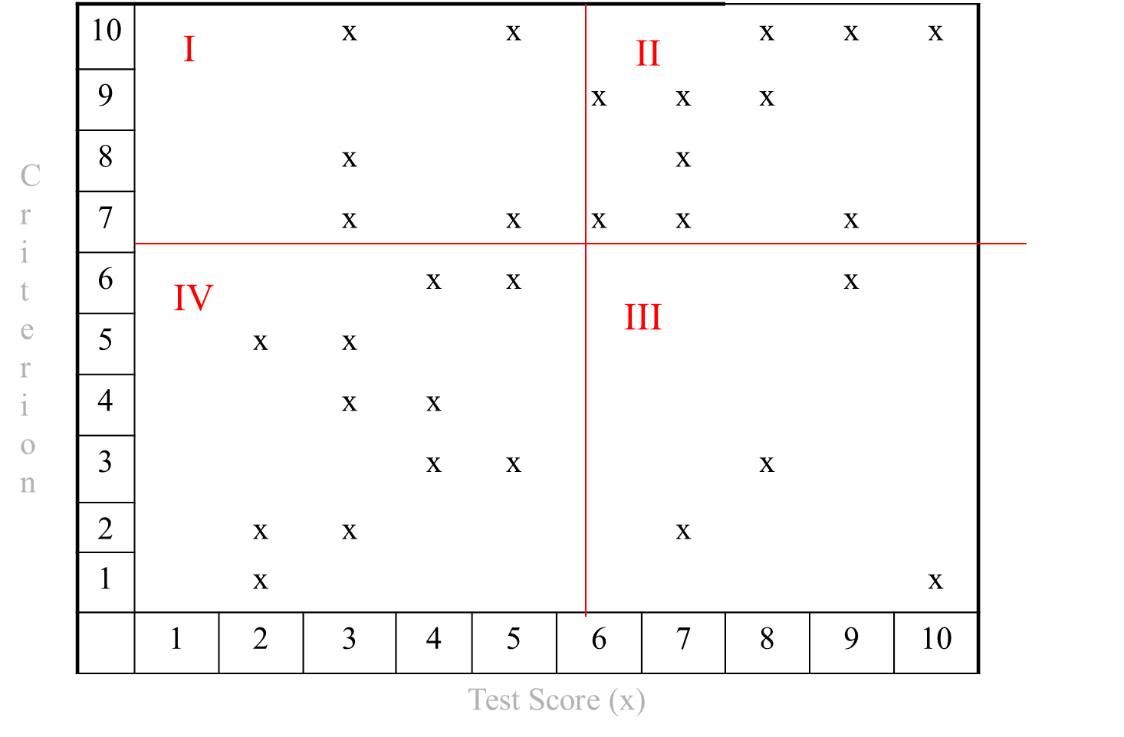
Determining the Proportion of Correct Decisions (based on method explanation)

Slide 37
Proportion of Correct Decisions: Computed
Proportion of Correct Decisions with Test
(10 + 11) ÷ (5 + 10 + 4 + 11)
Quadrant II Quadrant IV Quadrants I+II+III+IV
= 21 ÷ 30 = 0.70
Baseline of Correct Decisions
5 + 10 ÷ 5 + 10 + 4 + 11
Quadrants I + II Quadrants I+II+III+IV
= 15 ÷ 30 = 0.50

Slide 38
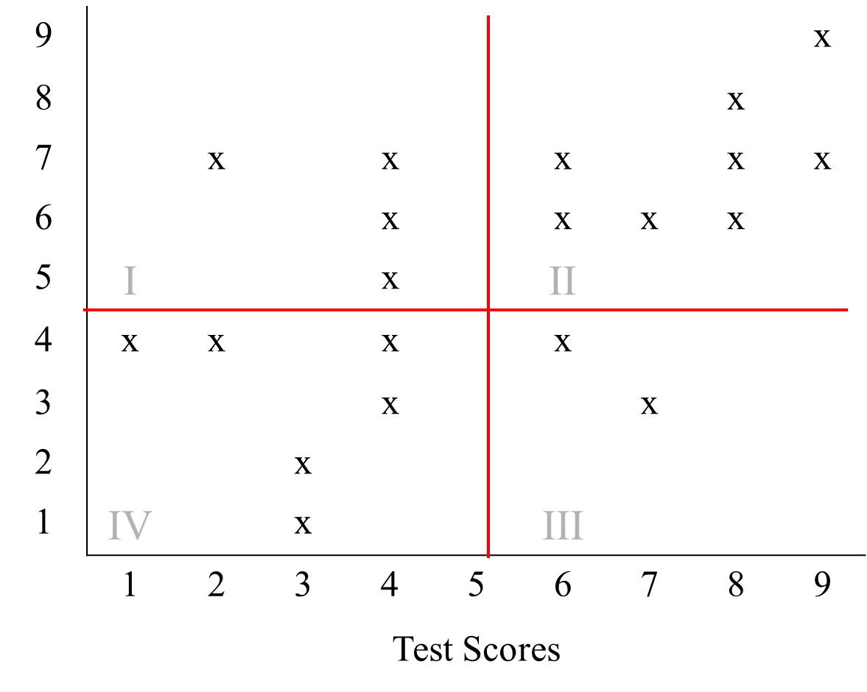
Determining the Proportion of Correct Decisions (based on computation)

Slide 39
Workbook Exercise 6.3 Computing the Proportion of Correct Decisions

Slide 40
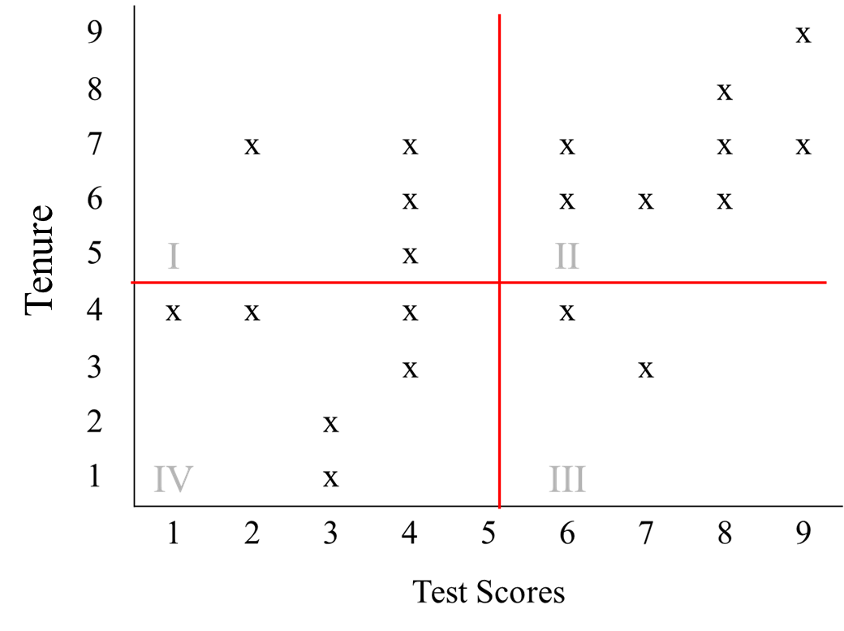
Plot of Scores for Exercise 6.3

Slide 41
Answer to Exercise 6.3
Proportion of Correct Decisions With Test
(8 + 6) ÷ (4 + 8 + 6 + 2)
Quadrant II Quadrant IV Quadrants I+II+III+IV
= 14 ÷ 20 = 0.70
Baseline of Correct Decisions
4 + 8 ÷ 4 + 8 + 6 + 2
Quadrants I + II Quadrants I+II+III+IV
= 12 ÷ 20 = 0.60

Slide 42
Lawshe Tables
Probability that a particular applicant will be successful
Based on correlation coefficients
Three components:
Validity coefficient
Base rate
Applicant’s test score

Slide 43
Expectancy Chart
Probability that a particular applicant will be successful
Based on raw data distributions

Slide 44
Brogden-Cronbach-Gleser Utility Formula
Gives an estimate of utility by estimating the amount of money an organization would save if it used the test to select employees
Savings = (n) (t) (r) (SDy) (m) – cost of testing
n = number of employees hired per year
t = average tenure
r = test validity
SDy = standard deviation of performance in dollars
m = mean standardized predictor score of selected applicants

Slide 45
Components of Utility
Selection ratio
The ratio between the number of openings to the number of applicants
Validity coefficient
Base rate of current performance
The percentage of employees currently on the job who are considered successful
Sdy
The difference in performance (measured in dollars) between a good and average worker (workers one standard deviation apart)

Slide 46
Calculating M (1 of 2)
For example, we administer a test of mental ability to a group of 100 applicants and hire the 10 with the highest scores. The average score of the 10 hired applicants was 34.6, the average test score of the other 90 applicants was 28.4, and the standard deviation of all test scores was 8.3.
The desired figure would be: (34.6 – 28.4) ÷ 8.3 = 6.2 ÷ 8.3 = ?

Slide 47
Calculating M (2 of 2)
You administer a test of mental ability to a group of 150 applicants, and hire 35 with the highest scores. The average score of the 35 hired applicants was 35.7, the average test score of the other 115 applicants was 24.6, and the standard deviation of all test scores was 11.2.
The desired figure would be: (35.7 – 24.6) ÷ 11.2 = ?

Slide 48
Standardized Selection Ratio
SR | m
1.00 | 0.00
0.90 | 0.20
0.80 | 0.35
0.70 | 0.50
0.60 | 0.64
0.50 | 0.80
0.40 | 0.97
0.30 | 1.17
0.20 | 1.40
0.10 | 1.76
0.05 | 2.08

Slide 49
Example
Suppose:
we hire 10 auditors per year
the average person in this position stays 2 years
the validity coefficient is 0.30
the average annual salary for the position is $30,000
we have 50 applicants for ten openings
Our utility would be: (10 × 2 × 0.30 × $12,000 × 1.40) – (50 × 10) = $100,300

Slide 50
Workbook Exercise 6.2 Utility

Slide 51
Answer Exercise 6.2
1. | Selection Ratio | 250 ÷ 500 = 0.50
 | Base rate | 800 ÷ 1000 = 0.80
 | Validity | 0.40
 | % of future successful employees | 89%

Slide 52
Taylor-Russell Table Example 1
 | Selection Ratio |  |  | ⬇
80% | r | 0.05 | 0.10 | 0.20 | 0.30 | 0.40 | 0.50 | 0.60 | 0.70 | 0.80 | 0.90 | 0.95
 | 0.00 | 0.80 | 0.80 | 0.80 | 0.80 | 0.80 | 0.80 | 0.80 | 0.80 | 0.80 | 0.80 | 0.80
 | 0.10 | 0.85 | 0.85 | 0.84 | 0.83 | 0.83 | 0.82 | 0.82 | 0.81 | 0.81 | 0.81 | 0.80
 | 0.20 | 0.90 | 0.89 | 0.87 | 0.86 | 0.85 | 0.84 | 0.84 | 0.83 | 0.82 | 0.81 | 0.81
 | 0.30 | 0.94 | 0.92 | 0.90 | 0.89 | 0.88 | 0.87 | 0.86 | 0.84 | 0.83 | 0.82 | 0.81
➔ | 0.40 | 0.96 | 0.95 | 0.93 | 0.92 | 0.90 | 0.89 | 0.88 | 0.86 | 0.85 | 0.83 | 0.82
 | 0.50 | 0.98 | 0.97 | 0.96 | 0.94 | 0.93 | 0.91 | 0.90 | 0.88 | 0.86 | 0.84 | 0.82
 | 0.60 | 0.99 | 0.99 | 0.98 | 0.96 | 0.95 | 0.94 | 0.92 | 0.90 | 0.87 | 0.84 | 0.83
 | 0.70 | 1.0 | 1.0 | 0.99 | 0.98 | 0.97 | 0.96 | 0.94 | 0.92 | 0.89 | 0.85 | 0.83
 | 0.80 | 1.0 | 1.0 | 1.0 | 1.0 | 0.99 | 0.98 | 0.96 | 0.94 | 0.91 | 0.87 | 0.84
 | 0.90 | 1.0 | 1.0 | 1.0 | 1.0 | 1.0 | 1.0 | 0.99 | 0.97 | 0.94 | 0.88 | 0.84

Slide 53
2. Answer: Current Test
Components:
We will hire 250 people
The average person in this position stays 4 years
The validity coefficient is 0.30
The average annual salary for the position is $70,000
We have 500 applicants for 250 openings
Our utility would be: (250 × 4 × 0.30 × $28,000 × 0.80) – (500 × 15) = $6,720,000 − $7,500 = $6,712,500

Slide 54
3. Answer: New Test
Components:
We will hire 250 people
The average person in this position stays 4 years
The validity coefficient is 0.40
The average annual salary for the position is $70,000
We have 500 applicants for 200 openings
Our utility would be: (250 × 4 × 0.40 × $28,000 × 0.80) − (500 × 10) = $8,960,000 − $5,000 = $8,955,000

Slide 55
4. Savings Over Old Test (1 of 2)
Test | Utility
New Test: Reilly Statistical Logic Test | $8,955,000
Old Test: Tribble Math | $6,712,500
Savings | $2,242,500

Slide 56
Standardized Selection Ratio (2 of 2)
SR | m
1.00 | 0.00
0.90 | 0.20
0.80 | 0.35
0.70 | 0.50
0.60 | 0.64
0.50 | 0.80
0.40 | 0.97
0.30 | 1.17
0.20 | 1.40
0.10 | 1.76
0.05 | 2.08

Slide 57
Table 5.2
Method | Validity | Method | Validity
Cognitive ability | 0.39 | References | 0.18
Biodata | 0.36 | Grades | 0.16
Structured Interview | 0.34 | Integrity tests | 0.13
Assessment centers | 0.28 | Agreeableness | 0.13
Work samples | 0.26 | Unstructured interviews | 0.11
Experience | 0.22 | Interest inventories | 0.10
Conscientiousness | 0.21 | Emotional stability | 0.08
Situational judgment | 0.20 | Openness | 0.06

Slide 58
Answer to Question 1 on Page 78
1. | Selection Ratio | 0.50
 | Base rate | 0.80
 | Validity | 0.34
 | % of future successful employees | 0.87 (round r down) 0.89 (round r up)

Slide 59
Taylor-Russell Table Example 2
 | Selection Ratio |  |  | ⬇
80% | r | 0.05 | 0.10 | 0.20 | 0.30 | 0.40 | 0.50 | 0.60 | 0.70 | 0.80 | 0.90 | 0.95
 | 0.00 | 0.80 | 0.80 | 0.80 | 0.80 | 0.80 | 0.80 | 0.80 | 0.80 | 0.80 | 0.80 | 0.80
 | 0.10 | 0.85 | 0.85 | 0.84 | 0.83 | 0.83 | 0.82 | 0.82 | 0.81 | 0.81 | 0.81 | 0.80
 | 0.20 | 0.90 | 0.89 | 0.87 | 0.86 | 0.85 | 0.84 | 0.84 | 0.83 | 0.82 | 0.81 | 0.81
➔ | 0.30 | 0.94 | 0.92 | 0.90 | 0.89 | 0.88 | 0.87 | 0.86 | 0.84 | 0.83 | 0.82 | 0.81
 | 0.40 | 0.96 | 0.95 | 0.93 | 0.92 | 0.90 | 0.89 | 0.88 | 0.86 | 0.85 | 0.83 | 0.82
 | 0.50 | 0.98 | 0.97 | 0.96 | 0.94 | 0.93 | 0.91 | 0.90 | 0.88 | 0.86 | 0.84 | 0.82
 | 0.60 | 0.99 | 0.99 | 0.98 | 0.96 | 0.95 | 0.94 | 0.92 | 0.90 | 0.87 | 0.84 | 0.83
 | 0.70 | 1.0 | 1.0 | 0.99 | 0.98 | 0.97 | 0.96 | 0.94 | 0.92 | 0.89 | 0.85 | 0.83
 | 0.80 | 1.0 | 1.0 | 1.0 | 1.0 | 0.99 | 0.98 | 0.96 | 0.94 | 0.91 | 0.87 | 0.84
 | 0.90 | 1.0 | 1.0 | 1.0 | 1.0 | 1.0 | 1.0 | 0.99 | 0.97 | 0.94 | 0.88 | 0.84

Slide 60
2. Answer: Unstructured Interview (1 of 2)
Components:
We will hire 250 people
The average person in this position stays 4 years
The validity coefficient is 0.11
The average annual salary for the position is $70,000
We have 500 applicants for 250 openings
Our utility would be: (250 × 4 × 0.11 × $28,000 × 0.80) − (500 × 25) = $2,464,000 − $12,500 = $2,451,500

Slide 61
2. Answer: Unstructured Interview (2 of 2)
Components:
We will hire 200 people
The average person in this position stays 4 years
The observed validity coefficient is 0.34
The average annual salary for the position is $60,000
We have 500 applicants for 200 openings
Our utility would be: (250 × 4 × 0.34 × $28,000 × 0.80) − (500 × 15) = $7,616,000 − $12,500 = $7,603,500

Slide 62
4. Savings Over Old Test (2 of 2)
Test | Utility
New Test: Structured Interview | $7,603,500
Old Test: Unstructured Interview | $2,451,500
Savings | $5,152,000

Slide 63
Determining the Fairness of a Test

Slide 64
Measurement Bias
Technical aspects of the test
A test is biased if there are group differences in test scores (e.g., race, gender) that are unrelated to the construct being measured (e.g., integrity)
Burden is on organization to prove test is valid if it causes adverse impact

Slide 65
Predictive Bias
A test is fair if people of equal probability of success on a job have an equal chance of being hired
Single-group validity
Differential validity
Not use the test
Use the test with separate regression equations

Slide 66
Making the Hiring Decision

Slide 67
Linear Approaches
Unadjusted top-down selection
Rule of three
Passing scores
Banding

Slide 68
The Top-Down Approach
A “performance first” hiring formula
Applicant | Sex | Test Score
Ferguson | M | 99
Letterman | M | 98
Fallon | M | 91
Kimmel | M | 90
Winfrey | F | 88
Lopez | M | 87
Should the person with the top score be offered the job?

Slide 69
Top-Down Selection
Advantages
Utility
Disadvantages
Less flexibility in decision making
Adverse impact = less workforce diversity
Compensatory approach

Slide 70
Rule of Three
Name of top three scorers given to person making hiring decision
Well-qualified
More choices

Slide 71
The Passing Scores Approach
Reducing adverse impact and increasing flexibility
Who will perform at an acceptable level?
A passing score is a point in a distribution of scores that distinguishes acceptable from unacceptable performance (Kane, 1994)
Multiple-cutoff approach
Multiple-hurdle approach

Slide 72
Multiple-Cutoff vs. Multiple-Hurdle
Multiple-cutoff approach
Less cost-effective
Can be administered in one day
Less likely to cause adverse impact
Multiple-hurdle approach
More cost-effective
Must be administered on several occasions
More likely to cause adverse impact

Slide 73
Banding
Standard Error of Measurement (SEM) Bands
A compromise between the top-down and passing scores approach
It takes into account that tests are not perfectly reliable (error)

Slide 74
SEM Banding
Compromise between top-down selection and passing scores
Based on the concept of the standard error of measurement
To compute you need the standard deviation and reliability of the test
Band is established by multiplying 1.96 times the standard error

Slide 75
Disadvantages of Banding
Lower utility than top-down
May not actually reduce adverse impact
Factors that affect usefulness in achieving affirmative action goals
Selection ratio
Percentage of minority applicants
SEM formula may be incorrect (Gasperson et al., 2013)

Slide 76
Workbook Exercise 6.4 Using Banding to Reduce Adverse Impact

Slide 77
Answer to Exercise 6.4
1. Standard Error | 3.06
2. Band | 3.06 * 1.96 = 6.0 points
3. Hire using nonsliding band
McCoy | Crane
Robinette | Carmichael
4. Hire using sliding band
Carmichael | McCoy
Ross | Crane
5. Hire using a passing score of 80
Carmichael | McCoy
Ross | Crane

Slide 78
Graphic Depiction of Answer
Applicant | Sex | Score | Band 1 | Band 2 | Band 3 | Band 4 | Band 5
McCoy | m | 97 | x | x | hired | hired | hired
Crane | m | 95 | x | x | x | x | hire
Robinette | m | 94 | x | x | x | x | x
Schiff | m | 94 | x | x | x | x | hired
Carmichael | f | 91 | x | hire | hired | hired | x
Carver | m | 89 |  |  |  | x | x
Ross | f | 89 |  |  |  | hire | hired
Cutter | m | 88
Kincaid | f | 87
Cabot | f | 86
Stone | m | 86
Lewin | f | 85
Shore | m | 83 |  | = 7.91 * .387
Branch | m | 80 |  | = 3.06
Sack | m | 78 |  | Band = 3.06 * 1.96 = 6

Slide 79
Activity: Discussion
Should the top scores on a test always get the job?

Slide 80
Activity: Applied Case Study
Thomas A. Edison’s employment test
https://www.nps.gov/edis/learn/education/the-edison-test.htm

Slide 81
Activity: Discussion: Focus on Ethics: Diversity Efforts
To increase diversity, it is often legal to consider race or gender as a factor in selecting employees. Although legal, do you think it is ethical that race or gender be a factor in making an employment decision? How much of a role should it play?
Is it ethical to hire a person with a lower test score because they seem to be a better personality fit for an organization?
If an I/O psychologist is employed by a company that appears to be discriminating against Hispanics, is it ethical for them to stay with the company? What ethical obligations do they have?

Slide 82
Self-Assessment
What is the difference between reliability and validity?
What method of establishing validity is the best?
Why is the concept of test utility so important?
What is the difference between single-group and differential validity?
Why should we use anything other than top-down selection? After all, shouldn’t we always hire the applicants with the highest scores?

Slide 83
Summary
Now that the lesson has ended, you should have learned how to:
Determine the reliability of a test and understand the factors that affect test reliability
Recognize the five ways to validate a test
Find information about tests
Determine the utility of a selection test
Evaluate a test for potential legal problems
Use test scores to make personnel selection decisions
Notes:
Review objectives.

