Slide 1

Industrial/Organizational Psychology: An Applied Approach, 9e
Chapter 7: Evaluating Employee Performance
Michael G. Aamodt, Industrial/Organizational Psychology: An Applied Approach, 9th Edition. © 2023 Cengage. All Rights Reserved. May not be scanned, copied or duplicated, or posted to a publicly accessible website, in whole or in part.

Slide 2
Icebreaker
Break into pairs of students.
Discuss any evaluations you have been administered, whether on their job or in a class, as well as your thoughts about the evaluations.
Present your discussions to the class.

Slide 3
Learning Objectives
07-01 Create a performance appraisal instrument
07-02 Administer a performance appraisal system
07-03 Describe the problems associated with performance ratings
07-04 Conduct a performance appraisal review
07-05 Explain how to legally terminate an unproductive employee
07-06 Determine the legality of a performance appraisal system

Slide 4
Determine the Reason for Evaluating Employee Performance

Slide 5
Effective and Legal Performance Appraisal Systems
Are job-related and based on a job analysis
Are properly administered
Formal
Standardized
Not too complicated
Provide specific feedback
Focus on behaviors rather than traits
Ratings are documented
Use appropriate raters
Raters are trained
All relevant raters are used
Raters used must be relevant and qualified

Slide 6
Steps in Developing the System (1 of 2)
Create a task-force that includes all levels in the organization
Determine why you are evaluating performance (your goal)
Most systems have no goal
90% of systems do not work (SHRM survey)
Will improving individual performance improve organizational performance?
Identify environmental and cultural variables that could affect the system

Slide 7
Steps in Developing the System (2 of 2)
Determine the sources to be used in appraising performance
Determine the best method to accomplish your goal

Slide 8
Determine Purpose of the Appraisal

Slide 9
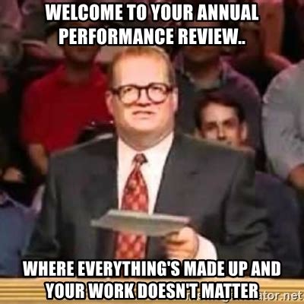
What Is the Purpose of the Appraisal?
Feedback and training
Performance appraisal review
Determining salary increases
Making promotion decisions
Peter Principle
Making termination decisions
Conducting organizational research

Slide 10
Identify Environmental and Cultural Limitations

Slide 11
Factors
Overworked supervisors
No resources available for merit pay
Cohesive employees (peer rating)

Slide 12
Determine Who Will Evaluate Performance

Slide 13
Who Will Appraise Performance?
Upper management
Direct supervisor
Peers
Subordinates
Support staff
Customers/the public
Vendors
Self
Notes:
Job 1 Job 2
Upper management _____ _____
Direct supervisor _____ _____
Peers _____ _____
Subordinates _____ _____
Support staff _____ _____
Customer/the public _____ _____
Vendors _____ _____
Self _____ _____

Slide 14
Using Multiple Sources
360-degree feedback
34% of organizations (Mercer Consulting, 2013)
Training and employee development
Seldom to determine salary increases or promotion/termination decisions
Multiple-source feedback

Slide 15
Supervisor and Peer Appraisal
Supervisors
Most common source of performance appraisal
74% of organizations (SHRM, 2013)
Results
Peers
Behavior
Fairly reliable (Mumford, 1983)
Factors that affect peer ratings

Slide 16
Subordinate, Customer, and Self Appraisal
Subordinates (upward feedback)
Difficult to obtain
Customers
Receipts
Survey at end of call
Secret shoppers
Self-Appraisal
72% of organizations (SHRM, 2013)
Leniency (cultural)

Slide 17
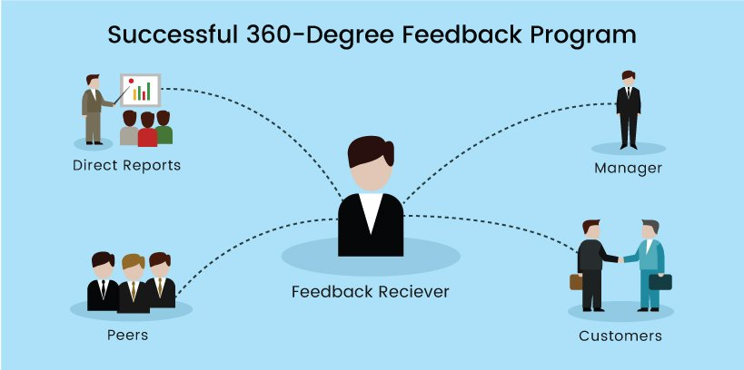
Workbook Exercise 7.1 360-degree Feedback

Slide 18
Activity: Discussion of Feedback
Would you implement a 360-degree feedback system in your organization?

Slide 19
Select the Best Appraisal Method to Accomplish Your Goals

Slide 20
Three Important Decisions
Decision 1: What will be the focus of the appraisal dimensions?
Decision 2: Should dimensions be weighted?
Decision 3: Should we use employee comparisons, objective measures, or ratings?

Slide 21
Decision 1: What Will Be the Focus?
Trait Focus
Honesty
Courtesy
Responsibility
Dependability
Cooperation
Provides poor feedback
Personal
Competency Focus
Report writing skills
Driving skills
Public speaking skills
Knowledge of the law
Easy to identify and provide feedback

Slide 22
What Will Be the Focus? Tasks and Goals
Task focus
Crime prevention
Arrest procedures
Court testimony
Use of vehicle
Easier to evaluate performance
Difficult to offer suggestions for improvement
Goal Focus (Results)
Prevent crimes from occurring
Finish shift without personal injury
Have arrests and citations stand up in court
Easier to identify
More legally defensible than trait-focused

Slide 23
What Will Be the Focus? Contextual Performance
Contextual performance
Tasks that are needed but not an official part of job description
Effort employee makes to get along with peers
Effort to improve the organization

Slide 24
Workbook Exercise 7.2 Creating Performance Dimensions

Slide 25
Decision 2: Should Dimensions Be Weighted?
Some dimensions may be more important to an organization than others
Administratively easier to avoid weighting
Perceptions of fairness

Slide 26
Decision 3: Should We Use Employee Comparisons, Objective Measures, or Ratings?
Employee Comparisons
Rank Order
Paired Comparison
Forced Distribution

Slide 27
How Will Performance Be Appraised?
Employee Comparisons
Results
Quantity
Accidents
Absenteeism
Tardiness
Subjective Ratings

Slide 28
Example of a Ranking Method
 |  | Rating Dimension
Employee | Knowledge | Dependability | Quality | Average
VanderWaal | 1 | 1 | 1 | 1.00
Farmer | 2 | 3 | 2 | 2.33
Lim | 3 | 2 | 3 | 2.67
Lee | 4 | 5 | 4 | 4.33
Leake | 5 | 4 | 5 | 4.67

Slide 29
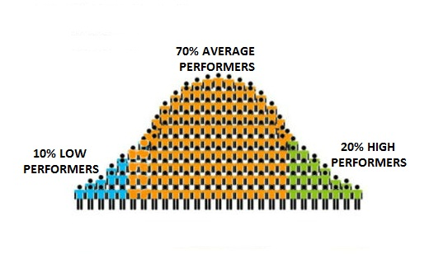
Example of a Forced Distribution
 |  | Kidman
 |  | Blunt
 | Davis | Streep | Gadot
Moss | Pompeo | McCarthy | Jolie | Vergara
10% | 20% | 40% | 20% | 10%
Terrible | Below Average | Average | Above Average | Excellent

Slide 30
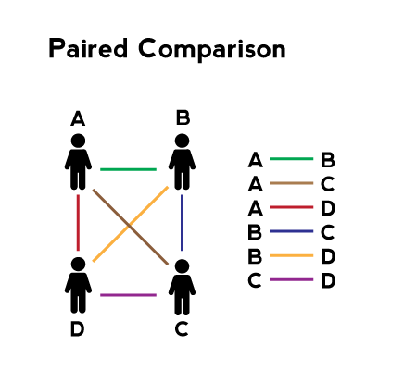
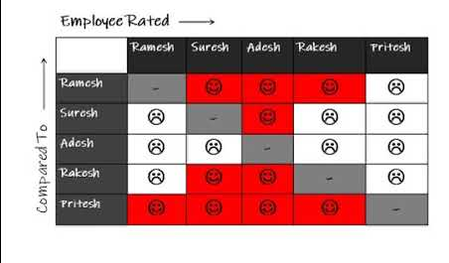
Workbook Exercise 7.3 Paired-comparison Exercise

Slide 31
Objective Measures
Quantity of work
Quality of work
Attendance
Absenteeism
Tardiness
Time theft
Safety

Slide 32
Ratings of Performance
Graphic rating scales
Behavioral checklist
Contamination
Comparison with other employees
Frequency of desired behaviors
Extent to which organizational expectations are met

Slide 33
Graphic Rating Scale Example
Job knowledge
Poor 1 2 3 4 5 Excellent
Patrol activity
Poor 1 2 3 4 5 Excellent
Decision making
Poor 1 2 3 4 5 Excellent
Use of weapons
Poor 1 2 3 4 5 Excellent

Slide 34
Example of Scale Types: Comparison to Other Employees
Dimension: Refers to Customers by Name
___ Much better than other tellers
___ Better than other tellers
___ The same as other tellers
___ Worse than other tellers
___ Much worse than other tellers

Slide 35
Example of Scale Types: Frequency
Dimension: Refers to Customers by Name
___ Always
___ Almost always
___ Often
___ Seldom
___ Never

Slide 36
Example of Scale Types: Extent to Which Expectations Were Met
Dimension: Refers to Customers by Name
___ Greatly exceeds expectations
___ Exceeds expectations
___ Meets expectations
___ Falls below expectations
___ Falls well below expectations

Slide 37
Example of a Mixed-Standard Scale
 |  | Rating
1. | Teller constantly argues with other employees (P)
2. | Teller smiles at customers (A)
3. | Teller asks customers how their families are doing (E)
4. | Teller helps other employees when possible (A)
5. | Teller is always friendly to other employees (E)
6. | Teller asks customers what they want (P)
 | Items 1, 4, and 5 are from the Employee Relations dimension Items 2, 3, and 6 and from the Customer Relations dimension

Slide 38
Example of a Forced-Choice Scale
 |  | Most | Least
1. | a) |  |  | Teller is always on time (neutral)
 | b) |  |  | Teller is never short at end of the day (poor)
 | c) |  |  | Teller smiles at each customer (excellent)
2. | a) |  |  | Teller usually cross-sells (excellent)
 | b) |  |  | Teller keeps work area neat and orderly (poor)
 | c) |  |  | Teller is friendly to other employees (neutral)

Slide 39
Evaluation of Performance Appraisal Methods
Consider:
Cost-effectiveness
How complicated the scale is
Face validity
Ease of providing suggestions for improvements
Legally defensible

Slide 40
Workbook Exercise 7.4 Writing Behavioral Statements

Slide 41
Train Raters

Slide 42
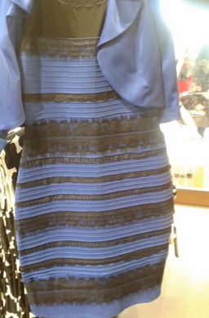
Training Raters
Few organizations train raters (ERC, 2010)
Frame-of-reference training

Slide 43
Observe and Document Performance

Slide 44
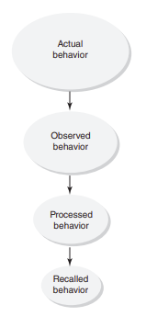
Why Document Performance?
Forces supervisor to look for behaviors
Aids in recall during evaluation
Provides examples to use when reviewing performance
Provides concrete data to support personnel decisions

Slide 45
Activity: Rating Exercise (1 of 2)
Who is the toughest rater?
Sgt. Esterhaus
Sgt. Jablonski
Capt. Furillo
1 is a low rating
5 is the highest rating

Slide 46
Activity: Rating Exercise (2 of 2)
 | Sgt. Esterhaus | Sgt. Jablonski | Capt. Furillo
Bobby Hill | 5 | 1 | 3
Aileen Chang | 5 | 1 | 3
Howard Hunter | 4 | 2 | 3
Sunita Singh | 3 | 2 | 3
Joe Coffey | 4 | 3 | 4
Norman Buntz | 4 | 2 | 2
Lucy Bates | 3 | 3 | 5
Harry Garibaldi | 3 | 3 | 1
Leo Schnitz | 2 | 4 | 1
Ray Callentano | 1 | 3 | 5
John Larue | 1 | 4 | 4
Elena Fung | 3 | 5 | 2
Tina Russo | 2 | 4 | 4
Sanjay Patel | 2 | 5 | 2

Slide 47
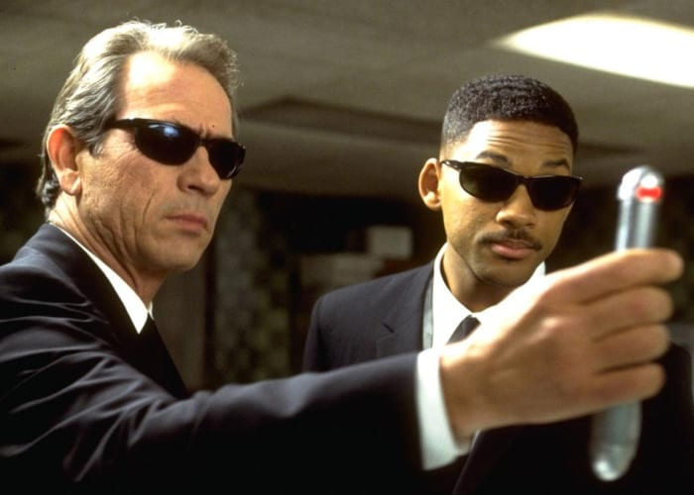
What We Tend to Remember
First impressions
Recent behaviors
Unusual behaviors
Extreme behaviors
Behavior consistent with opinion

Slide 48
What We Tend to Forget
Details
The source of the information

Slide 49
Critical Incidents
Are examples of poor or excellent performance
Provide behavioral examples
Are usually collected through logs
Employee performance record can be used

Slide 50
Employee Performance Record
Record examples of good behaviors
Record examples of poor behaviors
Advantages: only job-relevant behaviors

Slide 51
Performance Record Example
Dimension | Poor Performance | Excellent Performance
Knowledge of law |  | 3/17 arrest procedure ruled OK by court
Report writing | 1/25 accident report contained five typos | 1/30 well written report 2/07 well written report
Patrol Performance | 3/16 complaint from motorist that officer did not help

Slide 52
Evaluate Performance

Slide 53
Evaluating Performance
Obtain and review objective data
Traffic citations
Arrests
Complaints
Commendations
Accidents
Read critical incident logs
Completing the rating form

Slide 54
Common Rating Errors (1 of 2)
Halo
Range Restriction
Leniency
Strictness
Central tendency
Location Errors
Proximity
Contrast
Low reliability across raters

Slide 55
Common Rating Errors (2 of 2)
Sampling problems
Recency effect
Infrequent observation
Cognitive processing of observed behavior
Observation of behavior
Emotional state
Bias

Slide 56
Example: Leniency Error in Ratings (1 of 5)
Andy Sipowicz
Job Knowledge | 1 | 2 | 3 | 4 | 5
Report Writing | 1 | 2 | 3 | 4 | 5
Patrol Activity | 1 | 2 | 3 | 4 | 5
Citizen Relations | 1 | 2 | 3 | 4 | 5
Judgment | 1 | 2 | 3 | 4 | 5
Alice Chan
Job Knowledge | 1 | 2 | 3 | 4 | 5
Report Writing | 1 | 2 | 3 | 4 | 5
Patrol Activity | 1 | 2 | 3 | 4 | 5
Citizen Relations | 1 | 2 | 3 | 4 | 5
Judgment | 1 | 2 | 3 | 4 | 5
James Martinez
Job Knowledge | 1 | 2 | 3 | 4 | 5
Report Writing | 1 | 2 | 3 | 4 | 5
Patrol Activity | 1 | 2 | 3 | 4 | 5
Citizen Relations | 1 | 2 | 3 | 4 | 5
Judgment | 1 | 2 | 3 | 4 | 5

Slide 57
Example: Strictness Error in Ratings (2 of 5)
Elizabeth Quinn
Job Knowledge | 1 | 2 | 3 | 4 | 5
Report Writing | 1 | 2 | 3 | 4 | 5
Patrol Activity | 1 | 2 | 3 | 4 | 5
Citizen Relations | 1 | 2 | 3 | 4 | 5
Judgment | 1 | 2 | 3 | 4 | 5
Jamal Parker
Job Knowledge | 1 | 2 | 3 | 4 | 5
Report Writing | 1 | 2 | 3 | 4 | 5
Patrol Activity | 1 | 2 | 3 | 4 | 5
Citizen Relations | 1 | 2 | 3 | 4 | 5
Judgment | 1 | 2 | 3 | 4 | 5
Maurice “Bosco” Boscorelli
Job Knowledge | 1 | 2 | 3 | 4 | 5
Report Writing | 1 | 2 | 3 | 4 | 5
Patrol Activity | 1 | 2 | 3 | 4 | 5
Citizen Relations | 1 | 2 | 3 | 4 | 5
Judgment | 1 | 2 | 3 | 4 | 5

Slide 58
Example: Central Tendency Rating Error (3 of 5)
Frank Pembleton
Job Knowledge | 1 | 2 | 3 | 4 | 5
Report Writing | 1 | 2 | 3 | 4 | 5
Patrol Activity | 1 | 2 | 3 | 4 | 5
Citizen Relations | 1 | 2 | 3 | 4 | 5
Judgment | 1 | 2 | 3 | 4 | 5
Ramesh Kumar
Job Knowledge | 1 | 2 | 3 | 4 | 5
Report Writing | 1 | 2 | 3 | 4 | 5
Patrol Activity | 1 | 2 | 3 | 4 | 5
Citizen Relations | 1 | 2 | 3 | 4 | 5
Judgment | 1 | 2 | 3 | 4 | 5
Meldrick Lewis
Job Knowledge | 1 | 2 | 3 | 4 | 5
Report Writing | 1 | 2 | 3 | 4 | 5
Patrol Activity | 1 | 2 | 3 | 4 | 5
Citizen Relations | 1 | 2 | 3 | 4 | 5
Judgment | 1 | 2 | 3 | 4 | 5

Slide 59
Example: Halo Rating Error (4 of 5)
Jessica Baker
Job Knowledge | 1 | 2 | 3 | 4 | 5
Report Writing | 1 | 2 | 3 | 4 | 5
Patrol Activity | 1 | 2 | 3 | 4 | 5
Citizen Relations | 1 | 2 | 3 | 4 | 5
Judgment | 1 | 2 | 3 | 4 | 5
Frank Poncherello
Job Knowledge | 1 | 2 | 3 | 4 | 5
Report Writing | 1 | 2 | 3 | 4 | 5
Patrol Activity | 1 | 2 | 3 | 4 | 5
Citizen Relations | 1 | 2 | 3 | 4 | 5
Judgment | 1 | 2 | 3 | 4 | 5
Henry Lao
Job Knowledge | 1 | 2 | 3 | 4 | 5
Report Writing | 1 | 2 | 3 | 4 | 5
Patrol Activity | 1 | 2 | 3 | 4 | 5
Citizen Relations | 1 | 2 | 3 | 4 | 5
Judgment | 1 | 2 | 3 | 4 | 5

Slide 60
Example: Proximity Rating Error (5 of 5)
Lenny Briscoe
Job Knowledge | 1 | 2 | 3 | 4 | 5
Report Writing | 1 | 2 | 3 | 4 | 5
Patrol Activity | 1 | 2 | 3 | 4 | 5
Citizen Relations | 1 | 2 | 3 | 4 | 5
Judgment | 1 | 2 | 3 | 4 | 5
Michelle Logan
Job Knowledge | 1 | 2 | 3 | 4 | 5
Report Writing | 1 | 2 | 3 | 4 | 5
Patrol Activity | 1 | 2 | 3 | 4 | 5
Citizen Relations | 1 | 2 | 3 | 4 | 5
Judgment | 1 | 2 | 3 | 4 | 5
Aliyah Smith
Job Knowledge | 1 | 2 | 3 | 4 | 5
Report Writing | 1 | 2 | 3 | 4 | 5
Patrol Activity | 1 | 2 | 3 | 4 | 5
Citizen Relations | 1 | 2 | 3 | 4 | 5
Judgment | 1 | 2 | 3 | 4 | 5

Slide 61
Workbook Exercise 7.5 Evaluating Employee Performance

Slide 62
Employee Performance by Area and Shift
 | Day Shift | Evening Shift | Night Shift
Area A | Malloy (33) Reed (34) | Romano (19) Hooker (23) | Ho (10) Williams (9) | 128
Area B | Boscarelli (17) Yokus (23) | Fife (14) Taylor (15) | Friday (8) Gannon (8) | 85
Area C | Briscoe (15) Green (17) | Sullivan (11) Davis (10) | Bates (12) Coffey (3) | 68
Area D | Cagney (7) Lacey (9) | Hill (6) Renko (4) | Poncherello (5) Baker (2) | 33
 | 155 | 102 | 57 | 314

Slide 63
Employee Rating by Area and Shift
 | Day Shift | Evening Shift | Night Shift
Area A | Malloy (+1.40) Reed (+2.40) 31.6 | Romano (−1.80) Hooker (+2.20) 20.8 | Ho (−1.60) Williams (−2.60) 11.6 | 128
Area B | Boscarelli (−3.90) Yokus (+2.10) 20.9 | Fife (+ 0.20) Taylor (+ 1.20) 13.8 | Friday (+ 0.30) Gannon (+ 0.30) 7.7 | 85
Area C | Briscoe (−1.80) Green (+0.20) 16.8 | Sullivan ( 0.00) Davis (−1.00) 11.0 | Bates (+ 5.80) Coffey (−3.20) 6.2 | 68
Area D | Cagney (−1.10) Lacey (+0.90) 8.1 | Hill (+0.60) Renko (−1.40) 5.4 | Poncherello (+ 2.00) Baker (−1.00) 3.0 | 33
 | 155 | 102 | 57 | 314

Slide 64
Workbook Exercise 7.6 Rating Errors

Slide 65
Discussion: Quotes from Actual Performance Evaluations
Since my last report, this employee has reached rock-bottom and shows signs of starting to dig
His squad would follow him anywhere, but only out of morbid curiosity
This associate is really not so much of a has-been but more of a definitely won’t be
Would be out of their depth in a parking lot puddle
This young employee has delusions of adequacy
This employee should go far – and the sooner the better
This employee is depriving a village somewhere of an idiot
Sets low personal standards and then consistently fails to achieve them

Slide 66
Communicate Appraisal Results to Employees

Slide 67
Effective Performance Appraisal Review Interviews
Employee input prior to the meeting
High level of employee participation
Helpful supervisor attitude
Focus on behaviors rather than traits
Identification of solutions to problems
Mutual setting of specific goals
Consistent application of standards
Rater is familiar with the employee’s work

Slide 68
Prior to the Interview
Employee Preparation
Give blank copy of forms to employee
Have the employee rate themselves
Scheduling
Schedule at least an hour for the performance review
Schedule the review in a private, neutral location
Supervisor Preparation
Review ratings and reasons for the ratings
Determine goals for the review

Slide 69
During the Interview
Quiet, private location
Establish rapport
Have employee discuss self-ratings
Discuss your ratings
Identify problems and determine solutions
Set goals

Slide 70
Workbook Exercise 7.7 Performance-appraisal Interviews

Slide 71
Terminate Employees

Slide 72
Employment-at-Will Doctrine
Concept
Limitations
Federal or state law
Public policy or interest
Contracts
Implied contracts
Covenants of good faith and fair dealing
At-Will Statements
Notes:
At-will statements – statements in an employees application and company manual reaffirming an organizations right to hire and fire at will

Slide 73
Legal Reasons for Terminating Employees
Probationary period
Violation of rules
Inability to perform
Layoff
Employment-at-Will

Slide 74
Violation of the Organization’s Rules
A rule must exist
Employee must have known about the rule
Violation of the rule must be proven
Rule must be equally enforced
Punishment must fit the crime
Progressive discipline must occur

Slide 75
Progressive Discipline
Punishment must fit the offense
A reasonable attempt must be made to change behavior
Counseling/training
Oral warning
Written warning
Probation
Suspension with pay
Suspension without pay
Transfer
Reduction in pay
Demotion
Termination

Slide 76
Inability to Perform
Standard of performance
Concrete
Reasonable
Job-related
Documented failure to meet the standard
Critical incident logs
Work samples
Performance ratings
Progressive discipline

Slide 77
Reduction in Force (Layoff)
Best economic interest of an organization
Worker Adjustment and Retraining Notification Act (WARN)
60 days’ notice

Slide 78
The Termination Meeting: Prior to the Meeting
Ensure that the legal process has been followed
Decide how much help you want to offer the employee
Choose a neutral, private place
Plan enough time for the meeting
Schedule the meeting for the middle of the week

Slide 79
The Termination Meeting: During the Meeting
Get to the point
Rationally state the reasons for the decision
Express gratitude for the employee’s efforts (if sincere)
Offer whatever assistance you wish to provide
Severance pay
Recommendation
Perform administrative duties
Ask employee to gather personal belongings and leave

Slide 80
The Termination Meeting: After the Meeting
Maintain your self-esteem
Protect yourself from guilt by reviewing the facts
Help other employees cope
Be honest with them
This will avoid “water cooler whispers”
Avoid negative public statements about the fired employee’s character
Notify all organizational units affected by employee’s departure

Slide 81
Monitor the Legality and Fairness of the Appraisal System

Slide 82
Questions to Ask
Has the organization provided training?
Are there gender, race, ethnicity, disability, or age differences in the ratings or opportunities given to improve performance?
Do employees with similar ratings receive similar rewards or consequences?
Are there employees who historically have received high ratings suddenly being given a low rating?

Slide 83
Activity: Discussion of Case Study
Applied Case Study: Kohl’s Department Store

Slide 84
Activity: Discussion of the At-Will Doctrine
What are other ethical dilemmas in the at-will doctrine?
Which argument do you agree with: that of critics of the doctrine or supporters?
Are there limitations that should be imposed on the doctrine, other than those outlined in your textbook, that would make the doctrine more ethical, and therefore, fairer?
Do you agree that having different laws for public and private sector employees (at-will versus for just cause) is fair?

Slide 85
Self-Assessment
What do you think is the most important purpose for performance appraisal? Why?
What problems might result from using a 360-degree feedback system?
The chapter mentioned a variety of ways to measure performance. Which one do you think is the best? Why?
What do you think is the best way to communicate performance-appraisal results to employees?
Is the employment-at-will doctrine a good idea? Why or why not?

Slide 86
Summary
Now that the lesson has ended, you should have learned how to:
Create a performance appraisal instrument
Administer a performance appraisal system
Describe the problems associated with performance ratings
Conduct a performance appraisal review
Explain how to legally terminate an unproductive employee
Determine the legality of a performance appraisal system
Notes:
Review objectives.

