Slide 1

Industrial/Organizational Psychology: An Applied Approach, 9e
Chapter 8: Designing and Evaluating Training Systems
Michael G. Aamodt, Industrial/Organizational Psychology: An Applied Approach, 9th Edition. © 2023 Cengage. All Rights Reserved. May not be scanned, copied or duplicated, or posted to a publicly accessible website, in whole or in part.

Slide 2
Icebreaker
Discuss any trainings you have completed for a job, or trainings you have heard about from others, as well as thoughts on the provided training.

Slide 3
Learning Objectives
08-01 Conduct a training needs analysis
08-02 Explain the various training methods
08-03 Develop a training program
08-04 Apply the psychological theories behind successful training
08-05 Evaluate the effectiveness of a training program

Slide 4
The Role of Training: Money Spent on Training
According to the American Society for Training and Development (ASTD), in 2020
Organizations spent $1,308 per employee on training efforts
47.6 hours on average

Slide 5
Training Steps
Determine training needs
Develop training program
Establish goals and objectives
Choose best training method
Deliver the training program
Motivate employees to learn during training
Evaluate training success

Slide 6
Determining Training Needs

Slide 7
What Is a Training Need?
Types of training needed
Practical means?
Learning objectives
Development of criteria

Slide 8

Types of Needs Analysis
Organizational analysis
Culture, funds, time, sentiment (layoffs)
Task analysis
Taken from job analysis
Person analysis
Data from performance appraisals
Upskilling
Don’t teach a waiter to code

Slide 9
Organizational Analysis
Goals and objectives
Economic analysis
Organizational climate
Employee readiness
Attitudes
Time
Commitment
Management support

Slide 10
Analysis of Need: Is the Program Practical?
Will people participate in the program?
Are the barriers insurmountable?
Do we have the expertise?
Do we have the funding?

Slide 11
Task Analysis
Job analysis identifies
Tasks
Conditions under which tasks are performed
KSAOs needed to perform tasks under those conditions
Task analysis identifies how tasks are learned
Expected at time-of-hire
Easily taught on-the-job
Current training program
No training

Slide 12
Example of a Task Analysis
Task | How task is learned
Answer customer questions about rates | Daily rate charts
Process customer transactions | Basic teller training
Calm irate customers
Check loan applications for accuracy | Loan processing course
Ask customers to complete VISA applications
Input customer transactions into the computer | Basic teller training
Answer customer questions about services | Basic teller training

Slide 13
Workbook Exercise 8.1 Task Analysis

Slide 14
Person Analysis
Performance appraisal scores
Surveys
Interviews
Skill and knowledge tests
Critical incidents

Slide 15
Workbook Exercise 8.2 Person Analysis

Slide 16
Person Analysis Exercise
 | Data Input | Drawer Accuracy | Cross-Selling | Friendliness | Attendance | Services Knowledge | Names
Lynch | 5 | 2 | 3 | 5 | 5 | 2 | 5
Coombs | 4 | 5 | 1 | 5 | 5 | 4 | 1
Anderson | 5 | 4 | 4 | 5 | 5 | 5 | 3
Trebek | 5 | 5 | 2 | 4 | 5 | 4 | 5
Sajak | 5 | 4 | 2 | 5 | 5 | 1 | 4
Karn | 5 | 2 | 2 | 5 | 5 | 5 | 5
Strahan | 4 | 5 | 4 | 5 | 5 | 2 | 4
Brady | 4 | 5 | 1 | 3 | 5 | 3 | 4
Harvey | 4 | 1 | 1 | 2 | 1 | 3 | 2
Carey | 5 | 4 | 3 | 5 | 5 | 1 | 2

Slide 17
Answers to Exercise 8.2
Employee | Training Need
All employees | Cross-selling
Lynch | Teller drawer accuracy, bank services knowledge
Coombs | Knowledge of customer names
Anderson | Customer names (perhaps)
Trebek
Sajak | Knowledge of bank services
Karn | Teller drawer accuracy
Strahan | Knowledge of bank services
Brady | Knowledge of bank services (perhaps)
Harvey | Needs so much training might be better to fire
Carey | Knowledge of bank services, Customer names

Slide 18
Example of Critical Incidents
Category | Excellent | Poor | Total
Interest in residents | 31 | 19 | 50
Availability | 14 | 27 | 41
Responsibility | 12 | 20 | 32
Fairness | 18 | 10 | 28
Self-adherence to rules | 0 | 28 | 28
Social skills | 19 | 7 | 26
Programming | 13 | 7 | 20
Self-confidence | 12 | 8 | 20
Rule enforcement | 4 | 4 | 18
Authoritarianism | 1 | 16 | 17
Counseling skills | 12 | 4 | 16
Self-control | 5 | 2 | 7
Confidentiality | 1 | 2 | 3

Slide 19
Establishing Goals and Objectives

Slide 20
Setting Goals and Objectives: What is to be Accomplished?
What do you want to accomplish?
Knowledge (general v. expert, narrow v. broad)
Skill (what level of proficiency?)
Motivation (How much and for how long?)
Appreciation (e.g., diversity)

Slide 21
Setting Goals and Objectives: Goals
Goals should state
What learners are expected to do
The conditions under which they are expected to do it
The level at which they are expected to do it
Goals should be
Concrete
Attainable
Can you accomplish your objectives?

Slide 22
Setting Goals and Objectives: Objectives
Properly written objective statements include:
Action word
Item
Condition
Standard

Slide 23
Example (1 of 3)
By the end of this training session, you will be able to:
answer / customer questions about loan rates/
(action word) (item)
without asking others / 90% of the time.
(condition) (standard)

Slide 24
Example (2 of 3)
By the end of this training session, you will be able to
balance / the teller drawer / without assistance /
(action word) (item) (condition)
in 30 minutes with no errors.
(standard)

Slide 25
Example (3 of 3)
By the end of this training session, you will be able to
compute / adverse impact levels / using a calculator /
(action word) (item) (condition)
with no errors.
(standard)

Slide 26
Choosing the Best Training Method

Slide 27
Using Lectures to Provide Knowledge
Classroom Training
Lecture to acquire knowledge (live or video)
Case studies to apply knowledge
Simulation exercises to practice new skills
Role play and behavioral modeling to learn interpersonal skills
Distance Learning
Books
Videos
Interactive video
Programmed instruction
Web-based instruction (e-learning)
Computer-based instruction

Slide 28
Creating Handouts
Considerations
Size of audience
Budget
Length and type of presentation
Include
Cover sheet
List of goals and objectives
Schedule
Information about the speaker
Notes
Activity sheets
References/further reading
Form to evaluate your presentation

Slide 29
Choosing the Best Training Method (1 of 2)
Classroom Training
Lecture to acquire knowledge (live or video)
Case studies to apply knowledge
Simulation exercises to practice new skills
Role play and behavioral modeling to learn interpersonal skills
Distance Learning
Books
Videos
Interactive video
Programmed instruction
Web-based instruction (e-learning)
Computer-based instruction

Slide 30
Choosing the Best Training Method (2 of 2)
On-the Job Training
Modeling
Job rotation
Apprentice training
Coaching
Mentoring
Performance appraisal

Slide 31
How Long Does It Take to Prepare?
Zemke (1997)
30 hours of prep for each training hour
Diekmann (2001)
50 hours of prep per training hour
Aamodt (2023)
16 hours of prep per training hour
Biech (2017)
70-100 hours of prep per training hour

Slide 32
Classroom Training Options
Lecture to acquire knowledge (live or video)
Case studies to apply knowledge
Simulation exercises to practice new skills
Role play and behavioral modeling to learn interpersonal skills
Behavior modeling
Video

Slide 33
Supplementing Lecture
Case studies to apply knowledge
Actual situations
Living cases are best
Simulations to practice new skills
Role play to practice interpersonal skills
Regular role play
Behavior modeling
Teach technique
View videos of good and bad performance
Critique videos
Have audience role play
Provide feedback on role play

Slide 34
Motivating Employees to Attend Training
Require attendance on the clock
Voluntary
On the clock
Just in time rather than just in case
Make training interesting
Focus on core competencies
Increase employee buy-in
Choice
Help develop
Provide incentives (food, certificates, college credit, pay increase)
Provide food
Reduce stress associated with attending

Slide 35
Delivering the Training Program

Slide 36
Delivering the Training Program: Initial Decisions
Who will conduct the training?
In-house trainers
External trainers
Videos
Local universities
Where will it be held?
On-site
Off-site
Local hotel
Resort area

Slide 37
Where Will It Be? (1 of 2)
Size of room
Comfort
Atmosphere
Need for PA system
Seating Arrangement
Theater style
Rows
Circle
Conference style
Rows
U-shape

Slide 38
Where Will It Be? (2 of 2)
Physical Aspects
Lighting
Temperature
Noise
Distractions
Acoustic quality
Types of chairs and tables

Slide 39
Length of Training
How long should the training be?
Considerations
Efficiency
Attention span
Time away from work
Massed vs. distributed practice
Microlearning techniques
Options
1-2 hours
Half day
Full day
Several days

Slide 40
Preparing for Classroom Training
Adjusting for the Audience
Considerations
Size
Demographics
Ability
Readiness
Options
Amount of discussion
Types of multi-media
Types of exercises

Slide 41

Activity: Discussion of Case Studies
Are case studies and scenarios an effective form of training?

Slide 42
The Introduction (1 of 3)
What are you trying to establish?
Identity
Credibility
Personality
Atmosphere
Issues
Do they already know you?
How long is the presentation?

Slide 43
The Introduction (2 of 3)
Who will make the introduction?
Other person
Provide an introduction in advance
Do not just give a resume
Bring a copy with you
Self-introduction
Keep short
Rely on speaker info in the handouts

Slide 44
The Introduction (3 of 3)
Introducing someone
Practice the introduction
Pronounce speaker’s name properly
Repeat the name several times
Greet the speaker on the stage
Don’t leave the stage empty
Shake hands and then leave/sit
Opening should grab the audience’s attention
Body should briefly establish purpose
Closing should lead into the presentation
Get the audience to applaud before and after the presentation

Slide 45
Making the Presentation: Icebreakers and Energizers (1 of 2)
Why?
Get people to know one another
Get people talking
Wake up the audience
Get people thinking about the topic

Slide 46
Making the Presentation: Icebreakers and Energizers (2 of 2)
Types
Introductions
Jokes or stories
Group activities
Open-ended questions to elicit audience response/discussion
Free writes
Considerations
Time
Nature of the audience

Slide 47
Activity: Discussion of Icebreakers
What icebreakers have you seen that you liked? Disliked?

Slide 48

Delivering the Presentation: Minimal Presentation Skills (1 of 2)
Making eye contact with the audience
Using effective gestures
Not reading your presentation
Use your visuals to guide you
Know your topic
Practice
Not hiding behind a podium

Slide 49
Delivering the Presentation: Minimal Presentation Skills (2 of 2)
Using a conversational style
Being confident
Avoid use of fillers
Speak at an appropriate volume
Don’t brag about yourself
Speaking at an appropriate pace
Not swearing or putting others down

Slide 50
Delivering the Presentation: Answering Questions
Anticipate questions in advance
Repeat the question if the room is large
If you are unsure of the question
Ask the person to repeat
“Is what you are asking…”
Ask if you have answered the question sufficiently
If you don’t know the answer
Don’t bluff, but you can qualify a guess
Ask if anyone in the audience knows
Tell the person you will get the answer for them

Slide 51
Delivering the Presentation: Using Humor (1 of 2)
Don’t force humor
If you are not a funny person, don’t rely on humor
The humor should meet an objective
Keep the audience interested
Demonstrate a point
Humor can come from
Jokes
Stories
Clip art
Audience members
Video clips
Cartoons

Slide 52
Delivering the Presentation: Using Humor (2 of 2)
Humor should not be at the expense of others
Self-deprecating humor works well in moderation
Avoid jokes that might offend

Slide 53
Categories of Distance Learning
Asynchronous
Employees complete the training at their own pace and at the time and place of their choosing
Synchronous
Employees complete the training at the same time and the same place although they may be in different physical locations
Webinars, webcasts, and teleconferences are common methods

Slide 54
Programmed Instruction
Concepts
Self-paced
Trainee is actively involved in the learning
Material is presented in small units
Formats
Books
Video
Interactive video
Computer based training (CBT)
Web based (e-learning)

Slide 55
Activity: Discussion of Distance Learning
Who has taken a distance learning course? What did you think?

Slide 56
On the Job Training: Learning by Modeling Others
Characteristics of the model
Successful
Status
Similarity
Characteristics of the observer
Attention
Retention
Reproduction skills

Slide 57
Learning through Job Rotation
Learning through Job Rotation
Job rotation
Cross training
Volunteerism
Learning through Apprentice Training
Used in crafts and trades
144 hours of formal class work each year
Work with an expert (usually 4 years)

Slide 58
Learning through Apprentice Training
Learning through Job Rotation
Job rotation
Cross training
Volunteerism

Slide 59
Learning through Coaching
Learning through Coaching
Experienced employee works with new employee
Problems
Not all employees are good coaches
Coaching can lower the coach’s work productivity
Pass-through programs and corporate coaches can alleviate problems

Slide 60
Learning through Mentoring
Learning through Mentoring
Mentoring is less formal than coaching
Good mentors can be difficult to find

Slide 61
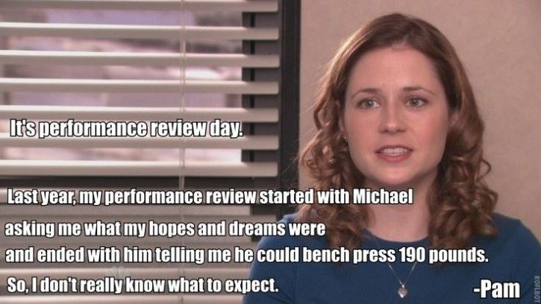
Learning through Performance Appraisal

Slide 62
Motivating Employees to Learn during Training

Slide 63
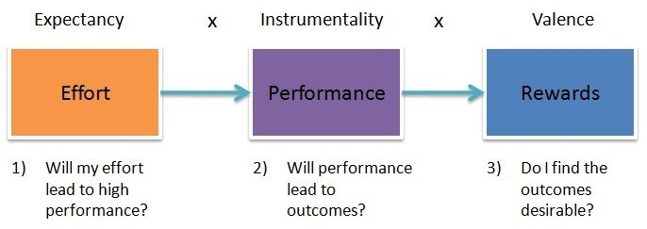
Provide Incentives
Basis for the incentive
Completion and degree based
Knowledge based
Skill based
Job performance based

Slide 64
Maintain Interest
Maintain interest
Relevance
Activity
Fun
Variety
Interaction
Expertise sharing
Provide feedback

Slide 65
Ensuring Transfer of Training: Five Strategies
Use realistic training programs
Have opportunities to practice work-related behavior during the training
Overlearning
Provide employees with the opportunity to apply their training
Ensure management is supportive of the training
Have employees set goals

Slide 66
Evaluation of Training Results

Slide 67
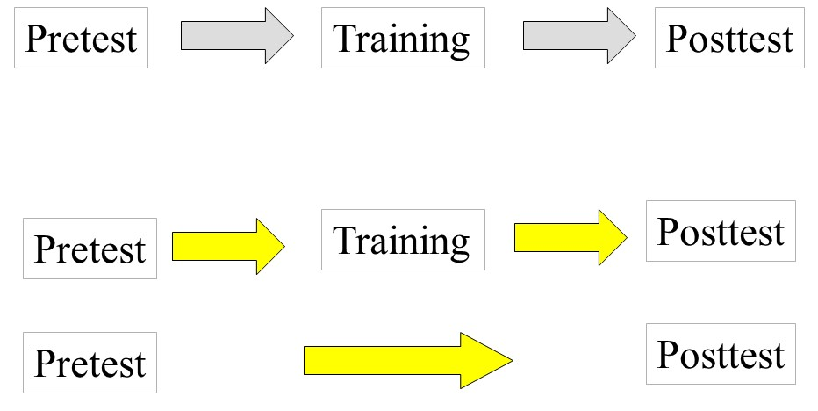
Evaluation of Training Results: Research Designs

Slide 68
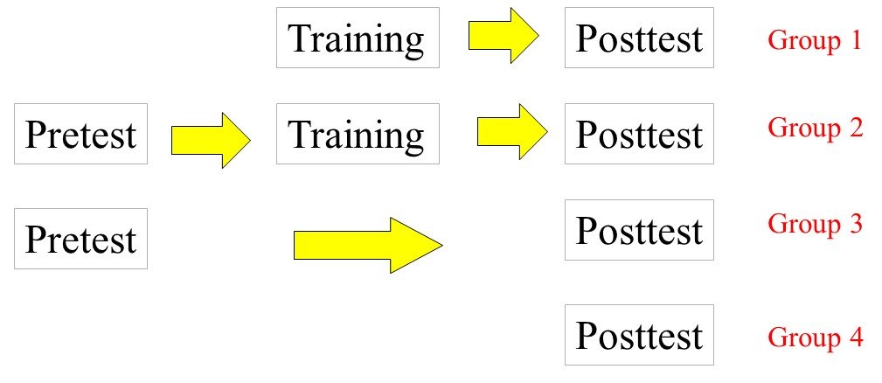
Solomon Four-Groups Design

Slide 69
Evaluation of Training Results: Criteria
Content validity
Employee reactions
Employee learning
Application of training
Business impact
Return on investment

Slide 70
Workbook Exercise 8.3 Evaluating Training Programs: 1

Slide 71
Answer to Exercise 8.3
 | Pre-test | Post-test | Difference
No training | 71.53 | 77.00 | 5.47
Training | 72.20 | 77.53 | 5.33

Slide 72
Workbook Exercise 8.4 Evaluating Training Programs: 2

Slide 73
Answer to Exercise 8.4
Trainer | Instructor Rating | Test Score | Customer Complaints
Leno | 4.4 | 80.6 | 1.7
Carson | 3.4 | 85.1 | 1.3
Parr | 4.0 | 79.7 | 0.8

Slide 74
Activity: Discussion of Case Study
Applied Case Study: Pal’s Sudden Service

Slide 75
Activity: Discussion: Ethics (1 of 2)
Focus on Ethics: Using Role Play in Training

Slide 76
Activity: Discussion: Ethics (2 of 2)
What are some of the other ethical concerns of using role plays to teach skills?
Do you think organizations should implement policies on the type of strategies trainers can use when conducting training?
Should role plays be a mandatory part of training?

Slide 77
Self-Assessment
In what type of situations is training most useful? Least useful?
What motivates employees to learn during training sessions?
What would be the best training technique for teaching computer skills? What would be the best technique for customer service skills?
Do all new employees model the behavior of more experienced employees? Why or why not?
Why would measures of employees’ attitudes about a training program and measures of actual learning be different?

Slide 78
Summary
Now that the lesson has ended, you should have learned how to:
Conduct a training needs analysis
Explain the various training methods
Develop a training program
Apply the psychological theories behind successful training
Evaluate the effectiveness of a training program
Notes:
Review objectives.

