Slide 1

Industrial/Organizational Psychology: An Applied Approach, 9e
Chapter 9: Employee Motivation
Michael G. Aamodt, Industrial/Organizational Psychology: An Applied Approach, 9th Edition. © 2023 Cengage. All Rights Reserved. May not be scanned, copied or duplicated, or posted to a publicly accessible website, in whole or in part.

Slide 2
Icebreaker
Break into pairs of students.
Discuss any instances in which you experienced a lack of motivation on a job or for a class. What strategies did you use to motivate yourself?
Present your discussions to the class.

Slide 3
Learning Objectives
09-01 Identify the types of people who tend to be more motivated than others
09-02 Motivate employees through goal setting
09-03 Realize the importance of providing feedback
09-04 Use operant conditioning principles to motivate employees
09-05 Treat employees fairly
09-06 Choose the types of individual and organizational incentives that best motivate employees

Slide 4
Employees Will Be Motivated if
They have a personality that predisposes them to be motivated
Their expectations have been met
The job and organization are consistent with their values
The employees have been given achievable goals
The employees receive feedback on their goal attainment
The organization rewards them for achieving their goals
The employees perceive they are being treated fairly, and
Their coworkers demonstrate a high level of motivation

Slide 5
Is an Employee Predisposed to Being Motivated?

Slide 6
Basis for an Employee’s Predisposition to Being Motivated
Personality
Conscientiousness
Self-esteem
Chronic
Situational
Socially influenced
Intrinsic motivation
Extrinsic motivation

Slide 7
Workbook Exercise 9.2 What is your Level of Self-esteem?

Slide 8
Workbook Exercise 9.3 What is your Level of Intrinsic Motivation?

Slide 9
Increasing Self-Esteem
Self-esteem workshops
Experience with success
self-fulfilling prophecy
trying new experiences and taking little steps
Galatea effect
Supervisor behavior
Pygmalion effect
Golem effect

Slide 10
Are Employees Effectively Involved in Self-Regulating Behavior?
Self-regulation process
Choose goals and set levels for each goal
Plan how to accomplish goals
Take action toward accomplishing goals (goal striving)
Evaluate progress toward goal attainment and either maintain, revise, or abandon goal

Slide 11
Have the Employee’s Values and Expectations Been Met?
Have the employee’s expectations been met?
Realistic job previews (RJPs)
Job descriptions
Have the employee’s needs, values, and wants been met?
Maslow’s Needs Hierarchy
ERG Theory
Two-Factor Theory

Slide 12
Job Characteristics Theory
Employees desire jobs that
Are meaningful
Allow autonomy
Provide them with feedback
Jobs will have motivating potential if they have
Skill variety
Task identification
Task significance

Slide 13
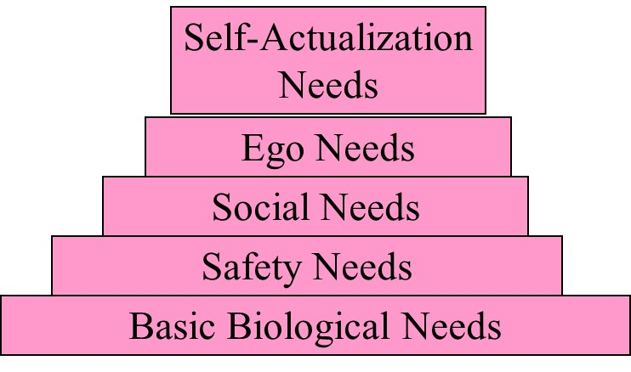
Maslow’s Needs Hierarchy

Slide 14
Evaluation of Maslow’s Needs Hierarchy
Too many levels
People do not progress up hierarchy
Once one level is satisfied, next needs level does not necessarily become most important

Slide 15
ERG Theory
Growth
Relatedness
Existence

Slide 16
Two-Factor Theory
Motivators
Responsibility
Growth
Challenge
Job control
Hygiene factors
Pay
Benefits
Coworkers
Security

Slide 17
Comparison of Needs Theories
Maslow | ERG | Two-Factor
Self-actualization | Growth | Motivators
Ego | Growth | Motivators
Social | Relatedness | Hygiene Factors
Safety | Existence | Hygiene Factors
Physical | Existence | Hygiene Factors

Slide 18
Need for Achievement
McClelland (1961)
Three needs
Need for achievement
Need for affiliation
Need for power

Slide 19
Do Employees Have Achievable Goals?

Slide 20
Setting Goals
Specific
Measurable
Difficult but attainable
Relevant
Time bound
Employee participation

Slide 21
Workbook Exercise 9.4 Setting Goals

Slide 22
Are Employees Receiving Feedback on Their Goal Progress?

Slide 23
Rewarding Excellent Performance
Timing of the incentive
Contingency of the consequences
Type of incentive used
Use of individual-based versus group-based incentives
Use of positive incentives (rewards) versus negative incentives (punishments)
Fairness of the reward system (equity)

Slide 24
The Premack Principle
Different things reinforce different people
We can get people to engage in behaviors they don’t like (e.g., studying) by reinforcing them with the opportunity to engage in behaviors they like better (e.g., taking out the trash)

Slide 25
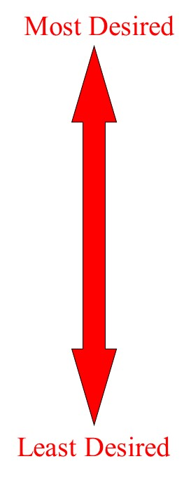
Sample Reinforcement Hierarchy (Premack Principle)
Money
Time off from work
Lunch time
Supervisor praise
Running the press
Getting printing plates
Throwing out oily rags
Typesetting
Cleaning the press

Slide 26
Workbook Exercise 9.5 Your Own Reinforcement Hierarchy

Slide 27
Type of Incentive Used
Financial incentive
Recognition
Travel

Slide 28
Example: Compensation Plan with Incentives
Variable Pay
Individual (tenure, performance, skill, and knowledge)
Organizational (gainsharing, profit sharing, stock options)
____________________________________________
Adjustments
Location (COLAs)
Shift
______________________________________________
Base Pay
Market value
Job evaluation
______________________________________________
Benefits

Slide 29
Financial Incentive Plans
Individual incentive plans
Pay for performance
Merit pay
Organizational incentive plans
Profit sharing
Gainsharing
Stock options

Slide 30
Expectancy Theory
Expectancy
Instrumentality
Valence
Motivation = Expectancy (Instrumentality x Valence)

Slide 31
Reward Versus Punishment
Positive Feedback
Should be specific
Should be sincere
Should be timely
Negative Feedback
Should be constructive
Should concentrate on behaviors
Should always be given in private
Employee self-worth

Slide 32
Activity: Discussion
What are the merits of rewarding good performance versus punishing bad performance?

Slide 33
Are Rewards and Resources Given Equitably?

Slide 34
Equitable Provision of Rewards and Resources
Equity theory
Components
Inputs
Outputs
Input/output ratio
Possible situations
Underpayment
Overpayment
Equal payment

Slide 35
Equity Theory
Underpayment
Work less hard
Become more selfish
Lower job satisfaction
Overpayment
No guilt feelings
Work harder
Become more team oriented

Slide 36
Workbook Exercise 9.6 Using Equity Theory

Slide 37
Are Other Employees Motivated?

Slide 38
Behavior Modeling and Equitable Provision of Rewards and Resources
Behavior modeling (Robinson & O’Leary-Kelly, 1998)

Slide 39
Integration of Motivation Theories

Slide 40
Fried and Ferris (1987) Meta-Analysis
Job Characteristic | Correlation with Work Behavior: Satisfaction | Correlation with Work Behavior: Performance | Correlation with Work Behavior: Absenteeism
Skill variety | 0.45 | 0.09 | −0.24
Task identity | 0.26 | 0.13 | −0.15
Task significance | 0.35 | 0.14 | 0.14
Autonomy | 0.48 | 0.18 | −0.29
Job feedback | 0.43 | 0.22 | −0.19
Motivating potential score | 0.63 | 0.22 | −0.32

Slide 41
Workbook Exercise 9.7 Case Study

Slide 42
Workbook Exercise 9.8 Your Own Theory

Slide 43
Discussion: Activity
Taco Bueno Restaurants

Slide 44
Discussion: Activity: Focus on Ethics (1 of 3)
Motivation Strategies

Slide 45
Activity: Discussion: Focus on Ethics (2 of 3)
Although there were some legal ramifications for what Hooter’s did, do you think what they did to the waitresses was also unethical?
Do you think that the waitresses were lied to? If so, do you think lying to employees is unethical?
Is humiliating employees ever ethical?

Slide 46
Activity: Discussion: Focus on Ethics (3 of 3)
Is it ethical to promise money or other monetary compensation to students for studying hard?
Does the fact that these motivation techniques have the desired result by increasing sales or decreasing the use of paper outweigh any negative consequences of such motivators?

Slide 47
Self-Assessment
Does getting paid for a task that one enjoys performing reduce intrinsic motivation? Why or why not?
If the right techniques are used, can everyone be motivated to perform well? Why do you think that?
Which of the individual incentive plans is most effective? Why?
Which of the theories in the chapter would be most useful for managers? Why?
Is the threat of punishment an effective motivator? Why or why not?

Slide 48
Summary
Now that the lesson has ended, you should have learned how to:
Identify the types of people who tend to be more motivated than others
Motivate employees through goal setting
Realize the importance of providing feedback
Use operant conditioning principles to motivate employees
Treat employees fairly
Choose the types of individual and organizational incentives that best motivate employees
Notes:
Review objectives.

