Slide 1

Industrial/Organizational Psychology: An Applied Approach, 9e
Chapter 12: Leadership
Michael G. Aamodt, Industrial/Organizational Psychology: An Applied Approach, 9th Edition. © 2023 Cengage. All Rights Reserved. May not be scanned, copied or duplicated, or posted to a publicly accessible website, in whole or in part.

Slide 2
Icebreaker
Break into pairs of students.
With your partner, discuss any instances you have had with a good leader, and a bad leader (or instructor). What made the difference between the leadership you experienced from either person?
Share your discussions with the class.

Slide 3
Learning Objectives
12-01 Identify the types of people that become good leaders
12-02 Explain the importance of leaders adapting their behavior to each situation
12-03 Recognize the skills that are essential for effective leadership
12-04 Differentiate among the theories of leadership
12-05 Explain how leaders use power and influence

Slide 4
Workbook Exercise 12.1 Thinking About Leadership

Slide 5
Activity: Discussion
How are leaders, managers, administrators, and supervisors different?

Slide 6
An Introduction to Leadership

Slide 7
Leadership
“Born leaders”
Specific skills or behaviors
Result of interaction between behaviors and situations

Slide 8
Personal Characteristics Associated with Leadership

Slide 9
Leader Emergence: Traits
Traits
Intelligence
Openness to experience
Extraversion
Low narcissism
Conscientiousness
Emotional stability
High self-monitoring
Cognitive ability
Leadership emergence seems to be stable across the life-span

Slide 10
Leader Emergence: Motivation to Lead
Motivation to Lead
Affective identity motivation
Noncalculative motivation
Social-normative motivation

Slide 11
Leadership Characteristics: Leader Performance
Traits
Cognitive Ability
Needs
Gender
Task- versus person-orientation
Unsuccessful leaders

Slide 12
Traits - Performance
Intelligence
Charisma
Dominance
Energy
Extraversion
Openness to experience
Agreeableness
Emotional stability
Self-monitoring

Slide 13
Individual Differences and Leader Emergence and Performance
Trait | Corrected Correlations: Emergence | Corrected Correlations: Performance | Meta-analysis
Personality
Neuroticism | − 0.24 | − 0.22 | Judge et al. (2002)
Extraversion | 0.33 | 0.24 | Judge et al. (2002)
Openness | 0.24 | 0.24 | Judge et al. (2002)
Agreeableness | 0.05 | 0.21 | Judge et al. (2002)
Conscientiousness | 0.33 | 0.16 | Judge et al. (2002)
Self-monitoring | 0.21 |  | Day et al. (2002)
Intelligence | 0.25 | 0.27 | Judge et al. (2004)
Need for Ach |  | 0.23 | Argus & Zajack (2008)

Slide 14
Workbook Exercise 12.2 (Section A) Your Self-monitoring Score

Slide 15
Cognitive Ability
Correlation between cognitive ability and leadership performance
Directive leadership style
Synthesis of:
Wisdom
Intelligence
Creativity

Slide 16
Needs
Types of Needs
Power
Achievement
Affiliation
Testing Types of Needs
Thematic Apperception Test (TAT)
Job Choice Exercise (JCE)
Leadership Motive Pattern
High need for power
Low need for affiliation

Slide 17
Workbook Exercise 12.2 (Section D) Your Leadership Needs

Slide 18
Gender
Complex
Eagly, Karau, & Makhijani, 1995
Men were more effective:
In situations that were traditionally defined in masculine terms
When subordinates were men
Women were more effective:
In situations that were traditionally defined in less masculine terms

Slide 19
Task Versus Person Orientation
Person-Oriented Leaders
Act in a warm, supportive manner and show concern for the employees
Believe employees are intrinsically motivated
Task-Oriented Leaders
Set goals and give orders
Believe employees are lazy and extrinsically motivated

Slide 20
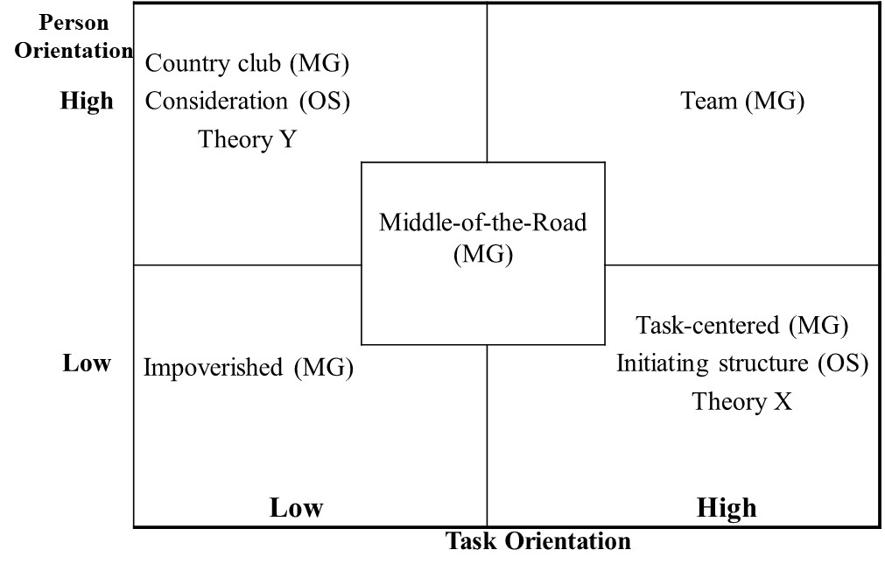
Relationship Among Theories

Slide 21
Consequences of Leader Orientation
High Person Orientation | Low performance Low turnover Few grievances | High performance Low turnover Few grievances
Low Person Orientation | Low performance High turnover Many grievances | High performance High turnover Many grievances
 | Low Task Orientation | High Task Orientation

Slide 22
Workbook Exercise 12.2 (Section C) Your Task and Person Orientation

Slide 23
Unsuccessful Leaders (Hogan, 1989)
Lack of training
Cognitive deficiencies
Personality problems
Paranoid/passive-aggressive
High likeability floater
Narcissist

Slide 24
Unsuccessful Leader Behavior (Rasch et al., 2008)
Engaging in illegal and unethical behavior
Avoiding conflict and people problems
Demonstrating poor emotional control (e.g., yelling and screaming)
Over-controlling (e.g., micromanaging)
Demonstrating poor task performance
Poor planning, organization, and communication
Starting or passing on rumors or sharing confidential information
Procrastinating and not meeting time commitments
Failing to accommodate the personal needs of subordinates
Failing to nurture and manage talent

Slide 25
Interaction Between the Leader and the Situation

Slide 26
Leader-Situation Interaction
Situational Favorability
Organizational Climate
Subordinate Ability
Relationships with Subordinates

Slide 27
Situational Favorability: Fiedler’s Contingency Model
Least-Preferred Coworker Scale
Situation favorability
High task structure
High position power
Good leader-member relations
High LPC leaders best with moderate favorability and Low LPC leaders best with low or high favorability

Slide 28
Relationship Between LPC Scores and Group Success
High LPC Score | Low Performance | High Performance | Low Performance
Low LPC Score | High Performance | Low Performance | High Performance
 | Low | Moderate | High
 | Situation Favorability

Slide 29
Workbook Exercise 12.2 (Section B) Your LPC Score

Slide 30
Organizational Climate: IMPACT Theory
Leadership Style | Ideal Climate
Information | Ignorance
Magnetic | Despair
Position | Instability
Affiliation | Anxiety
Coercive | Crisis
Tactical | Disorganization

Slide 31
IMPACT Leadership Strategies
Find a climate consistent with your leadership style
Change your leadership style to better fit the existing climate
Change your followers’ perception of the climate
Change the actual climate

Slide 32
Workbook Exercise 12.2 (Section E) Your Impact Style

Slide 33
Workbook Exercise 12.2 Your Leadership Profile

Slide 34
Subordinate Ability: Path-Goal Theory
Instrumental style
Plans, organizes, controls
Supportive style
Shows concern for employees
Participative style
Shares information and lets employees participate
Achievement-oriented style
Sets challenging goals and rewards increases in performance

Slide 35
Subordinate Ability: Situational Leadership Theory
 | Employee Is Unable | Employee Is Able
Employee Is Unwilling | Directing (R1) | Supporting (R3)
Employee Is Willing | Coaching (R2) | Delegating (R4)

Slide 36
Relationships with Subordinates: Leader-Member Exchange (LMX) Theory
Concentrates on the interactions between leaders and subordinates
Subordinates fall into either the:
In-group
Out-group
In-group employees
More satisfied
Higher performance
Less likely to leave

Slide 37
Specific Leader Skills

Slide 38
What Does Effective Leadership Look Like?
Initiates ideas
Informally interacts with subordinates
Stands up for and supports subordinates
Takes responsibility
Develops a group atmosphere
Organizes and structures work
Communicates formally with subordinates
Rewards and punishes subordinates
Sets goals
Makes decisions
Trains and develops employee skills
Solves problems
Generates enthusiasm

Slide 39
Characteristics of Great Leaders
Provides clarity
Listens and allows others to be heard
Values conversations
Models desired behaviors
Encourages healthy conflict
Creates an environment of emotional safety
Has high levels of self-awareness
Empowers others
Welcomes feedback

Slide 40
Leadership Through Decision Making
Vroom-Yetton Model

Slide 41
Leadership Through Contact
Management by walking around

Slide 42
Leadership Through Power
Expert Power
Legitimate Power
Reward Power
Coercive Power
Referent Power

Slide 43
Leadership Through Vision: Transformational Leadership
Visionary
Charismatic
Inspirational
Challenge the status-quo
Carefully analyze problems
Confident and optimistic

Slide 44
Leadership Through Vision: Hunt and Laing (1997)
Vision
Differentiation
Values
Transmission of visions and values
Flaws

Slide 45
Authentic Leadership
Bill George (2003)
Leaders become self-aware by reflecting on their own:
Ethics
Core beliefs
Values
They lead out of a desire to serve others.

Slide 46
Cultural Differences in Leadership: Project Globe

Slide 47
Project GLOBE
Global Leadership and Organizational Behavior Effectiveness
Culture differentiation on nine dimensions:
Uncertainty avoidance
Power distance
Social collectivism
In-group collectivism
Gender egalitarianism
Assertiveness
Future orientation
Performance orientation
Humane orientation

Slide 48
Leadership: Where Are We Today?

Slide 49
Leadership: Current Thinking
Leadership emerges as a set of interactions:
Between a leader’s traits and skills
Between a situation’s demands and characteristics
Between followers’ needs and characteristics

Slide 50
Summary of Theories
A summary of theories suggest a successful leader:
Has received leadership training
Is a high self-monitor
Is high in both task and person orientations
Has the leadership motive pattern
Is intelligent
Is emotionally stable
Possesses the skills and personality to be a transformational leader

Slide 51
Assumptions We Can Make
A successful leader:
Has a wide variety of relevant skills
Attends leadership conferences
Takes college courses
Gains a variety of experiences
Can adapt their interpersonal styles to fit the needs of followers
Can understand the needs of the situation, the follower, or both

Slide 52
Putting It All Together
Applied Case Study: Developing Leaders at Claim Jumper Restaurants

Slide 53
Let’s Talk
Focus on Ethics: Ethical Leadership

Slide 54
What Do You Think?
In the first situation, do you think it is unethical for the professor to bend the rules under those circumstances?
If you were one of the students failed because of high absenteeism and you found out that the professor didn’t fail another student for their high absenteeism, would you think you were being treated unfairly?
What would you do?
Do you think what the leaders did in the other examples was ethical? Why or why not?
In the example with the brother, is it okay to lie in this situation?
Do you consider lying as unethical?
Are there ever times when lying is better than telling the truth?
What are some situations in which bending the rules might be more ethical than following policy?

Slide 55
Self-Assessment
Do those who seek leadership roles, those who emerge as leaders, and those who are successful leaders share similar traits?
Which of the situational theories seems to provide the best explanation for successful leadership?
Hogan identified three main reasons for unsuccessful leadership. Are there others that he did not mention?
Can effective leadership actually be taught?
How can a leader be more persuasive?

Slide 56
Summary
Now that the lesson has ended, you should have learned how to:
Identify the types of people that become good leaders
Explain the importance of leaders adapting their behavior to each situation
Recognize the skills that are essential for effective leadership
Differentiate among the theories of leadership
Explain how leaders use power and influence
Notes:
Review objectives.

