Slide 1

Industrial/Organizational Psychology: An Applied Approach, 9e
Chapter 13: Group Behavior, Teams, and Conflict
Michael G. Aamodt, Industrial/Organizational Psychology: An Applied Approach, 9th Edition. © 2023 Cengage. All Rights Reserved. May not be scanned, copied or duplicated, or posted to a publicly accessible website, in whole or in part.

Slide 2
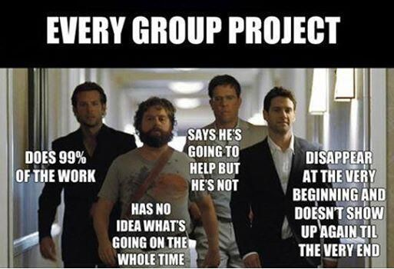
Icebreaker
Break into pairs of students.
With your partner, discuss a time that you were put in a group (whether for a job or for a class) and had a great experience. Then, discuss a time that you did not have a good experience in a group. What differed between the two situations?
Share your discussions with the class.

Slide 3
Learning Objectives
13-01 Define what constitutes a group and a team
13-02 Explain why people join groups
13-03 Increase group performance
13-04 Explain how teams operate
13-05 Decide when groups perform better than individuals
13-06 Decide why the team approach is not always the best
13-07 Identify the causes of conflict
13-08 Reduce conflict

Slide 4
Workbook Exercise 13.1 Focused Free-Write

Slide 5
Group Dynamics

Slide 6
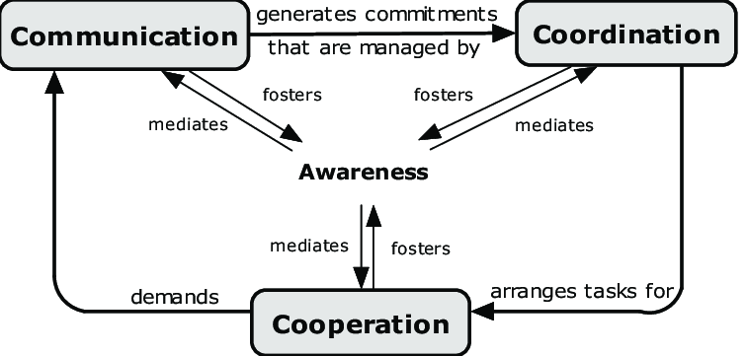
Definition of a Group
Multiple members
2 or more people
Perceive themselves as a group
Group rewards
Corresponding effects
Common goals

Slide 7
Reasons for Joining Groups
Assignment
Physical proximity
Affiliation
Identification
Emotional support
Assistance or help
Common interests
Common goals

Slide 8
Workbook Exercise 13.2 Increasing Group Membership

Slide 9
Factors Affecting Group Performance

Slide 10
The Factors Affecting Group Performance
Group Cohesiveness
Group Ability and Confidence
Personality of the Group Members
Communication Structure
Group Roles
Presence of Others: Social Facilitation and Inhibition
Individual Dominance
Groupthink

Slide 11
Factors Affecting Group Performance: Group Cohesiveness
Group Homogeneity
Homogeneous
Heterogeneous
Slightly heterogeneous
Stability of Membership
Isolation
Outside Pressure
Group Size
Group Status

Slide 12
Group Size
Smaller is best for cohesiveness
Performance depends on task type
Additive tasks
Sum of combined team member performance
Conjunctive tasks
Least effective team member
Disjunctive tasks
Most effective team member

Slide 13
Examples of Task Types
Task Type | Group Activity
Additive | Relay Race
Disjunctive | Problem solving Brain storming Golf tournament ‘best ball’
Conjunctive | Assembly line Hiking

Slide 14
Factors Affecting Group Performance (cont.)
Group Ability and Confidence
High-ability members vs. low-ability members
High team efficacy
High team potency
Personality of the Group Members
Task-related experience
Openness to experience
Emotional stability
Intellectual vs. physical tasks

Slide 15
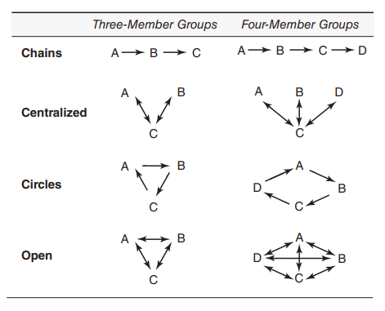
Factors Affecting Group Performance: Communication Structure

Slide 16
Factors Affecting Group Performance: Group Roles
Task Oriented
Offering new ideas
Coordinating activities
Social Oriented
Encouraging cohesiveness
Encouraging participation
Individual
Blocking group activities
Calling attention to oneself

Slide 17
Factors Affecting Group Performance: Presence of Others (1 of 2)
Social facilitation and inhibition
Mere presence of others
Comparison of performance
Evaluation apprehension
Audience effects
Coaction
Explaining social facilitation effects
Performance increases when task is easy or well learned
Performance decreases when task is difficult or not well learned

Slide 18
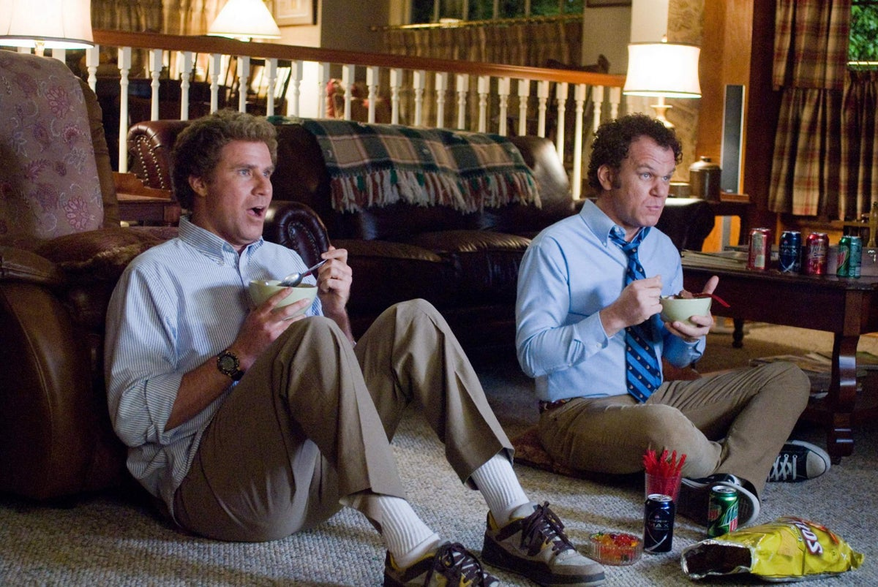
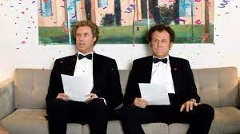
Factors Affecting Group Performance: Presence of Others (2 of 2)
Social Loafing
Effort won’t be noticed
Free-rider theory
Things are going well… so why work hard?
Sucker-effect theory
Everyone sucks so why try?

Slide 19
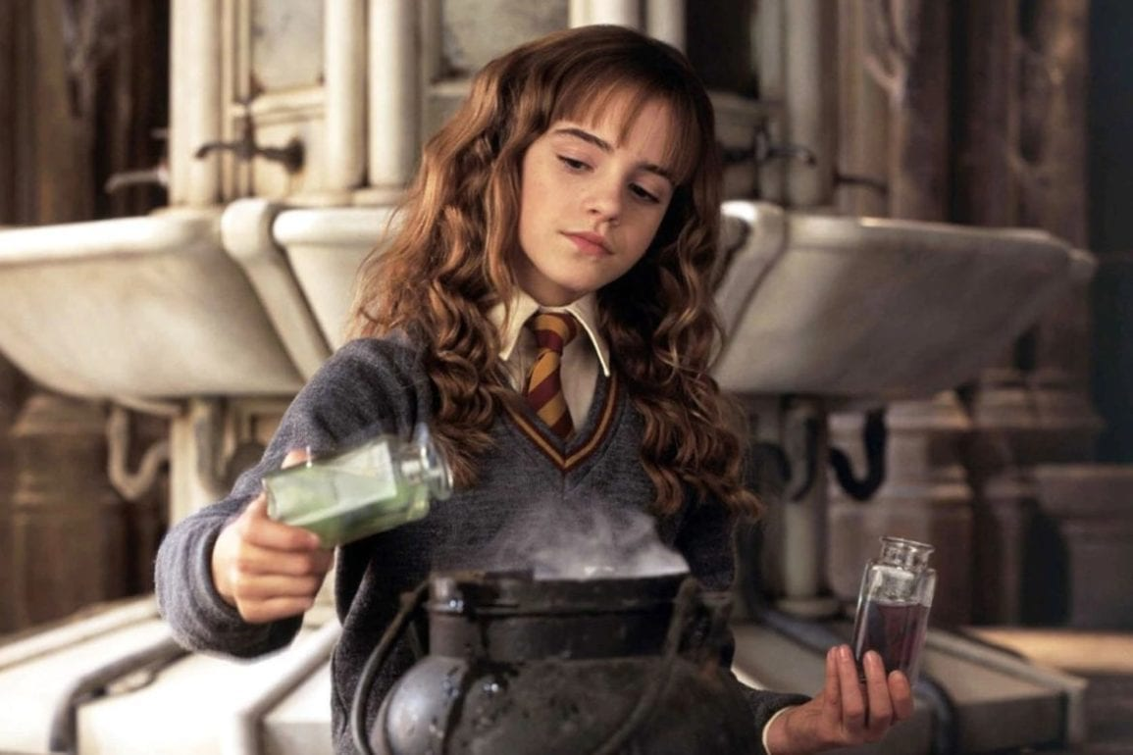
Factors Affecting Group Performance: Individual Dominance
By the group leader
By a group member

Slide 20
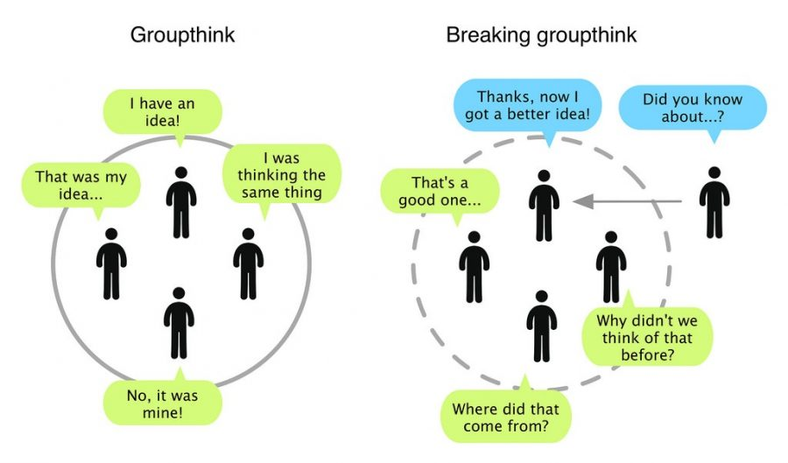
Factors Affecting Group Performance: Groupthink
Groupthink can occur when the group:
Is cohesive
Is insulated from outsiders
Believes it is infallible
Believes it is morally superior
Is under pressure to conform
Has a leader who promotes a favorite solution
Has gatekeepers who keep information from members

Slide 21
Individual Versus Group Performance

Slide 22
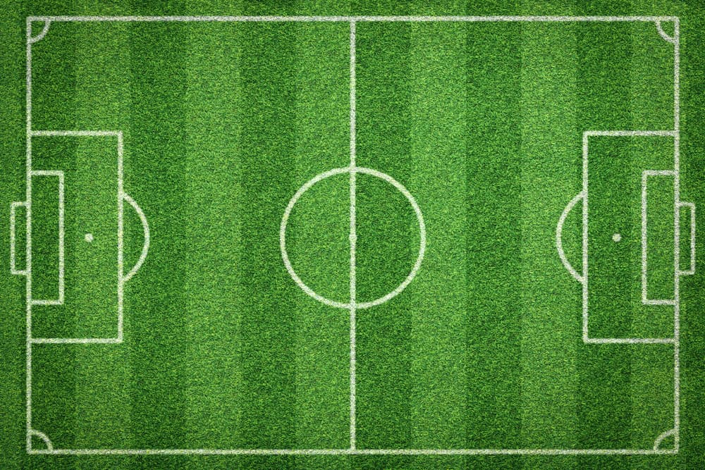
Group Versus Individual Performance
Interacting groups
Work together to perform a task
Have higher quality decisions
Are more risky (group polarization)
Individuals (nominal groups)
Results are pooled but never work together
Are more creative
Make a decision more quickly

Slide 23
Teams

Slide 24
What Is a Team? Donnellon (1996)
Identification
Interdependence
Power differentiation
Social distance
Conflict management tactics
Negotiation process

Slide 25
Types of Teams
Work Teams
Parallel Teams
Project Teams
Management Teams

Slide 26
How Teams Develop: Tuckman (1965) Theory
Forming
Team members get to know one another
Everyone is on their good behavior
Group clarifies its mission
Storming
Disagreement and frustration set in
Norming
Group members work at easing tension
Acceptance of team leader
Performing
Goals get accomplished

Slide 27
How Teams Develop: Punctuated Equilibrium Theory (Gersick, 1988)
Teams do not go through set stages
Basic method of formation
Develop direction and strategy during first meeting
Follow this direction for a period of time
Revise their strategy about halfway through the life of the team

Slide 28
Why Teams Don’t Always Work
The team is not a team
Excessive meeting requirements
Lack of empowerment
Lack of skill
Distrust of the team process
Unclear objectives

Slide 29
Workbook Exercise 13.3 Teams

Slide 30
Group Conflict

Slide 31
Conflict Defined
Psychological and behavioral reaction to a perception that another person is:
Keeping you from reaching a goal
Taking away your right to behave a certain way
Violating the expectancies of a relationship
Types of conflict
Functional
Dysfunctional

Slide 32
Consequences of Dysfunctional Conflict
Decreased team performance
Decreased member satisfaction
Lessened productivity
Increased turnover

Slide 33
Types of Conflict
Interpersonal
Individual – Group
Group – Group

Slide 34
Causes of Conflict
Competition for resources
Task interdependence
Jurisdictional ambiguity
Communication barriers
Physical
Cultural
Psychological
Beliefs
Personality

Slide 35
Workbook Exercise 13.4 Competition and Conflict

Slide 36
Types of Difficult People
Type | Need | Description
Tank | Control | Pushes, yells, intimidates
Sniper | Control | Uses sarcasm, criticizes
Know-it-all | Control | Dominates conversations
Whiner | Perfection | Constantly complains
No person | Perfection | Disagrees with everything
Nothing person | Perfection | Doesn’t do anything
Yes person | Approval | Agrees to everything
Maybe person | Approval | Won’t commit or make a decision
Grenade | Attention | Throws tantrums
Friendly sniper | Attention | Uses jokes to pick on others
Think-they-know-it-all | Attention | Exaggerates, lies, gives advice

Slide 37
Activity: Discussion of Difficult People
Who has worked with a difficult person?

Slide 38
Conflict Styles
Avoiding style
Withdrawal
Triangling
Accommodating style
Forcing style
Winning at all costs
Collaborating style
Compromising style
Negotiation and bargaining
Least acceptable result (LAR) and maximum supportable position (MSP)

Slide 39
Workbook Exercise 13.5 Your Conflict Style

Slide 40
Resolving Conflict
Prior to Conflict Occurring
Formal policies
Employee training
When Conflict Occurs
Employees should try to solve conflict
Third-party intervention

Slide 41
Third Party Intervention (1 of 2)
Mediation
Arbitration

Slide 42
Third Party Intervention (2 of 2)
Mediation and negotiation are best when:
Parties are rational
Parties want to work out a solution together
Some trust still exists
There are no time constraints
Arbitration
Same as mediation but use when parties get stuck during mediation
Types
Binding
Nonbinding

Slide 43
Workbook Exercises 13.6, 13.7 Reactions to Conflict

Slide 44
Activity: Applied Case Study
Applied Case Study: Conflict at a nonprofit agency

Slide 45
Activity: Discussion of Group Hazing
Focus on Ethics: Group Hazing
Do you think the stunts described are harmless jokes or a form of hazing? If you consider it to be hazing, are they then, unethical?
Are practical jokes ever acceptable in the workplace? Are some less ethical than others?
Do you think it is ethical for management to support such practical jokes?
Is it unethical for a manager not to warn new employees that they may be subject to a practical joke as part of an initiation process?

Slide 46
Activity: Self-Assessment
How can you use the knowledge of why people join groups to increase group effectiveness?
When are interacting groups better than nominal groups or individuals?
Why does the presence of others cause increased performance in some situations and decreased performance in others?
When can a group be too cohesive?
How do we build effective teams?
How are mediation and arbitration different?

Slide 47
Summary
Now that the lesson has ended, you should have learned how to:
Define what constitutes a group and a team
Explain why people join groups
Increase group performance
Explain how teams operate
Decide when groups perform better than individuals
Decide why the team approach is not always the best
Identify the causes of conflict
Reduce conflict
Notes:
Review objectives.

