Slide 1

Industrial/Organizational Psychology: An Applied Approach, 9e
Chapter 14: Organization Development
Michael G. Aamodt, Industrial/Organizational Psychology: An Applied Approach, 9th Edition. © 2023 Cengage. All Rights Reserved. May not be scanned, copied or duplicated, or posted to a publicly accessible website, in whole or in part.

Slide 2
Icebreaker
Break into pairs of students.
With your partner, discuss what your ideal organizational culture would consist of.
Share your discussions with the class.

Slide 3
Learning Objectives
14-01 Explain how and why organizations change 14-02 Increase employee acceptance of change
14-03 Explain the importance of organizational culture
14-04 Effectively handle change
14-05 Decide when empowering employees is a good idea
14-06 Recognize the levels of employee input
14-07 Select the best type of flexible work schedule
14-08 Properly conduct a layoff
14-09 Realize the effects of layoffs on victims, survivors, the organization, and the community

Slide 4
Workbook Exercise 14.2 Acceptance of Change

Slide 5
Managing Change

Slide 6
Sacred-Cow Hunts
The Paper Cow
The Meeting Cow
The Speed Cow

Slide 7
Workbook Exercise 14.1 Sacred Cow Hunts

Slide 8
Employee Acceptance of Change: Stages of Change
Organizational Stages (Lewin, 1958)
Unfreezing
Moving
Refreezing
Employee Stages (Carnall & By, 2014)
Denial
Defense
Discarding
Adaptation
Internalization

Slide 9
Employee Acceptance of Change: The Type of Change
The Type of Change
Evolutionary
Revolutionary

Slide 10
Employee Acceptance of Change: The Reason Behind the Change
Legitimate
Financial reasons
External mandates
Organizational improvement
Whim
Everybody else is doing it

Slide 11
Employee Acceptance of Change: The Person Making the Change
Within work group vs. external source
Leaders who are well liked and respected
Leaders whose motives are suspect

Slide 12
Employee Acceptance of Change: The Person Being Changed
Change agents
Change analysts
Receptive changers
Reluctant changers
Change resisters

Slide 13
Implementing Change
Creating an atmosphere for change
Communicating details
Communicating is hard work
Training is needed
Two-way communication
Honesty is essential
Time frame
Training needs

Slide 14
Organizational Culture: The Importance of Organizational Culture
Optimal employee behavior
Could lead to undesirable behaviors

Slide 15
Organizational Culture: Steps to Changing Culture
Assessing the new culture
Creating dissatisfaction with existing culture
Maintaining the new culture
Selection of employees

Slide 16
Workbook Exercise 14.3 Organizational Culture

Slide 17
Organizational Culture: Assessing the New Culture
Needs assessment
Determining executive direction
Implementation considerations
Training
Evaluation of the new culture

Slide 18
Organizational Culture: Creating Dissatisfaction with Existing Culture
Communicating to employees the future impact
Data of technological trends
Financial performance of company
Distribute attitude surveys
Key at this point is to seek input from employees

Slide 19
Organizational Culture: Maintaining the New Culture
Select new employees who are consistent with the new culture
Create a socialization process where new employees will learn about the new culture
Reward behaviors consistent with the new culture
Rituals
Symbols

Slide 20
Empowerment

Slide 21
Factors in Making the Decision to Empower
Importance of decision quality
Leader knowledge of problem area
Structure of the problem
Importance of decision acceptance
Probability of decision acceptance
Subordinate trust and motivation
Probability of subordinate conflict

Slide 22
Decision-Making Strategies Using the Vroom-Yetton Model
Autocratic I
Autocratic II
Consultative I
Consultative II
Group I

Slide 23
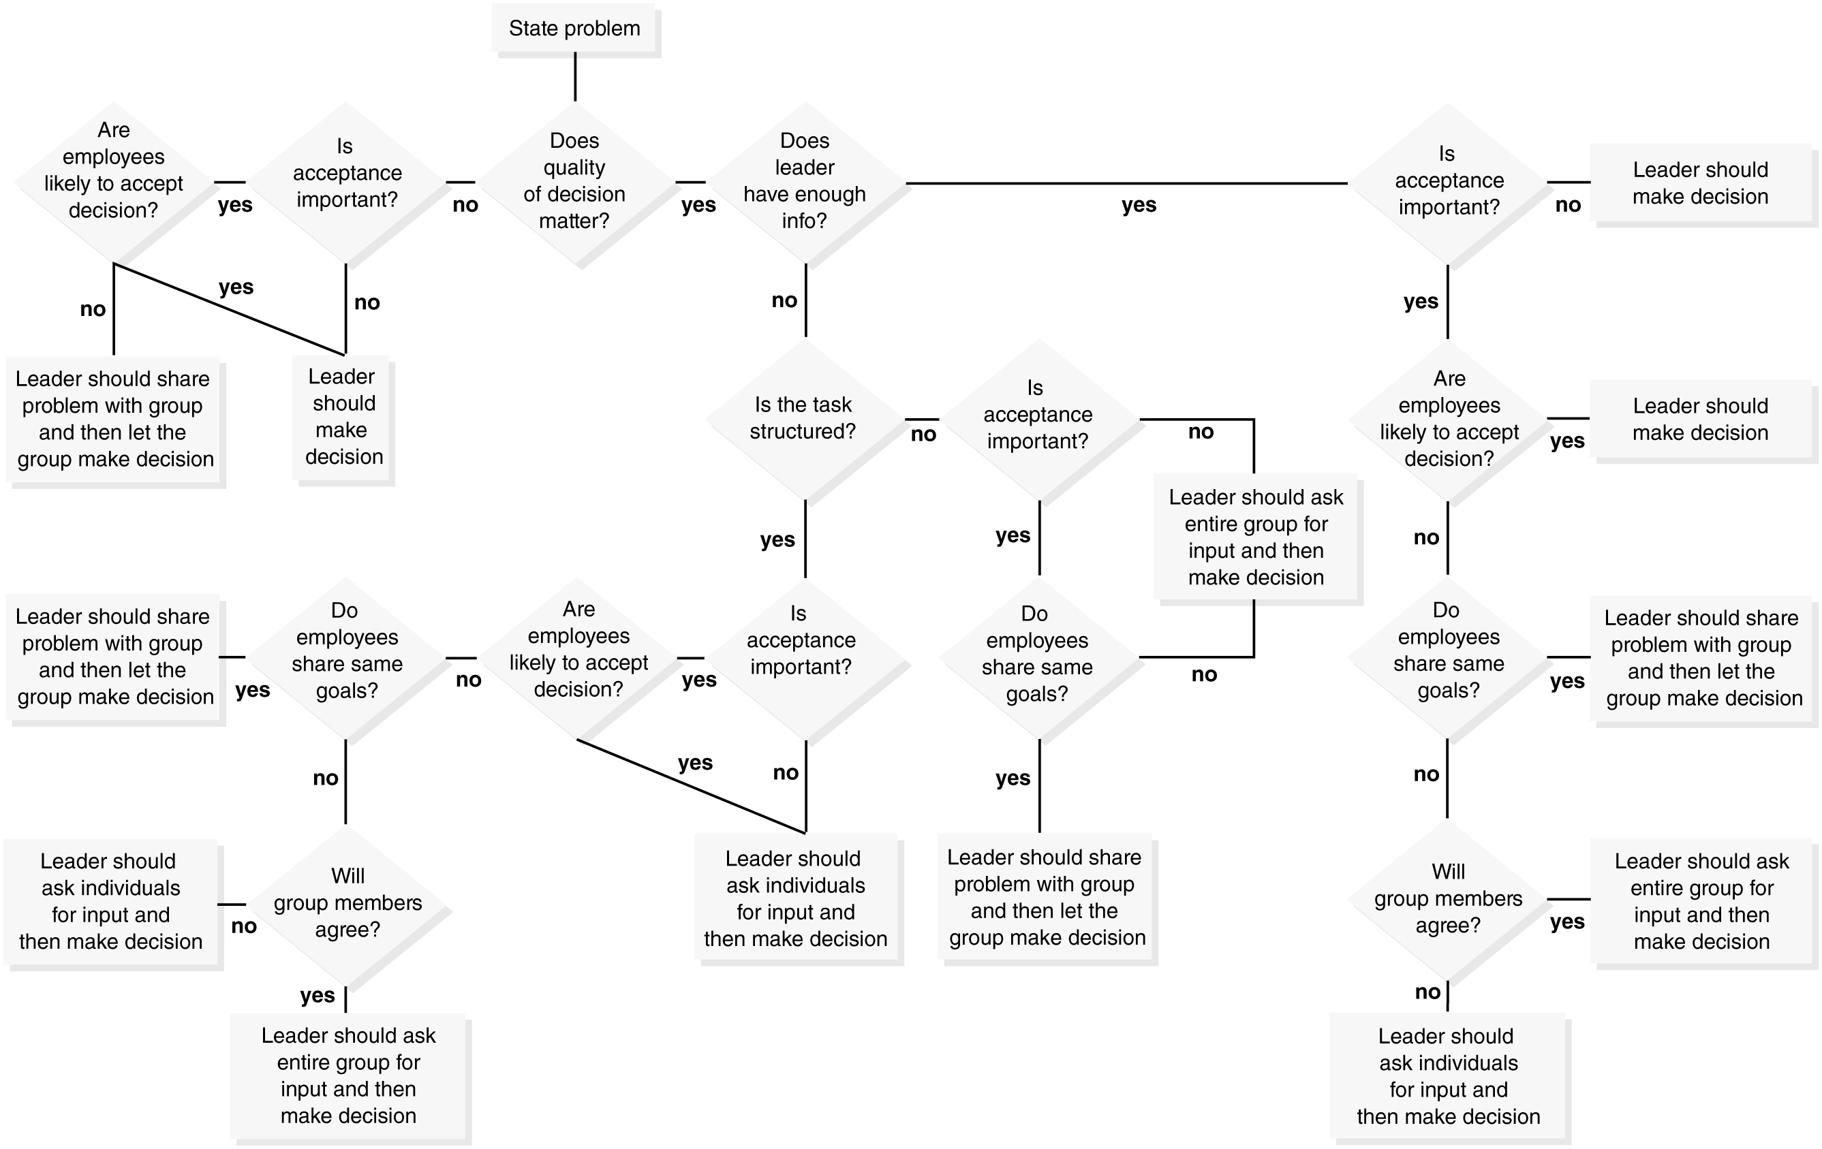
The Vroom-Yetton Decision-Making Flowchart

Slide 24
Workbook Exercise 14.4 Vroom-Yetton Decision Making Model

Slide 25
Levels of Employee Input (1 of 2)
Following
Work is closely checked by others
Employee is closely supervised
Ownership of Own Output
Employees are responsible for their own quality control
Control is only at the individual level
Advisory
Makes recommendations
Suggests new ideas
Provides input

Slide 26
Levels of Employee Input (2 of 2)
Shared/Participative/Team
Has an equal vote with management or other employees
Reaches decisions through group consensus or voting
Absolute
Sole responsibility for making decisions

Slide 27
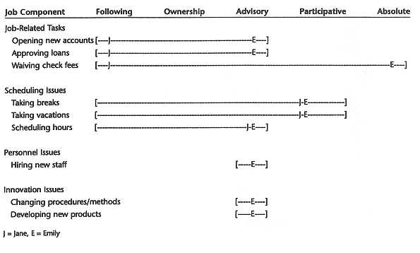
Empowerment Charts

Slide 28
Consequences to Empowerment
Personal
Increased job satisfaction for most
Stress
Decreased stress due to greater control
Increased stress due to greater responsibility
Financial
Bonuses
Pay increases
Career
Increased job security
Promotions
Increased marketability
Increased chance of being terminated

Slide 29
Flexible Work Arrangements

Slide 30
Benefits of Flexible Work Arrangements
Benefits
Lower absenteeism
Lower turnover
Higher productivity
Higher job satisfaction
Better work-life balance
Lower community costs
If
Management is supportive
The job itself allows for flexibility

Slide 31
Types of Flexible Arrangements
Full-time work, flexible hours
Compressed workweeks
Reduced work hours
Work from home

Slide 32
Strategy 1: Flexible Work Hours
Use of flextime
Offered by 57% of organizations in 2019
Components
Bandwidth
Core hours
Flexible hours
Gliding time
Flexitour

Slide 33
Strategy 2: Compressed Work Weeks
Regular work schedule is 5 days, 8 hours
32% of organizations offer compressed schedules in 2019
Common compressed schedules
10 hours a day for 4 days
12 hours a day for 3 days
Advantages
Decreased absenteeism
Increased job satisfaction
Small increase in productivity
Decreased start-up times and cost

Slide 34
Strategy 3: Reducing Work Hours
Peak-Time Pay
Casual Work
Job Sharing

Slide 35
Strategy 4: Working from Home
Offered by 69% of U.S. organizations (SHRM, 2019)
Advantages
Reduced commuting time
Better ability to balance home and work responsibilities
Getting to spend more time with family
Flexible hours
Disadvantages
Lack of in-person collaboration with colleagues
Hard to unplug at the end of the day
More distractions and interruptions
Juggling both work and children’s schoolwork

Slide 36
Activity: Discussion of Naps
Does taking naps at work help reduce fatigue or does it reduce efficiency and performance?

Slide 37
Workbook Exercise 14.6 Work Schedules

Slide 38
Downsizing

Slide 39
Reducing the Impact of Downsizing: Signs of Problems
Temporary employees
Outsourcing
Help employees change careers
Early retirement packages
Pay cuts
Adjusting work schedules
Restricting overtime
Job sharing
Reduced hours

Slide 40
Reducing the Impact of Downsizing: Selecting the Employees to Be Laid Off
Work is being eliminated, not people
Criteria:
Seniority
Performance
Salary level
Organizational need
Diverse in terms of race, sex, and age (Segal, 2001)
Determine potential adverse impact against protected classes or intentional discrimination against older workers

Slide 41
Reducing the Impact of Downsizing: The Announcement
Best done in person
General or supervisor notification
Employees need answers to their questions

Slide 42
Reducing the Impact of Downsizing: Outplacement Programs
Emotional counseling
Denial
Anger
Fear
Acceptance
Financial counseling
Career assessment and guidance

Slide 43
Effects of Downsizing: Victims
Victims
Physical health
Psychological health
Social wellbeing

Slide 44
Effects of Downsizing: Survivors
Survivors
More apprehensive, less secure
Lower morale and satisfaction

Slide 45
Effects of Downsizing: Local Community
Local Community
Lower tax base
Greater unemployment payments
Fewer donations to charity
Less spending

Slide 46
Effects of Downsizing
Organization
Most do not improve financial success
Half report lower productivity
Increased disability and health costs

Slide 47
Workbook Exercise 14.5 Downsizing

Slide 48
Activity: Discussion of Layoffs
Do layoffs accomplish what they are intended to?

Slide 49
Activity: Applied Case Study
Applied Case Study: Managing Change at Carlson Restaurants

Slide 50
Activity: Discussion: Focus on Ethics (1 of 2)
In Situation A, did you see any ethical problems? If so, what were they and why do you say that?
What was the “end” in this case and what was the “means”?
That is, what was the change the company wanted to make and what steps did they take to make the change?
Did the end justify the means?

Slide 51
Activity: Discussion: Focus on Ethics (2 of 2)
In Situation B, were there any ethical problems? If so, what were they and why do you think that?
What was the “end” in Situation B and what was the “means”? That is, what was the change the company wanted to make and what steps did they take?
Did the end justify the means?
What would you do, as a leader, if you faced this situation?
What was the change that the department manager wanted to make and how did they do it?
Did the end justify the means?

Slide 52
Activity: Self-Assessment
Why are employees reluctant to change?
How important is organizational culture in organization development?
When organizations talk about “empowering employees,” what do they actually mean?
Is downsizing a good idea? Why or why not?
What factors determine the effectiveness of flexible work schedules?

Slide 53
Summary
Now that the lesson has ended, you should have learned how to:
Explain how and why organizations change
Increase employee acceptance of change
Explain the importance of organizational culture
Effectively handle change
Decide when empowering employees is a good idea
Recognize the levels of employee input
Select the best type of flexible work schedule
Properly conduct a layoff
Realize the effects of layoffs on victims, survivors, the organization, and the community
Notes:
Review objectives.

