Slide 1




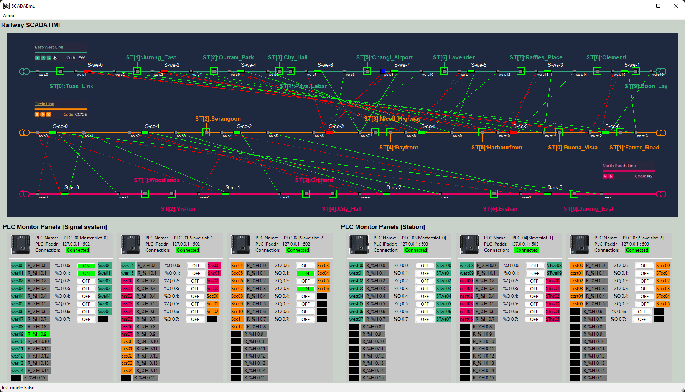





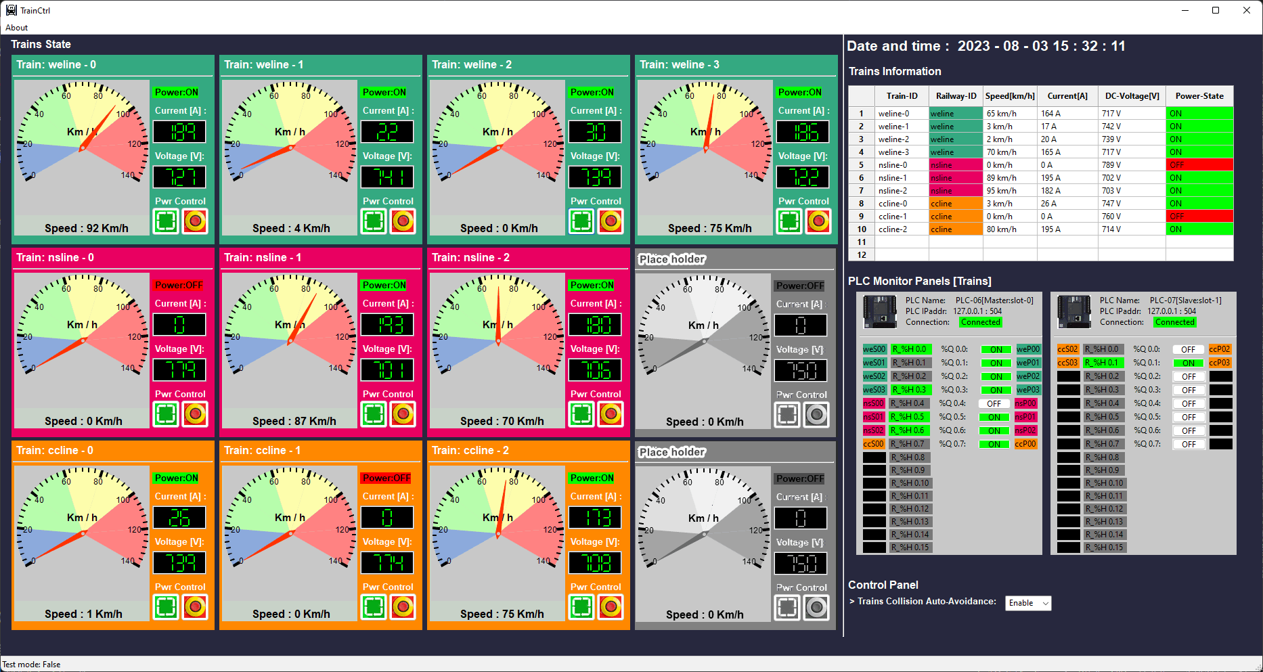

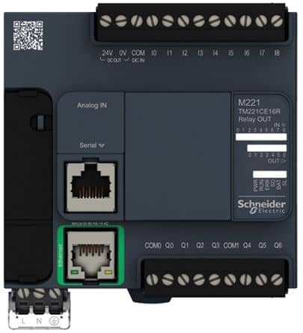
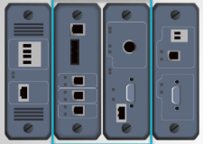
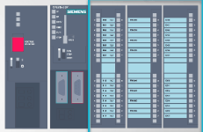
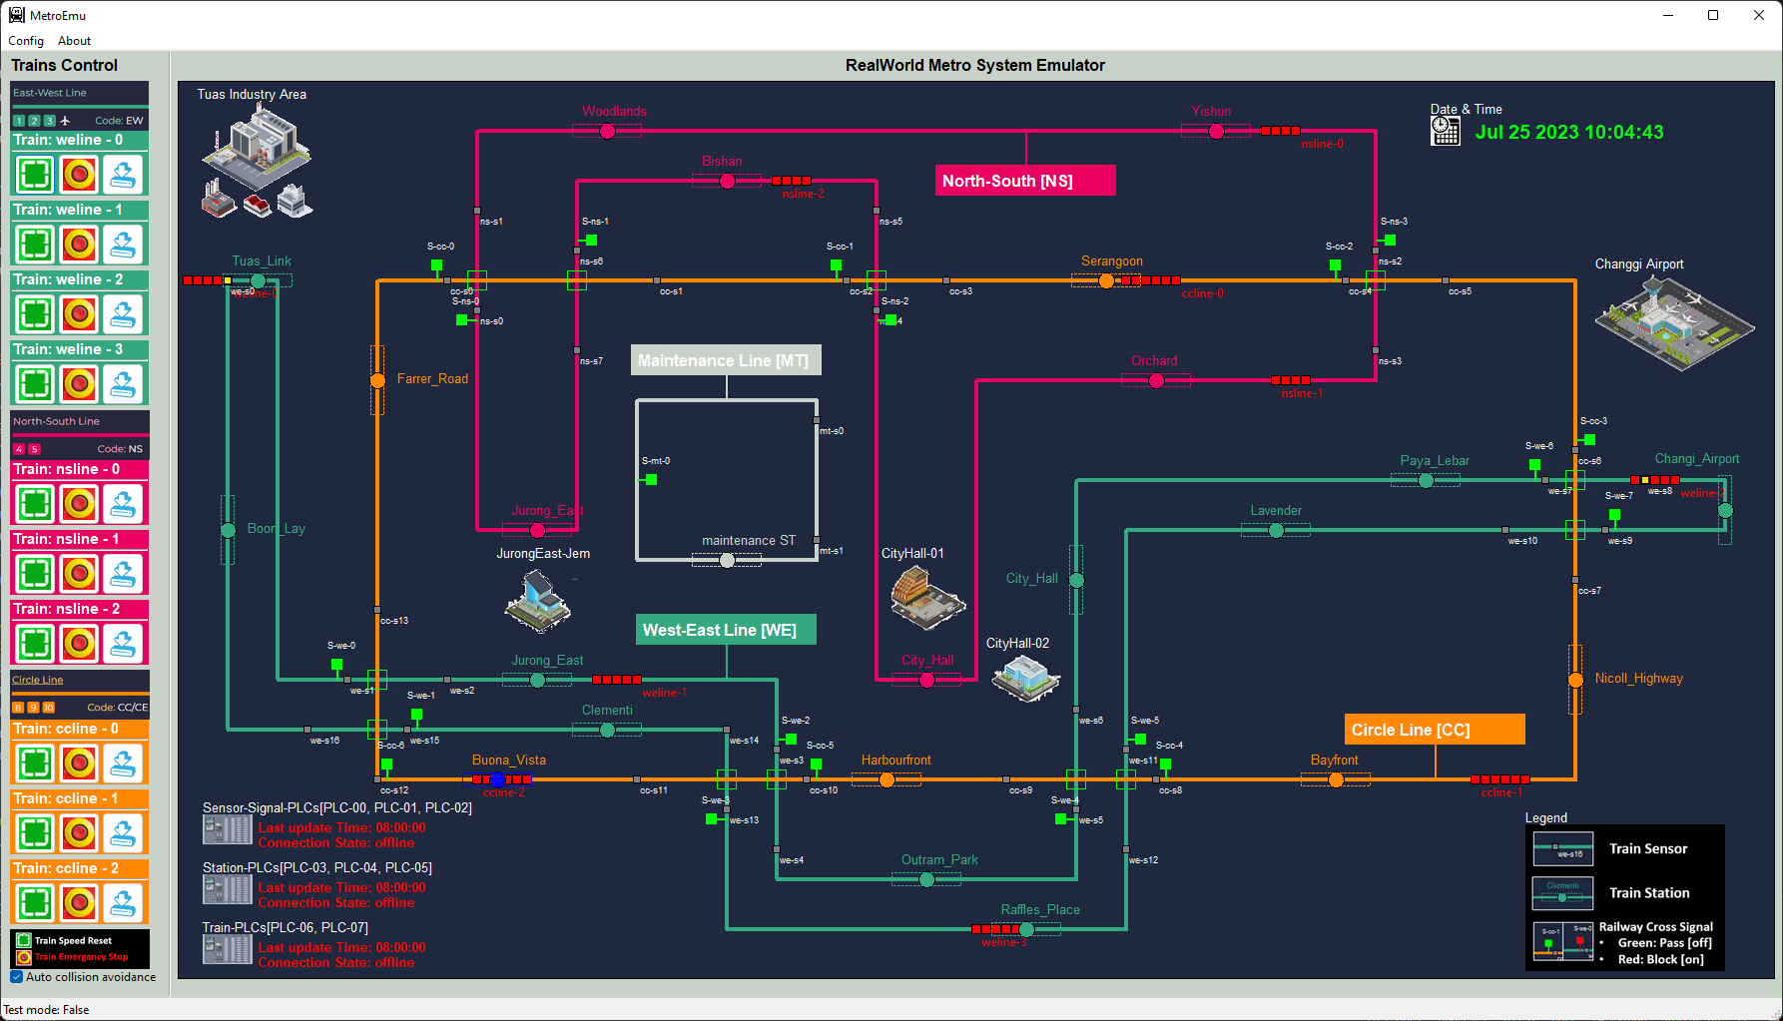
Mini Railway Cyber Range (Railway [Metro] IT-OT System Cyber Security Test Platform)
Level 5
Internet DMZ
Zone
External Web-Server
Email Server
Railway Track Control HMI
Level 4
Enterprise
Zone
Domain Controller
Internal Web-Server
Business Server
Staff laptop/Desktops
Level 3
Operations Management Zone
Data Base Server
Railway Train Control HMI
Management HMI
Application Server
Historian Server
Engineer workstations
Level 2
Control Center (HQ) Processing LAN
Railway Track Control HMI
Railway Train Control HMI
PLC Simulator
Railway Physical World Simulator
Level 1
Controller LAN
Railway PLC
Train RTU
Train PLC
RTU Simulator
Level 0
Physical Process
Field I/O device
Railway Sensors
Railway Signals
Train Sensors
Train Moto
Train Brake

Slide 2









Mini Railway Cyber Range Network Diagram and Components View
Physical real world emulation network
ICS [OT network ]
Real world emulator
Corporate network [IT network]
Corporate Network
Supervision network SCADA
Production network
Maintenance laptops
Junction sensor-signal control PLCs set [emulator]
IT management computers
Electrical signal out
IT engineer
ICS engineer
Track junction sensors-signals control emulators
Ethernet TCP/IP
Ethernet TCP/IP and Modbus TCP
Station sensor-signal control PLCs set [emulator]
Corporate IT servers
ERP servers
Railway system SCADA server
Trains system SCADA server
Electrical signal in
Modbus TCP and S7Comm
Train station sensors-signals control emulators
Train controller PLCs [emulator]
Production management workstation
Railway monitor & control HMI
Trains monitor & control HMI
Train Monitor RTUs [emulator]
Railway Trains emulators
Local HW-Engineering admin laptop
Railway HQ operator
Trains driver /operator
Field device admin
Users, staff and manager

Slide 3
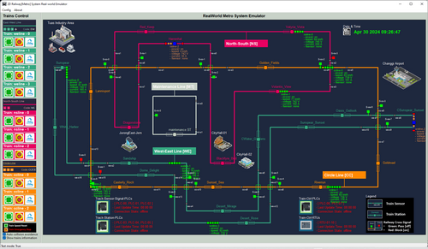



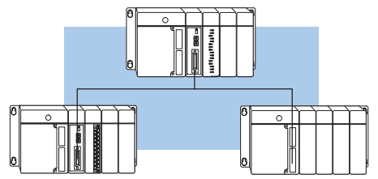

Railway Physical-world Simulator
Railway Track SCADA Monitor HMI(s)
Users
Railway engineer
Slave HMI(s)
Electrical signal communication simulation module (10.0.10.100)
39 track sensors state ( input to PLC)
Master HMI IP: 192.168.10.100
Slave HMI(S) IP:192.168.10.10X
22 PLC coils state (output to signals )
22 station sensor state (input to PLC)
19 PLC coils ( output to signal)
10.0.10.10X
10.0.10.11X
Railway track station signaling control PLC network
Railway track junction signaling control PLC network
HMI network 192.168.10.x
Legend
[Master, Slot-0]
I/O: 8/8
[Master, Slot-0]
I/O: 15/7
Modbus-TCP data flow
PLC-03
PLC-00
UDP data flow (simulate electrical signal )
PLC-04
PLC-05
PLC-01
PLC-02
[Slave, Slot-1] I/O: 8/8
[Slave, Slot-2] I/O: 6/6
[Slave, Slot-1] I/O: 15/7
Switch or Router
[Slave, Slot-2] I/O: 9/5
Modbus IP: 192.168.100.1X/24
Modbus IP: 192.168.101.2X/24
Modbus Network 192.168.100.0/24
Register read request and Coils set request
Register read request and Coils set request

Slide 4
Railway Physical-world Simulator
Railway Track SCADA Monitor HMI(s)
Users
Railway engineer
5
6
Slave HMI(s)
2
3
Electrical signal communication simulation module (10.0.10.100)
39 track sensors state ( input to PLC)
Master HMI IP: 192.168.10.100
9
Slave HMI(S) IP:192.168.10.10X
22 PLC coils state (output to signals )
22 station sensor state (input to PLC)
1
19 PLC coils ( output to signal)
10.0.10.10X
10.0.10.11X
Railway track station signaling control PLC network
Railway track junction signaling control PLC network
HMI network 192.168.10.x
Legend
[Master, Slot-0]
I/O: 8/8
4
[Master, Slot-0]
I/O: 15/7
7
Modbus-TCP data flow
PLC-03
PLC-00
UDP data flow (simulate electrical signal )
PLC-04
PLC-05
PLC-01
PLC-02
[Slave, Slot-1] I/O: 8/8
[Slave, Slot-2] I/O: 6/6
[Slave, Slot-1] I/O: 15/7
Switch or Router
[Slave, Slot-2] I/O: 9/5
Modbus IP: 192.168.100.1X/24
Modbus IP: 192.168.101.2X/24
Modbus Network 192.168.100.0/24
Register read request and Coils set request
Register read request and Coils set request
8

Slide 5

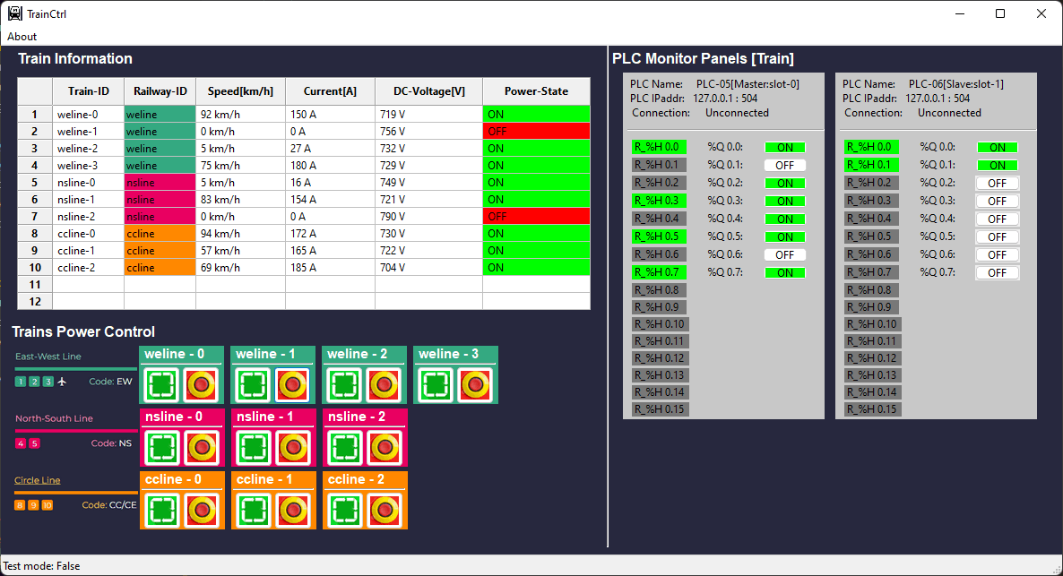
Railway real-world Emulator
Railway SCADA HMIs
Slave HMI(s)
Master HMI
Slave HMI IP: 192.168.10.10X
Master HMI IP: 192.168.10.100
Electrical signal communication simulation module (10.0.10.100)
39 sensors input
10 train throttle
input
19 signal coils output
Register control
Coils control
Register data fetch
Coils data fetch
Train control PLC network [under progress ]
22 station
Sensors input
22 station
Signal output
HMI network 192.16.10.x
Junction Signal control PLC network
10.0.11.10
10.0.13.10
Station Signal control PLC network
10.0.12.10
[Master, Slot-0]
I/O: 15/7
Train Control panel
[Master, Slot-0]
I/O: 0/8
[Master, Slot-0]
I/O: 8/8
PLC-00
PLC-06
PLC-03
PLC-01
PLC-02
[Slave, Slot-1] I/O: 0/2
PLC-04
PLC-05
PLC-07
[Slave, Slot-1]
I/O: 15/7
[Slave, Slot-2]
I/O: 9/5
[Slave, Slot-1] I/O: 8/8
[Slave, Slot-2] I/O: 6/6
Modbus IP: 192.168.100.13
Coils control request
Modbus IP: 192.168.100.12
Register control request
Coils control request
Modbus IP: 192.168.100.11
Register control request
Coils control request
Coils control request
Modbus IP: 192.168.100.2xx
Modbus Network 192.168.100.0/24
UDP data flow:
Modbus TCP data flow:

Slide 6






Train Sensor
Train Station
Railway Cross Signal
Green: Pass [off]
Red: Block [on]
Train Speed Reset
Train Emergency Stop

Slide 7
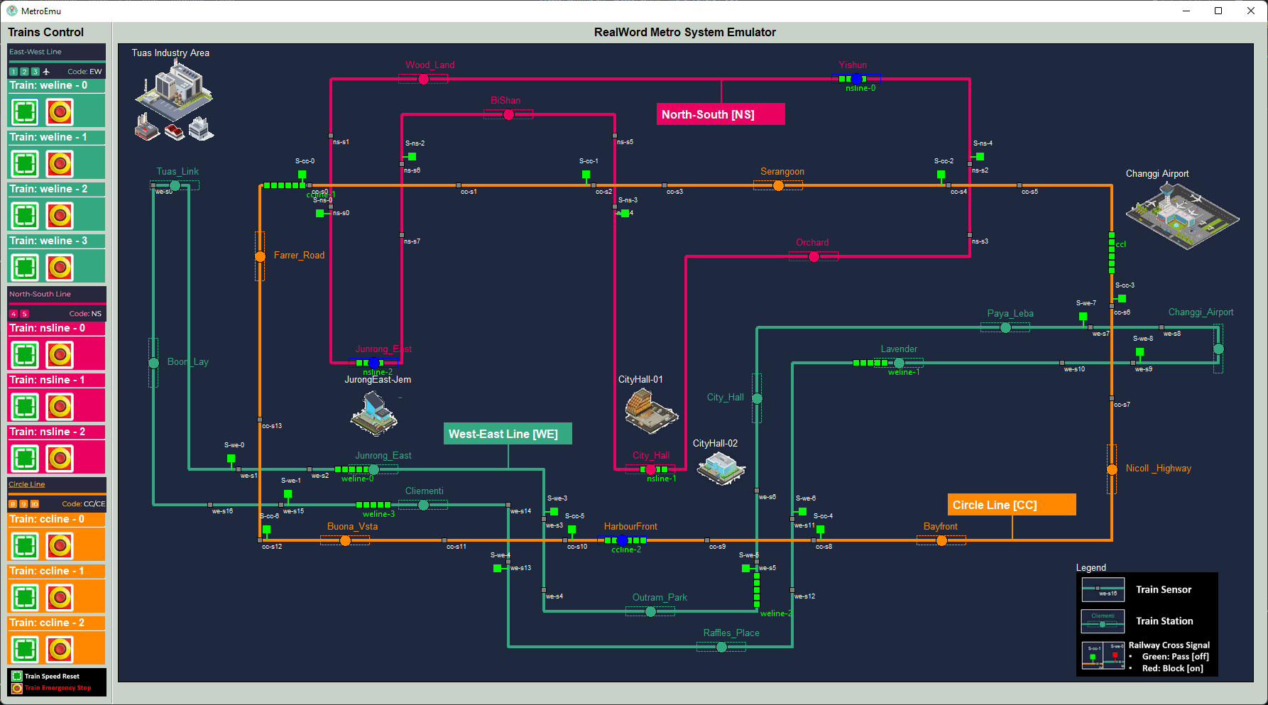
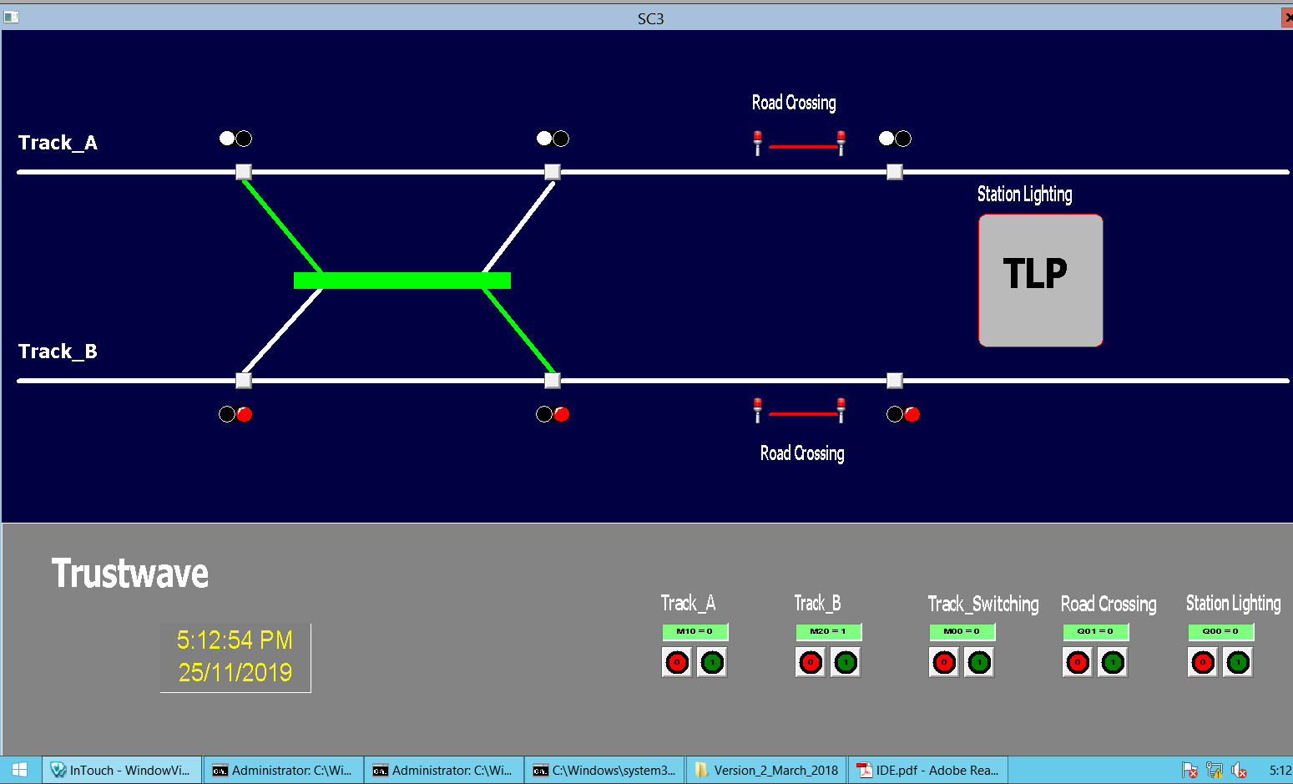
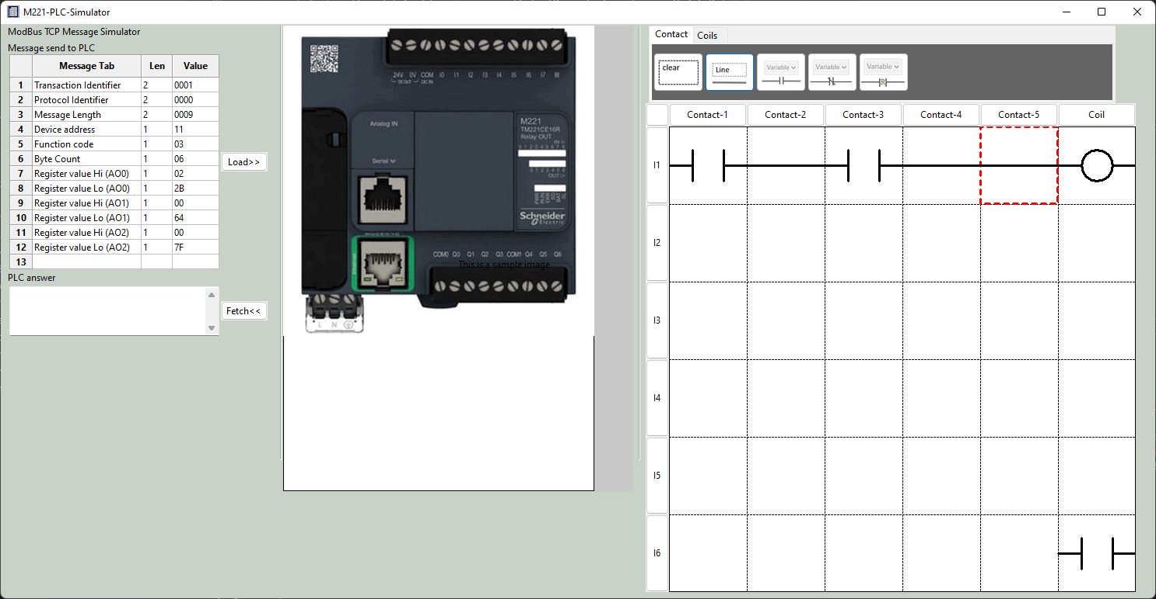
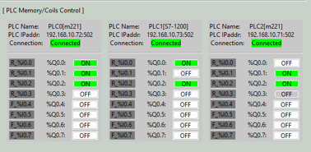
Metro Control HMI
Real work sensor data
PCL coil output data
Database
PLC simulator VM
SCADA HMI data Visualization
PCL input data
ModBus TCP
Communication manager
PCL coil output data

Slide 8
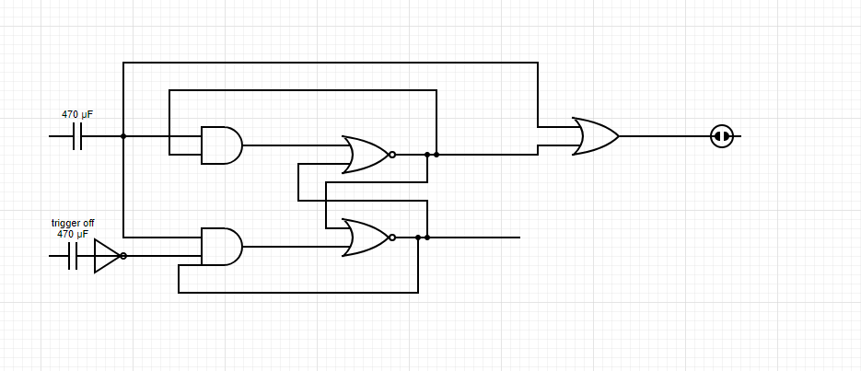
Use PLC to create a T Flip – Flop latching relay with signal trigger on has high priority
Signal Trigger on sensor
Railway control signal
Signal Trigger off sensor

Slide 9


Railway System Emulator [ Program workflow diagram]
Network
Program system config file
Station config file
Scenario config file
Program start
Loading config files
Init main UI (main thread)
Init PLC request handler (sub thread )
Holding register data
PLC data controller (data manager)
Use UDP to simulate the real-word electrical system wires connection
UI data controller (map manager)
Coil state change data
PLC state data
Other PLC modules
Control event
Display UI map panel
PLC Connector (UDP server)
Other PLC modules
Train power control panels
Components state data
Other PLC modules
Display UI refresh loop
All Plc connection and data update state
System auto controller ( if test mode )

Slide 10
Scenario load drop down menu
Train
Station
Date and Time
Trains power control panels
PLC connection state
Trains collision auto avoidance control
Train position sensors
Railway track signals

Slide 11
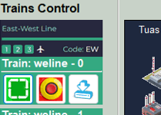
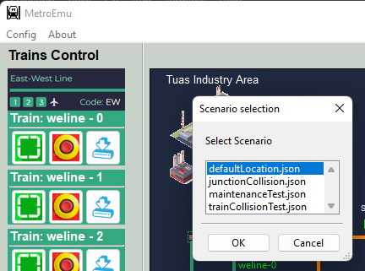
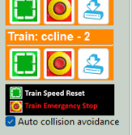

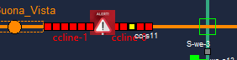
Train control panel
Step 1: click config dropdown menu and select “load scenario”
Step 2:When the Scenario selection window pop-up,
Click the Scenario you want to load
Train position reset button
Emergency Stop button (power cut off)
Train power on Button
Step 3: Click “OK” to load to the real-world simulator
Train auto collision avoidance ON:
Behind train will change speed to 0 to wait the front train if the train’s sensor detects a train in it front in the safety threshold distance.
UI scenario :
Train auto collision avoidance OFF:
Behind train will “hit” the front stopped train directly and stop. An accident indicator will flash at the accident position
UI scenario :
Train auto collision avoidance on/off control

Slide 12
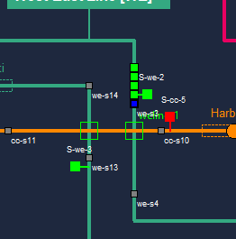
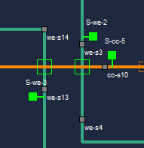
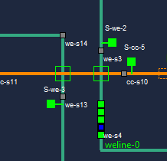
Junction’s Senor-Signal physical wire connection and operating logic
Operation Scenario 1: Junction block when train pass through
Step 1: When a train is entering the junction and trigger the entrance block sensor (sensor color change from grey to blue )
Junction entrance block sensor
Train entrance block signal
Step 2: Junction entrance block signal will turn on (red) to block the train on yellow track to enter the junction
Step 4: Junction entrance block signal will turn OFF (green) to allow the train on yellow track to enter the junction
Junction Area
Junction entrance release sensor
Operation Scenario 1: Junction release when train leaving
Step 3: When a train is leaving the junction and trigger the entrance release sensor (sensor color change from grey to blue )
Physical wire
T-flip-flop latching relay implemented by PLC ladder logic

Slide 13
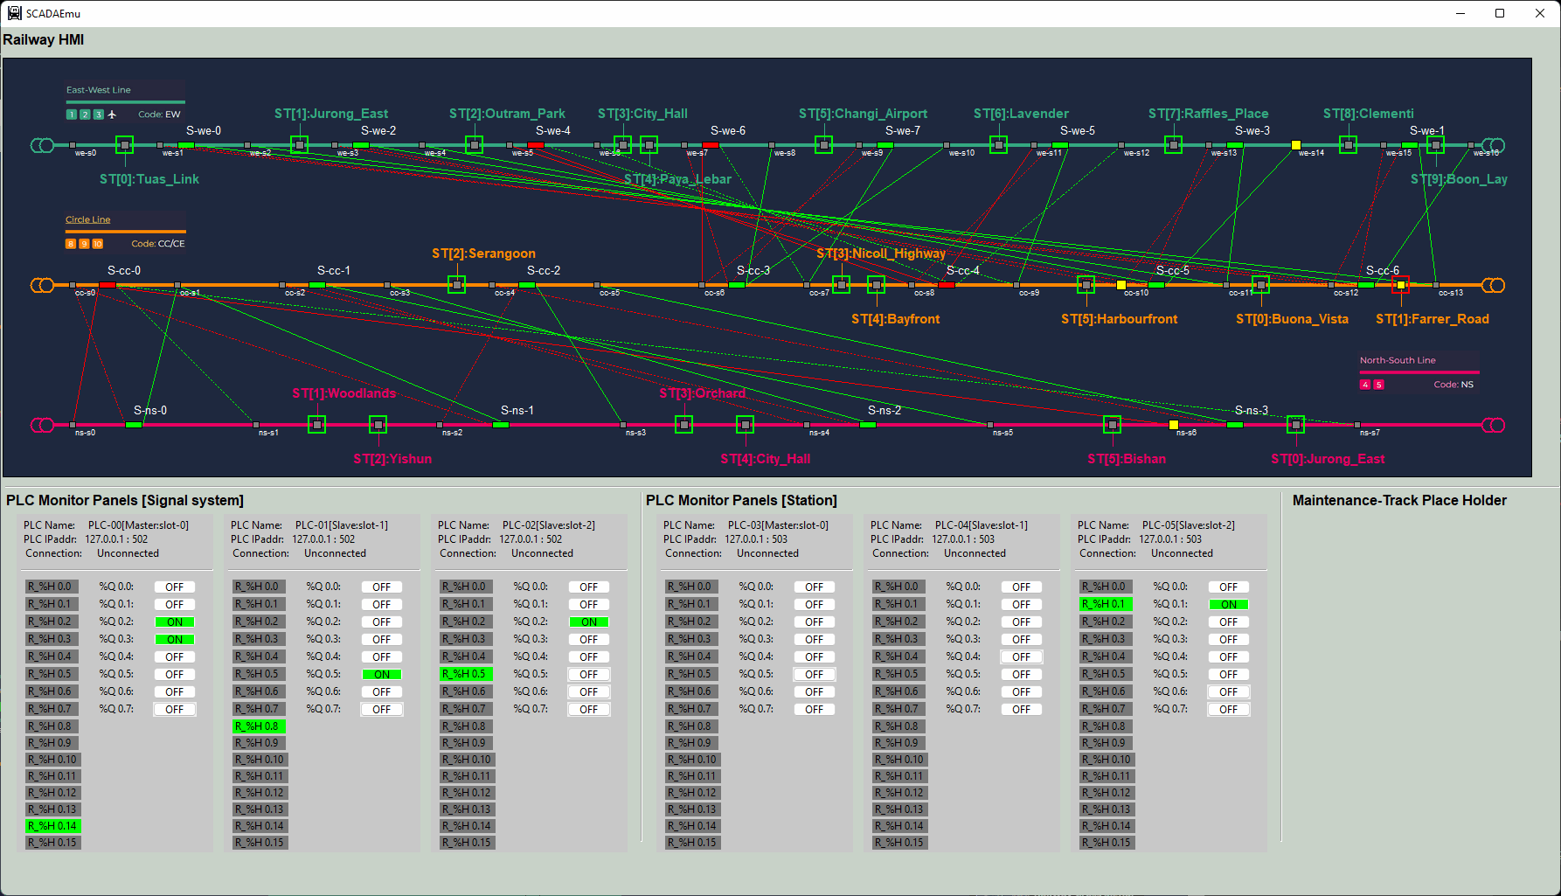
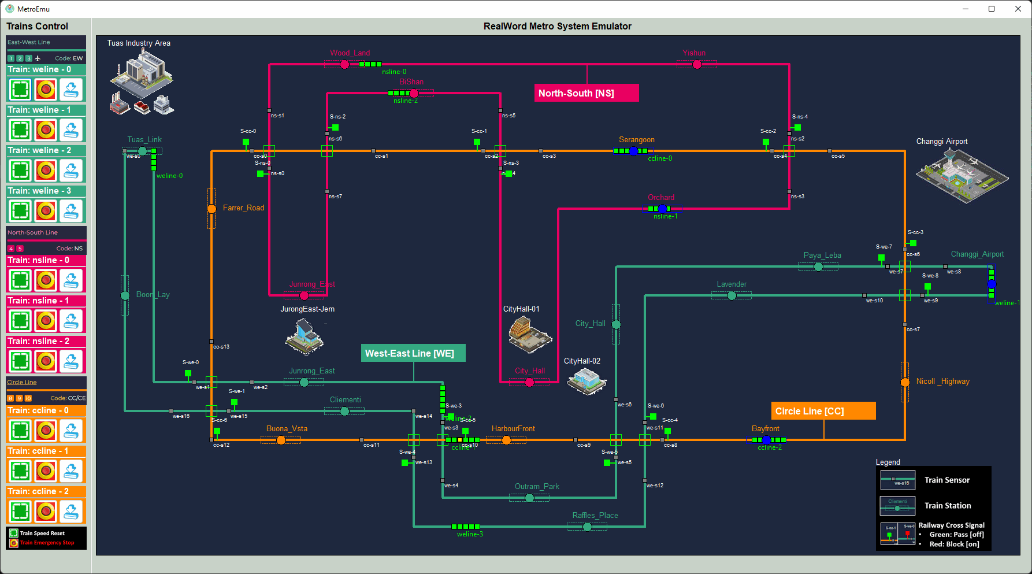
Railway System Emulator [ Program workflow diagram]
Network
Network
Program system config file
Program start
2D Railway[Metro] System Real-world Emulator
Loading config files
Ladder logic bank
Real world connector (thread1)
Logic calculator (thread2)
Modbus server (thread3)
Holding register state change data
Coils state change data
Railway[Metro] System SCADA-HMI
real-world input sensor data
UDP data flow
Real world Communication loop
Register and coils state manager
Modbus request queue handling loop
Change Coils state
real-world output signal data
Read holing register state

Slide 15

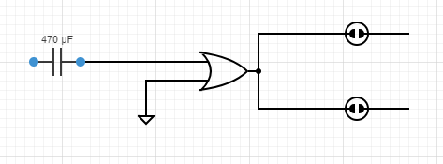

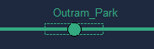
Station’s Senor-Signal physical wire connection and operating logic
Operation Scenario 1: Train enter the station and trigger the docking sensor:
Train docking sensor
Operation Scenario 2: Station turn on train exit signal to stop the train for docking, also turn on the station enter block signal to avoid other trains enters the station:
Train exit station block signal light
Operation Scenario 3: When the train finished docking, turn off both signal light to allow train left the station:
Train enter station block signal light
Station waits another train dock:
Physical wire
Direct trigger latching relay implemented by PLC ladder logic

Slide 16

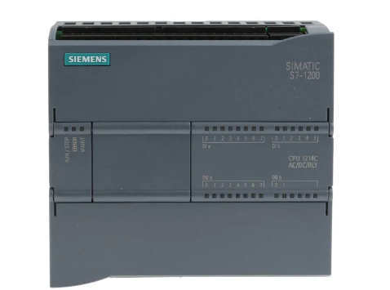
Train’s Senor-Power physical wire connection and operating logic
Operation Scenario 1(Red) : Train power off, Train speed is 0 km/ h
Train speed sensor
Operation Scenario 2(Orange) : Train power on , Train speed is low (0 km/ h – 20km/h)
Train power (moto)
Operation Scenario 2(Green) : Train power on , Train speed is normal (56 km/ h – 90 km/ h)
PLC input connector
PLC output connector

Slide 17
Railway System Emulator [ Program workflow diagram]
Network
Network
Program system config file
Program start
2D Railway[Metro] System Real-world Emulator
Loading config files
Real world connector (thread1)
Modbus server (thread2)
Trains Control HMI
real-world input sensor data
UDP data flow
Real world Communication loop
Register and coils state manager
Modbus request queue handling loop
Change Coils state
real-world output signal data
Read holing register state

Slide 18
Program system config file
Network
Program start
Loading config files
Init main UI (main thread)
Init PLC Connector (sub thread )
Holding register data
UI data controller (map manager)
PLC data controller (data manager)
Trains information
Coil state change data
PLC state data
Display UI info panel
Modbus TCP data
PLC client (Modbus TCP client)
Trains Sensor-Power System Control PLC Simulator module
Train power control panels
Power Control event
PLC state panels
PLC state data
Display UI refresh loop

Slide 19
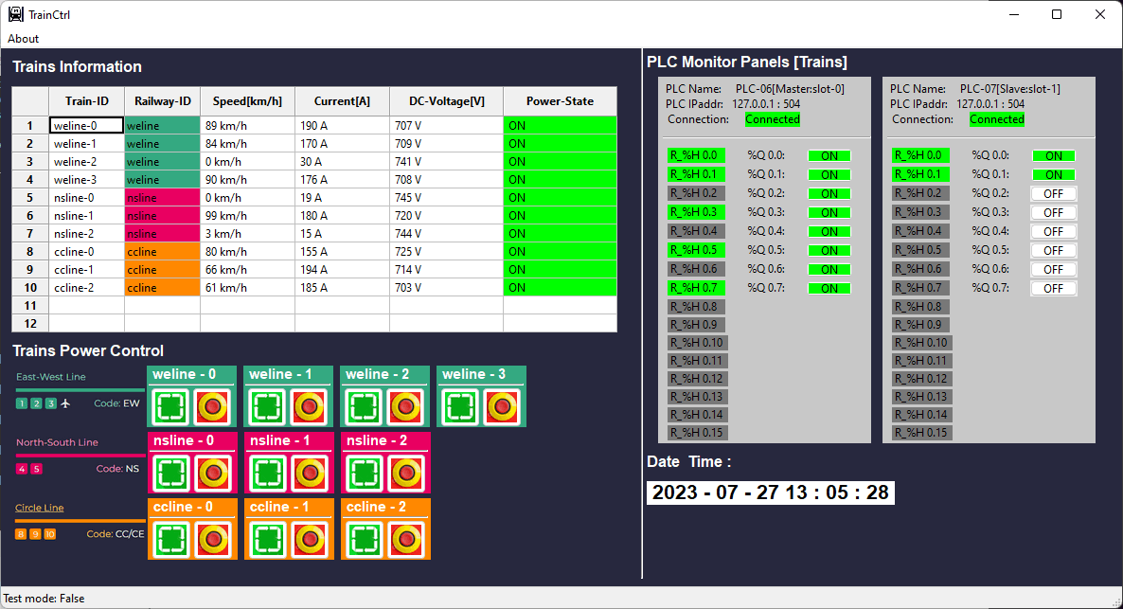
Trains information display grid
PLC state panel
PLC connection state
PLC coils state indicator
PLC holding register state indicator
Critical information and error state display bar
Turn train power ON button
Turn train power OFF button (emergency stop)
Date & time

Slide 20
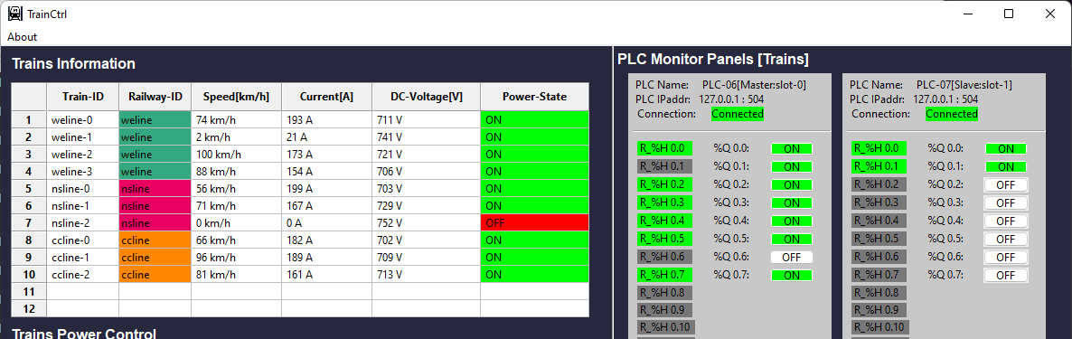
Train normal operation mode A-1 (docking/waiting):
Train power on, Train speed very low [<5km/h], Current drop low. Voltage range in (Min. permanent , Normal)
PLC speed sensor (Register) indicator OFF (grey).
PLC train motor power indicator ON (green)
Train normal operation mode A-2 (running)
Emergency Stop button pressed (Mode-B) :
Train power off, Train totally stop[speed=0], Current cut off. Voltage range in (Normal , Max. permanent)
PLC speed sensor (Register) indicator OFF (grey).
PLC train motor power indicator OFF (white)

Slide 21
Program system config file
Network
Program start
Loading config files
Init main UI (main thread)
Init PLC Connector (sub thread )
Holding register data
UI data controller (map manager)
PLC data controller (data manager)
Digital I/O Information
Coil state change data
Map display panel
PLC state data
Modbus TCP data
Railway Junctions Sensor-Signal System Control PLC Simulator
Junction PLC client (Modbus TCP client)
PLC set 1 state display panels
PLC state data
Modbus TCP data
PLC state data
Station PLC client (Modbus TCP client)
Railway Stations Sensor-Signal System Control PLC Simulator
PLC set 2 state display panels
PLC state data
Display UI refresh loop

Slide 22
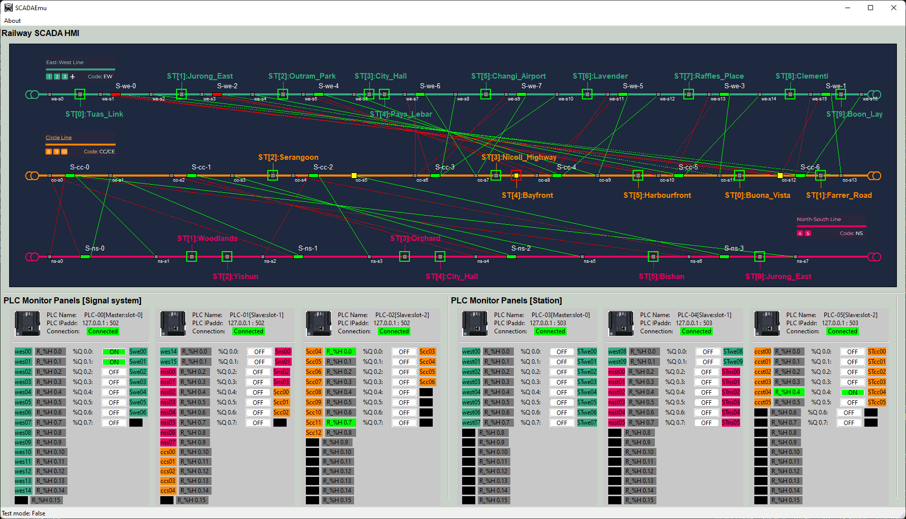
Train station docking sensor [Grey]
Junction block signal ON [Red]
Junction release sensor triggered [ Yellow]
Junction block signal OFF [Green]
Junction block sensor [with red dash line]
Junction block sensor [with green dash line]
Train station signal [green]
Junction block sensor triggered [ Yellow]
Train station docking sensor triggered [Yellow]
PLC information
PLC coil voltage low
PLC coil voltage high
Digital input connected
Digital input empty
PLC register state voltage high
PLC register state voltage low
Digital output connected
Digital output empty

Slide 23
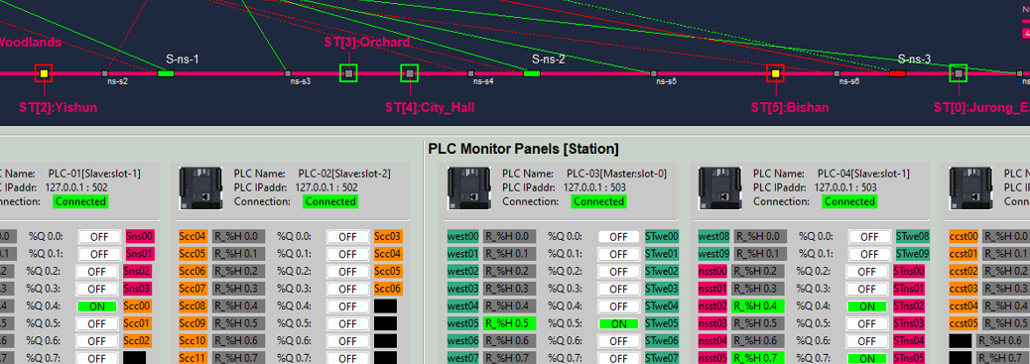
Station triggered example
Step 1.1 :Map station sensor changed to triggered state (yellow color)
Step 2.0: Map station signal changed to block state (red color)
Step 1.0: In real-world emulator, train triggered the station docking sensor, Digital input signal change the register’s state
Step 2.0: PLC executes the ladder logic, turn on coils to change the digital output
Step 3: Real-world emulator signal turn on to block the train.

Slide 24
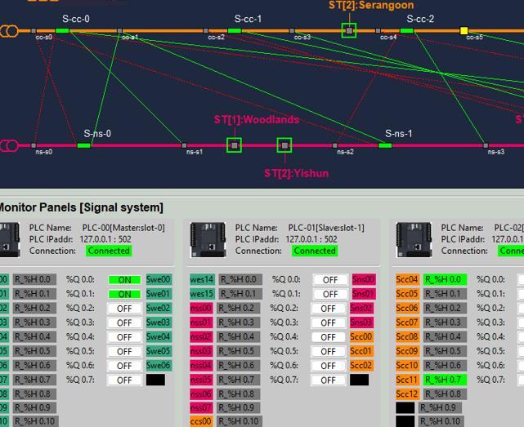
Step 2.1: digital output will change the related signal connect to it to block the junction
Step 3.1: digital output will change the related signal connect to it to release the junction
Step 1.1: In the map the sensor will show triggered state (yellow color)
Step 3.0: In real-world emulator, train triggered the junction release sensor, Digital input change the register’s state
Step 1.0: In real-world emulator, train triggered the junction entrance sensor, Digital input change the register’s state
Step 2.0: PLC execute the ladder logic, then change the coil sate

Slide 25


IT-Network
SCADA HMI Monitor VM/Node
Railway Real-world Emulator VM/Node
SCADA HMI Operation VM/Node
Real world emulator program
Railway HMI program [master]
Railway HMI program
192.168.10.100
192.168.11.10
192.168.11.1X
192.168.10.10X
10.0.10.100
SCADA HMI subnet
Real world electrical signal simulation subnet
OT-Network
Train control program
Train Control PLC VM/VMs
10.0.10.13
Station Control PLC VM/VMs
10.0.10.12
Signal Control PLC VM/VMs
10.0.10.11
192.168.100.2xx
PLC Simulator Program
Train driver subnet
PLC Simulator Program
PLC Simulator Program
192.168.100.11
192.168.100.13
192.168.100.12

Slide 26
Railway[Metro] IT/OT System Security Test Platform Network Diagram and Components View
Physical real world emulation network
ICS [OT network ]
Real world emulator
Corporate network [IT network]
Corporate Network
Supervision network SCADA
Production network
IT management computers
Maintenance laptops
Junction sensor-signal control PLCs set [emulator]
IT engineer
ICS engineer
Electrical signal out
Track junction sensors-signals control emulators
Ethernet TCP/IP
Ethernet TCP/IP and Modbus TCP
Corporate IT servers
ERP servers
Railway system SCADA server
Trains system SCADA server
Station sensor-signal control PLCs set [emulator]
Modbus TCP
Train station sensors-signals control emulators
Electrical signal in
Production management workstation
Train controller PLCs [emulator]
Railway monitor & control HMI
Trains monitor & control HMI
Train emulators
Local HW-Engineering admin laptop
Railway HQ operator
Trains driver /operator
Field device admin
Users, staff and manager

Slide 27
Railway[Metro] IT/OT System Security Test Platform Network Diagram and Components View
Physical real world emulation network
ICS [OT network ]
Corporate network [IT network]
Corporate Network
Supervision network SCADA
Production network
IT management computers
Maintenance laptops
Junction sensor-signal control PLCs set [emulator]
IT engineer
ICS engineer
Electrical signal out
Track junction sensors-signals control emulators
Ethernet TCP/IP
Ethernet TCP/IP and Modbus TCP
Corporate IT servers
ERP servers
Railway system SCADA server
Trains system SCADA server
Station sensor-signal control PLCs set [emulator]
Modbus TCP
Train station sensors-signals control emulators
Electrical signal in
Production management workstation
Train controller PLCs [emulator]
Railway monitor & control HMI
Trains monitor & control HMI
Train emulators
Local HW-Engineering admin laptop
Railway HQ operator
Trains driver /operator
Field device admin
Users, staff and manager

Slide 28
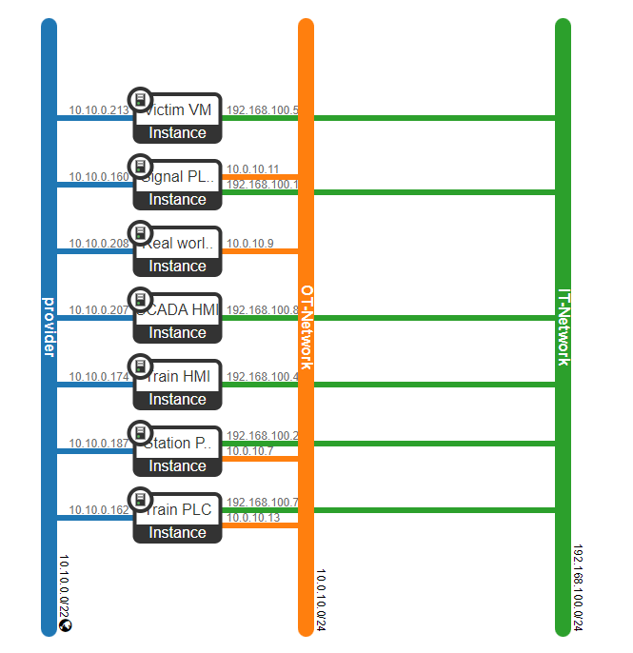
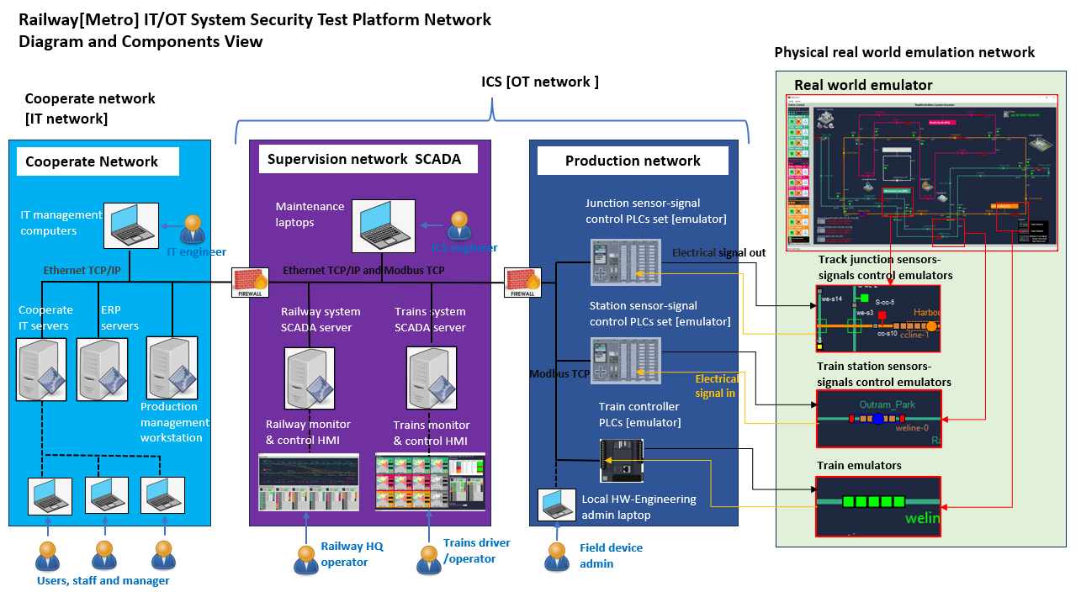
Railway system cyber range system on OpenStack
Network Map Info:
Physical wire connection emulation network
Network Map Info:
Supervision network SCADA.(For OT attack test )
OpenStack provider network used as the Green team development network
Next Step work:
Add one subnet (jump host link to OT network) with 10 small empty ubuntu VMs named as HR server, Web billing server , finance server, file server, email server … to simulate the corporate network.
Add one subnet (jump host link to corporate network) with 5 small empty ubuntu VMs named as DC server, NTP server , DNS server, VPN server … to simulate the DMZ network.

Slide 29
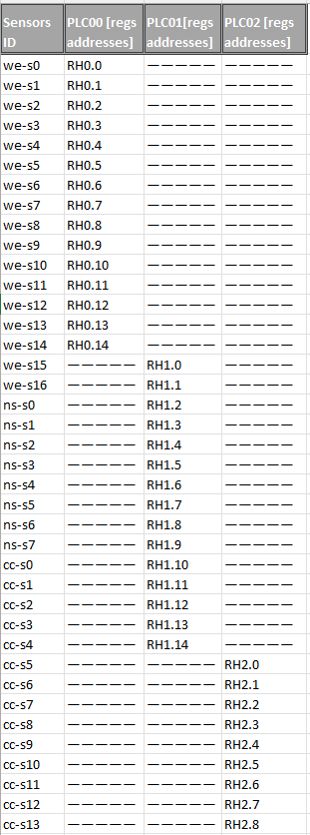
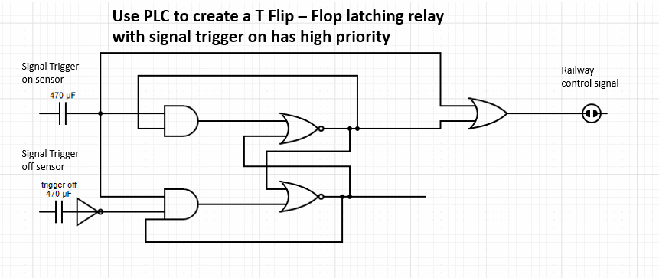
Railway Signal System PLC set ladder logic
Junction Signal control PLC network
PLC-00
[Master, Slot-0]
I/O: 15/7
PLC0 Q0.3
S-we-3
PLC1 Q0.1
S-ns-0
PLC-01
PLC-02
[Slave, Slot-1]
I/O: 15/7
[Slave, Slot-2]
I/O: 9/5
PLC0 Q0.5
S-we-5
PLC1 Q0.2
S-ns-1
PLC2 Q0.1
S-cc-3
PLC1 Q0.0
S-we-7
PLC1 Q0.3
S-ns-2
PLC0 Q0.6
S-we-6
PLC2 Q0.2
S-cc-4
Ladder Diagram set information:
PLC number: 3
Holding register: 39
Coil: 19
Total ladder diagram: 19
Ladder diagram detail:
PLC1 Q0.4
S-ns-3
PLC2 Q0.3
S-cc-5
PLC0 Q0.4
S-we-4
PLC1 Q0.5
S-cc-0
PLC0 Q0.2
S-we-2
PLC2 Q0.4
S-cc-6
PLC1 Q0.6
S-cc-1
PLC0 Q0.0
S-we-0
PLC0 Q0.1
S-we-1
PLC2 Q0.0
S-cc-2

Slide 30
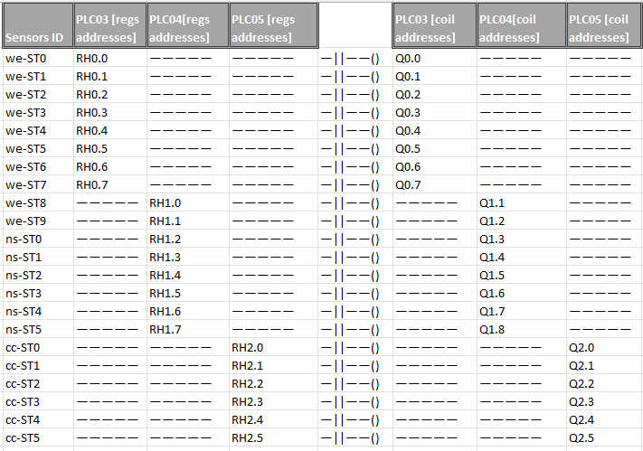
Railway Station system PLC set ladder logic
Station Signal control PLC network
10.0.12.10
PLC-03
[Master, Slot-0]
I/O: 8/8
PLC-04
PLC-05
[Slave, Slot-1] I/O: 8/8
[Slave, Slot-2] I/O: 6/6
Ladder Diagram set information:
PLC number 3
Holding register: 22
Coil: 22
Total ladder diagram: 22
Ladder diagram detail:

Slide 31
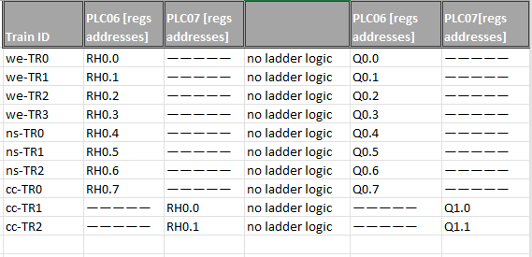
Train control PLC network [under progress ]
Train Control PLC Configuration
[Master, Slot-0]
I/O: 0/8
PLC-06
[Slave, Slot-1] I/O: 0/2
PLC-07
Ladder Diagram set information:
PLC number 2
Holding register: 0
Coil: 10
Total ladder diagram: N.A (direct control)
Ladder diagram detail: N.A
Fetch PLC Input sensor voltage and set the register
t0
t2
t3
t4
Low frequence false data injection attack not success on real PLC because the false data is overwritten by the sensor data read on t2 and t3.
Real PLC with 20ms clock cycle
10ms
10ms
t1: Inject false register value to overwrite sensor reading
False data injection attack success, the PLC execute the ladder logic based on the false injected sensor volage value.
PLC Emulator with 80ms clock cycle
80ms
Execute the ladder logic

Slide 32
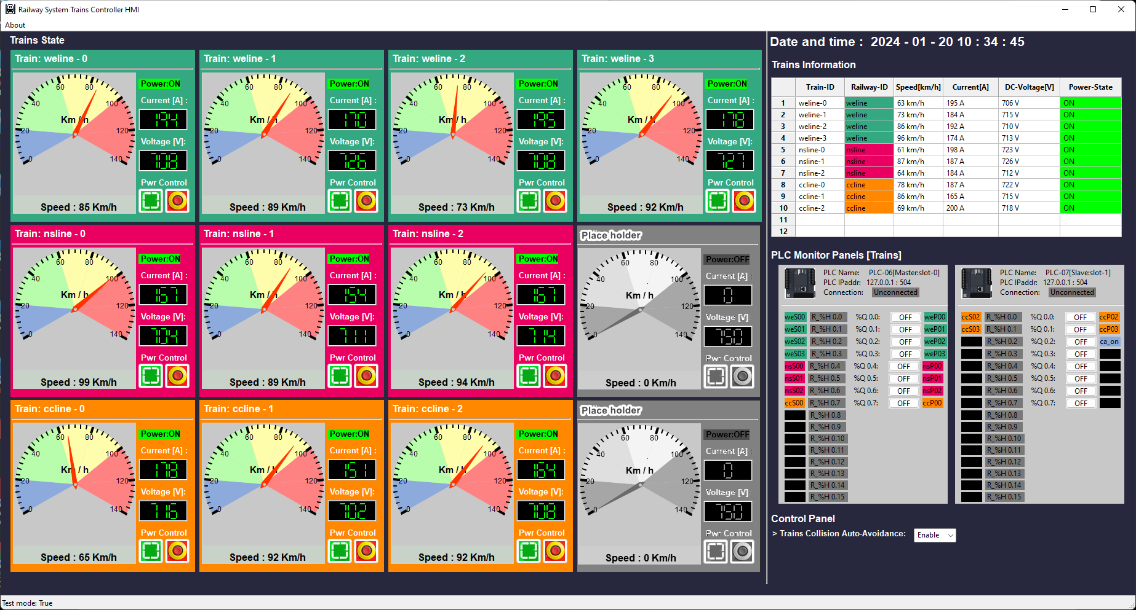
Train State Panel
Train ID
Train DC power state
Train DC Current(A)
Train DC Voltage(V)
Train state history table
Train average speed indicator
Train poser state reset button
Train emergency stop button
Train’s Control PLC state panel
Train’s collision avoidance overload control
Train current speed gauge

Slide 33
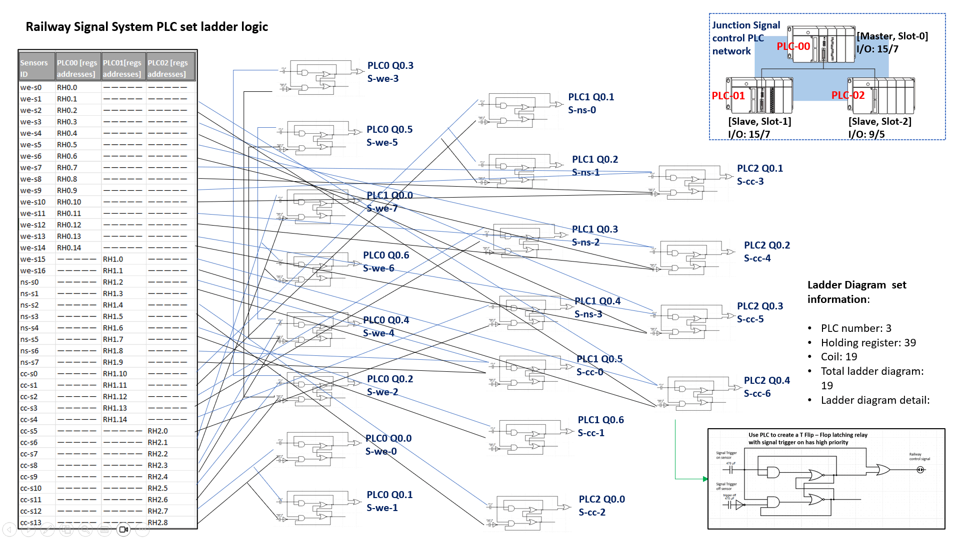
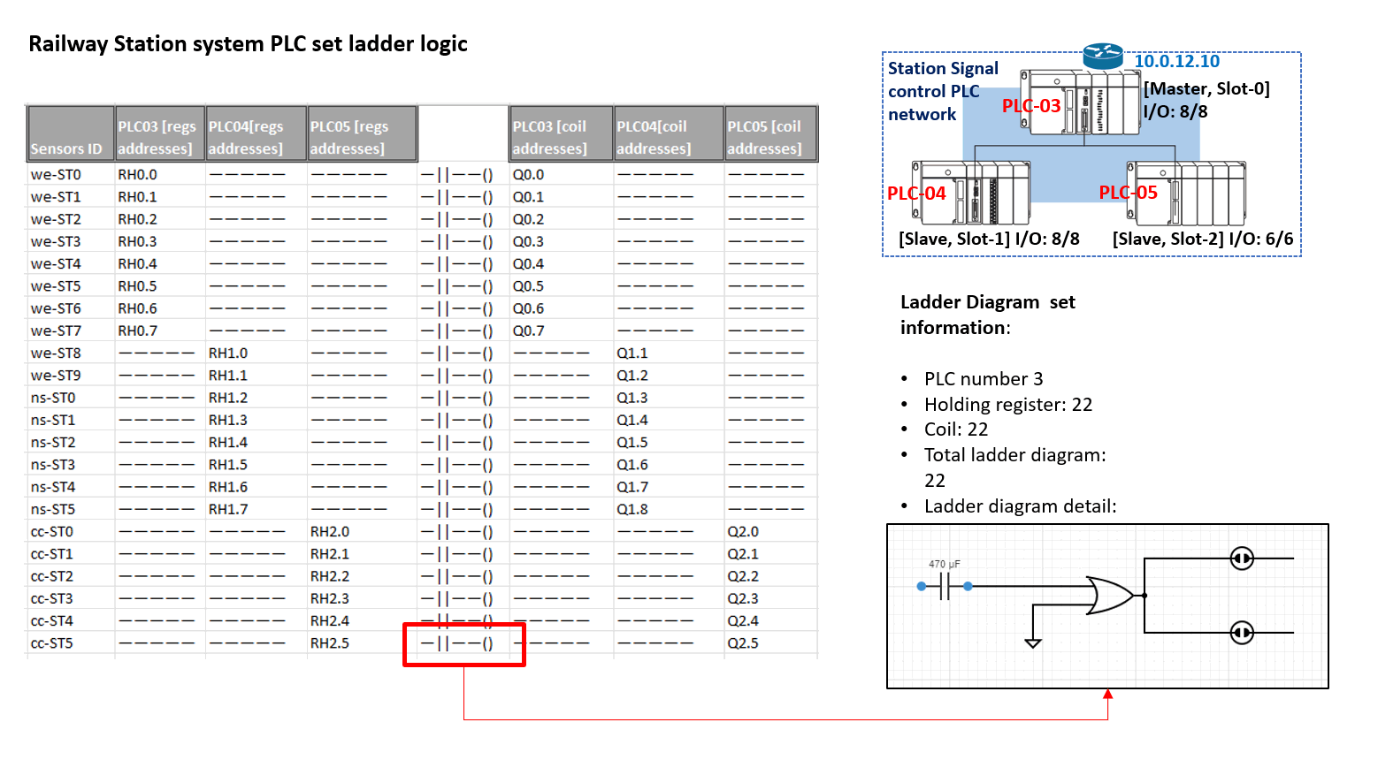
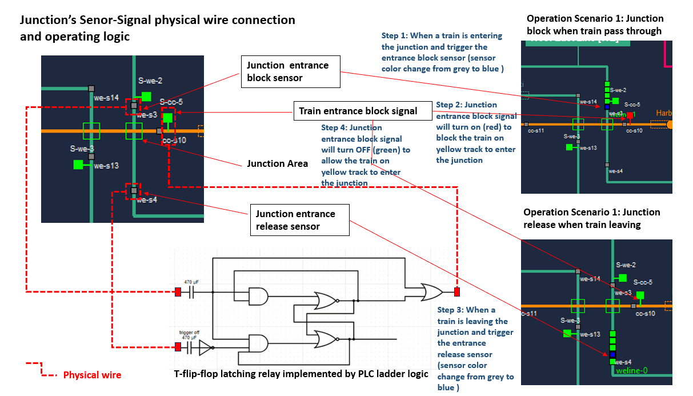
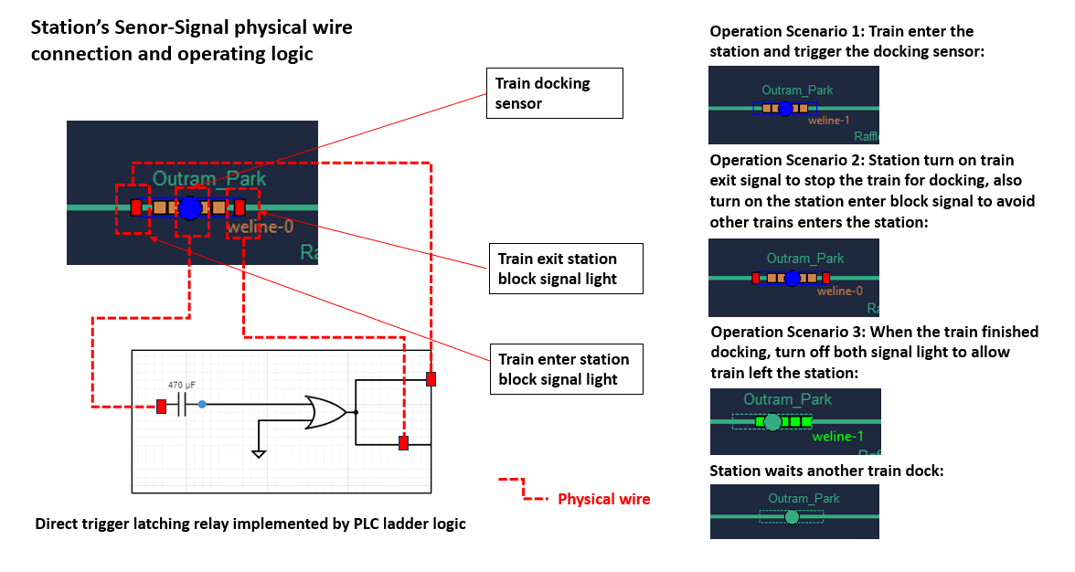
Modbus-TCP
Junction PLC
Station PLC
Real word junction sensors and signal
UDP simulate electrical signal
UDP simulate electrical signal
Real word station sensors and signal

Slide 34
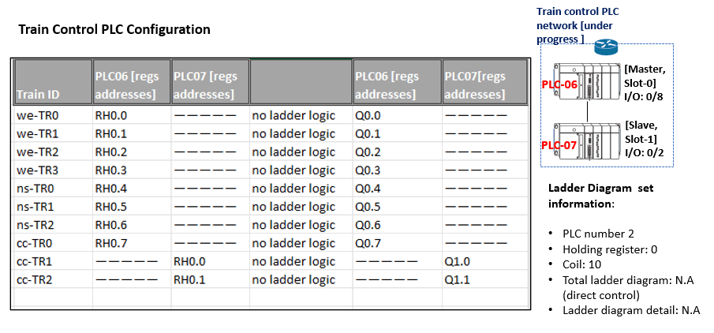
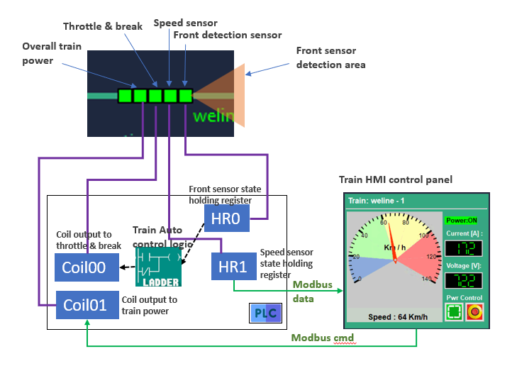
Train Control PLC
Modbus-TCP
UDP simulate electrical signal
Real word trains PLC throttle and brake control

