Slide 1


MyAnimeList.Com Data Analyis
By Alexander Wood

Slide 2

Introduction
MyAnimeList (or MAL for short) is one of the largest anime websites in the world
It provides users with a list-like system to organize and score anime
This data was scraped and run through several analyses to determine the largest contributing factors to anime score

Slide 3
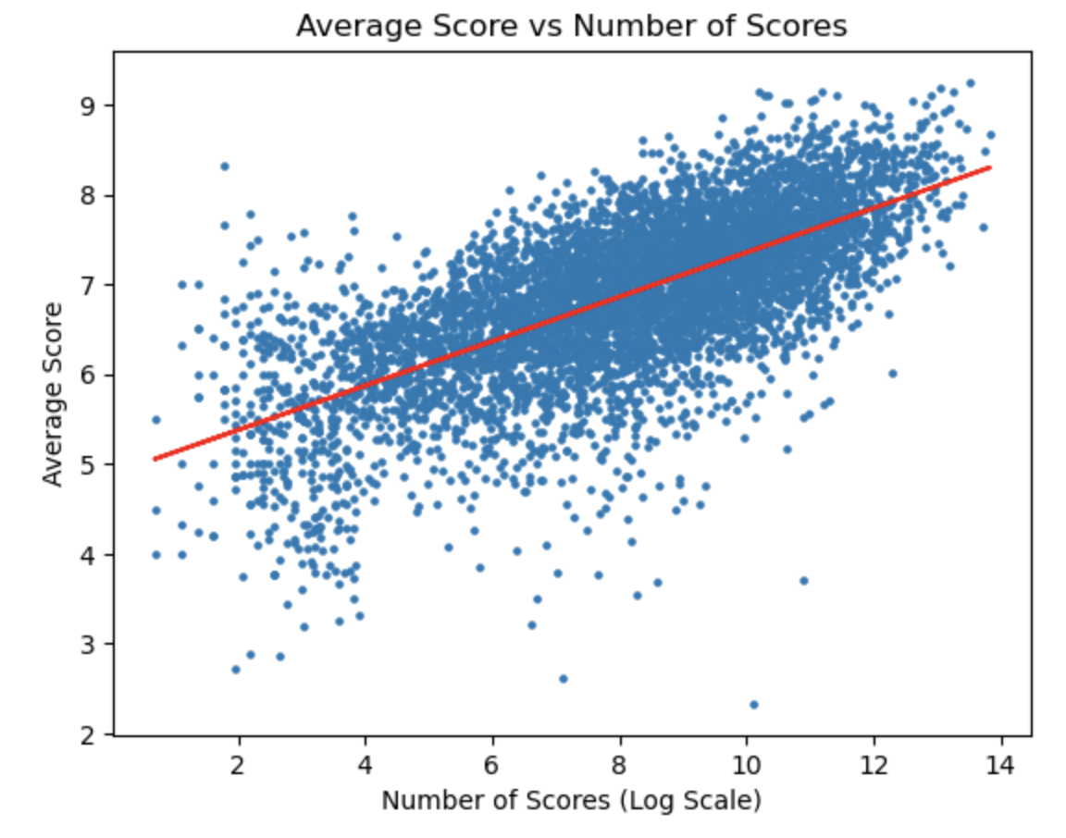
Average Number of Viewers
All the numerical values were run through several filters and multiple regression analysis to determine which values were correlated with the user scores of the anime
The only numerical value that was significantly correlated with score was the number of viewers of the anime
In general the higher the number of viewers, the higher the average score is
While not directly useful it does indicate that MAL scores are a reliable indicator of how popular an anime will be

Slide 4

Categorical Data
We ran multiple regression analysis on three categorical sets of data, genre, source, and original viewing format (or type)
The analysis showed that this data was significant

Slide 5
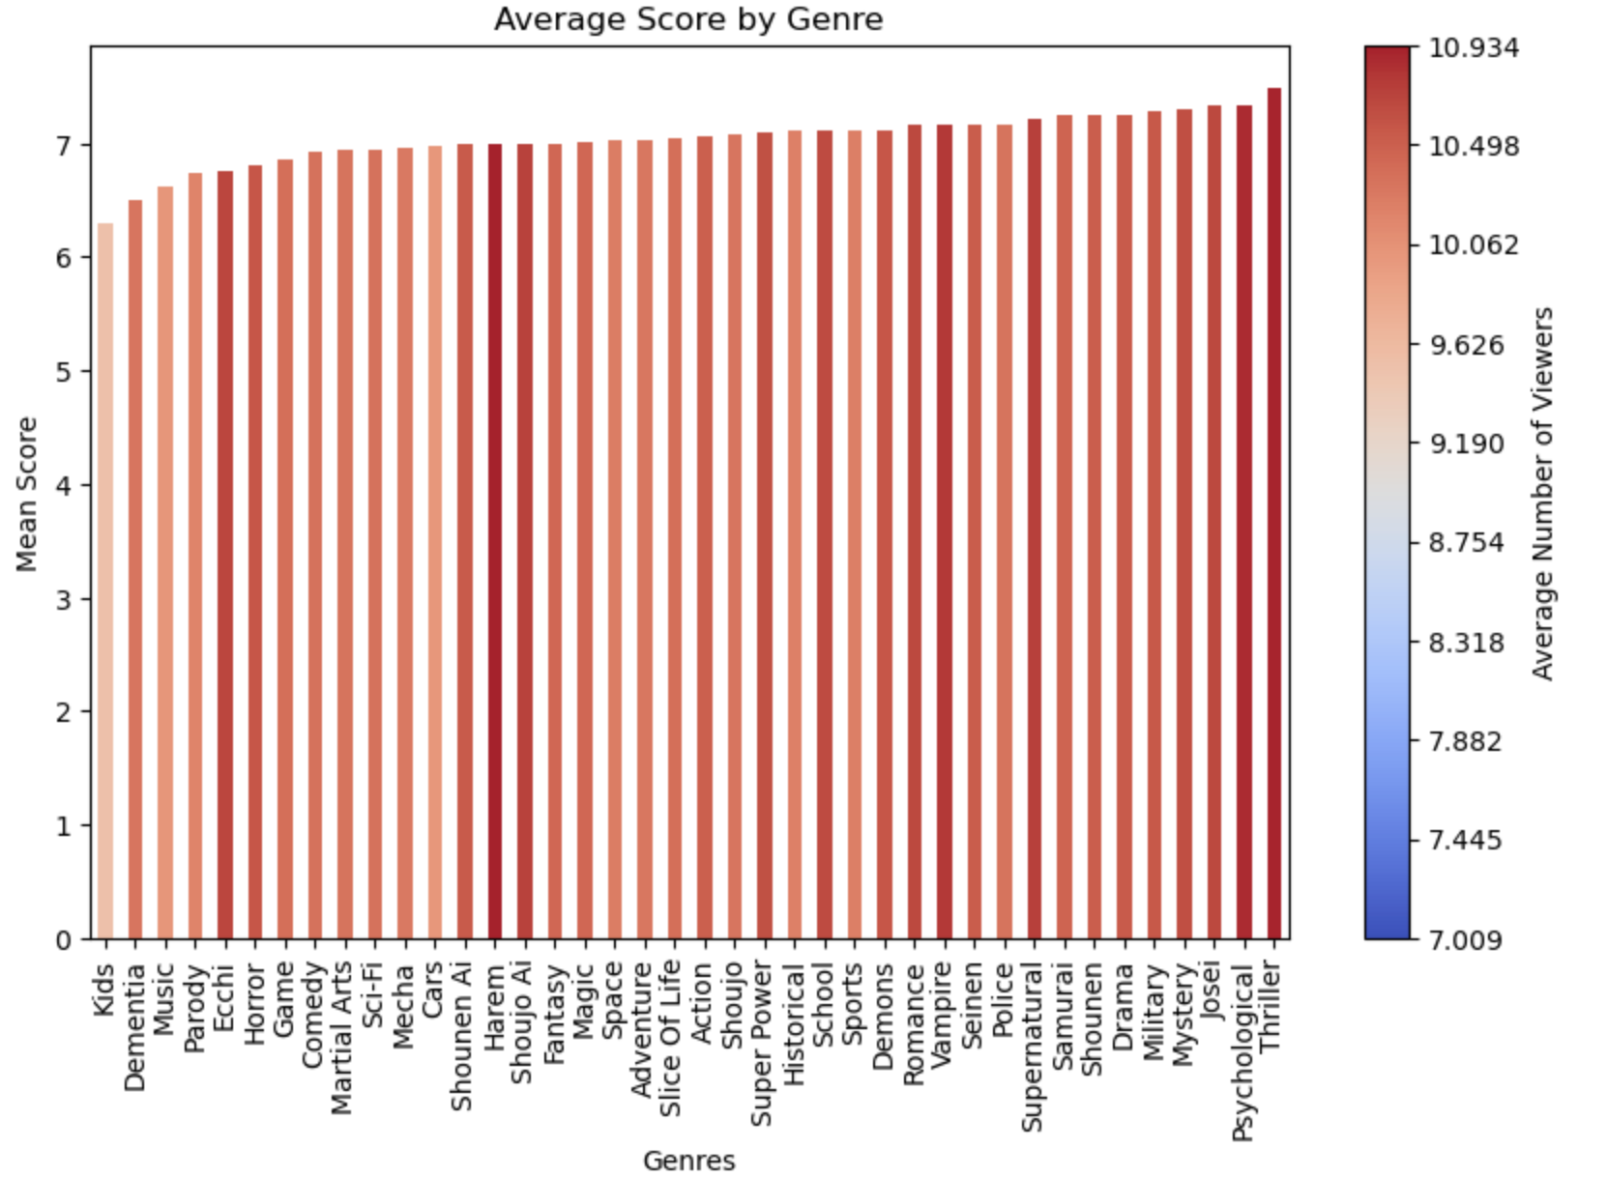
Genre
The most highly rated genre of anime was Thriller, and the lowest rated was Kids
Thriller also received the highest average number of viewers

Slide 6
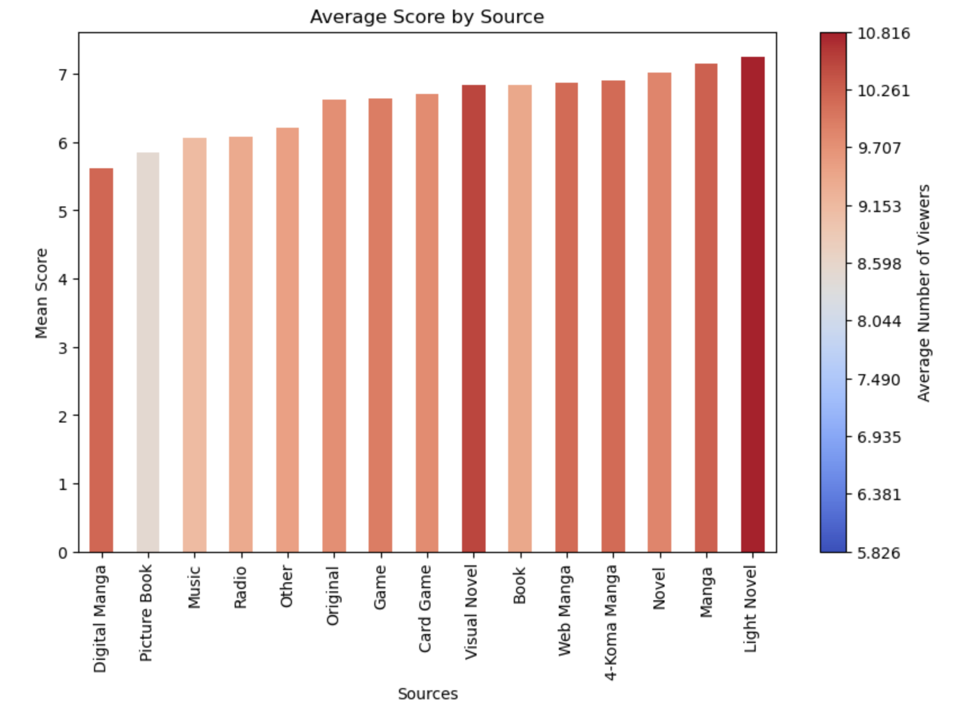
Source
The most highly rated anime were sourced from light novels, which also received the highest average number of viewers
Visual Novels have a notably high average number of viewers in comparison to their average score

Slide 7
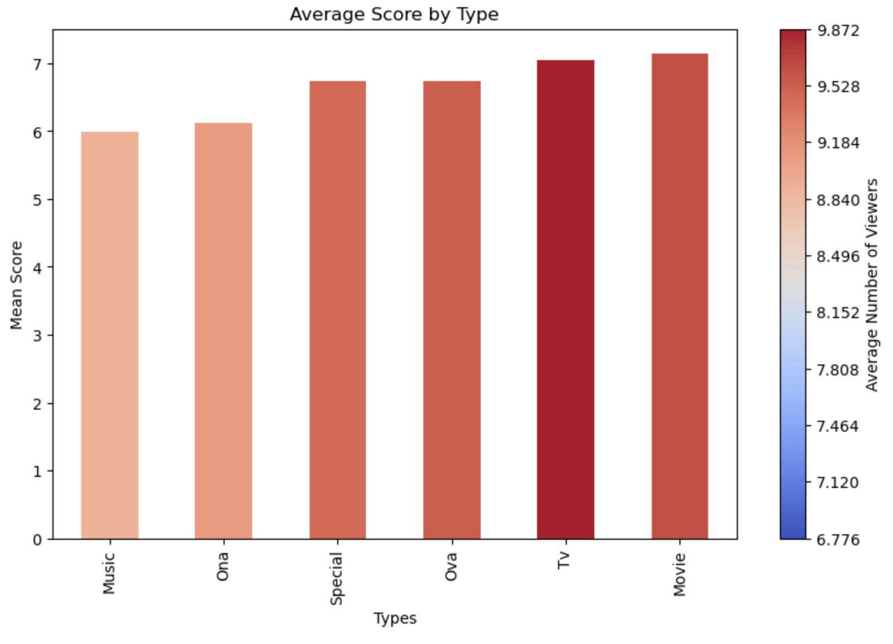
Original Viewing Format (Type)
Movies were the highest rated anime on average
Tv anime have the highest average number of viewers per show

Slide 8
Conclusions and Recommendations
MAL is a reliable indicator of anime popularity and quality via its user scores
Demographic research to find a target market is recommended

Slide 9

Thank you

