Slide 1
CS165 Final Project
Kevin Zhang

Slide 2
Features/ToDo List
Completed:
Creates – database, table, column, index
Inserts – data into any table
Selects – range operators only
Fetches – fetches from any table
Loads – data from files
Indexes – multiple types of indexes
Joins – hash joins
Deletion in B+ trees
To Do:
Updates
Nested-loop joins

Slide 3
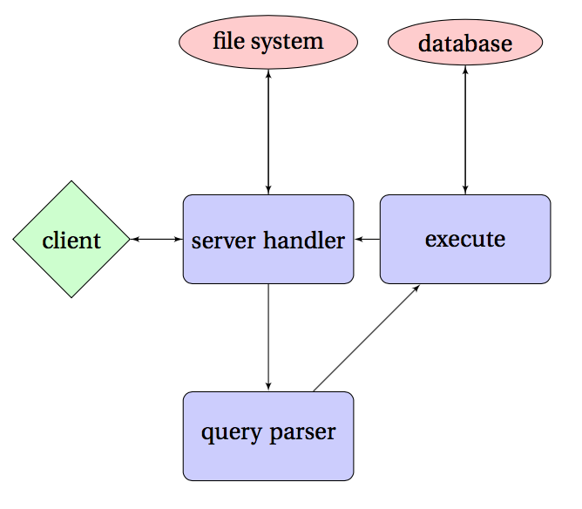
System Overview

Slide 4
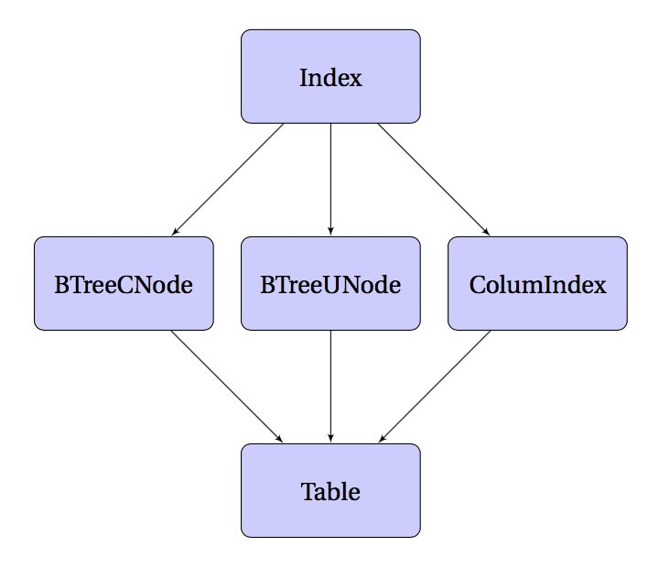
Creates

Slide 5
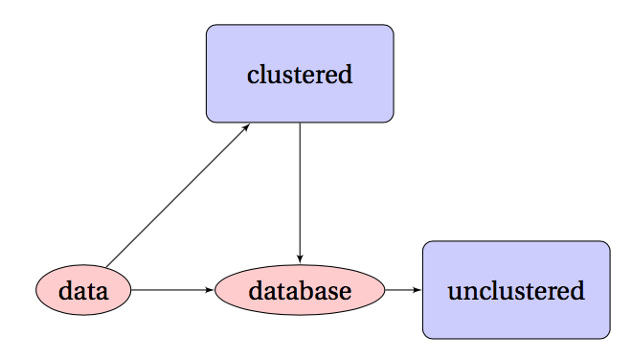
Inserts
Inserts without indexes are trivial
Inserts with indexes:
Search for clustered indexes
Insert into clustered indexes first and retrieve new position indices
Insert data into columns using position indices
Update all other indexes

Slide 6
Selects
Again, no index is easy to handle
Different behavior based on type of index
Clustered: search for minimum and maximum, then generate all intermediate indices
Unclustered: find minimum, iterate forward until you retrieve the maximum
Batched selects:
Clustered: iterate across select queries first, build each result array one by one by generation
Unclustered: iterate down index and build all result arrays together
Avoid leapfrogging where possible, prioritize avoiding random access

Slide 7
Fetches / Loads / Indexes / Joins
Discussed in previous slides
Alternative fetch implementation: maintain two sets of Index objects so that we can find values using their indexes as well
Additional overhead
Doesn’t solve random access
Alternative load implementation: batch send data (costly), construct indexes using clever logic
Not necessarily much faster
Index fanout: still need to do an experiment to figure out optimal value
Joins: haven’t implemented nested-loop yet (easy to implement)
Still need to do a performance comparison test

