Slide 1

Marketing Analysis Report
A comprehensive, data-driven review of market position, audience insights, channel performance, and strategic growth opportunities.
2024 STRATEGIC REPORT

Slide 2
01 — Executive Summary
Key Insights at a Glance
12%
3.4x
Revenue Growth
Avg. ROI
YoY performance above industry average
Across all paid marketing channels
68%
#2
Brand Awareness
Market Position
Among core target segments
Within primary competitive set
Top Priority
Quick Win
Growth Signal
Invest in retention & loyalty programs to reduce churn by 15%
Reallocate 20% of paid spend to high-converting SEO content
Emerging segment (25–34) shows 2x engagement vs. prior year

Slide 3

02 — Market Overview
A Growing, Competitive Landscape
Market Size & Trends
Key Growth Drivers
Global market valued at $48.6B, projected to reach $72B by 2027
CAGR of 8.3% driven by digital adoption and shifting consumer behavior
Post-pandemic recovery accelerating demand in key verticals
Mobile-first consumption reshaping purchase journeys
AI personalization elevating customer expectations
Sustainability and brand values increasingly decisive
D2C models disrupting traditional retail channels

Slide 4
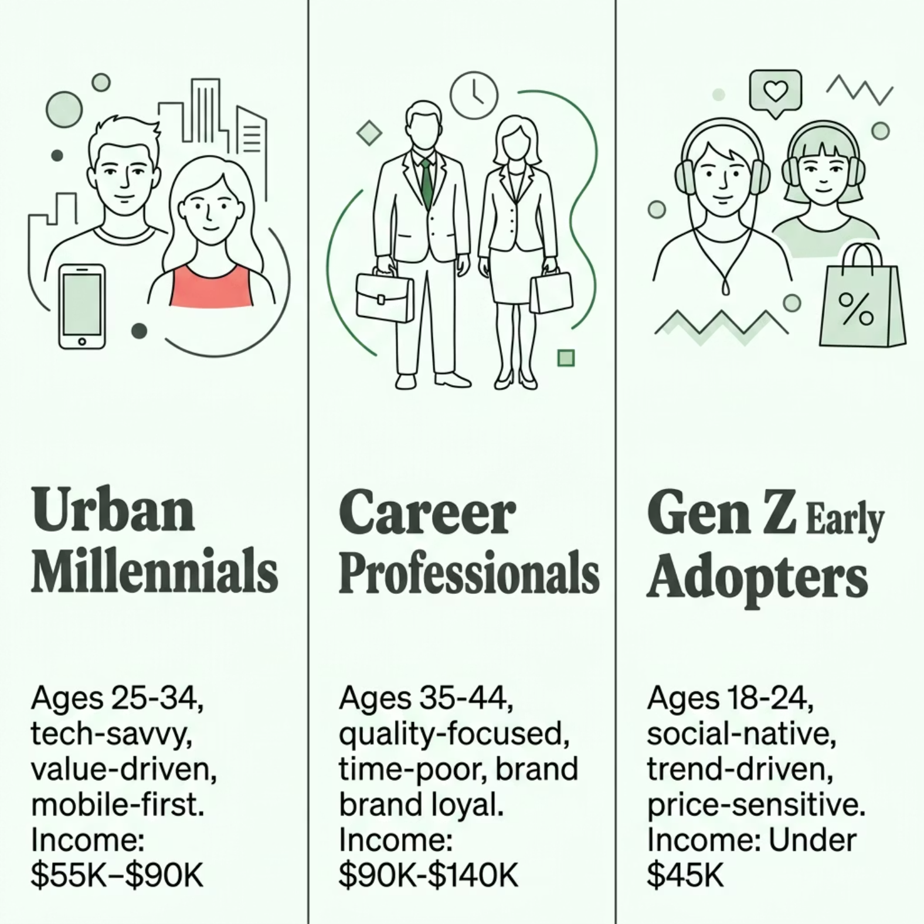


03 — Target Audience Analysis
Who We're Reaching
Core Pain Points
Information overload — difficulty finding trustworthy, concise guidance
Price sensitivity — seeking perceived value over lowest cost
Fragmented experience — inconsistent brand touchpoints across channels

Slide 5
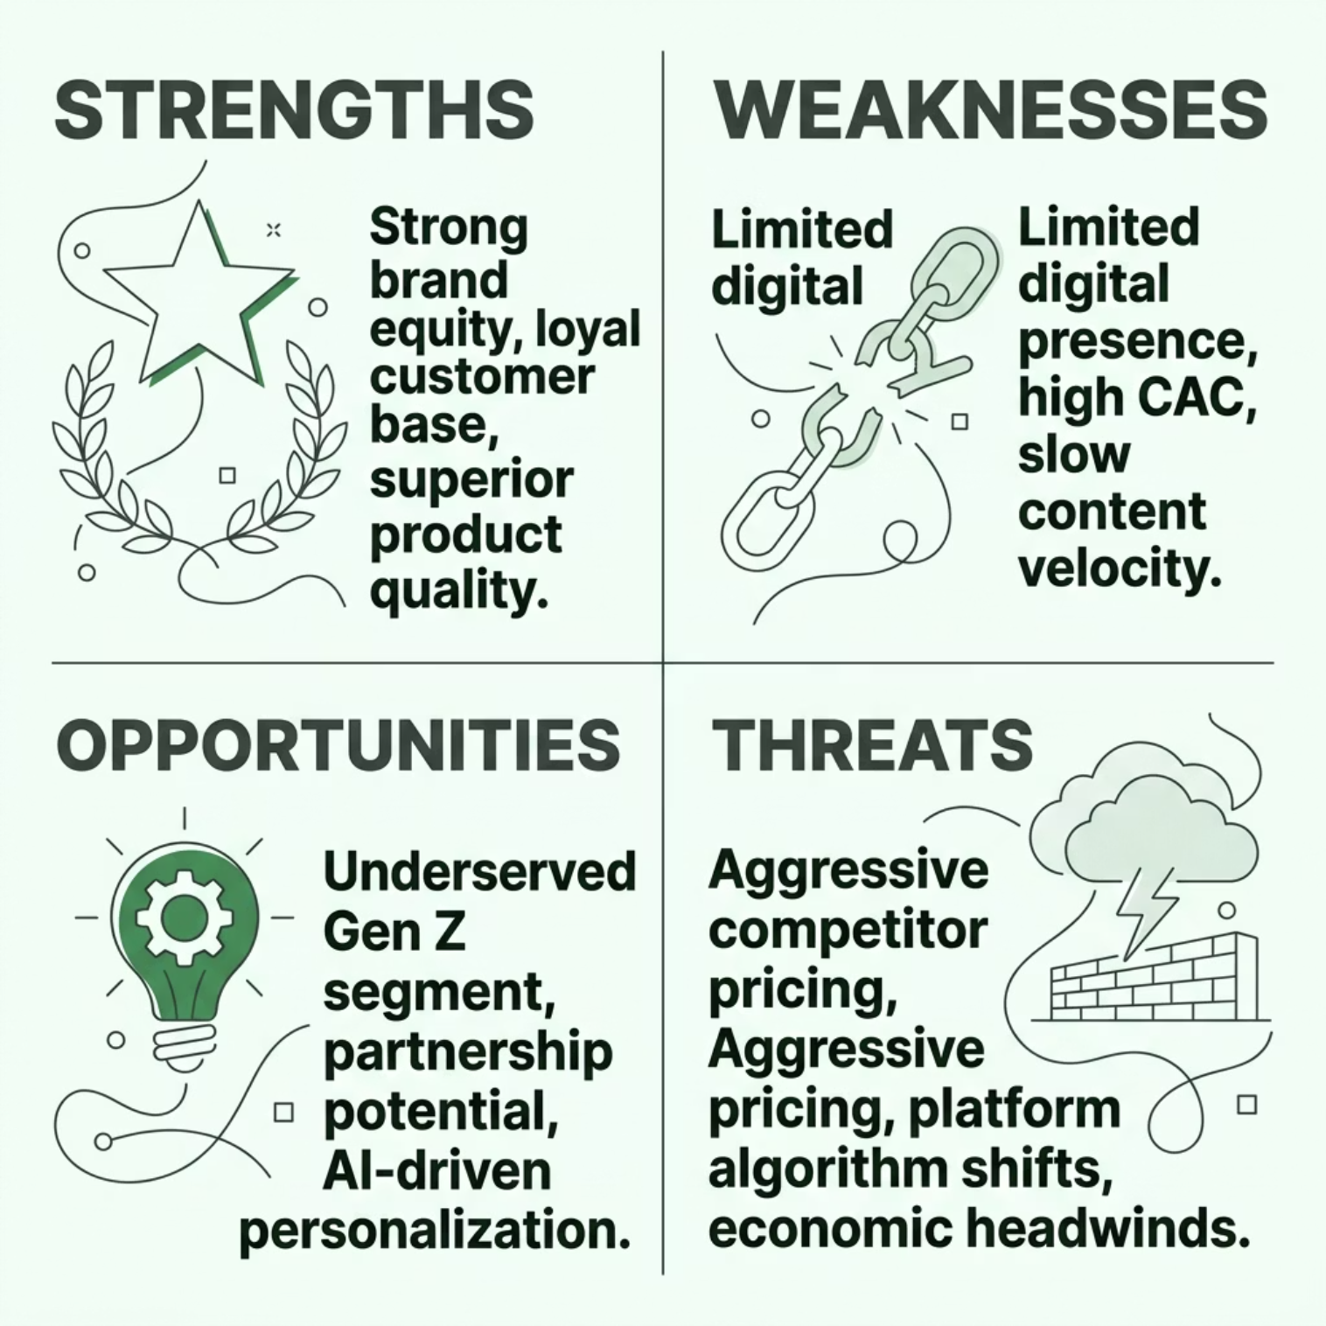


04 — Competitive Analysis
Where We Stand
Competitive Positioning
Dimension
Us
Rival A
Rival B
Brand Awareness
68%
74%
52%
NPS Score
42
38
29
Avg. Price Point
$$
$$$
$
Digital Spend
Medium
High
Low
Content Velocity
Low
High
Medium
Despite lower awareness than Rival A, our NPS outperforms — a key retention advantage.

Slide 6
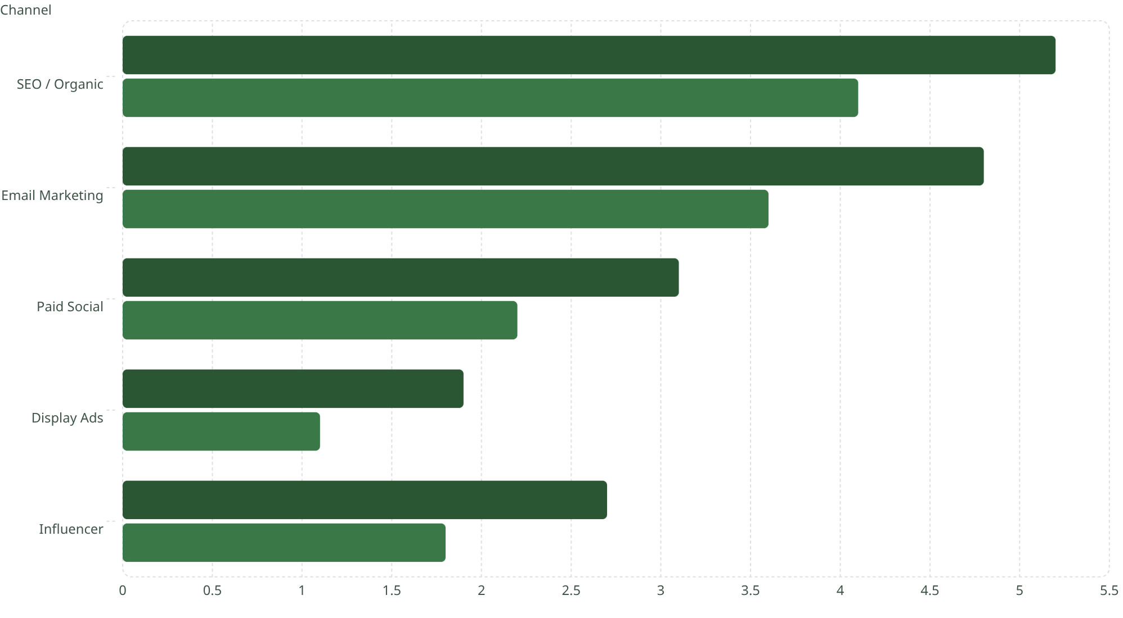
05 — Channel Performance
What's Working, What's Not
ROI (x)
Conv. Rate (%)
Key Takeaways
5.2
SEO delivers highest ROI — underinvested relative to impact
Email remains top converter — needs list growth focus
Paid Social reach is strong but conversion lags
Display ROI below threshold — reallocate budget
4.1
4.8
3.6
3.1
2.2
1.9
1.1
2.7
1.8

Slide 7
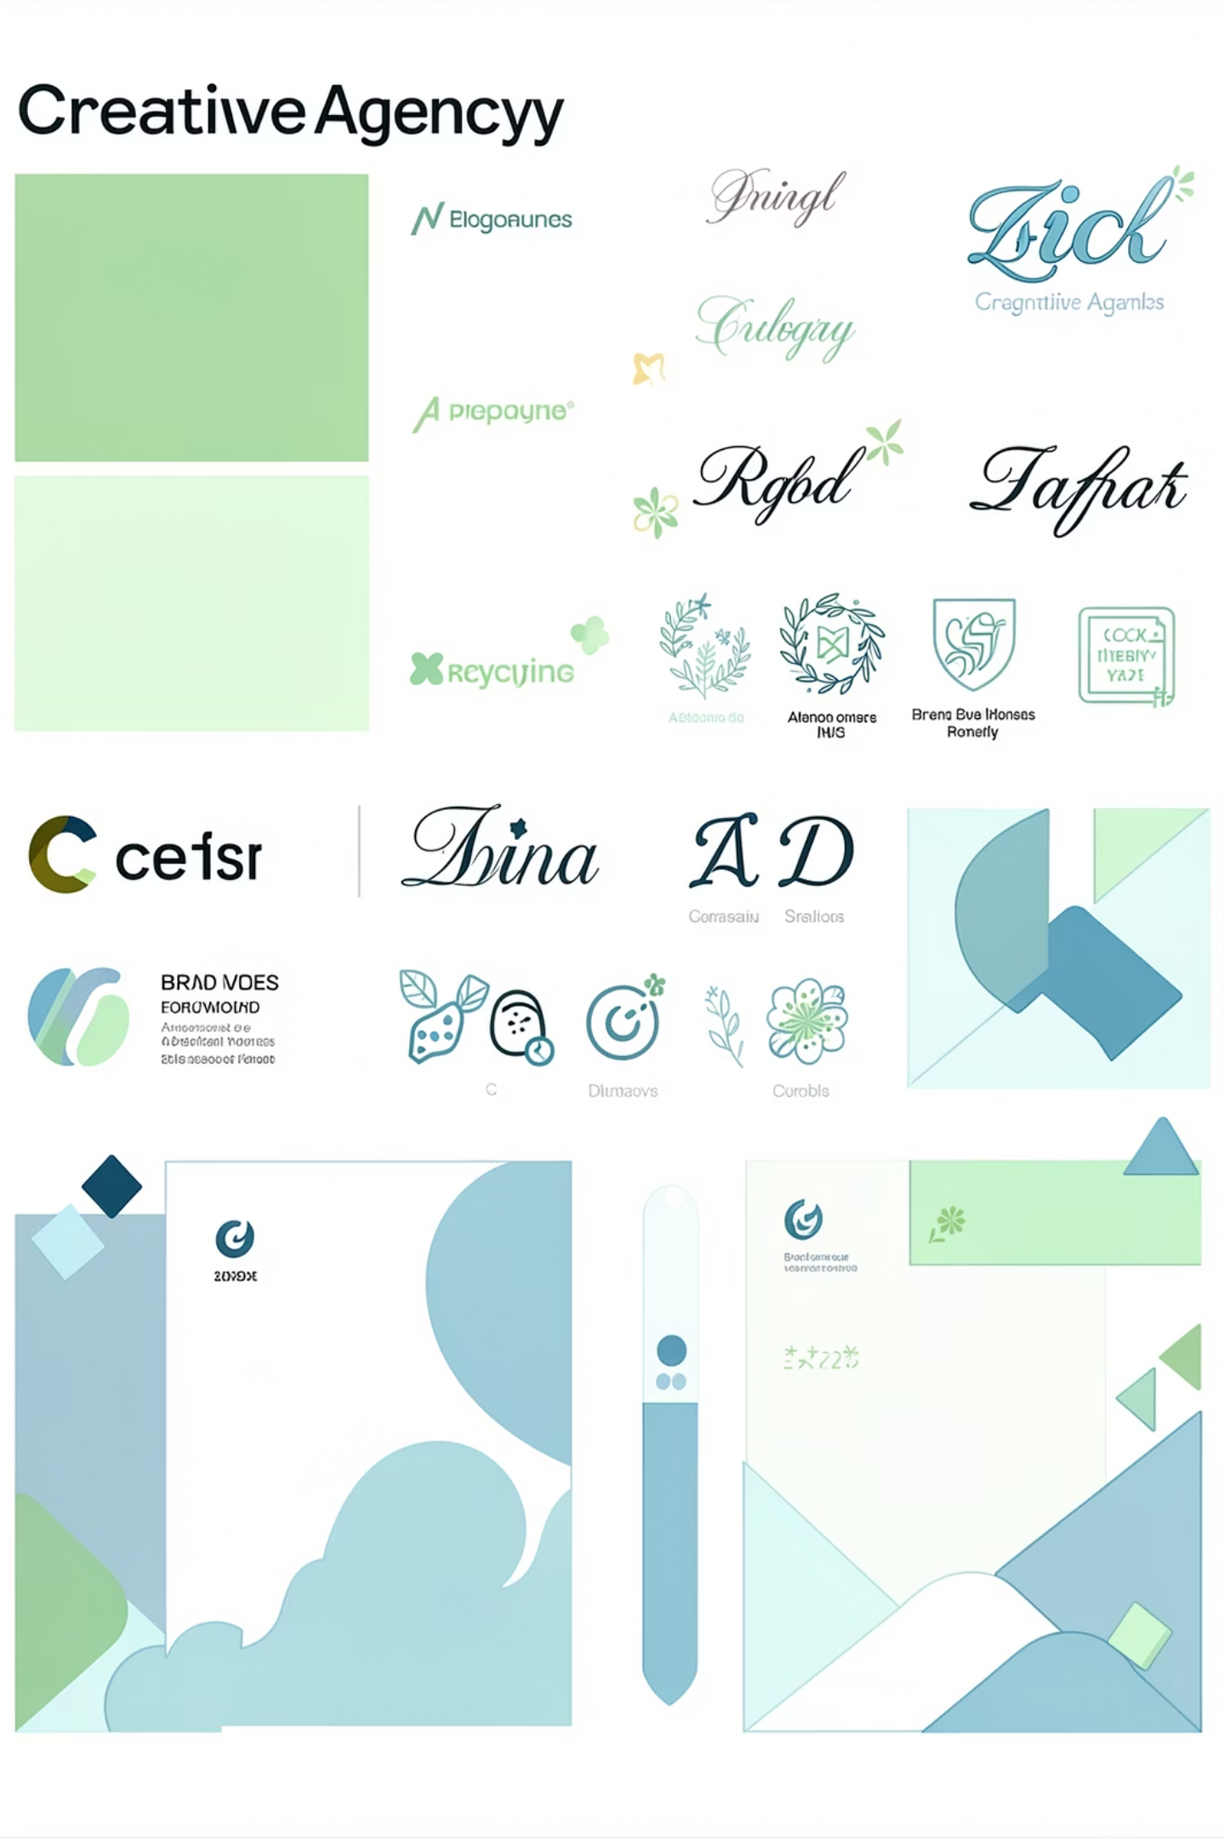
06 — Brand Positioning & Messaging
How the Market Sees Us
Brand Perception
Unique Value Proposition
We empower customers to make confident decisions — through clarity, quality, and a brand that genuinely stands for something.
Trusted
Strong credibility among 35–44 segment
Tone & Voice
Premium
Clear, warm, and authoritative
Data-informed without being cold
Empowering, never condescending
Associated with quality, not exclusivity
Reliable
Consistent delivery perceived as a core strength

Slide 8



07 — Customer Journey Analysis
From Discovery to Loyalty
Awareness
Conversion
Consideration
Drop-off Alert: 38% of users exit at the Consideration stage — product comparison pages underperforming.
Retention Strength: Customers who engage with onboarding content show 2.4x higher LTV.

Slide 9

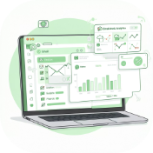


08 — Key Insights & Findings
The Data Tells a Clear Story
Mobile-First Gap
Email Outperforms
Gen Z Emerging
Retention Pays
61% of traffic is mobile, yet mobile conversion rate is 40% lower than desktop — a critical UX opportunity.
Segmented email campaigns generate 3x the revenue of broadcast sends — personalization drives results.
The 18–24 cohort grew 2x YoY in engagement — currently underserved by messaging and creative strategy.
A 5% increase in retention rate correlates with a 25% increase in profitability across active customer cohorts.

Slide 10


09 — Recommendations
Strategic Actions to Drive Growth
🚀 Short-Term (0–3 Months)
Rebuild mobile product pages for conversion parity
Launch segmented email sequences for top 3 personas
Reallocate 20% of display budget to SEO content production
📈 Long-Term (3–12 Months)
Develop Gen Z-targeted creative and channel strategy
Build loyalty program tied to onboarding milestones
Invest in AI-driven personalization across all touchpoints
North Star Metric: Increase 12-month customer LTV by 30% through retention, personalization, and mobile experience improvements.

