Slide 1

In the Name of Allah
the Most Gracious, the Most Merciful

Slide 2
Zakat (Poor's due)

Slide 3
Literal meaning
The literal meaning of Zakat is
'to cleanse‘
‘to purify’.
to grow (in goodness) or 'increase’

Slide 4
In Islamic Terminology
A term used in Islamic finance to refer to the obligation that an individual has to donate a certain proportion of wealth each year to charitable causes.

Slide 5
One of the most important principles of Islam is that:
All things belong to Allah
And the wealth is therefore held by human beings in trust.
وَرَفَعَ بَعْضَكُمْ فَوْقَ بَعْضٍ دَرَجٰتٍ لِّيَبْلُوَكُمْ فِيْ مَآ اٰتٰىكُمْ
"He has raised some of you in ranks above others that He may try you in the gifts He has given you." (6: 165)
Thus, a Muslim, whether prosperous or needy, considers his condition in this world as a test from God. Those who have wealth have the obligation to be generous and charitable and to share the bounties of God with their brothers.

Slide 6
Cont:
Zakah not only purifies the property of the contributor but also purifies his heart from selfishness and greed.
It also purifies the heart of the recipient from envy and jealousy, from hatred and uneasiness and it fosters instead good-will and warm wishes for the contributors

Slide 7
Salat & Zakat
Mostly referred In Quran together
Both are the Fundamental form of Worship
Mostly mentioned after “Eaiman”
Practical demonstration of “Eaiman”
Salat Connect Human being with Allah
Zakat Connect Human being with Others humans

Slide 8
Who should pay zakat
Any one who has in his possession more than equivalent of the value of 85gm gold or 612gm of silver, over and above his living expenses
On agricultural produce zakat is payable if the value of crop is more than 3265kg of wheat, rice or corn (popular grain)

Slide 9
Importance of Zakat in the light of Quran
At 70 places in the Quran, Allah Almighty the commands that Salah and Zakat co-exist
Quran has depicted its virtue of 1 rupee equal to 700 rupees
وَاٰتَوُا الزَّكٰوةَ لَھُمْ اَجْرُھُمْ عِنْدَ رَبِّهِمْ ۚ وَلَا خَوْفٌ عَلَيْهِمْ وَلَا ھُمْ يَحْزَنُوْنَ
"Lo! Those who pay zakat, their reward is with their Sustainer; and no fear shall come upon them, nor shall they grieve." (2:277)
وَيُؤْتُوْنَ الزَّكٰوةَ وَهُمْ بِالْاٰخِرَةِ هُمْ يُوْقِنُوْنَ
اُولٰۗىِٕكَ عَلٰي هُدًى مِّنْ رَّبِّهِمْ وَاُولٰۗىِٕكَ هُمُ الْمُفْلِحُوْنَ
“ who pay zakat and have the assurance of the Hereafter. These are on guidance from their Sustainer, and these are the ones who will prosper ." (31 :1-5)

Slide 10
Contt.
وَ قَالَ اللّٰهُ اِنِّیْ مَعَكُمْؕ-لَىٕنْ اَقَمْتُمُ الصَّلٰوةَ وَ اٰتَیْتُمُ الزَّكٰوةَ
I am truly with you. If you establish prayer, pay alms-tax,
وَآتوا حَقَّهُ يَومَ حَصادِهِ
and give its due on the day of harvest,
وَآتُوا الزَّكاةَ وَأَقرِضُوا اللَّهَ قَرضًا حَسَنًا ۚ وَما تُقَدِّموا لِأَنفُسِكُم مِن خَيرٍ تَجِدوهُ عِندَ اللَّهِ
and pay the zakat and lend Allah a good loan. Whatever good you send ahead for your souls you will find it with Allah.

Slide 11
The term (INFAQ) for poor's due
أَنفِقوا مِمّا رَزَقناكُم
Spend out of what We have provided you
وَمِمّا رَزَقناهُم يُنفِقونَ
and spend¹ out of what We have provided for them;
أَنفِقوا مِن طَيِّباتِ ما كَسَبتُم وَمِمّا أَخرَجنا لَكُم مِنَ الأَرضِ
Spend of the good things you have earned, and of what We bring forth for you from the earth
مَثَلُ الَّذينَ يُنفِقونَ أَموالَهُم في سَبيلِ اللَّهِ كَمَثَلِ حَبَّةٍ أَنبَتَت سَبعَ سَنابِلَ في كُلِّ سُنبُلَةٍ مِائَةُ حَبَّةٍ ۗ وَاللَّهُ يُضاعِفُ لِمَن يَشاءُ
The parable of those who spend their wealth in the way of Allah is that of a grain which grows seven ears, in every ear a hundred grains. Allah enhances severalfold whomever He wishes

Slide 12
Punishment for not paying zakah in Quran
وَالَّذِيْنَ يَكْنِزُوْنَ الذَّهَبَ وَالْفِضَّةَ وَلَا يُنْفِقُوْنَهَا فِيْ سَبِيْلِ اللّٰهِ ۙ فَبَشِّرْهُمْ بِعَذَابٍ اَلِيْمٍ
يَّوْمَ يُحْمٰي عَلَيْهَا فِيْ نَارِ جَهَنَّمَ فَتُكْوٰي بِهَا جِبَاهُهُمْ وَجُنُوْبُهُمْ وَظُهُوْرُهُمْ ۭهٰذَا مَا كَنَزْتُمْ لِاَنْفُسِكُمْ فَذُوْقُوْا مَا كُنْتُمْ تَكْنِزُوْنَ
"Those who hoard up treasures of gold and silver and spend them not in the way of Allah; give them the news of a painful punishment, on the Day when that (wealth) will be heated in the Fire of Hell and with it will be branded their forehead, their sides, and their backs, (and it will be said to them:) 'This is the treasure which you hoarded for yourselves. Now taste of what you used to hoard.'" [Al-Quran 9:34-35]
وَأَنفِقوا في سَبيلِ اللَّهِ وَلا تُلقوا بِأَيديكُم إِلَى التَّهلُكَةِ
Spend in the way of Allah, and do not cast yourselves with your own hands into destruction
الَّذِيْنَ لَا يُؤْتُوْنَ الزَّكٰوةَ وَهُمْ بِالْاٰخِرَةِ هُمْ كٰفِرُوْنَ
Those who don’t pay zakah are the disbelievers of last day

Slide 13
Importance of Zakat in the light of Hadith
Zakat is the bridge of Islam; so whoever performs it can cross the bridge and whoever withholds it will be detained beneath it.
The Prophet said “He who paid zakah of his wealth, he has saved his wealth from trial and tribulation (al fitnah)
The Prophet said “protect your wealth through zakah”
Hazrat Aisha narrated: "The Messenger of Allah came to me and saw me wearing silver rings, whereupon, he asked: 'What is this, Aisha?' I replied: 'I made them to adorn myself for you, O Messenger of Allah.' He said: 'Did you pay their Zakat?' I said: 'No, or what Allah wishes.' Then he said: 'Their punishment in Hell is enough for you.’
The Prophet said, "Do not with-hold your money by counting it (i.e. hoarding it), (for if you did so), Allah would also with-hold His blessings from you.“
The Prophet said, giving a dirham in charity during his life is better than giving one hundred dirham at the movement of his death.

Slide 14
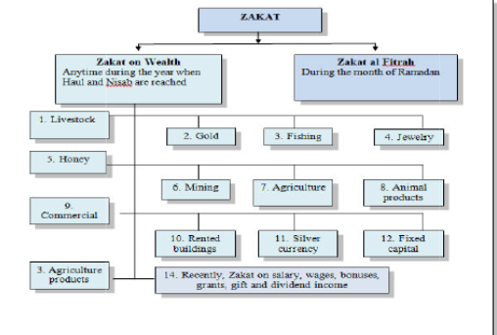

Slide 15
Concept / Philosophy
To share a small part of Allah’s material blessings with people Who are materially less blessed
Help society at micro and macro level to provide basic needs to all members with dignity and love
To establish the Writ of Allah (S W T)

Slide 16
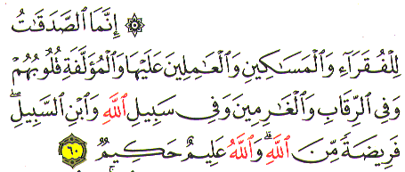
Expense of Zakat
Alms are only (exclusively) for the poor and the needy and those employed to administer, and those whose hearts are to be reconciled and to free the captives and those in debt and in the way of Allah and the wayfarer a duty imposed by Allah and Allah is Knowing, Wise” Surah Tuba:60

Slide 17
Recipient of Zakat
Fuqara (is penny less and)
Maskeen (is needy one)
Administrator
Influencing heart
Freeing from bondage
Debtors
In way of Allah
Wayfarer

Slide 18
Administrators
Aameleen; Those employed for Collection and maintenance of record, paid from Zakat, even if they are rich
Wages should not exceed half the Zakat collection
Only those employed by State

Slide 19
Influencing Hearts
Maallafatatil Quloob; Influence hearts towards Islam thru charity, kindness

Slide 20
Freeing from Bondage
Riqab; neck, signifies someone who is freed from bondage
Slaves and captives of war

Slide 21
Debtors
Gharimeen; Debt, bankruptcy
Condition that debtor himself should not possess sufficient funds or goods to clear the debt
Debt incurred for legitimate purpose incl. Blood money, unexpected penalty and not due to gambling, drinking, intoxicants or lavish expense in marriage

Slide 22
In Way of Allah
Fe sabeelillah; Wide interpretation, implication and application, incl. Jihad, invitation to Islam, education, anything serving the cause of Islam

Slide 23
Traveler
Ibnis Sabeel; Can be paid from Zakat, even though he may be rich at home, if during the journey he becomes destitute and unable to meet his expenses to return

Slide 24
Where zakat can’t be used
For persons with sufficient / adequate means of living
For ones dependents like “parents, children.
Trust for investments.
Buying luxury goods.
On wasteful Activities.
On road works and infrastructure.

Slide 25
Effective Rate P.A
On wealth and Income 2.5%
On Agricultural produce
Irrigated 5%
Non irrigated” 10%
On Natural resources 20%
Based upon Lunar Calendar

Slide 26
The Rate of Zakat
On every 7.5 tolas of gold = 2.5%
On every 52.5 tolas of silver or (equivalent in cash) = 2.5%
Khums is 1/5 of the produce from mines.
For every 5 camels, 1 Sheep
For every 30 cows, bulls or buffalos, a one year old bull
For 40-120 sheep,1 sheep;
The produce of land. (The rate is one tenth of the produce of the unirrigated and undeveloped land and one twentieth of the produce of the irrigated and developed land.)

Slide 27
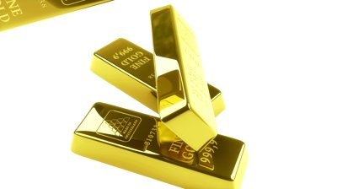
ZAKAT Rules for giving zakat On gold
If a person possesses 7 ½ Tola or 87.479 grams of gold or any currency that equals the value of this amount of gold ,this wealth remains in his possession for a complete year, then on the expiry of this year it will be wajib on him to give zakaat for it. If his wealth is less than this, zakaat will not be wajib. If it is more than this, zakaat will still be wajib.

Slide 28
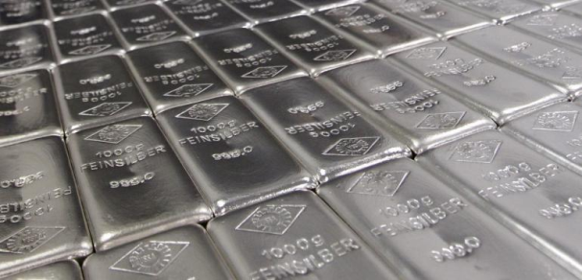
ZAKAT Rules for giving zakat On Silver
If a person possesses 52 ½ Tola or 612.35 grams of silver any currency that equals the value of this amount of gold or silver, and this wealth remains in his possession for a complete year, then on the expiry of this year it will be wajib on him to give zakaat for it. If his wealth is less than this, zakaat will not be wajib. If it is more than this, zakaat will still be wajib.

Slide 29
ZAKAT Rules for giving zakat On animals

Slide 30
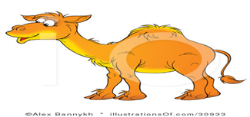
For the camel, there are twelve following Nisaab:
•Five (5) camels -Its Zakah is one (1) sheep. (There is no Zakah unless it has reached this number.)
Ten (10) camels -Its Zakah is two (2) sheep.
Fifteen (15) camels - Its Zakah is three (3) sheep.
Twenty (20) camels - Its Zakah is four (4) sheep.
Twenty five (25) camels - Its Zakah is five (5) sheep.
Twenty six (26) camels - Its Zakah is a (Bint Makhaadh) and it is the female camel which has entered into the second year.

Slide 31
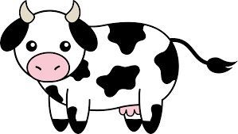
For cows ,bulls & buffalo there are two Nisaab
The First Nisaab: Thirty (30) head of cows, meaning that when the number of cows reach 30 heads and the previously mentioned conditions are fulfilled, it is obligatory to give a Tabee' or Tabee'ah. They are the cows that have entered into the second year at the minimum.
The Second Nisaab: Forty (40) head of cows. Its Zakah is a Musannah, meaning the female cow that has entered into the third year at the minimum.

Slide 32
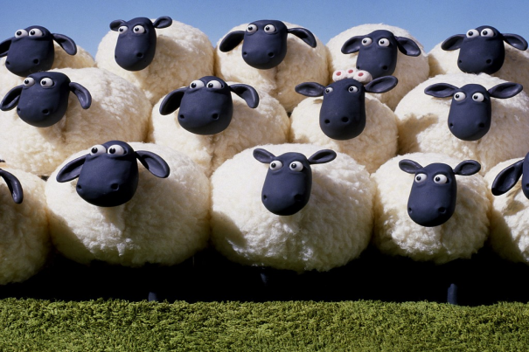
For goats ,sheep etc. there are (5) Nisaab
• 40 Sheep - Its Zakah is one (1) sheep.
• 121 Sheep - Its Zakah is two (2) sheep.
• 201 Sheep - Its Zakah is three (3) sheep.
• 301 Sheep - Its Zakah is four (4) sheep.
• 400 Sheep or more. One sheep is given per each hundred sheep

Slide 33
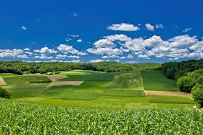
Zakat on Agricultural lands
Agricultural land:
There is no zakat on land itself. Zakat is levied on the production from zakat.
(5%) if expenses were incurred to produce the crops.
(10%) if none or very little expenses were incurred for producing the crops.

Slide 34
Conditions of acceptance of zakat

Slide 35
Obtained from honest income
يَا أَيُّهَا الَّذِينَ آمَنُواْ أَنفِقُواْ مِن طَيِّبَاتِ مَا كَسَبْتُمْ
“O believer! Spend on others out of the good things which you may have acquired”.

Slide 36
It should be for the sake of Allah
وَمَا تُنفِقُونَ إِلاَّ ابْتِغَاء وَجْهِ اللّهِ
you spend only out of a longing for God's countenance
كَالَّذِي يُنفِقُ مَالَهُ رِئَاء النَّاسِ
“who spends his wealth only to be seen and praised by men”.
Prophet said”
He who gives charity to be shown off he, in fact makes partnership with Allah.

Slide 37
It should be beloved (good) thing
وَلاَ تَيَمَّمُواْ الْخَبِيثَ مِنْهُ تُنفِقُونَ
“and choose not for your spending the bad things which you yourselves would not accept”.
لَن تَنَالُواْ الْبِرَّ حَتَّى تُنفِقُواْ مِمَّا تُحِبُّونَ
you can never attain to true piety unless you spend your the most beloved thing.

Slide 38
Recipients self respect should not be hurt
يَا أَيُّهَا الَّذِينَ آمَنُواْ لاَ تُبْطِلُواْ صَدَقَاتِكُم بِالْمَنِّ وَالأذَى
“O Believer! Do not deprive your charitable deeds of all worth by stressing your own benevolence and hurting [the feelings of the needy]”.

Slide 39
Why Pay Zakat

Slide 40


Zakat Increases Wealth
The interest that you give in order to increase the wealth of the people, does not increase in the sight of Allah: and the Zakat that you pay in order to win Allah’s approval, its payer do indeed increases their wealth.

Slide 41
Why Muslims are Suffering
"O Muhajirun, beware of five traits: if ever immorality spreads in a community and there is no sense of shame on its occurrence or mentioning it [and people talk about it as if nothing bad has taken place], diseases which were not present in the time of their predecessors will spread among them.
If they decrease the measure and weight (of sold grains or food), they will be overcome by poverty, their provisions will decrease and their ruler will be unjust.
If they refrain from paying the zakah due on their properties, they will be deprived of rain, unless they get it only for the sake of their cattle.
If they renounce their commitment to Allah and His Messenger, they will be governed by an enemy who is a stranger to them and who will take away some of what they possess.
If their rulers do not rule according to Allah's Book, they will be afflicted by civil war. Allah forbid that these should happen to you."
Ibn Maja

Slide 42
Objectives of Zakat
Purification Of The Soul
Help Of The Poor
Support Of Islam.

Slide 43
Objectives of Zakat
Establish a welfare System in the Society
Ensure circulation of wealth
Create spirit of sharing
Reduce love for Wealth
Generate harmony/love in the community
    A Way to Earn Rewards

Slide 44
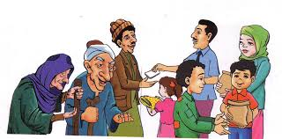
SOCIAL BENEFITS OF ZAKAT
Zakat reduces class struggles
Zakat strengthens the lower class
Zakat cures social diseases
Zakat liberates society from interest

