Slide 1
PROPHETHOOD (RISALAT)
Meaning and concept

Slide 2
MEANING
Risalat is the Arabic word which means’ Apostleship’
Two terms are used for the above assigned task.
Nabi
Rasool
Nabi means prophet, reviver
Rasool means messenger ,Informer or harbinger.
The messenger( Rasool) is one who brought the new Sharia (code of life) like Moses, Jesus and Muhammed (S.A.W)
Where as the Nabi is one who revived the Sharia of the previous prophet.

Slide 3
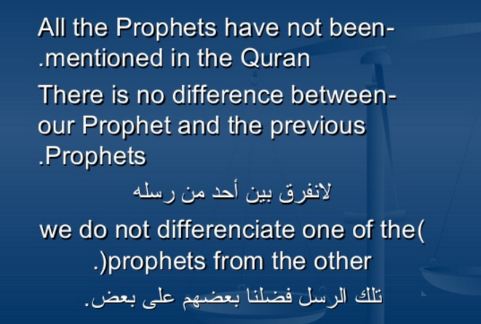
وَلَقَدْ أَرْسَلْنَا رُسُلًا مِّن قَبْلِكَ مِنْهُم مَّن قَصَصْنَا عَلَيْكَ وَمِنْهُم مَّن لَّمْ نَقْصُصْ عَلَيْكَ

Slide 4
NEED FOR PROPHETHOOD
The aim of man's creation and the responsibility assigned to him by Islam is that he should worship Allah and submit to Him.
Submission is made to injunctions. Man becomes curious to know the injunctions of His master which he is required to know. The question arises as to how we come to know of His injunctions and will.
Following are few of the means to achieve it:
1- REASON
2- INTUATION
3- COLLECTIVE CONTEMPLATION

Slide 5
Cont:
Above all means are not enough to guide man to the true injunctions of Allah. Some external arrangement had to be made by Allah for his guidance.
A person through whom Allah done this arrangement is called Prophet.
It is abundantly clear that man can not learn divine injunctions without prophet hood.
In the absence of prophet hood we would even fail to know Allah and after life, what to say of divine guidance.

Slide 6
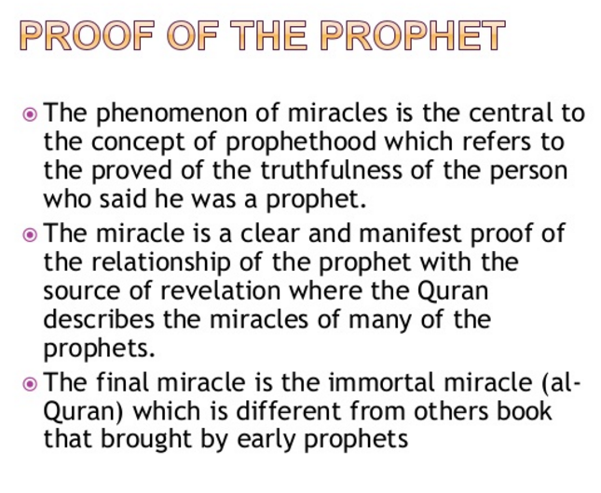

Slide 7
Testimony of scientists
Keith Moore, head of the department of anatomy, at the University of Toronto, was shown verses of the Qur’an dealing with the microscopic stages of the human embryo. He was so surprised at what he found that he went back and revised the history of embryology in his standard texts on the subject. The books that Keith Moore authored are used at prestigious institutions like Yale and at universities all around the world. He stated, after being unable to provide an explanation on how microscopic details of the embryo could be accurately described in a book written before the discovery of the microscope:
"It is clear to me that these statements (in the Qur’an on embryology) must have come to Muhammad from God. This proves to me that Muhammad must have been the Messenger of God." (Rehaili 1995)

Slide 8
The ‘Big Bang’ theory
Qur’an:
أَوَلَمْ يَرَ الَّذِينَ كَفَرُوا أَنَّ السَّمَاوَاتِ وَالْأَرْضَ كَانَتَا رَتْقًا فَفَتَقْنَاهُمَا
"Do not the unbelievers see that the Heavens and the earth were joined together, then We split them apart."
Professor Alfred Kroner, chairman of the Department of Geology at the Institute of Geosciences, Johannes Gutenburg University, Mainz, Germany stated about this verse in the Qur’an: "Somebody who did not know something about nuclear physics 1400 years ago could not, I think, be in a position to find out from his own mind for instance that the earth and the heavens had the same origin, (Rehaili 1995)"

Slide 9
Sir George Bernard Shaw
‘The Genuine Islam,’ Vol. 1, No. 8, 1936
“I have studied him – (Prophet Muhamned S.A.W) the wonderful man – in in my opinion far from being an anti-Christ he must be called the Savior of Humanity. I believe that if a man like him were to assume the dictatorship of the modern world, he would succeed in solving the problems in a way that would bring much needed peace and happiness.
I have prophesied about the faith of Muhammad that it would be acceptable to the Europe of tomorrow as it is beginning to be acceptable to the Europe of today.”

Slide 10
Rev. Bosworth Smith
“Mohammed and Mohammedanism”, 1874
“By a fortune absolutely unique in history, Mohammed is a threefold founder, of a nation, of an empire and of a religion.
He was Caesar and Pope in one, but he was Pope without the Pope’s pretensions and Caesar without the legions of Caesar: without a standing army, without a bodyguard, without a palace, without a fixed revenue,
if ever any man had the right to say that he ruled by right Divine, it was Mohammed, for he had all the powers without its instruments and without its supports.”

Slide 11
NATURE OF PROPHETHOOD
The designation of prophethood is not something that can be achieved by practicing virtue and gaining piety. It is solely a gift (WAHABE) not earned(KASABI). Allah has clearly indicated in the Holy Quran:
‘ Allah knows best with whom to place his message’
اللَّهُ أَعْلَمُ حَيْثُ يَجْعَلُ رِسَالَتَهُ

Slide 12
UNIVERSALITY OF PROPHETHOOD
Prophets have been sent to every nation: Quran says:
وَاِنْ مِّنْ اُمَّةٍ اِلَّا خَلَا فِيْهَا نَذِيْرٌ
“and there is not a nation but a Warner had passed among them”
The reason is that men all over the world are equal. They have been created with one purpose.
It may be noted here that when we claim that a prophet was sent to every nation it means that he was sent in a certain generation of a nation

Slide 13
POSITION OF PROPHETS
1- EXPOUNDER OF THE BOOK OF ALLAH
لِيُبَيِّنَ لَهُمْ
2- AUTHORIZED DIVINE LAW GIVER
وَمَآ اٰتٰىكُمُ الرَّسُوْلُ فَخُذُوْهُ ۤ وَمَا نَهٰىكُمْ عَنْهُ فَانْتَهُوْا
3- JUSTICE AND ABSOLUTE ARBITRATOR
اِذَا قَضَى اللّٰهُ وَرَسُوْلُهٗٓ اَمْرًا اَنْ يَّكُوْنَ لَهُمُ الْخِـيَرَةُ مِنْ اَمْرِهِمْ
4- TEACHER OF THE BOOK AND WISDOM
يَتْلُوْا عَلَيْھِمْ اٰيٰتِھٖ وَيُزَكِّيْھِمْ وَيُعَلِّمُھُمُ الْكِتٰبَ وَالْحِكْمَةَ
5- SHOULD BE OBEYED
وَمَآ اَرْسَلْنَا مِنْ رَّسُوْلٍ اِلَّا لِيُطَاعَ بِاِذْنِ اللّٰهِ
6- NOT TO BE DENIED AS IT IS A DISBELIEF
وَمَنْ يَّعْصِ اللّٰهَ وَرَسُوْلَهٗ فَقَدْ ضَلَّ ضَلٰلًا مُّبِيْنًا

Slide 14
SPECIAL CHARACTERISTICS OF LAST PROPHET
Chastity, trusteeship, humanness, and teachings from Allah are the common characteristics of all the prophets. Following are the only special characteristics related with our Holy Prophet:
UNIVERSALITY OF THE MESSAGE
COMPLETION OF THE DEEN
FINALITY OF THE RELIGION
FINALITY OF THE PROPHETHOOD

Slide 15
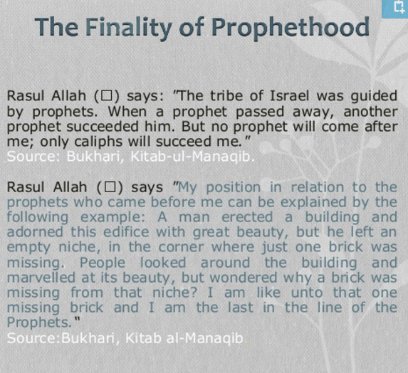

Slide 16
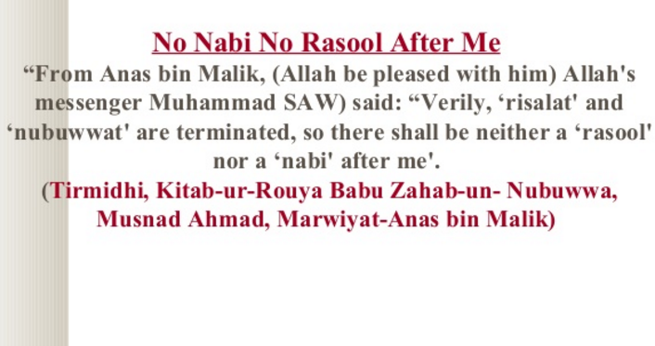

Slide 17
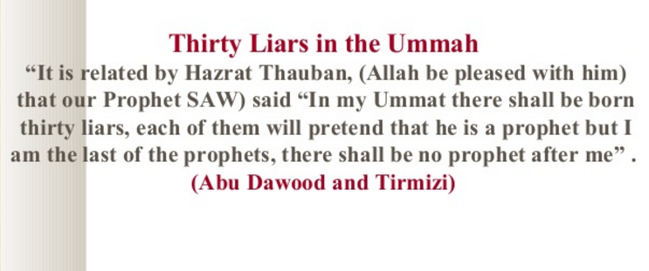

Slide 18
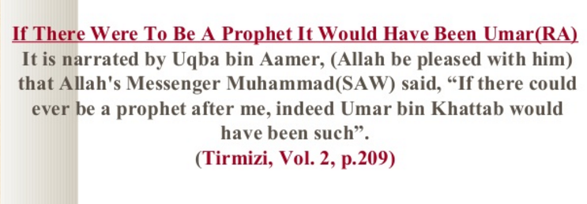

Slide 19
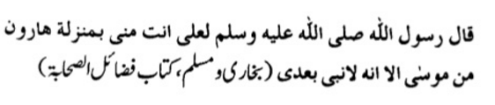


Slide 20




Slide 21
Mirza Gulam Ahmed Qadyani
Birth 13 Feb 1835
Qadyan distt Gurdaspur India
1864 got employment in district courts at Sialkot.
1882 claimed to have receiver wahi to be mamoor manallah.
1890 claimed to be misl-e- Maseeh
1901 claimed to be zilee Nabi
Died in 1908 and declared his follower to be the only true Muslims

