Slide 1
SURAH
Al Hujurat
سورة الحجرات

Slide 2
Facts and figures of al Hujrat
Madni
2 Ruku
18 verses
49th ( number in sequence of Touqeefi)
Lies in sipara(para) 26.
Previous sura: Fateh
Next sura: Qaaf
The name Al-Hujrat, or inner apatments ,Rooms, chambers

Slide 3
Teachings / topics of surah
Beliefs
Etiquettes & manners in the presence of holy prophet.
Brotherhood and equality.
Principle for the settlement of the disputes of Muslims
Avoid to act on any information without verification
Islamic ethics

Slide 4
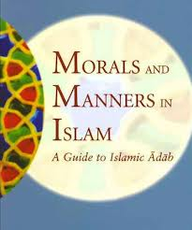
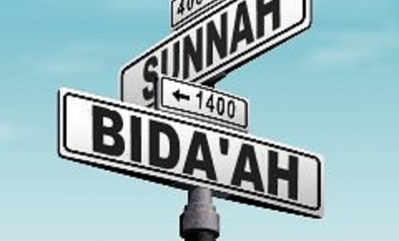
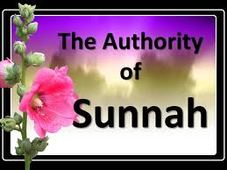

Ruku No 1:
Manners of living are being taught in this surah
Obeying the Prophet (saw) ---Importance of Hadith and Sunnah
Manners of talking to the Prophet --- to the teachers and scholars
Respecting the Prophet---Taqwa of Allah
ICNA Sisters' Wing

Slide 5
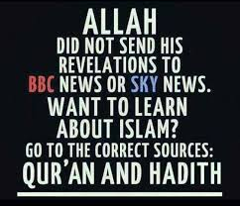
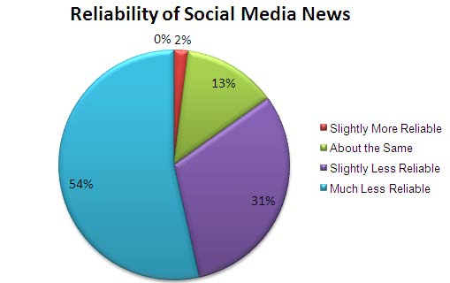
Checking the reliability of the news
Training the nafs to follow what is right.
What to do when two muslim groups are fighting? --- being just
ICNA Sisters' Wing

Slide 6
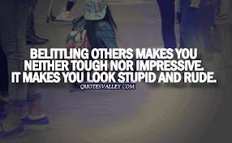
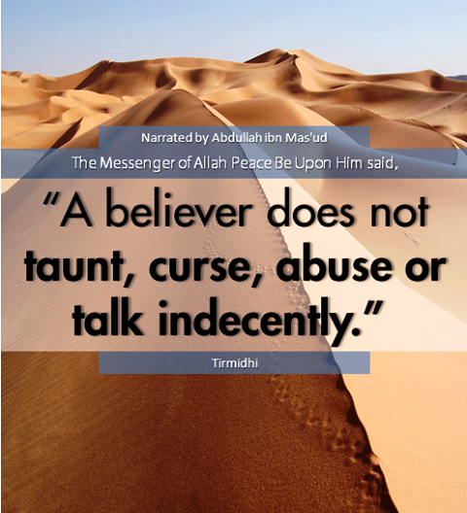
Ruku No 2:
Reforms in the social life of a muslim community
Don’t make fun of people --- Issue of men and women interacting with each other
Pride is the cause of belittling others.
Mocking at others, mimicking their voice and actions.
ICNA Sisters' Wing

Slide 7
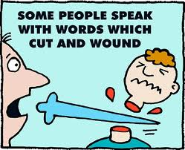
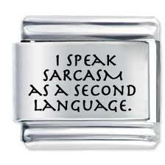


Taunting others --- Sarcasm
Don’t call each other by bad names
Suspicion and spying on others.
ICNA Sisters' Wing

Slide 8
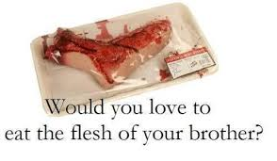

Backbiting --- Slandering vs Backbiting
Situations when backbiting is permitted.
Allah Consciousness --- Repentance
Don’t be proud on your tribe/family.
Basis of giving preference is Allah Consciousness
ICNA Sisters' Wing

Slide 9
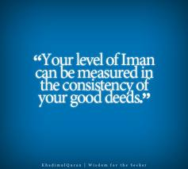
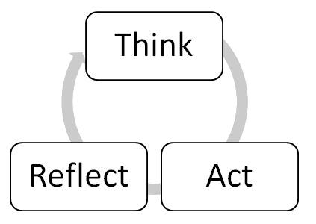
Difference between Iman and Islam --- Iman is related to the condition of heart and Islam is concerned with outer actions of a person.
Iman is not limited to a claim and will be tested by Allah in different circumstances
whereas Islam (fulfilling the obligatory pillars) helps increase ones Iman.
Ihsan
Islam
Iman
ICNA Sisters' Wing

Slide 10
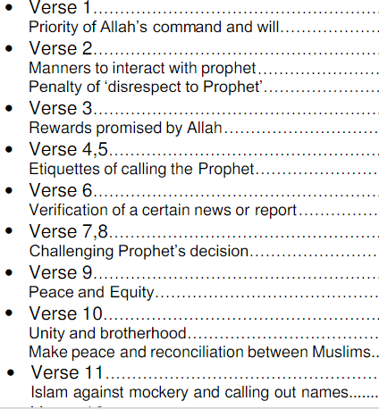

Slide 11
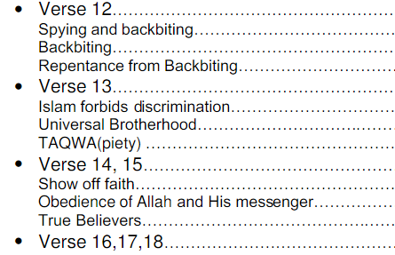

Slide 12
. يٰٓاَيُّهَا الَّذِيْنَ اٰمَنُوْا لَا تُـقَدِّمُوْا بَيْنَ يَدَيِ اللّٰهِ وَرَسُوْلِهٖ وَاتَّقُوا اللّٰهَ ۭ اِنَّ اللّٰهَ سَمِيْعٌ عَلِيْمٌ
'O believers! Exceed not over Allah and his Messenger and fear Allah. Undoubtedly Allah Hears, Knows

Slide 13
يٰٓاَيُّهَا الَّذِيْنَ اٰمَنُوْا لَا تَرْفَعُوْٓا اَصْوَاتَكُمْ فَوْقَ صَوْتِ النَّبِيِّ وَلَا تَجْـهَرُوْا لَهٗ بِالْقَوْلِ كَجَــهْرِ بَعْضِكُمْ لِبَعْضٍ اَنْ تَحْبَــطَ اَعْمَالُكُمْ وَاَنْتُمْ لَا تَشْعُرُوْنَ
'O believers! Raise not your voices above the voice of the Communicator of unseen (the Prophet) and speak not aloud in presence of him as you shout to one another, lest your works become vain while you are unaware.

Slide 14
اِنَّ الَّذِيْنَ يَغُضُّوْنَ اَصْوَاتَهُمْ عِنْدَ رَسُوْلِ اللّٰهِ اُولٰۗىِٕكَ الَّذِيْنَ امْتَحَنَ اللّٰهُ قُلُوْبَهُمْ لِلتَّقْوٰى ۭ لَهُمْ مَّغْفِرَةٌ وَّاَجْرٌ عَظِيْمٌ
Undoubtedly, those who lower down their voices in the presence of the messenger of Allah those are they whose hearts Allah has tested for piety. For them is forgiveness and great reward.

Slide 15
اِنَّ الَّذِيْنَ يُنَادُوْنَكَ مِنْ وَّرَاۗءِ الْحُـجُرٰتِ اَكْثَرُهُمْ لَا يَعْقِلُوْنَ
Undoubtedly, those who call you from behind your private apartments, most of them are stupid.

Slide 16
وَلَوْ اَنَّهُمْ صَبَرُوْا حَتّٰى تَخْرُجَ اِلَيْهِمْ لَكَانَ خَيْرًا لَّهُمْ ۭ وَاللّٰهُ غَفُوْرٌ رَّحِيْمٌ
And if they had patience, until you yourself come out to them that had been better for them. And Allah is Forgiving, Merciful.

Slide 17
يٰٓاَيُّهَا الَّذِيْنَ اٰمَنُوْٓا اِنْ جَاۗءَكُمْ فَاسِقٌۢ بِنَبَاٍ فَتَبَيَّنُوْٓا اَنْ تُصِيْبُوْا قَوْمًۢا بِجَــهَالَةٍ فَتُصْبِحُوْا عَلٰي مَا فَعَلْتُمْ نٰدِمِيْنَ
'O believers! If any disobedient comes to you with any news make a strict inquiry lest you may hurt any people improperly then remain repenting on what you have done.

Slide 18
وَاعْلَمُوْٓا اَنَّ فِيْكُمْ رَسُوْلَ اللّٰهِ ۭ لَوْ يُطِيْعُكُمْ فِيْ كَثِيْرٍ مِّنَ الْاَمْرِ لَعَنِتُّمْ وَلٰكِنَّ اللّٰهَ حَبَّبَ اِلَيْكُمُ الْاِيْمَانَ وَزَيَّنَهٗ فِيْ قُلُوْبِكُمْ وَكَرَّهَ اِلَيْكُمُ الْكُفْرَ وَالْفُسُوْقَ وَالْعِصْيَانَ ۭاُولٰۗىِٕكَ هُمُ الرّٰشِدُوْنَ
And know that the Messenger of Allah is among you. If he were to do according to your liking in much of the affairs, you would then surely be in trouble, but Allah has endeared the faith to you and has adorned it in your hearts and He has made infidelity, and iniquity and disobedience hateful to you such persons are on the right course.

Slide 19
فَضْلًا مِّنَ اللّٰهِ وَنِعْمَةً ۭ وَاللّٰهُ عَلِيْمٌ حَكِيْمٌ
A grace and favour of Allah. And Allah is Knowing, Wise.

Slide 20
وَاِنْ طَاۗىِٕفَتٰنِ مِنَ الْمُؤْمِنِيْنَ اقْتَتَلُوْا فَاَصْلِحُوْا بَيْنَهُمَا ۚ فَاِنْۢ بَغَتْ اِحْدٰىهُمَا عَلَي الْاُخْرٰى فَقَاتِلُوا الَّتِيْ تَبْغِيْ حَتّٰى تَفِيْۗءَ اِلٰٓى اَمْرِ اللّٰهِ ۚ فَاِنْ فَاۗءَتْ فَاَصْلِحُوْا بَيْنَهُمَا بِالْعَدْلِ وَاَقْسِطُوْا ۭ اِنَّ اللّٰهَ يُحِبُّ الْمُقْسِطِيْنَ
And if two groups of the Muslims fight each other, then make peace between them, but if one of them commits excessiveness against the other, then fight the one that has committed excessiveness till it reverts to the command of Allah. Then if it reverts rectify between them with justice and do justice. Verily Allah loves the equitable.

Slide 21
اِنَّمَا الْمُؤْمِنُوْنَ اِخْوَةٌ فَاَصْلِحُوْا بَيْنَ اَخَوَيْكُمْ ۚ وَاتَّقُوا اللّٰهَ لَعَلَّكُمْ تُرْحَمُوْنَ
Muslims are brothers, therefore make peace between the two brothers and fear Allah that the mercy may be shown to you.

Slide 22
يٰٓاَيُّهَا الَّذِيْنَ اٰمَنُوْا لَا يَسْخَرْ قَوْمٌ مِّنْ قَوْمٍ عَسٰٓى اَنْ يَّكُوْنُوْا خَيْرًا مِّنْهُمْ وَلَا نِسَاۗءٌ مِّنْ نِّسَاۗءٍ عَسٰٓى اَنْ يَّكُنَّ خَيْرًا مِّنْهُنَّ ۚ وَلَا تَلْمِزُوْٓا اَنْفُسَكُمْ وَلَا تَنَابَزُوْا بِالْاَلْقَابِ ۭ بِئْسَ الِاسْمُ الْفُسُوْقُ بَعْدَ الْاِيْمَانِ ۚ وَمَنْ لَّمْ يَتُبْ فَاُولٰۗىِٕكَ هُمُ الظّٰلِمُوْنَ
'O believers! Let not the men scoff at the men, perchance they may be better than those who scoff, and nor the women at other women, perchance that they may be better than those women who scoff, and do not taunt one another and nor call one another by nick-names. What a bad name is, to be called a disobedient after being a Muslim, and those who repent not, they are the unjust.

Slide 23
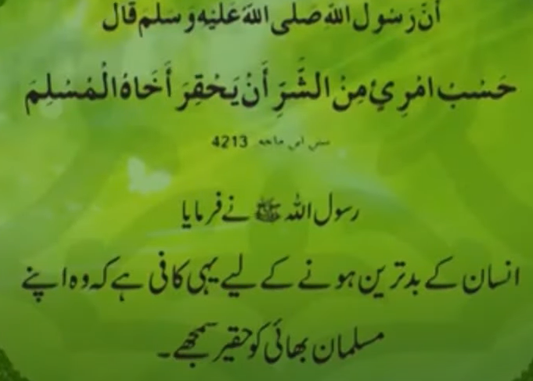

Slide 24
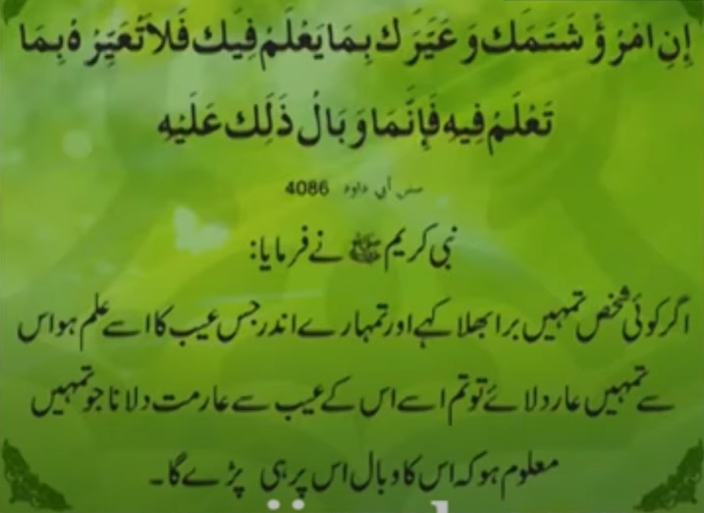

Slide 25
يٰٓاَيُّهَا الَّذِيْنَ اٰمَنُوا اجْتَنِبُوْا كَثِيْرًا مِّنَ الظَّنِّ ۡ اِنَّ بَعْضَ الظَّنِّ اِثْمٌ وَّلَا تَجَسَّسُوْا وَلَا يَغْتَبْ بَّعْضُكُمْ بَعْضًا ۭ اَيُحِبُّ اَحَدُكُمْ اَنْ يَّاْكُلَ لَحْمَ اَخِيْهِ مَيْتًا فَكَرِهْتُمُوْهُ ۭ وَاتَّقُوا اللّٰهَ ۭ اِنَّ اللّٰهَ تَوَّابٌ رَّحِيْمٌ
'O believers! Avoid most suspicions, verily some suspicion is a sin and do not look out for faults and do not backbite one another. Would any of you like to eat the flesh of his dead brother? You would abominate it. And fear Allah, Verily Allah is Oft Returning, Merciful

Slide 26
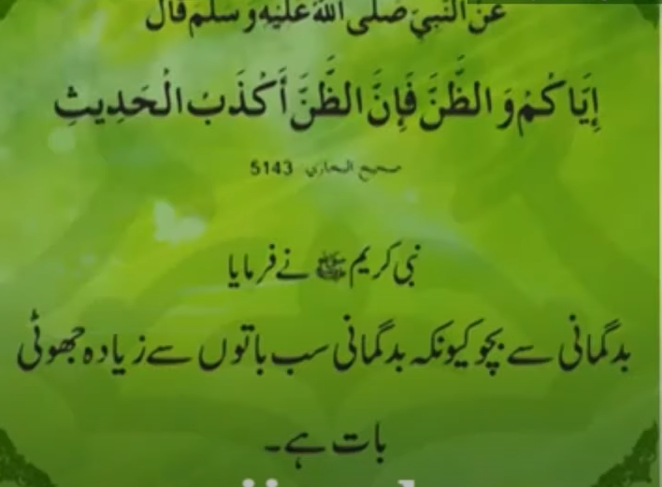

Slide 27

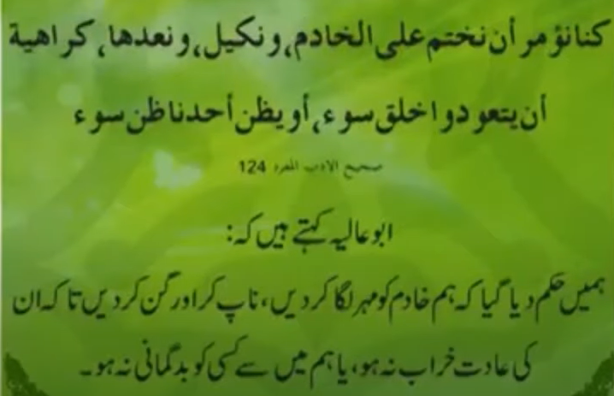

Slide 28
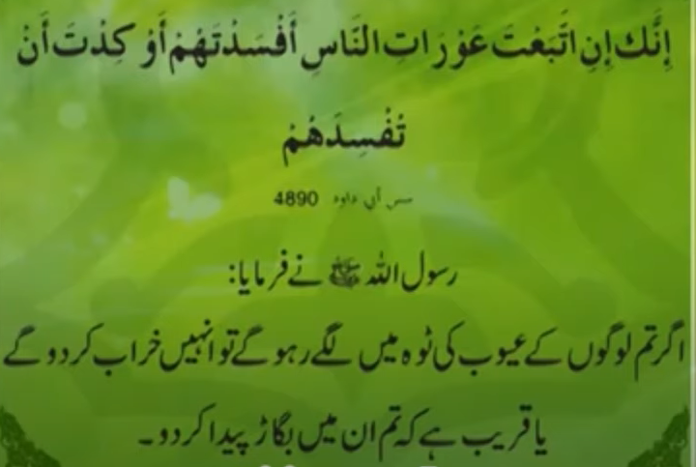

Slide 29
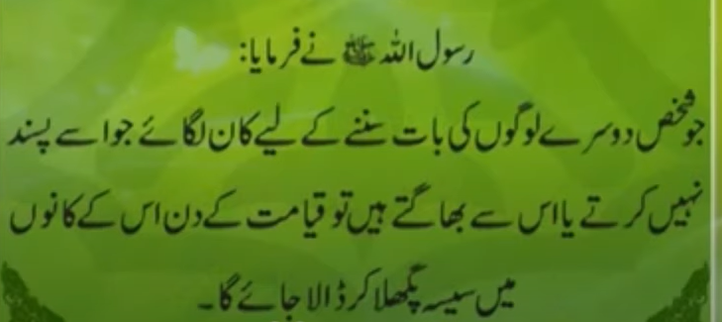

Slide 30
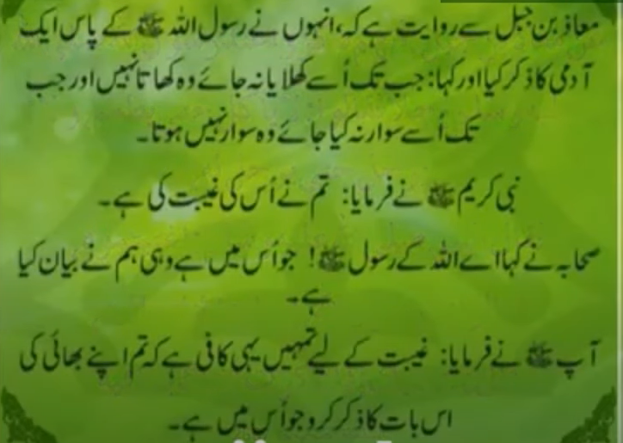

Slide 31
يٰٓاَيُّهَا النَّاسُ اِنَّا خَلَقْنٰكُمْ مِّنْ ذَكَرٍ وَّاُنْثٰى وَجَعَلْنٰكُمْ شُعُوْبًا وَّقَبَاۗىِٕلَ لِتَعَارَفُوْا ۭ اِنَّ اَكْرَمَكُمْ عِنْدَ اللّٰهِ اَتْقٰىكُمْ ۭ اِنَّ اللّٰهَ عَلِيْمٌ خَبِيْرٌ
O people! We created you from one man and one woman and made you in branches and tribes that you may recognize one another. Undoubtedly, the most respected among you in the sight of Allah is he who is more pious, verily, Allah is knowing, Aware

Slide 32
قَالَتِ الْاَعْرَابُ اٰمَنَّا ۭ قُلْ لَّمْ تُؤْمِنُوْا وَلٰكِنْ قُوْلُوْٓا اَسْلَمْنَا وَلَمَّا يَدْخُلِ الْاِيْمَانُ فِيْ قُلُوْبِكُمْ ۭ وَاِنْ تُطِيْعُوا اللّٰهَ وَرَسُوْلَهٗ لَا يَـلِتْكُمْ مِّنْ اَعْمَالِكُمْ شَـيْـــــًٔا ۭ اِنَّ اللّٰهَ غَفُوْرٌ رَّحِيْمٌ
The villagers said 'we have believed'. Say, you, 'you believed not, yes, you rather say, we have surrendered', for the belief has not yet entered in your hearts. But if you shall obey Allah ends His Messenger, He will not make you to lose anything of your works. Surely, Allah is Forgiving, Merciful.

Slide 33
اِنَّمَا الْمُؤْمِنُوْنَ الَّذِيْنَ اٰمَنُوْا بِاللّٰهِ وَرَسُوْلِهٖ ثُمَّ لَمْ يَرْتَابُوْا وَجٰهَدُوْا بِاَمْوَالِهِمْ وَاَنْفُسِهِمْ فِيْ سَبِيْلِ اللّٰهِ ۭ اُولٰۗىِٕكَ هُمُ الصّٰدِقُوْنَ
The believers are only those who have believed in Allah and His Messenger and then, have never doubted and have struggled with their possession and their persons in the way of Allah. It is they who are truthful.

Slide 34
قُلْ اَتُعَلِّمُوْنَ اللّٰهَ بِدِيْنِكُمْ ۭ وَاللّٰهُ يَعْلَمُ مَا فِي السَّمٰوٰتِ وَمَا فِي الْاَرْضِ ۭ وَاللّٰهُ بِكُلِّ شَيْءٍ عَلِيْمٌ
Say you, 'do you tell Allah your religion? And Allah knows whatever is in the heavens and whatever is in theearth. And Allah knows everything.

Slide 35
يَمُنُّوْنَ عَلَيْكَ اَنْ اَسْلَمُوْا ۭ قُلْ لَّا تَمُنُّوْا عَلَيَّ اِسْلَامَكُمْ ۚ بَلِ اللّٰهُ يَمُنُّ عَلَيْكُمْ اَنْ هَدٰىكُمْ لِلْاِيْمَانِ اِنْ كُنْتُمْ صٰدِقِيْنَ
Say you, 'do you tell Allah your religion? And Allah knows whatever is in the heavens and whatever is in the earth. And Allah knows everything.

Slide 36
يَمُنُّونَ عَلَيْكَ أَنْ أَسْلَمُوا ۖ قُل لَّا تَمُنُّوا عَلَيَّ إِسْلَامَكُم ۖ بَلِ اللَّهُ يَمُنُّ عَلَيْكُمْ أَنْ هَدَاكُمْ لِلْإِيمَانِ إِن كُنتُمْ صَادِقِينَ ٘
'O beloved (prophet)! They take it as a favour to you that they have become Muslims. Say you, 'do not place the favour of your Islam on me; but rather Allah confers a favour upon you in that He has guided you to Islam, if you are truthful.

Slide 37
اِنَّ اللّٰهَ يَعْلَمُ غَيْبَ السَّمٰوٰتِ وَالْاَرْضِ ۭ وَاللّٰهُ بَصِيْرٌۢ بِمَا تَعْمَلُوْنَ
Undoubtedly, Allah knows the unseen of the heaven and of the earth, and Allah is seeing your works.

