Slide 1
Magnetic field and force,
Sources of Magnetic force on a current ,
torque on a current loop .
Mufeedullah Rind
Saqib Nazeer

Slide 2
Agenda:
Introduction to Magnets
Magnetic field
Working of Magnetic fields
Magnetic Forces and its working
Sources of Magnetic force on a current
Torque
Torque on a current Loop
Applications
Conclusion

Slide 3
Introduction to Magnets
A Magnet is an object that has an special property to attract certain Materials such as Iron, Steel, Nickel and cobalt.

Slide 4
Magnetic field
A Magnetic field is area or a region
where a magnetic materials experiences
a force.
How does Magnets create a Magnetic field
Magnets consists up of two poles
North Pole and South Pole
These poles causes Magnetic field in magnets

Slide 5
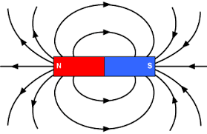
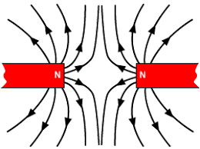
Magnetic Forces
Magnetic force can be simply defined as Pushing or pulling between Magnets or magnetic materials
How does Magnetic force works ?
Opposite poles attracts
Like poles repels

Slide 6
Torque on a current Loop

Slide 7
What is Torque ?
Torque is a measure of the rotational force applied to an object.
It's often represented by the symbol "τ" and is calculated by multiplying the force
applied to an object
by the distance from the axis of rotation to the point where the force is applied.
In simpler terms, it's the product of force and the distance from
the point of rotation.
Mathematically, torque (τ) is expressed as:
𝜏=𝑟×𝐹×sin⁡(𝜃)τ=r×F×sin(θ)
When you open / close a door.
Opening a bottle cap.

Slide 8
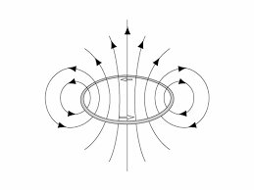
Torque on a current Loop
The magnetic field pushes or pulls on the wires in the loop, causing it to want to turn or rotate. This turning force is what we call torque on a current loop.
τ = N I A B sin θ
The loop carries a current I , has N turns, each of area A , and the perpendicular to the loop makes an angle θ with the field B .

Slide 9
Applications
Electric Motors
Electric motors use the interaction between magnetic fields and current-carrying conductors to produce mechanical motion.
Transformers
Transformers help get electricity from power plants to our homes.
MRI Machines
When doctors need to see inside your body, they use MRI machines.

Slide 10
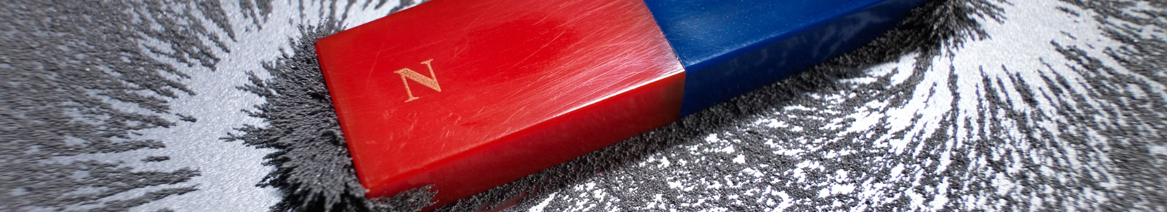
Conclusion
1
Magnetic Fields and Forces
2
Torque on Current Loops
3
Real-World Applications
Magnetic fields can be created by electric currents and permanent magnets
When a current-carrying loop is placed in a magnetic field, a torque is exerted on the loop, causing it to rotate and align with the field.
Magnetic fields and forces have a wide range of applications, including in electric motors, generators, loudspeakers, and medical imaging technologies.

Slide 11
Thanks!

