Slide 1
Conductor
A conductor is an object or type of material that allows the flow of charge(electric current)in one or more directions
Insulator
A material or an object that does not easily allow heat, electricity, light, or sound to pass through it.

Slide 2
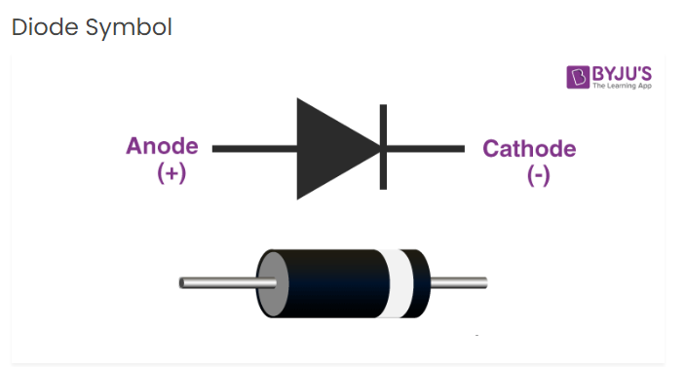
What Is a Diode?
Diodes are used to protect circuits by limiting the voltage and to also transform AC into DC. Semiconductors like silicon and germanium are used to make the most of the diodes. Even though they transmit current in a single direction, the way with which they transmit differs.

Slide 3
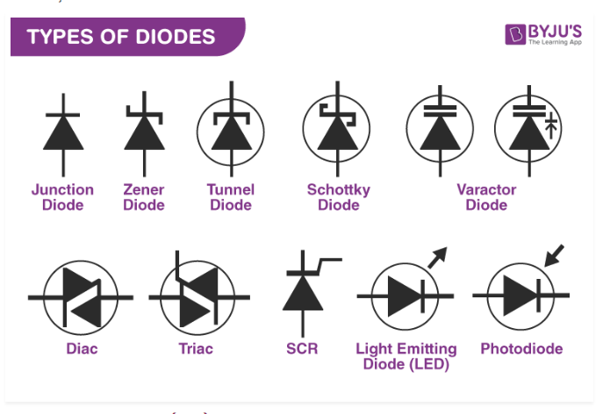
Types of Diodes
Light Emitting Diode
Laser diode
Avalanche diode
Zener diode
Schottky diode
Photodiode
PN junction diode

Slide 4
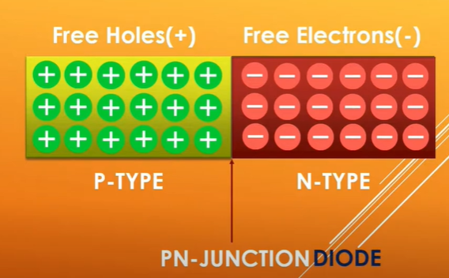
P-N Junction Diode:
It is a semiconductor with n and p type materials that are chemically combined, forms a junction that allows conduction in one direction only.

Slide 5
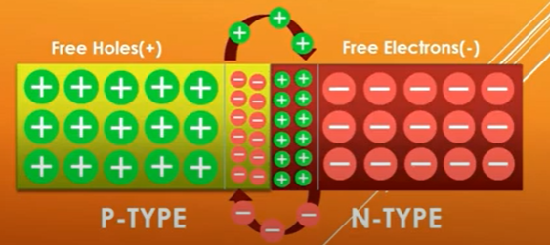
Depletion region

Slide 6
Characteristics of Diode
The following are the characteristics of the diode:
Forward-biased diode
Reverse-biased diode
Zero biased diode

Slide 7
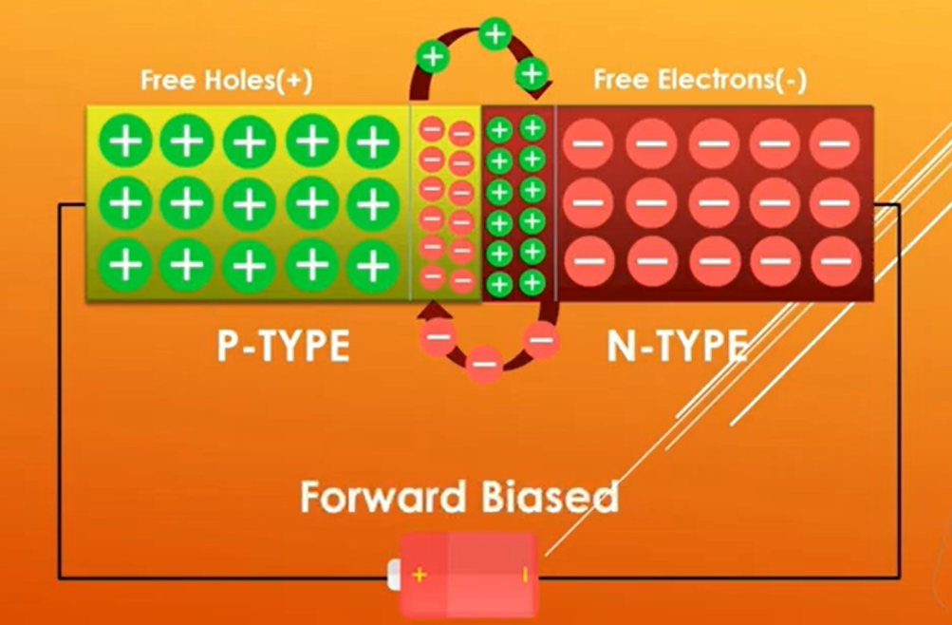
Forward biased
Forward bias meaning is that the current flows in the forward direction due to the voltage applied in the forward direction. In forward bias, the p-type(anode) of the semiconductor is connected to the positive end, and the n-type(cathode) is connected to the negative end of the battery.

Slide 8
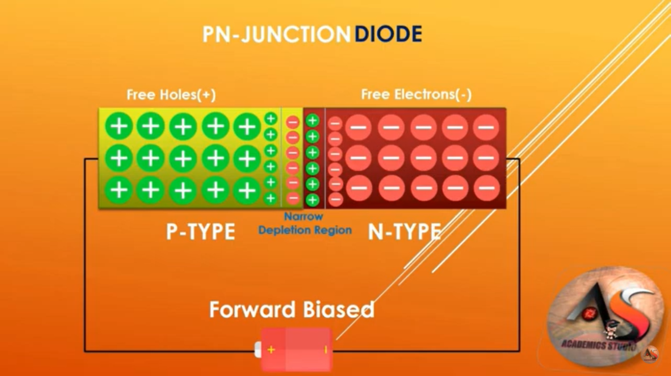

Slide 9
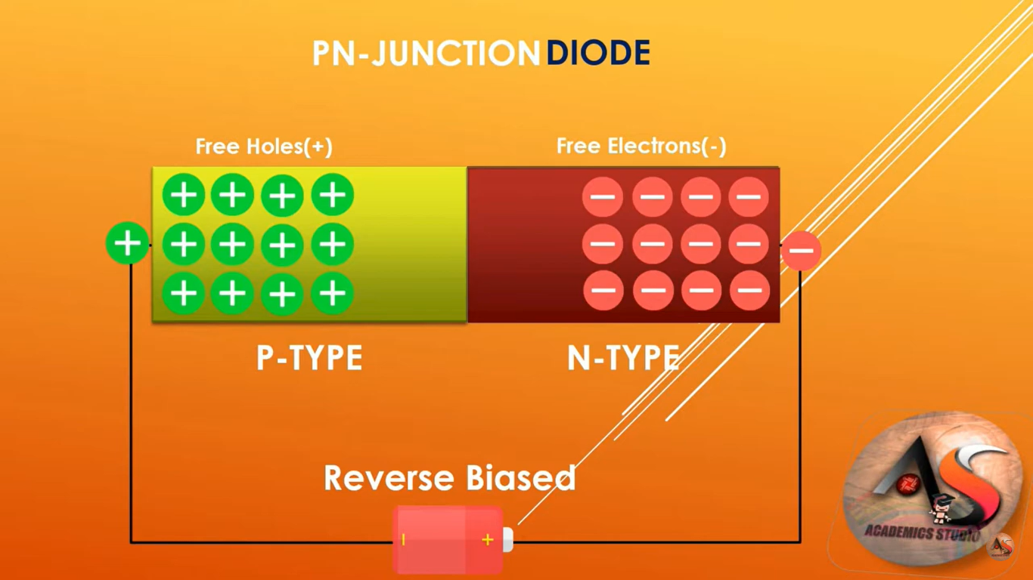
Reverse bias
Reverse bias refers to the application of an external voltage across a semiconductor diode so that the positive terminal of the battery is linked to the n-side and the negative terminal is attached to the p-side of the diode.

Slide 10
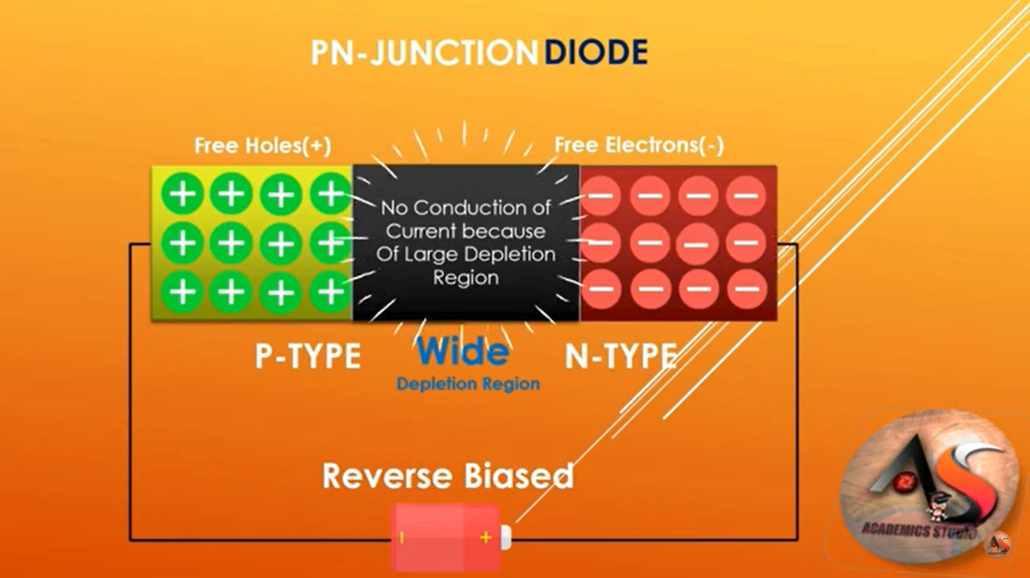

Slide 11
Zero bias
Zero bias: No external voltage is applied to the P-N junction diode there is no external voltage is applied and this means that the potential barrier at the junction does not allow the flow of current.

Slide 12
Applications of p-n junction diode
DC power supply
Rectifier circuit
It can be used as solar cell
It can be used as rectifier in many electric circuit and as voltage controlled
When the diode is in forward biased , it can be used in led lightning application

