Slide 1
Semiconductor
P-N Junction
Applied Physics
(Computer Science Department)
Kashish Goindani & Geeta Khatri

Slide 2
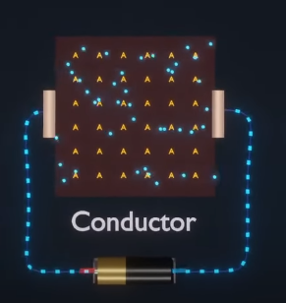
Conductor
Conductors are the materials or substances which allow electricity to flow through them.
They conduct electricity because they allow electrons to flow easily inside them from atom to atom.
Ex: Copper, Brass, Steel, Gold, and Aluminium

Slide 3
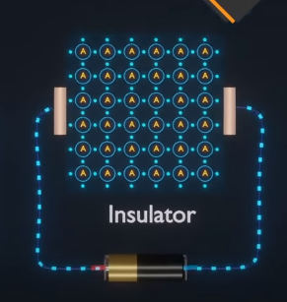
Insulator
Insulator materials that do not allow electricity to pass through them.
Ex : glass, air, wood, plastic and rubber.

Slide 4
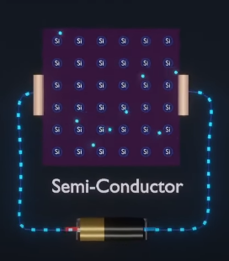
Semiconductor
Semiconductors are materials which have a conductivity between conductors (generally metals) and nonconductors or insulators (such as most ceramics).
Ex : silicon, germanium

Slide 5
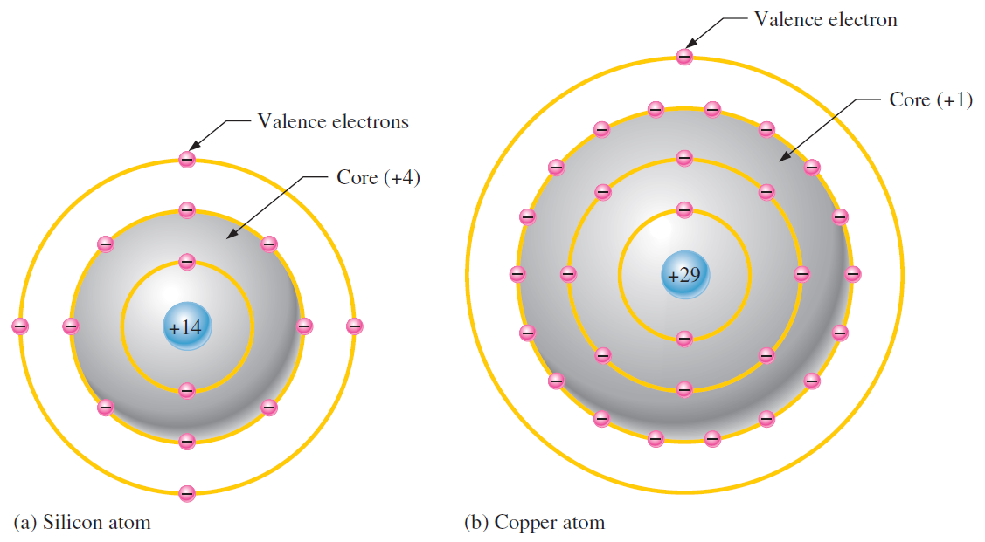
Comparison
Semiconductor Atom
Conductor Atom

Slide 6
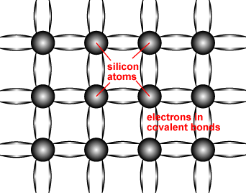
Structure of Semiconductor
Semiconductors, such as Silicon are made up of individual atoms bonded together in a regular, periodic structure.
Each atom forms 4 covalent bonds with the 4 surrounding atoms to form an arrangement whereby each atom is surrounded by 8 electrons.

Slide 7
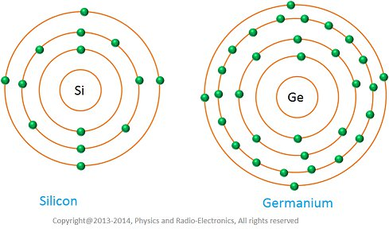
Silicon and Germanium

Slide 8
Characteristics of Semiconductor
A semiconductor is a material that has a very low electrical resistance.
It is very pure chemically and has only one defining characteristic conduction.
When exposed to an electric field, electrons in this material will move at a very high speed. The same applies to holes.

Slide 9
Types of Semiconductor
Intrinsic
. Extrinsic
. N-type
. P-type

Slide 10
Extrinsic Semiconductors
Intrinsic Semiconductor
The number of excited electrons is equal to the number of holes (n = p).
pure semiconductor, undoped semiconductor , or i-type semiconductor.
A semiconductor without any significant amount of impurity.
Extrinsic semiconductors are semiconductors that are doped with specific impurities.
The impurity modifies the electrical properties of the semiconductor and makes it more suitable for electronic devices such as diodes and transistors.
They exhibit poor electrical conductivity.

Slide 11
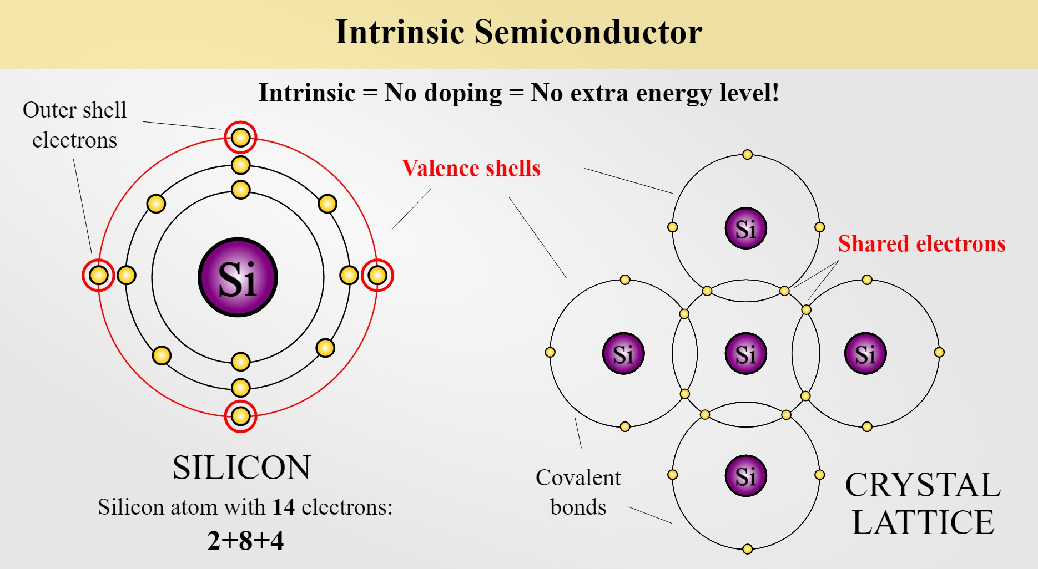

Slide 12
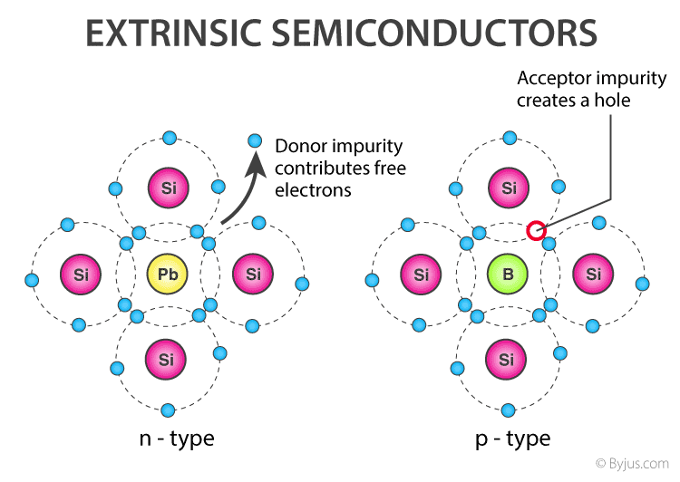

Slide 13
P-type Semiconductor
P-type semiconductor is formed due to the dopping of III group elements
i.e. Boron, Aluminium, Thallium
These are also known as Trivalent semi conductors
P-type semiconductors is positive type semiconductor it means it deficiency of 1 electron is required
In P-type semiconductor majority charge carries are holes and minority charge carries are electrons.
A hole indicates a missing electron. In this no. of holes is more than the no. of electrons.

Slide 14
N-type Semiconductor
N-type semi conductor is formed due to dopping of Nitrogen,
Phosphorus, Arsenic, Antimony, Bismuth
These are also known pentavalent semiconductor
N-type semiconductor is negative type semi-conductor it means excess of 1 electron is required
In N-type semiconductor majority charge carries are electrons and minority charge carries are hole.
In N-type semiconductor the no. of holes is less than the no. of free electron

Slide 15
P-N Junction Diode:
Is is a semiconductor with n and p type materials that are chemically combined, forms a junction that allows conduction in one direction only.

Slide 16
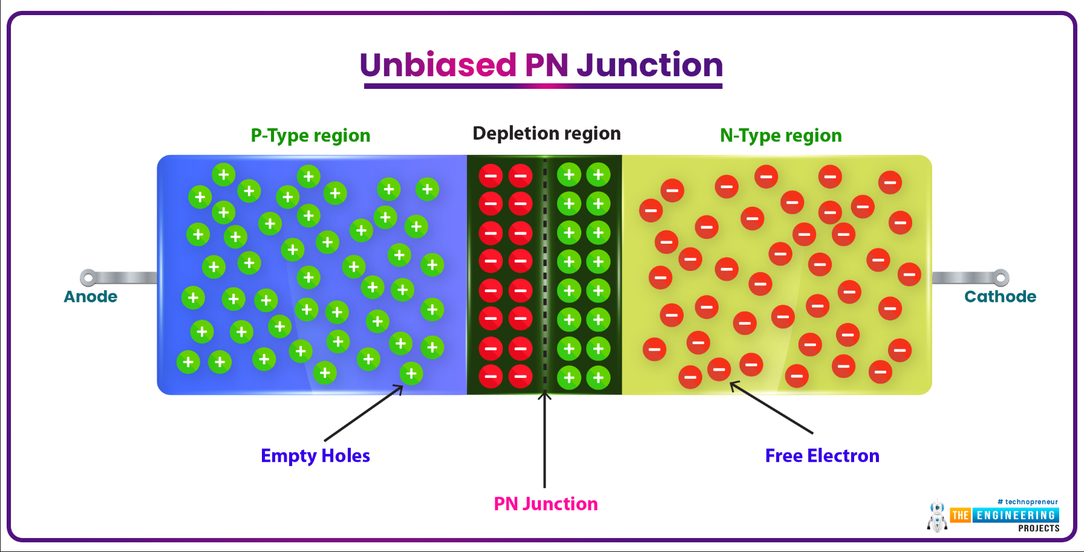

Slide 17
Characteristics of a Diode:
Forward biased diode
Reverse biased diode
Zero biased diode

Slide 18
Forward Biased Diode:
When the diode is forward-biased and the current is flowing, there is a minor voltage drop across it. The potential energy across the p-type material is positive, while the potential energy across the n-type material is negative.

Slide 19
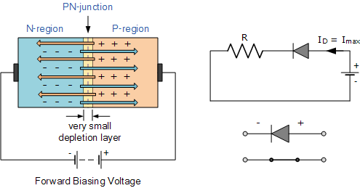
Forward Biased Diode

Slide 20
Reverse Biased Diode:
A diode is said to be reverse-biased when the battery voltage is totally depleted (battery has been completely discharged and current does not flow). The potential energy across the p-type material is negative, while the potential energy across the n-type material is positive.

Slide 21
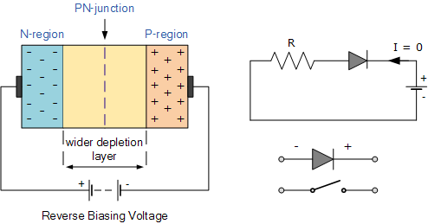

Slide 22
Thankyou…

