Slide 1
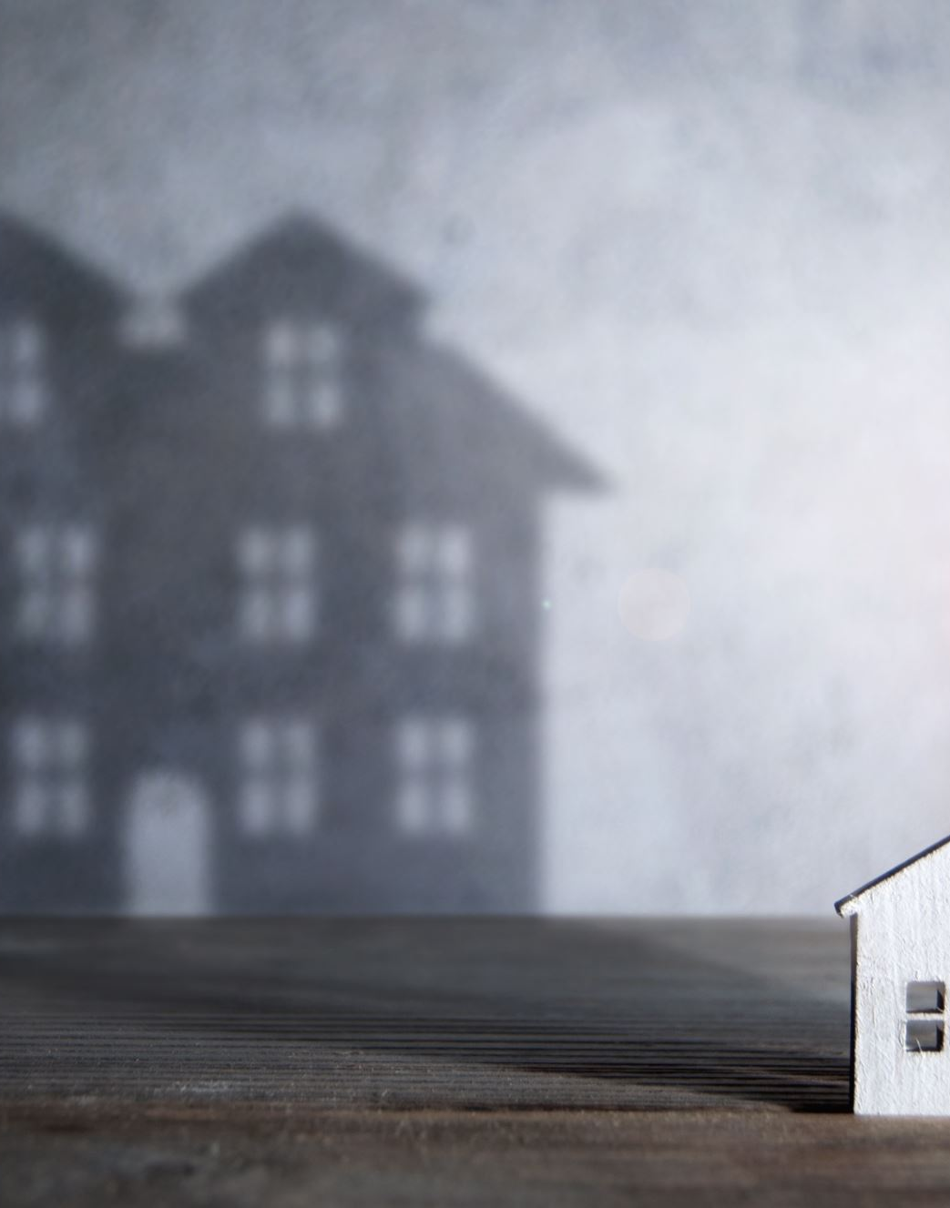
Smart Homes
Convenient, or Privacy Invading?

Slide 2
What is a smart home?
“A home equipped with lighting, heating, and electronic devices that can be controlled remotely by smartphone or computer”
With this definition in mind do you think you have appliances that are spying on you?

Slide 3
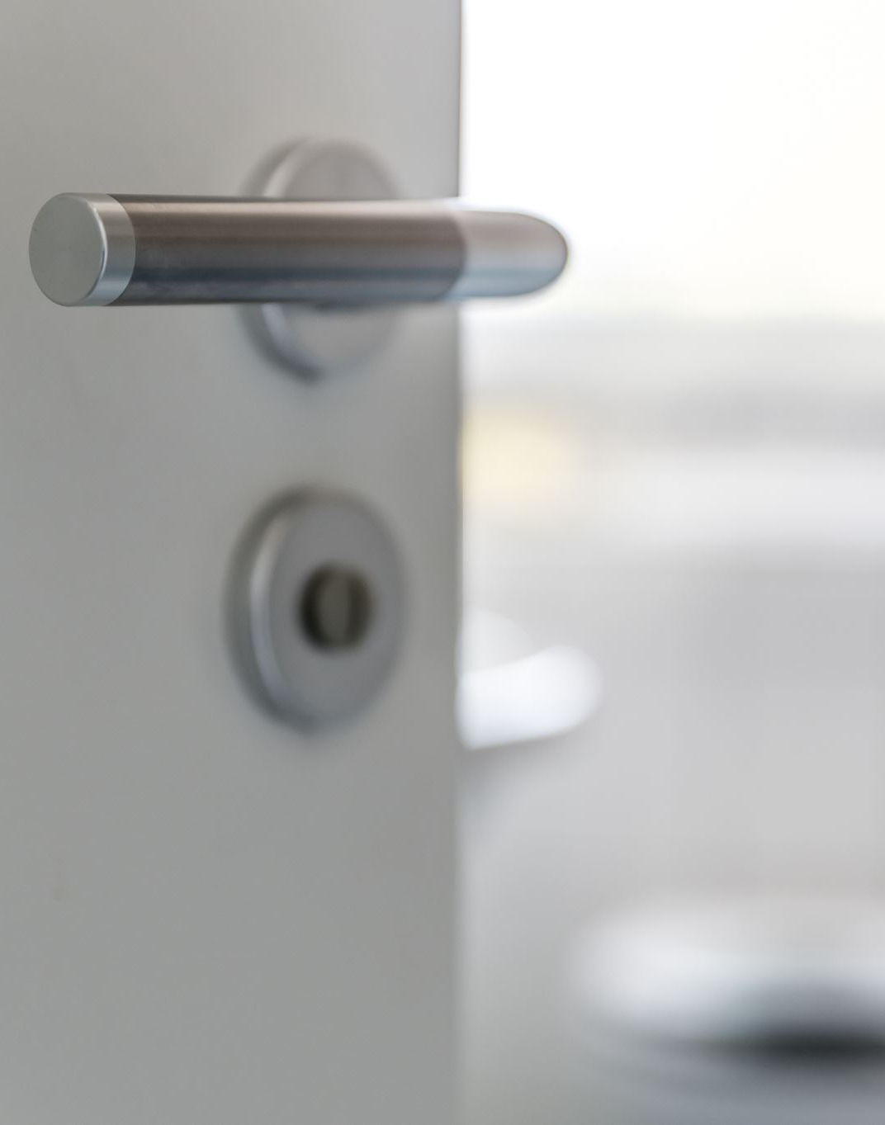
Is your Smart Home Spying on you?
List of common smart home appliances – Alexa devices, Amazon Ring Door Bell, Kindle or smart controlled lights.
Task - Think of smart devices you have at home. Have you ever considered that these devices are breaching your privacy?

Slide 4



How may these devices breach your privacy?
Ring Doorbell knows:
Live and recorded video, audio and photos of the outside of your house; when people come and go and you receive packages; status of linked devices like lights.
Echo Speaker knows:
Collects audio recordings through an always-on microphone; keeps voice IDs to differentiate users; logs smart-home device activity and temperature; detects presence of people through ultrasound.
Kindle knows:
What and when you read and watch entertainment and news; when you open, close and how long you use third-party apps; your location.
Notes:
Ethical Echo Speaker –
Among the best-selling speakers in history, Echos respond to the wake word “Alexa” to summon the voice assistant to play music, answer questions, shop and control other devices.
It counts snores? Yes, if you turn that on. Alexa can hear more than you might realize.
Amazon touts privacy controls like a physical microphone mute button, but when I downloaded my Alexa voice history, I found the Echo had recorded many sensitive conversations after its microphone activated unintentionally. (Amazon says its systems now double check whether you intended to say the wake word and label accidental recordings.)
Only after years of criticism did Amazon add a setting to not keep any audio recordings.
“Providing customers with transparency and control over their information has always been incredibly important to Amazon, and we believe we’ve been very good stewards of peoples’ data,” says spokeswoman Kristy Schmidt.
Ethical Concerns Ring Doorbell - Acquired by Amazon in 2018, Ring doorbells have tiny cameras inside that let you live-stream, record and interact with whomever is at your doorstep — even if you’re not home. You’re not the only one who wants to peer through your doorbell. Police have made tens of thousands of requests for Ring video clips, and Amazon has handed footage to police without owners’ permission at least 11 times this year. (Amazon says it reserves the right to respond to emergency police requests when they relate to matters of life and death.)
Ring brought surveillance cameras to millions of more homes, igniting a privacy debate about recording neighbors without permission.
Ethical Concerns Kindle- Amazon knows exactly how fast you read and how far you actually got through your last novel. Kindles and Fire Tablets are another way Amazon gets to know your tastes, which helps it sell you things.

Slide 5
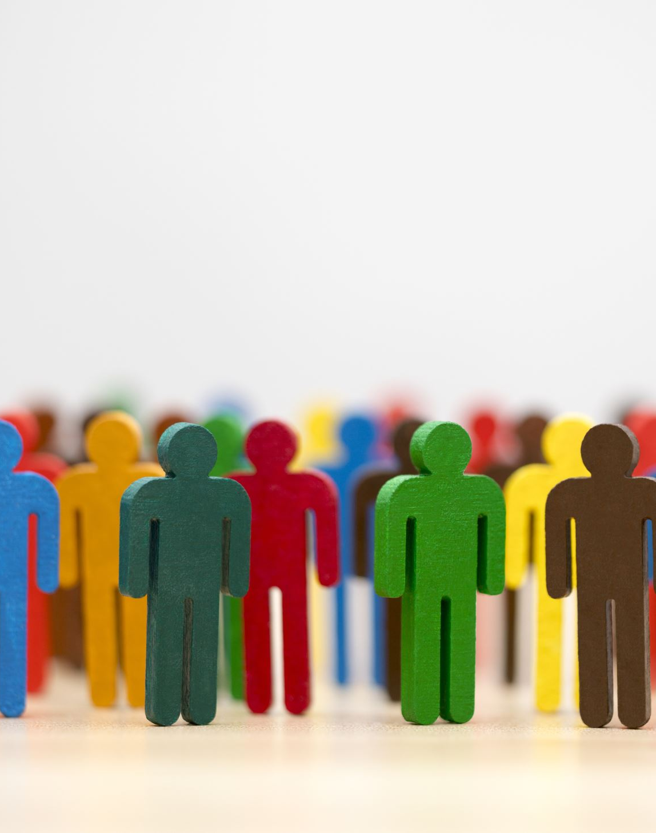
Additional Ethical Considerations
Consumer Choice
Social Isolation
Environmental Concerns
Dependency

Slide 6
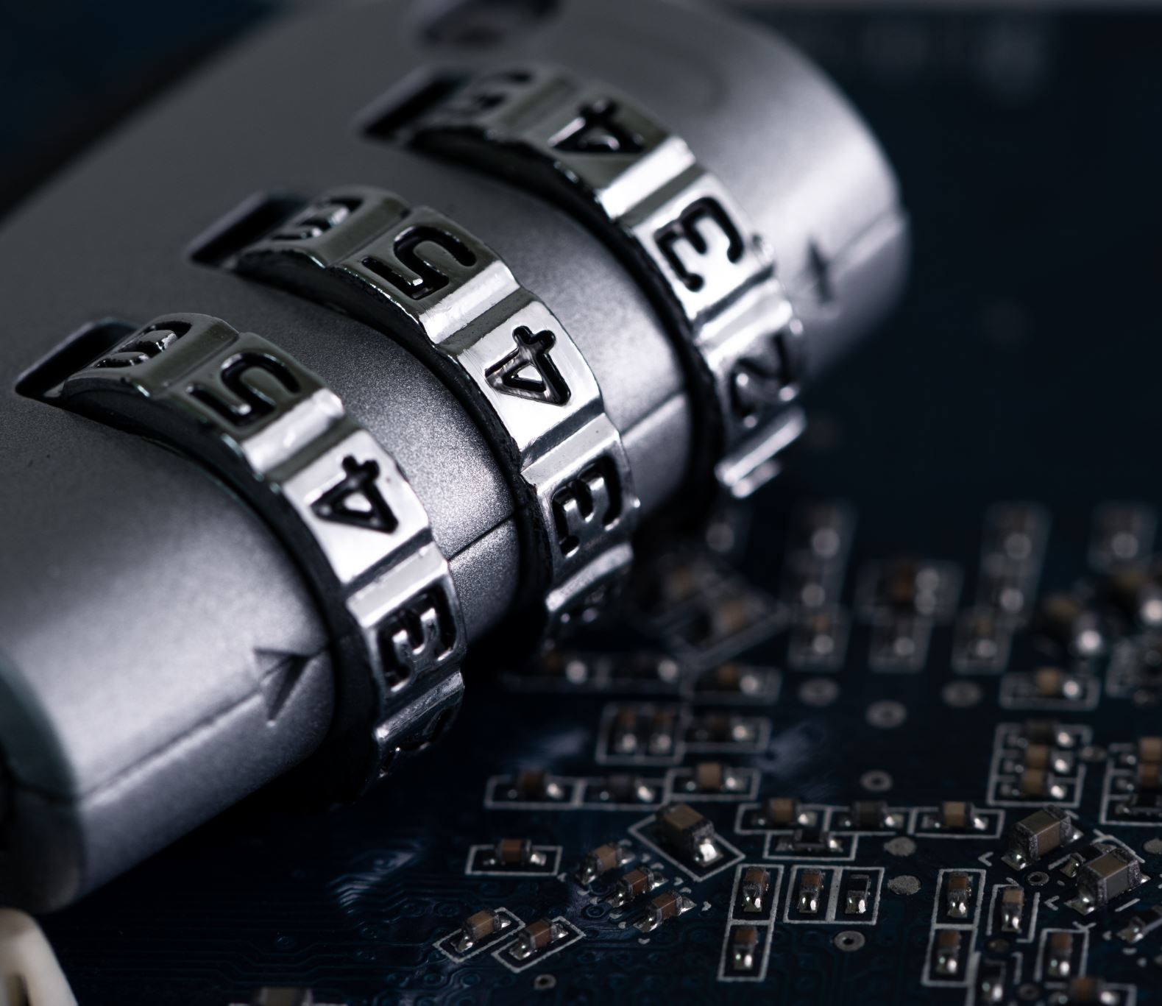
Smart Homes & Devices:
The trade-off between convenience and privacy raises some ethical questions
Notes:
This trade-off between convenience and privacy raises a number of ethical questions. For example:
Is it ethical for companies to collect and analyze personal data in order to provide convenient services?
Do consumers fully understand the privacy implications of using smart home devices, and are they aware of the risks?
Should companies be required to obtain explicit consent from consumers before collecting and using personal data?
How can we ensure that personal data is protected from hackers or other unauthorized access?
Should companies be required to provide consumers with greater transparency and control over their personal data?
These are complex ethical questions that require careful consideration from both consumers and policymakers. Ultimately, it is important to strike a balance between convenience and privacy, ensuring that smart home technologies are used in a responsible and ethical manner.

Slide 7

We have given a brief overview of how smart homes can make life more convenient whilst simultaneously infiltrating your privacy.
Consider these questions:
When does convenience outweigh the right to privacy?
Who determines the balance between convenience and privacy? The consumer or organisations?
Does there need to be more transparency on how smart homes utilise your data?

