Slide 1


Computer Hardware and Software
Unit
Contents
Starting with You Why is it important to organize files on your computer? To find out, go to the Online Learning Center at concepts.glencoe.com. Choose Before You Read Quizzes and take the Unit 2 Pre-Quiz.
Tech Talk: Introducing Your Computer
  Types of Computers (pg. 41–42)
  Hardware Basics (pg. 43–44)
  Computer Memory and Storage Basics (pg. 45–46)
  Software Basics (pg. 47–48)
  Computer Network Basics (pg. 49)
Projects
  Project 1: Use Microsoft Windows (pg. 51–68)
  Project 2: Use Microsoft Help (pg. 69–81)
Copyright © The McGraw-Hill Companies, Inc. All rights reserved.
Technology in Your Life

Slide 2


Introducing Your Computer
pg. 41-50
Key Terms
You Will Learn
personal computer (PC)
central processing unit (CPU)
bit
byte
hardware
input
output
random-access memory (RAM)
read-only memory (ROM)
storage device
software
operating system (OS)
network
  How computers work
  To identify hardware
  How memory and storage are used
  To identify software
  How networks work
Technology in Your Life

Slide 3
Introducing Your Computer
Types of Computers
pg. 41-42
personal computer (PC)
A computer used by one person at a time. (pg. 41)
Computers can be grouped by size, purpose, and number
of users.
Type of Computer | Number of User at One Time | Size | Typical User/Purpose
Personal computer (PC) (microcomputer) | One | Fits on a desk, on a lap, or in a hand | Used by individuals for organizing information, creating products, and entertainment
Minicomputer | Several to hundreds | Occupies part of a room | Used by small to medium-sized organizations, such as schools
Mainframe (super computer) | Thousands | Room-sized | Used by large corporations and government agencies
Technology in Your Life

Slide 4
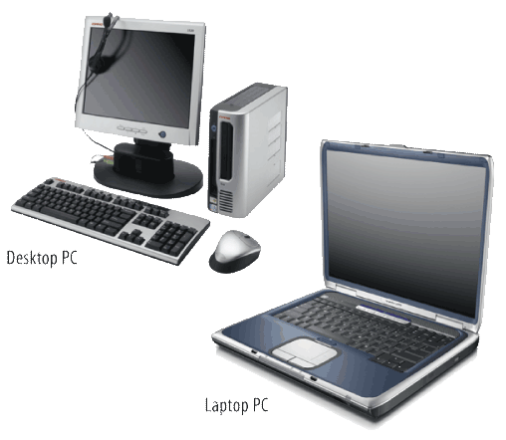
Introducing Your Computer
Types of Computers
pg. 41-42
PCs and Macs
Personal computers are grouped by the software they use:
  PC - uses the Microsoft Windows operating system
  Mac - uses the Macintosh operating system
Examples of personal computers are:
  Desktops
  Laptops
  MP3 players
  Personal digital assistants (PDAs)
Technology in Your Life

Slide 5
Introducing Your Computer
Types of Computers
pg. 41-42
central processing unit (CPU)
A microprocessor, or tiny computer chip, that receives and carries out all the instructions given to a computer. (pg. 42)
How Does My Computer Work?
The “brain” of a computer is the central processing unit (CPU). When the CPU receives and carries out an instruction, it has completed one cycle.
Computer’s speed = number of cycles completed in one second
Cycles are measured in:
  Megahertz (MHz) = millions of cycles per second
  Gigahertz (GHz) = billions of cycles per second
Technology in Your Life

Slide 6
Introducing Your Computer
Types of Computers
pg. 41-42
bit
The smallest unit of computerized data. (pg. 42)
byte
The building block for all information that flows through a computer. (pg. 42)
Bits, Bytes, and Binary Numbers
Bits and bytes are small pieces of computerized data that communicate commands to a computer’s CPU:
  A bit is either a 1 or a 0 (binary digits).
  A byte contains eight bits.
Each letter in the English language is represented by
one byte.
Technology in Your Life

Slide 7
Introducing Your Computer
Types of Computers
pg. 41-42
How Big Is a Terabyte?
Common storage units:
  Kilobyte (KB) = 1,000 bytes
  Megabyte (MB) = 1,000 bytes, or 1 million (1,000,000) bytes
  Gigabyte (GB) = 1,000 MB, or 1 billion (1,000,000,000) bytes
  Terabyte (TB) = 1,000 GB, or 1 trillion (1,000,000,000,000) bytes
Technology in Your Life

Slide 8

Introducing Your Computer
Types of Computers
Compare and Contrast What are some similarities and differences between mainframe computers and personal computers?
Some similarities are:
  Both have a central processing unit (CPU).
  Both read only 1s and 0s.
  Both recognize and process bits and bytes.
  For both, speed is determined by cycles per second.
Some differences are:
  Mainframes are very large. PCs can be very small.
  Mainframes can be used by thousands of people at once. PCs can only be used by one person at a time.
  Mainframes are used by corporations and government agencies. PCs are used by individuals, like students!
Technology in Your Life

Slide 9
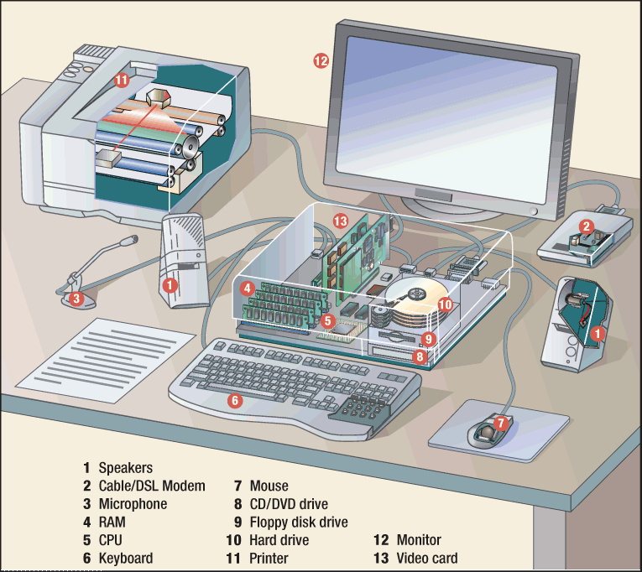
Introducing Your Computer
Hardware Basics
pg. 43-44
hardware
The collection of physical pieces, or components, that make up a computer. (pg. 43)
Your computer may use hardware like the components shown here.
Technology in Your Life

Slide 10
Introducing Your Computer
Hardware Basics
pg. 43-44
Hardware can be inside or outside the computer:
  The CPU and hard drive are inside the computer.
  The keyboard, monitor, and printer are outside the computer and must be connected by cables.
Technology in Your Life

Slide 11
Introducing Your Computer
Hardware Basics
pg. 43-44
input
Information that is entered into a computer. (pg. 44)
output
Information that a computer produces and delivers back to the user. (pg. 44)
What Are Input and Output Devices?
Information flows between you and your computer through input and output devices. Examples of input devices are:
  keyboard
  mouse
  scanner
  digital camera
  joystick
Examples of output devices are:
  monitor
  printer
  speakers
Technology in Your Life

Slide 12
Introducing Your Computer
Hardware Basics
Identify Name three hardware components that are also input devices, and three hardware components that are also output devices. (Try to think of input and output devices that have not been mentioned yet.)
Input devices include:
  digital camera
  joystick
  keyboard
  microphone
  mouse
  scanner
  touch screen
  trackball
Output devices include:
  monitor
  printer
  projector
  speakers
Technology in Your Life

Slide 13
Introducing Your Computer
Computer Memory and Storage Basics
pg. 45-46
read-only memory (ROM)
Memory that permanently stores data and that cannot be erased or changed. (pg. 45)
random-access memory (RAM)
Temporary memory that a computer uses to store data and process information while working in a program. It is erased when the computer is turned off. (pg. 45)
When Do I Use RAM and ROM?
When you use your computer to perform any type of task, you are using two types of memory:
Type of Memory | What Does It Do? | When Is It Used?
Read-only memory (ROM) | Stores permanent information like telling the computer how to start up | When you turn a computer on or off
Random-access memory (RAM) | Stores temporary information when you are working in a file | When you start and use software
Technology in Your Life

Slide 14
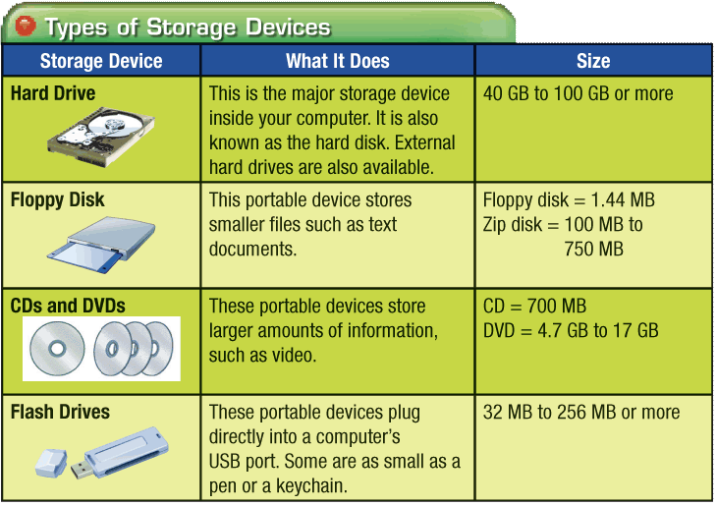
Introducing Your Computer
Computer Memory and Storage Basics
pg. 45-46
storage device
Computer equipment used to store data. Examples of storage devices are hard drive, network server, floppy disk, CD, DVD, and USB flash drive. (pg. 46)
How Is Information Stored?
When you save a file, you move the information from RAM to a storage device. The type of storage device depends on how much space is needed. Music and video files require more storage space than text files.
Technology in Your Life

Slide 15
Introducing Your Computer
Hardware Basics
Explain What do ROM and RAM stand for, and what do they do?
ROM:
  Stands for read-only memory
  Is permanent memory
  Works when you turn a computer on or off
  Stores data even when a computer is turned off
RAM:
  Stands for random-access memory
  Is temporary memory
  Works when you start and use software
  Stores data only while a computer is on
Technology in Your Life

Slide 16
Introducing Your Computer
Software Basics
pg. 47-48
software
A set of instructions, also called a program or application, that tells a computer how to perform tasks. (pg. 47)
operating system (OS)
Software that controls all the other software programs and allows a computer to perform basic tasks. (pg. 47)
Software is the set of instructions that lets you “talk” to your computer. Software translates commands into bits and bytes. Different types of software have different functions:
  Operating system (OS) software - makes your computer work
  Application software - lets you do different tasks on your computer
  Utility software - helps you maintain your computer and keep it in good running condition
Technology in Your Life

Slide 17
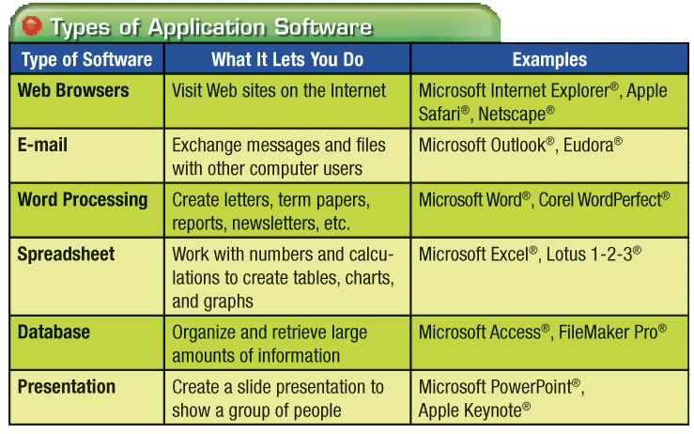
Introducing Your Computer
Software Basics
pg. 47-48
How Do I Use Software?
It is important to choose the right software program for the type of task you want to do:
Technology in Your Life

Slide 18
Introducing Your Computer
Software Basics
pg. 47-48
What Is an Operating System?
The operating system (OS) controls all other software and allows the hardware devices to work properly. Some popular operating systems are:
  Microsoft Windows - for PCs
  Mac OS - for Apple computers
  Linux - for very large network computers
  Handheld operating systems - for PDAs, MP3 players, and cell phones
  What Is a GUI?
  Nearly all modern operating systems use a graphical user interface (GUI). This lets users click on images or text on the screen instead of having to type commands.
Technology in Your Life

Slide 19
Introducing Your Computer
Software Basics
Draw Conclusions What types of software could you use to accomplish your school tasks?
Possible types of software and sample tasks you could accomplish with them are:
Type of Software | Sample Task
Web browsers | Conduct Internet research
Instant messaging | Communicate with friends
E-mail | Send a file to your teacher
Word processing | Write a letter, paper, or essay
Presentation | Create a slide show
Spreadsheet | Make calculations
Database | Organize and access large amounts of information, such as at a library
Technology in Your Life

Slide 20
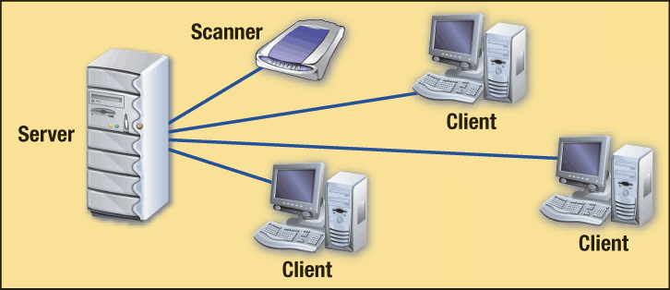
Introducing Your Computer
Computer Network Basics
pg. 49
network
A group of computers connected together, often through a central server, using telephone lines, cables, satellite links, radio, and/or other communication devices. (pg. 49)
A computer network is a group of computers connected together. Networks allow people to share:
  information
  hardware
  storage devices
  Internet connections
A network allows you to send data back and forth between different computers, servers, storage devices, and shared output devices:
Technology in Your Life

Slide 21
Introducing Your Computer
Computer Network Basics
pg. 49
The Internet is the biggest network there is. Types of networks are:
  Local-area network (LAN) - covers a small area, such as a school or office
  Wide-area network (WAN) - covers a large geographic area, such as an international corporation
  Intranet - lets people within an organization or business share information
Technology in Your Life

Slide 22
Introducing Your Computer
Tech Talk Assessment
pg. 50
Identify What are some activities for which you might use computer networks?
Possible answers include:
  Send and receive e-mail
  Surf the Internet
  Access the school library
  Share information
  Share documents
  Share hardware, such as printers and scanners
  Share Internet connections
Technology in Your Life

Slide 23
Introducing Your Computer
Tech Talk Assessment
pg. 50
Analyze If your teacher asked you to write a paper using a computer, how would the following help you?
  ROM
  RAM
  Application software
  Storage devices
  ROM would let you turn your computer on and start the operating system.
  RAM would let you use software, such as word processing, to perform tasks.
  Application software, such as word processing software, would let you create a text document.
  Storage devices would let you save files without having to print them on paper.
Technology in Your Life

Slide 24

Introducing Your Computer
Tech Talk Assessment
pg. 50
Compare How is a computer’s central processing unit (CPU) similar to the human brain?
The CPU receives input, interprets its meaning, and responds by processing it. Similarly, the human brain receives input from the sense organs via the central nervous system, interprets its meaning, and responds.
Self-Check Assess your understanding of what you read. Go to the Online Learning Center at concepts.glencoe.com. Choose After You Read Quizzes and take the Unit 2 Tech Talk Quiz.
Technology in Your Life

Slide 25

1
Use Microsoft Windows
pg. 51-68
Contents
Key Terms
Exercise 1-1
  Use Windows Explorer to view folders and files
Exercise 1-2
  Create, copy, paste, and rename folders
Exercise 1-3
  Copy, paste, rename, and delete files
Exercise 1-4
  Use Save As
  Delete folders
Exercise 1-5
  Manage folders and files on the desktop
Exercise 1-4
  Search for files and folders
file manager
drive
folder
file
Save As
shortcut
Technology in Your Life

Slide 26

Use Microsoft Windows
1
Exercise 1-1 Get to Know Windows Explorer
pg. 52-54
file manager
A program that lets you view and organize files stored on a computer or network. (pg. 52)
folder
A place to save and organize files, such as documents or pictures. (pg. 52)
In this exercise you will use Windows Explorer to practice organizing files. You will also display the file’s or folder’s size, type, and date modified.
It is important to keep data on your computer organized so that it is easy to access. File manager programs like Windows Explorer can help you organize your:
  folders
  files
APPLICATIONS USED
Windows Explorer
Technology in Your Life

Slide 27
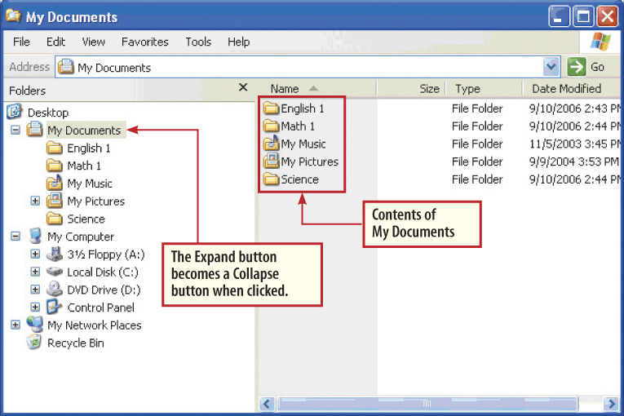
Use Microsoft Windows
1
Exercise 1-1 Get to Know Windows Explorer
pg. 52-54
file
A named collection of data that is stored on a computer disk. Examples of file types include document, graphic, audio clip, and video clip. (pg. 52)
drive
A storage area identified by a letter and a colon (e.g., A:, B:, C:, and D:). (pg. 52)
For each network, drive, or folder, you can:
  Click the Expand button (+) to reveal folders and files
  Click the Collapse button (–) to hide folders and files
Technology in Your Life

Slide 28
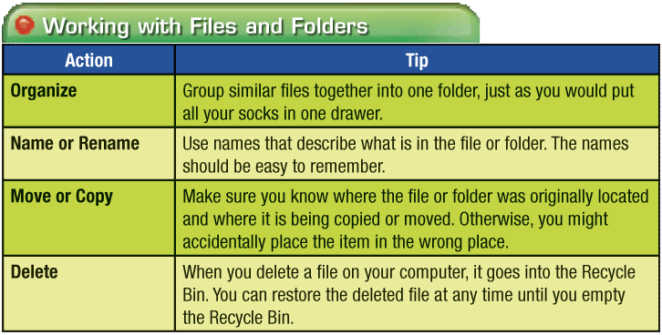
Use Microsoft Windows
1
Exercise 1-2 Work with Folders
pg. 55-56
In this exercise you will use Windows Explorer to create a new folder. You will also copy a folder and paste it into your new folder.
When you work with files and folders, follow these guidelines:
APPLICATIONS USED
Windows Explorer
DATA FILES USED
2A Mars Project
Technology in Your Life

Slide 29
Use Microsoft Windows
1
Exercise 1-3 Work with Files
pg. 57-58
In this exercise you will move a file by copying it, then pasting it. You will then practice renaming and deleting the file.
When you rewrite or create a new version of a document, you may want to rename the file. To remember the name and location of the latest version, you can:
  Add a date to the file name. The latest date is the most recent.
  Place all versions of the document into a folder with the same document name.
APPLICATIONS USED
Windows Explorer
DATA FILES USED
2A Mars Project
Technology in Your Life

Slide 30
Use Microsoft Windows
1
Exercise 1-4 Create a Copy Using Save As
pg. 59-60
Save As
A Microsoft Word command that allows you to rename a file and, at the same time, copy the file by saving it to a new location. (pg. 59)
In this exercise you will use Save As to save a photo from a data file to your own folder and rename it.
Use the Save As command to:
  Copy a file
  Rename a file
  Move a file to a new location
  Make changes in a file and keep the original version
APPLICATIONS USED
Windows Explorer
Microsoft Word
DATA FILES USED
2A Mars Project
Technology in Your Life

Slide 31
Use Microsoft Windows
1
Exercise 1-5 Work on the Desktop
pg. 61-63
Shortcut (desktop)
An icon on the desktop that links directly to a file or folder you use often. (pg. 61)
In this exercise you will create, rename, and move files on the desktop instead of in Windows Explorer.
The desktop is the main work area on a computer.
  Desktop shortcuts are small images or icons you can click for quick access to files, folders, and programs.
  You can create desktop shortcuts to folders or files that you use frequently.
APPLICATIONS USED
Windows Explorer
DATA FILES USED
2A Mars Project
Technology in Your Life

Slide 32
Use Microsoft Windows
1
Exercise 1-6 Search for Files
pg. 64-65
In this exercise you will use the Windows Search methods.
The Search option on your computer allows you to look for files or folders by:
  Exact name
  Partial name
  Exact location
  General location
  Size
  When it was modified
APPLICATIONS USED
Windows Explorer
Technology in Your Life

Slide 33
1
Use Microsoft Windows pg. 51–68
Project Assessment
Identify How would you open a file saved on the desktop?
  A. Single-click the file’s icon
  B. Double-click the file’s icon
  C. Right-click the file’s icon
  D. Drag the file’s icon to the taskbar
The correct answer is:
B. Double-click the file’s icon
Technology in Your Life

Slide 34
1
Use Microsoft Windows pg. 51–68
Project Assessment
Describe What are two important things to remember about organizing files and folders?
Possible answers include:
  Group similar files together in one folder.
  Use file and folder names that are easy to remember.
  Keep track of where you move files and folders.
  Delete files and folders you no longer need.
  After emptying the Recycle Bin, you cannot retrieve deleted items.
Technology in Your Life

Slide 35
1
Use Microsoft Windows pg. 51–68
Project Assessment
Identify Which of the following is not a search criteria you can use to find a word processing document on your computer?
  A. name
  B. location
  C. size
  D. number of pages
The correct answer is:
D. number of pages
Technology in Your Life

Slide 36
2
Use Microsoft Help
pg. 69-81
Contents
Key Terms
keyword
content search
index search
keyword search
Exercise 2-1
  Open Microsoft Windows Help
  Identify search options
Exercise 2-2
  Perform a content search
  Perform a keyword search
  Perform an index search
Exercise 2-3
  Open Microsoft Office Help
Exercise 2-4
  Find information in Office Help
  Identify keywords and phrases for searches
Technology in Your Life

Slide 37
2
Use Microsoft Help
Exercise 2-1 Get to Know Microsoft Windows Help
pg. 70-71
content search
Looking for information from a list of categories and topics. (pg. 70)
index search
Scrolling through an alphabetical list of keywords to find information. (pg. 70)
keyword
A word or words that identify a topic of interest. (pg. 70)
keyword search
Using keywords to find information. (pg. 70)
In this exercise you will learn about the different ways to search for information using Microsoft Windows Help.
When you have a problem, you may be able to solve it using your software’s Help program. You can find information using one of three types of searches:
Type of Search | How It Works
Content search | You choose from a list of categories and topics
Index search | You scroll through an alphabetical list of keywords
Keyword search | You enter keywords to see related topics
Technology in Your Life

Slide 38
2
Use Microsoft Help
Exercise 2-2 Perform a Search
pg. 72-74
APPLICATIONS USED
In this exercise you will perform a content search, a keyword search, and an index search to find information about how to open an application.
The type of search you choose depends on what you know and what information you want to find:
  Content search – allows you to browse through a list of general categories to find topics
  Index search - helps you see how topics are related and narrows your search
  Keyword search - useful whether you are looking for something specific or a general topic
Microsoft Help
Technology in Your Life

Slide 39
2
Use Microsoft Help
Exercise 2-3 Get to Know Microsoft Office Help
pg. 75-76
APPLICATIONS USED
In this exercise you will learn how to use the different Help options in Microsoft Word, which you can apply to any Microsoft Office application.
There are four basic ways to use Help in a Microsoft Office application:
  Microsoft Office Help - search by keyword or browse through the Table of Contents
  Enter a question - in the Help Search box or Type a Question for Help box
  Office Online - connect to Microsoft’s Web site for the latest information available
  Office Assistant - get answers and tips
Microsoft Word
Technology in Your Life

Slide 40
2
Use Microsoft Help
Exercise 2-4 Search Microsoft Word Help
pg. 77-78
APPLICATIONS USED
In this exercise you will use a number of search methods to learn how to create a table.
When you use Help, choose the Search method that works best for you. In Microsoft Office you can use the Office Assistant, which:
  Pops up with more efficient ways to complete tasks
  Lets you enter questions
  Does not always wait for you to ask before it offers help
  Can be hidden while you are working
Microsoft Word
Technology in Your Life

Slide 41
1
Use Microsoft Help, pg. 69–81
Project Assessment
Analyze When you need help in Microsoft Office, why might you choose to enter a question in the Help Search box rather than look through the Table of Contents?
If you have a specific question, it may be faster to type it in the Help Search box than locate the topic in the Table of Contents.
Technology in Your Life

Slide 42
1
Use Microsoft Help, pg. 69–81
Project Assessment
Describe What is the Office Assistant, and what does it do?
The Office Assistant is one of several Help options available in Microsoft Office. If you run the Office Assistant while you are working, it will display alerts and offer tips automatically.
Technology in Your Life

Slide 43
1
Use Microsoft Help, pg. 69–81
Project Assessment
Explain Name the three ways to find help in Microsoft Windows (not Microsoft Office). Explain how each method works and why you might use it.
Content search:
  Lets you choose from a list of categories and topics
  Lets you browse through a list of categories to find topics that help you learn basic computer tasks
Index search:
  Lets you choose from an alphabetical list of keywords
  Helps you see how topics are related and narrows your search
Technology in Your Life

Slide 44
1
Use Microsoft Help, pg. 69–81
Project Assessment
Keyword search:
  Lets you enter keywords to see related topics
  May be useful whether you are looking for something specific or just have a general idea
Technology in Your Life

Slide 45

Computer Hardware and Software
Unit
Unit Assessment
Draw Conclusions Why is it important to understand the hardware components of your computer?
Possible answers include:
  To care for your computer properly
  To avoid problems with your computer
  To know what equipment you need for different tasks
  To make the most of what your computer has to offer
  To know the fun things you can do!
Assessment Check your knowledge of Microsoft Windows.Go to the Online Learning Center at concepts.glencoe.com. Choose Unit 2 > e-Review Quizzes and take the Unit 2 Tech Assess Quiz.
Technology in Your Life

Slide 46
Computer Hardware and Software
Unit
Unit Assessment
Identify Name three places where you can save a file after you are done working with it.
Possible answers include:
  hard drive
  network
  desktop
  floppy disk
  compact disc (CD)
Technology in Your Life

Slide 47
Computer Hardware and Software
Unit
Unit Assessment
Explain What is the purpose of application software? Name two types of software you might use during a normal day.
The purpose of application software is to let you do tasks on your computer. During a normal day, you might use the following types of software:
  Web browser
  instant messaging
  e-mail
  word processing
  presentation
  spreadsheet
  database
Technology in Your Life

Slide 48
Computer Hardware and Software
Unit
Unit Assessment
Analyze Computers come with a wide variety of different hardware and software options. Why do you think there are so many choices? Support your answer with examples.
Computers come with different hardware and software options because they are used by many different people for many different purposes. Possible users include:
  Individuals like you!
  Small to medium-sized organizations, such as schools or offices
  Large corporations and government agencies
Technology in Your Life

Slide 49
Computer Hardware and Software
Unit
Unit Assessment
Possible purposes include:
  Collecting, organizing, processing, and distributing information
  Creating products such as word processing documents, presentations, spreadsheets, and databases
  Making Web sites, graphics, and animations
  Taking pictures
  Recording and editing videos
Technology in Your Life

Slide 50
Computer Hardware and Software
Unit
Unit Resources
For more resources on this unit, go to the Online Learning Center at http://www.concepts.glencoe.com.
Technology in Your Life

