Slide 1

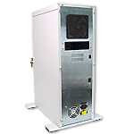
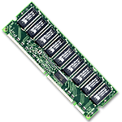
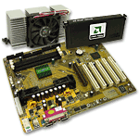
Assembling a Computer

Slide 2
Safety Procedures
Clean work area free of clutter and food
Never open a monitor
Remove jewelry and watches
Turn power off and remove power plug
Fire extinguisher available
Use anti static mat and wrist strap
Hold cards by edges/avoid touching chips
Put components on non conductive surface
Do not use magnetized screw drivers

Slide 3
Electrostatic Discharge
If you notice it, it’s at least 2000 volts
Charge of 200 volts can damage components
Keep all components in anti-static bags
Humidity above 50%
Use grounded mats (workbench and floor)
Use wrist straps
Periodically touch unpainted grounded metal computer parts to lower the body’s static energy

Slide 4
Keeping an Inventory
Document all components, parts purchased
  Use an inventory checklist
  May be difficult to recall later
  Will be helpful in locating and downloading device drivers
Note specific warranty info
  Save specifics about installation and maintenance requirements so warranties will be valid
Use small box to hold all manuals and disks
  Label box for specific computer
  Store in secure place

Slide 5
Choosing a computer case and system unit
Case
  Allows easy access to internal components
  Provides room for expansion (space, #bays)
  ATX form factor
  Available desk top space
  Sturdy
  Adequate ventilation
  LED indicators on front
  Dust filters if area where computer to be used is dusty
  aesthetics
Power supply
  Minimum 250 watts
  ATX
    Single 20 pin
    Fan pulls air through case from front to back

Slide 6
Preparing to install Motherboard
Review the motherboard location map
Configure the motherboard
  Install the CPU, heat sink and fan, RAM
  Connect power supply cables to motherboard power connectors and misc. connectors to correct switches and lights
  Set the system BIOS

Slide 7
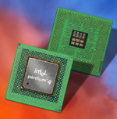
Configuring the processor
Set jumper settings for appropriate frequency
Ensure the CPU used supports the BUS speed and the CPU clock speed

Slide 8
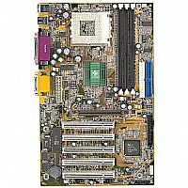
Motherboard jumper settings
A jumper is used to bridge a pair of pins that are to be connected to complete a circuit on the board.
Follow motherboard manual instructions carefully
Common jumper settings
  Processor voltage
  Password clear
  CMOS clear
  BIOS setup access
  Host bus frequency
  Processor frequency
  BIOS Recovery

Slide 9
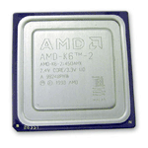
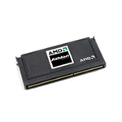
Types of CPU interfaces
Two main types
  Socket
    Socket 7 very common
    Socket A for AMD Athlon and Duron chips
    Socket 370 for Celeron and some Pentium II and III chips
  Slot
    Similar to expansion card interface
    Slot 1 used by Intel Pentium II processors

Slide 10
Installing the CPU
ZIF (Zero Insertion Force) trait on nearly all socket 7 and similar types
Inspect pins for damage
Locate pin 1 on both chip and socket
Open the ZIF socket (raise lever)
Insert processor (should easily slide on)
Make sure there is not a gap between bottom of chip and socket
Push lever down
Set CPU voltage jumper settings if necessary (Pentium II and later CPU’s adjust automatically to voltage)

Slide 11
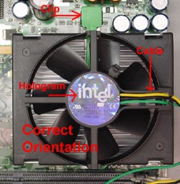
Install Heat Sink and Fan
Attach fan to heat sink if not already attached
Apply thin layer of compound to chip surface
Attach heat sink by placing squarely on top of processor and press down gently
Bend clips in place to hold sink
Make sure there is good contact between sink and Chip surface
Wipe off any excess compound
Plug power cord from fan to fan power pins on motherboard

Slide 12
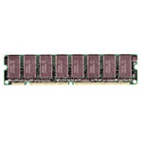
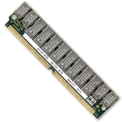
Install RAM
Two types memory modules used on most PC’s
  DIMM (168 pin, used on all current machines)
  SIMM (72 pin)
Look at motherboard map to determine which bank to place DIMM 1 module in
Orient the Dimm chip over the slot (keyed) and insert into slot
Lock in place by closing levers

Slide 13
Installing the Motherboard
Position case for easy access, locate holes on motherboard and corresponding holes on case
Insert spacers that came with motherboard into holes on case and install plastic standoffs into holes on motherboard
Carefully slide the board into the case, lining up holes
Tighten board to case with screws
Verify that the back of the motherboard is not touching the case, all slots and connectors line up properly, board is securely held in place, and board does not bend when pressed

Slide 14
Attaching LEDs, keylock and speaker
Use motherboard manual as a guide for proper placement
  Turbo LED (mainly legacy item)
  Power LED
  Hard drive activity LED
  Keylock switch (common with older systems, rare now; prevented BIOS meddling)
  PC speaker

Slide 15
Connect power supply cables
AT motherboard
  Locate two large wire leads from power supply (P8 and P9)
  Locate 12 pin power connector on motherboard
  Plug P8 and P9 into connector
  Be sure black wires are in the middle beside one another
ATX motherboard
  Attach the connector that is keyed to fit only one way into the motherboard connector

Slide 16
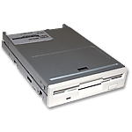
Attach the floppy drive
Select 3.5”drive bay, remove faceplate and insert drive into bay, ensuring fit and secure drive with screws
Attach power and ribbon cable (or save this step until later if cable will be in the way of installing other drives
Check your work

Slide 17
Attach hard drive and CD-ROM
Use separate IDE cables if possible and set both jumpers to Master (or single on the hard drive if available)
If sharing an IDE cable, set the hard drive to Master and the CD-ROM to slave
Install hard drive away from power supply which can act like a magnet and destroy data
Keep hard drive near front of case to benefit from air drawn into case and keep away from other hardware
Slide drive into selected drive rail and screw drive into place
Attach ribbon cable to the primary controller of the motherboard and attach power cord
Follow with CD-ROM installation and attach to secondary controller of the motherboard

Slide 18
Attaching ribbon cables
Usually, red stripe on cable indicates pin 1
Usually pin 1 on floppy data connectors is closest to the power connector
If two floppy drives are on one cable, drive A is configured on the end connector and drive B is configured on the middle connector. Drive A is used for just one floppy drive.
Floppy drive IDE is 34 pin
HDD and CD-ROM IDE cables are typically 40 pins

Slide 19
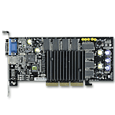
Installing a video card
Use AGP expansion slot if available, otherwise use PCI or ISA
Remove slot insert and insert video card by aligning pins and gently applying pressure
Secure to case with a screw
Some motherboards have built-in video. If you want to install an external card then you must disable the built in video in the CMOS
AGP VIDEO CARD

Slide 20
Post Assembly Checklist
All expansion cards are fully inserted
CPU fan is attached to power
The 110/220 volt switch is configured properly
Drives are connected to power
Ribbon cables are attached correctly
Fans are free from interference from wires
CPU voltage settings are correctly configured
Power switch is off and power supply connectors are connected properly to motherboard
All connections are tight
Pins are properly aligned
Close the case before booting
Connect keyboard, mouse and monitor and plug in AC power cord

Slide 21
Booting the system
BIOS = Basic Input Output System
  Embedded in ROM chip on motherboard
  Contains program code required to control all basic operating components of the system
    Contains software needed to test the hardware and load the O.S.

Slide 22
Entering the BIOS configuration
Follow the prompt early in the startup process (usually strike the “delete” key or “cntrl-alt-del”) to access the CMOS Setup utility.
Enter date and time
Set hard disks fields to “auto” to allow BIOS to auto detect and configure the hard drives
Make sure that the floppy drive and the video card are detected
Program Halt On to “all errors” so that error problems can be reported before they corrupt data.

Slide 23
BIOS and Chipset Features setup screens
BIOS Features
  Place where system hardware can be fine tuned for optimal performance
  Set up boot sequence
Chipset Features
  Auto Configuration should be set to “Enabled”

Slide 24
Power Management and PnP/PCI setup
Power Management
  Feature settings control the computer’s optional power management for devices
  Recommended to disable the choice “power management” as when enabled, devices can be put into sleep mode, but some software applications and OS may not recognize the devices in this mode
Plug n Play
  Default settings should be used when working on newer systems because any manual configurations require a good knowledge of the bus devices installed.
  If any conflicts occur, the “reset configuration data” feature will clear this portion of the BIOS setup and return it to defaults upon reboot

Slide 25
Integrated Peripherals and Fixed disk detection screens
Integrated Peripherals
  Includes devices such as floppy and hard drive controllers, USB controller, serial and parallel ports, sound card chip
  Set these features to “auto”to permit the BIOS to issue for example, the appropriate IDE drive commands to determine what mode the hard drives will support
Fixed Disk Detection
  In the event that the “Hard Disks AUTP setting” in the CMOS setup screen is not automatically detecting the hard drive’s geometry, the Fixed Disk Detection will allow the manual running of the IDE auto detection program and select the auto detection for each drive on the controller channel. The BIOS will scan and report drive parameters which can then be accepted or rejected.

Slide 26
Passwords screens and the load setup defaults screen
Passwords screens
  User password
    Allows the installation of a password that will keep the system from booting unless the password is entered
    Prevents access to the BIOS
  Supervisor password
    Usually found in large institutions
    Once set, the BIOS setups are locked with a master password
Load Setup Defaults Screen
  Resets the BIOS setup to default settings
  Will not affect the settings in the standard CMOS Setup screen
  Can be used when configuring the system for the first time and problems are encountered.

Slide 27
BIOS EXIT OPTIONS
Exit without saving setup
Save and exit setup
Computer will restart with new configuration

Slide 28
POST errors, troubleshooting
POST routine ensures that all the hardware the system needs for startup is there and that everything is functioning properly before the boot process begins
Post error codes take the form of a series of beeps that identify a faulty hardware component.
If the new system is functioning normally, one short beep will usually be heard at the completion of POST.

Slide 29
Troubleshooting POST continued
POST typically provides three types of output messages: audio codes (beeps), onscreen text messages, and hexadecimal numeric codes that are sent to an I/O port address.
POST generally continues past non-fatal problems, but fatal problems cause POST to halt the boot process. If problems occur early, before any drivers are loaded for the monitor, for example, then POST can only signal that a problem exists using beeps.
If the POST and the boot sequence can advance up to a point where the system can use the system video to display messages, then a message can be displayed on the screen. The message indicates what problems occurred and the probable cause. These are referred to as visual error codes. These error messages are usually in the form of a numeric code, for example, 1790-Disk 0 Error.

Slide 30
You’ve successfully assembled a computer
All the best on your unit exam!

