Slide 1
avast ! antivirus installation guide
Short guide for avast ! antivirus Home/Professional Edition
Start with initial steps to:
- downloading,
- installing,
- basic configuration (vps, program and connections),
- resident protection settings,
- insert license key,
- program start
_____________________________________________
For full advanced instruction including trubleshooting, please see our support web page www.mm-ptuj.si .
M&M doo www.mm-ptuj.si avast@mm-ptuj.si
avast ! is registered trademark of ALWIL Software a.s.

Slide 2
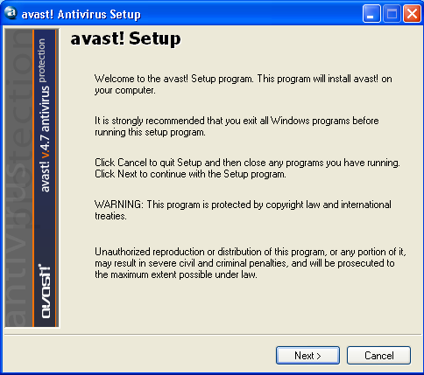

Slide 3
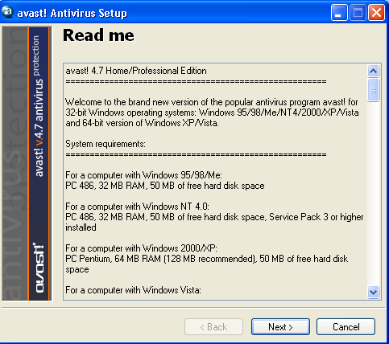

Slide 4
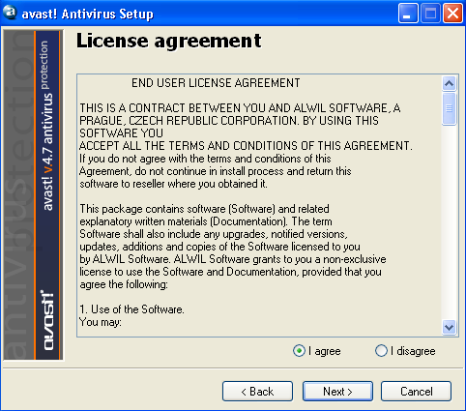

Slide 5
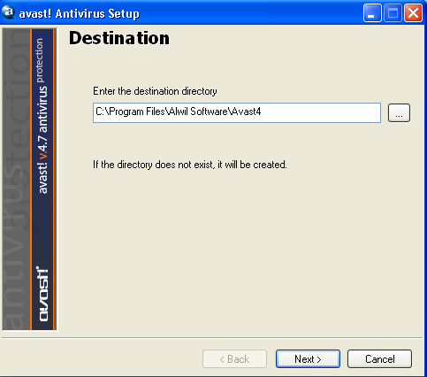

Slide 6
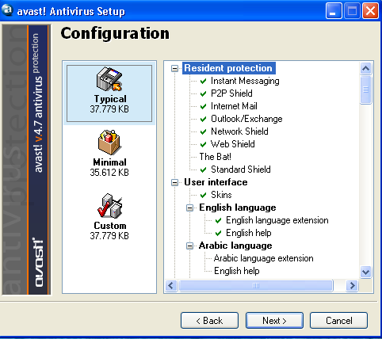

Slide 7
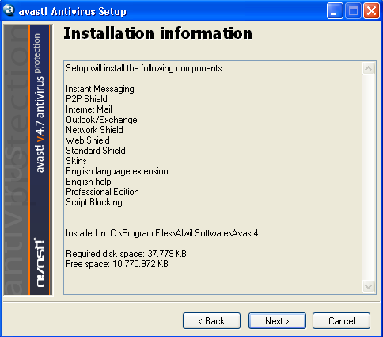

Slide 8
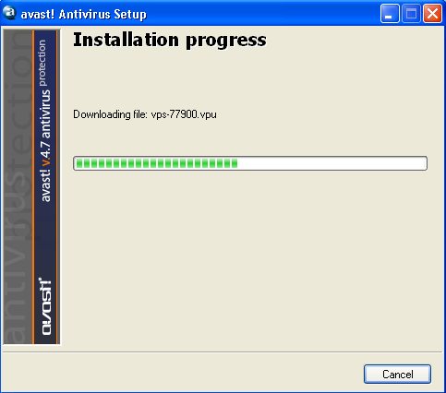

Slide 9
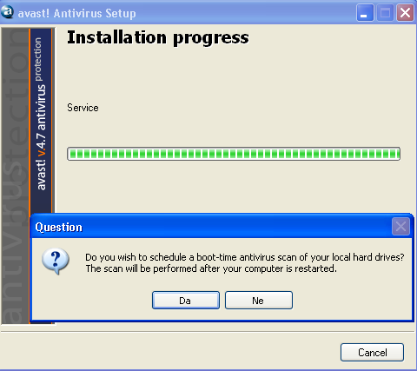

Slide 10
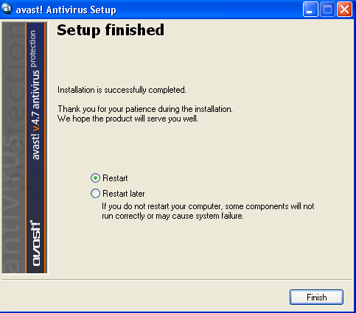

Slide 11
