Slide 1
COMPUTER HARDWARE

Slide 2
BASIC TERMS
Hardware
CPU
Peripheral
Input
Storage device
  Hard drive
  Floppy drive
  Flash drive, Jump drive, etc. – Plugs into a USB port and provides from 64 MB to 32 GB of storage
  Optical drive – includes CD and DVD drives
  Memory cards and memory card readers – Compact Flash (Types I and II), SmartMedia, Memory Stick and Memory Stick Pro, xD-Picture Card, Secure Digital, MultiMedia – Up to 8-16 GB of storage
  Most MP3 players
  Tape drive (several varieties)
  ZIP drive

Slide 3
BASIC TERMS (continued)
Bytes
  Byte – Stores the equivalent of one character.
  Kilobyte (1 KB) – 1,024 bytes.
  Megabyte (1 MB) – 1,048,576 bytes.
  Gigabyte (1 GB) – 1,073,741,824 bytes.
  Terabyte (1 TB) – 1,099,511,624,776 bytes.

Slide 4
Types of Computers
Microcomputer – PC and Apple Macintosh
Mainframe
Supercomputer

Slide 5
Components of a Typical PC
(Continued)
Computer Case (see Figure 1):
Monitor (sometimes referred to as the screen)
Speakers
Keyboard
Mouse
Modem

Slide 6
Computer Case (see Figure 1)
System board – Usually referred to as a mainboard or motherboard
Power supply – Converts AC to DC for components within case – Power supply averages between 200 and 400 watts. Fan inside power supply prevents overheating.
Storage controllers, of IDE, SCSI or other type, that control hard disk(s), floppy disk, Optical disk(s), and other drives. The controllers either are built into the mainboard or are on expansion cards
Interface controllers (parallel, serial, USB, Firewire) that connect the computer to external peripheral devices such as printers, scanners, and USB Jump/Flash/Travel drives.Expansion Board – Video (graphics) board, sound card, internal modem

Slide 7
Computer Case (see Figure 1)
CPU (microprocessor)
RAM – SDRAM or Rambus memory modules
Internal drives:
  Hard drive – 5 ¼” or 3 ½”
  Optical drive – CD+-R (i.e., CD-ROM), CD-RW, DVD+-(i.e., DVD-ROM), DVD-RW, or combination CD/DVD drive
  Floppy drive – 3 ½”

Slide 8
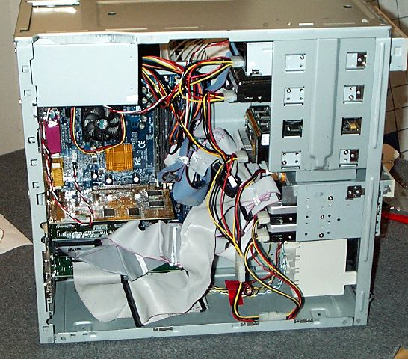
Figure 1
Inside a Computer Case
(Inside the Box)

Slide 9
Hardware Components on the System Board
(See Figures 2 and 3)
CPU (see CPU chip in Figure 15) and CPU Slot (see installation of CPU in slot in Figure 6)
Chipset
DIMM (or RIMM) memory module slots (see Figures 7 and 8)
  DIMM is an acronym for dual in-line memory module
  RIMM is an acronym for Rambus inline memory module
PCI expansion board slots
AGP graphics board slot
IDE – Two hard disk drive connectors
FDD – Floppy disk drive connector

Slide 10
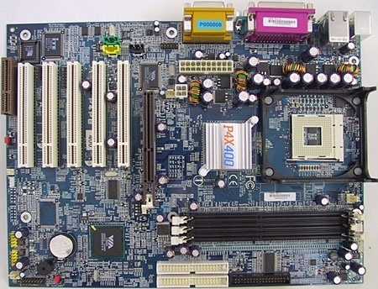
Figure 2
VIA P4PB 400 MAINBOARD

Slide 11
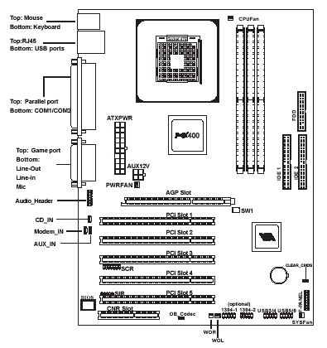
Figure 3
VIA P4PB 400 MAINBOARD
(Layout)

Slide 12
Hardware Components on the System Board (continued)
Connectors and ports (see Figures 3 and 4):
  Mouse connector (green)
  Keyboard connector (purple)
  Network port – frequently called an ethernet port, ethernet 10/100 connector, or RJ45 connector – The network or ethernet port is used for connection to a Local Area Network (LAN) or a cable modem.
  USB port connectors – For connecting many devices such as printers, digital cameras, digital video cameras, scanners, flash and jump drives, ZIP drives, external CD and DVD drives, etc.
  Parallel port connector – Primarily for connecting a printer to a computer (obsolete)
  Serial port connectors (obsolete)
  Video port connector – May be on an expansion board
  Game connector
  Audio port connectors (3) – Line-out, line-in, and Mic-in

Slide 13
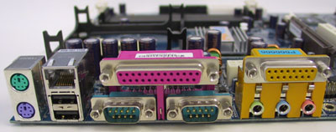
Figure 4
VIA P4PB 400 MAINBOARD
(Back Panel)

Slide 14
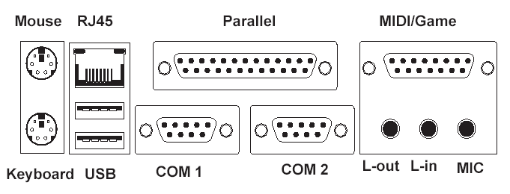
Figure 5
VIA P4PB 400 MAINBOARD
(Back Panel Layout)

Slide 15
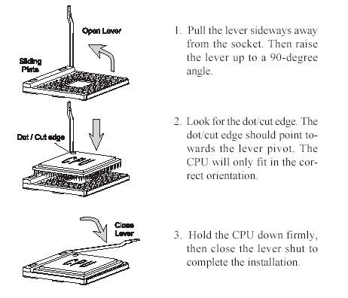
Figure 6
Installation of CPU in CPU Slot of Motherboard

Slide 16
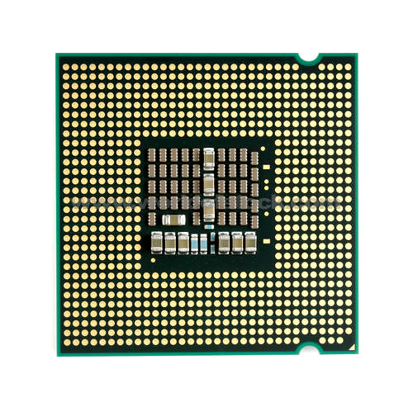
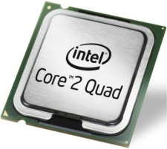
Figure 15
Top and Bottom Views of
Core 2 Quad Microprocessor

Slide 17
Computer Cases
Tower case – Minitower, Midtower, Full tower (see Figures 9 through 11)
  Power supply
  5 ¼” and 3 ½” drive bays (one or more of which may be internal only)
  Slots (openings) for PCI and AGP expansion boards
  Openings for mainboard’s ports and connectors
  Cooling fans
Desktop
Notebook (portable)

Slide 18
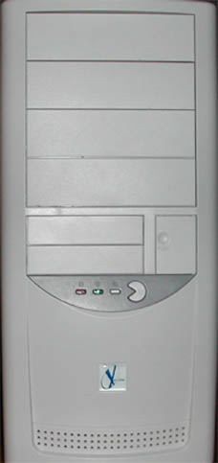
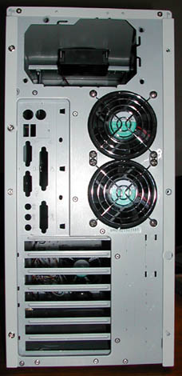
Figure 9 & Figure 10
Computer Case Front & Rear

Slide 19
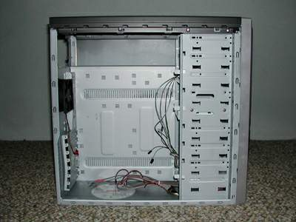
Figure 11
Computer Case
(Open & Empty)

Slide 20
Expansion Boards – Enable Upgrading or Expansion of a Computer’s Capabilities
Expansion boards are printed circuit boards that you can insert into a computer’s expansion slot to allow you to upgrade or expand the capabilities of a computer.
Type of expansion boards include:
  Video adapter – Called a graphics board (see Figures 12 through 14)
  Sound card
  Modem (internal modem)
  Network interface board – This capability may be built into the mainboard. If so, it is used in lieu of a network expansion board for connection to a Local Area Network (LAN) or a cable modem.

Slide 21
Graphics Board
Not all computers have a graphics board. Sometimes the graphics capability is built into the motherboard.
Can include its own processor.
Can include its own memory of 16MB, 32MB, 64MB, 128MB, 256, 512, or 640 MB or 1 GB of RAM.
If it does not include its own memory, then it shares RAM on the motherboard with the CPU.
AGP (Accelerated graphics port) graphics board – Displays 3D images faster
PCI Express – Displays images even faster than AGP

Slide 22
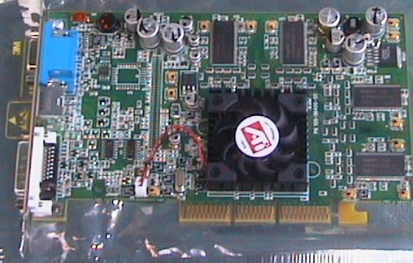
Figure 12
Video Graphics Board

Slide 23
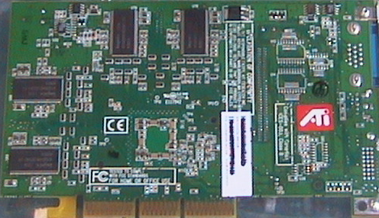
Figure 13
Video Graphics Board

Slide 24
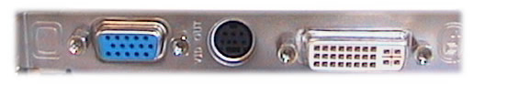
Figure 14
Video Graphics Board
Connectors

Slide 25
Printer Resolution
Most printers print the same number of dots horizontally and vertically, though some may have differing numbers.
Basically, 9600-by-2400 dpi printers print 9600 tiny little dots across one inch and 2400 dots vertically for one inch.
The higher the resolution (i.e., the more dots per inch), the higher the quality of the printed page.

Slide 26
Types of Printers
Inkjet and Photo Printers– Relatively high resolution upwards of 4,800 or more DPI)
  Can be slow – sometimes ink can smear.
  Photo inkjet printers can produce photos on special glossy photo paper.
  May have installed memory of up to 64 MB.
Laser printer – High resolution (600 to 9,600 DPI), fast speed.
  Cost relatively low for monochrome
  Cost relatively high for color
  Will have installed memory up to 1 GB.
Multifunction printers – Fax, printer, copier, and scanner in one device.
Dot-matrix printer – Very slow. Useful for printing multipart forms.

Slide 27
Monitor
Type – Either a picture tube or flat-panel screen.
Size:
  14”, 15”, 17”, 19”, 21”, 22”, 23”, 24”, or 26”
  The size of the monitor refers to the diagonal measurement of picture tube inside monitor and, for picture tube monitors, is typically greater than actual viewing area. For example, the typical viewing area of a 17” monitor is 15.9”.
  For flat-panel screen monitors, the size is usually very close to the actual viewing area.
Dot Pitch – The smaller the dot pitch, the higher the resolution. Select a monitor with a dot pitch of 0.28 mm or less (preferably 0.26 mm or less).
Refresh rate – How many times per second the monitor redraws the entire screen. The faster the better. Select a monitor with a refresh rate of 72 Hz or more.
Energy Star – Monitor and computer sleep when not in use for a period of time.

Slide 28
Monitor and
Graphics Board
Resolution – The higher the resolution, the clearer the characters and images on the screen and the more characters that appear on the screen. But the characters are smaller on the screen. Higher resolutions require larger screen sizes:
  640 x 480 (VGA)
  800 x 600 (SVGA)– most web sites are designed to display at this resolution
  1,024 x 768 (XGA)
  1,280 x 1,024 (SXGA)
  1,600 x 1,200 (UGA)
  1,920 x 1,200
  2,048 x 1,536

Slide 29
Monitor and Graphics Board
(continued)
Color depth – Most recently developed programs require 256 colors or more:
  16 colors – (4-bit color)
  256 colors (8-bit color)
  65,636 colors (16-bit color)
  1,677,216 colors (24-bit color)
  16,777,216 (32-bit color)

Slide 30
Connections to Internet
Kbps – Refers to the data transfer rate in kilobits per Second – Figure Kbps as approximately 128 bytes per second.
Dial-Up Modem:
  Internal vs. external
  Up to 56 Kbps receive, 33.6 Kbps send
ISDN – 56 Kbps to 128 Kbps
DSL (digital line service) and cable company modems:
  DSL - phone companies – Up to 256Kbps to 15 Mbps receive; 128Kbps to 384 Kbps send, depending upon the residential plan (BellSouth).
  Above is also true of cable company internet services.

Slide 31
Connections to Internet
(continued)
WI-FI:
  High speed wireless networks provide connection to the Internet.
  This wireless technology is referred to as IEEE 802.11 (a, b, g, n) architecture.
  Transmission speed ranges from 11 megabits per second to 108 megabits per second.
  Can transmit and receive within 50 to 300 feet inside a building to several hundred feet outside.

Slide 32
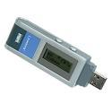
Wireless WIFI USB Adapter
One of Three Types of Wireless Adapters

Slide 33
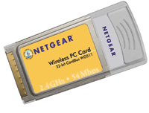
Wireless PC Card $39.99
One of Three Types of Wireless Adapters
Fits PCMIA Card Slot on Notebook
(PCMCIA cards - Personal Computer Memory Card International
Association)

Slide 34
Memory
Types:
  RAM
  ROM – Read-only
RAM (Random Access Memory) Size
  For Core 2 Quad computers, 2 GB to 8GB, depending upon the motherboard.
  For use with Windows XP – Preferably 512MB
  For use with Windows Vista – Preferable 2 to 4 GB
Virtual memory – Computer uses part of hard drive when it runs out of RAM memory

Slide 35
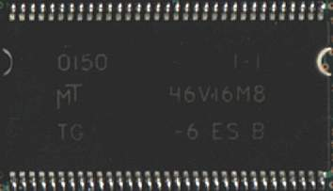
Figure 7
Memory Chip

Slide 36
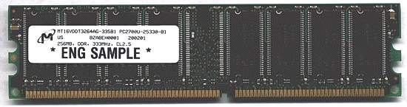
Figure 8
DIMM Memory Module

Slide 37
Types of RAM
SDRAM – Synchronous Dynamic Random Access Memory – 200 MHz.
DDR SDRAM – Double-Data-Rate SDRAM – Effectively doubles the speed of SDRAM up to 400 MHz.
DDR2 SDRAM – high-performance DDR SDRAM memory. As compared with its predecessor, DDR-SDRAM, DDR2-SDRAM offers greater density in a smaller package along with a reduction in power consumption. In addition DDR2-SDRAM offers new features and functions that enable higher a clock speed of 533 MHz, 667, 800 MHz, and above. DDR2-SDRAM memory is not compatible with current DDR-SDRAM memory slots.
RDRAM – Rambus Dynamic Random Access Memory) – a type of memory (DRAM) developed by Rambus, Inc. Whereas the fastest current SDRAM and DDR SDRAM memory technologies used by PCs can deliver data at maximum speeds of about 200 MHz and 400 MHz, respectively; RDRAM transfers data at up to 800 MHz.

Slide 38
Figure 15
Top and Bottom Views of
Core 2 Quad Microprocessor

Slide 39

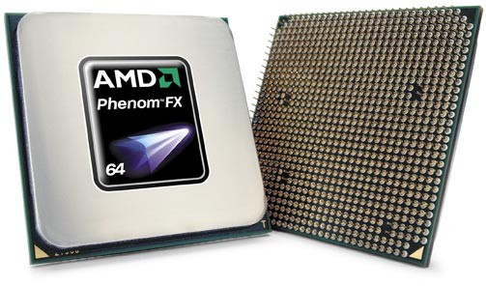
Figure 16
Top and Bottom Views of Phenom 9600 CPU
(a Quad-Core Microprocessor)

Slide 40
CPU - Intel
Core 2 Quad – Quad-core processors that incorporate four processors and four L2 memory caches into one piece of silicon (i.e., a single chip, functioning, in theory, like four separate CPUs (central processing units).
Core 2 – Dual-core processors that incorporate two processors and two L2 memory caches or four processors and four L2 memory caches into one piece of silicon functioning, in theory, like two or four separate CPUs.
Pentium M – For notebook computers:
  Up to 2.26 GHz
  Latest CPU architecture for notebook computers and component of Intel’s Centrino™ Mobile Technology
Pentium IV – Single chip version now obsolete.
Celeron (crippled version of Pentium II) – Up to 3.46. GHz
P4 – For network servers

Slide 41
CPU - AMD
Phenom 9600 – Quad-core processor - Up to 2.3 GHz
Athlon 64 X2 – Up to 3.0 GHz - Dual-core processors that incorporate two processors and two L2 memory caches and are aimed at users running software that's designed to take advantage of the two cores and users performing multiple tasks simultaneously.
Athlon 64 – 64-bit processor – Up to 2.4 GHz
Mobile Athlon 64 – 64-bit processor for notebook computers
Sempron – Budget line of AMD microprocessors to compete with Intel Celeron
Opteron – For network servers – Up to 2.6 GHz

Slide 42
CPU Clock Speed and Power
MHz and GHz – A microprocessor’s (CPU) or component’s clock speed:
  Mhz – An abbreviation for megahertz. One MHz represents one million cycles per second.
  GHz – An abbreviation for gigahertz. One GHz represents one billion cycles per second.
The speed of CPUs, called the clock speed, is measured in gigahertz and megahertz.
  For example, a CPU that runs at 3.2 GHz executes 3.2 billion cycles per second.
  Each computer instruction requires a fixed number of cycles, so the clock speed determines how many instructions per second the CPU can execute.
  To a large degree, this controls how powerful the CPU and hence a PC is.
  Clock speeds of different CPUs can only be compared within a specific architecture of CPUs.
Another chief factor in determining a CPU's power is its data width (that is, how many bits it can manipulate at one time). For example, a 64-bit CPU is more powerful than a 32-bit CPU.

Slide 43
Multiple processors and
Multiprocessing
As noted in the material on Computer Software, the ability to process instructions simultaneously on multiple processors is referred to as multiprocessing.
Windows 2000, Windows XP Professional, and Windows Vista support the processing of instructions on two or four processors simultaneously, whether the two processors are on separate chips or on a single chip like the Intel or AMD Core 2 Duo or Quad-Core microprocessors.
Dual-core and Quad-core microprocessors perform like two or four processors, each of which can run instructions in parallel, independent of the other, and each of which can access system resources independently. By multiplying the number of cores in a microprocessor, Intel and AMD dramatically increase a PC's capabilities and computing power. However, these processors are still single microprocessors according to most definitions, which view a microprocessor as a single chip that fits into a single socket.

Slide 44
SOCKETS
Pentium II, Pentium III, Pentium 4, Core-2 Duo, and Quad-core processors all require different sockets
Sometimes there are variations within processor families.
  For example, the first Pentium 4 came out for Socket 423, which Intel from day one determined would have a life span of no more than a few months.
  Today all Pentium 4 systems have Socket 478, which is incompatible with many previous Pentium 4 CPUs.

Slide 45
AMD CPU Prices - Week of August 17, 2009
(http://www.sharkyextreme.com/guides/WCPG)
CPU Type Price
Athlon 64 X2 5400+ (2.8GHz/AM2 - Retail) $67
Phenom X3 8650 (2.3GHz/AM2+ - Retail) $84
Phenom X3 8750 (2.4GHz/AM2+ - Retail) $88
Phenom X4 9650 (2.3GHz/AM2+ - Retail) $110
Phenom X4 9850 (2.5GHz/AM2+ - Retail) $118
Phenom X4 9950 (2.6GHz/AM2+ - Retail) $129
Phenom II X3 710 (2.6GHz - Retail) $110
Phenom II X3 720 (2.8GHz - Retail) $119
Phenom II X4 810 (2.6GHz - Retail) $139
Phenom II X4 940 (3.0GHz - Retail) $180
Phenom II X4 945 (3.0GHz - Retail) $168
Phenom II X4 955 (3.2GHz - Retail) $199

Slide 46
Intel CPU Prices - Week of August 17, 2009
(http://www.sharkyextreme.com/guides/WCPG)
CPU Type Price
Celeron E1400 2.0GHz LGA775 $54
Celeron E1500 2.2GHz LGA775 $44
Celeron E1600 2.4GHz LGA775 $62
Core 2 Duo E7400 2.8GHz/1066 LGA775 (Retail) $110
Core 2 Duo E8400 3.0GHz/1333 LGA775 (Retail) $168
Core 2 Duo E8500 3.16GHz/1333 LGA775 (Retail) $185
Core 2 Duo E8600 3.33GHz/1333 LGA775 (Retail) $270
Core 2 Quad Q8200 2.33GHz/1333 LGA775 (Retail) $150
Core 2 Quad Q8300 2.5GHz/1333 LGA775 (Retail) $169
Core 2 Quad Q8400 2.66GHz/1333 LGA775 (Retail) $165
Core 2 Quad Q9400 2.66GHz/1333 LGA775 (Retail) $185
Core 2 Quad Q9550 2.83GHz/1333 LGA775 (Retail) $218
Core 2 Quad Q9650 3.0GHz/1333 LGA775 (Retail) $319
Core i7 920 2.66GHz LGA1366 (Retail) $279
Core i7 940 2.93GHz LGA1366 (Retail) $550
Core i7 950 3.06GHz LGA1366 (Retail) $556
Core i7 Extreme 975 3.33GHz LGA1366 (Retail) $990

Slide 47
Cache
High speed memory, much higher speed than RAM memory, that greatly speeds up a computer’s operations.
Without cache, most processors would be limited in speed by RAM memory.
Cache is split up into 2 different levels:
  L1
  L2

Slide 48
L1 Cache
L1 – The first level, L1, is built in the CPU core.
L1 Cache is split into two parts.
  The first part stores commonly used data;
  the second part stores common instructions that the processor carries out on the data.
Depending upon the CPU chip, the L1 cache ranges upwards of 20 KB.

Slide 49
L2 Cache
L2 – The second level of cache, called L2, is for data only. Some L2 Caches are on the mainboard. Newer L2 Caches are in the CPU core, along with the L1 cache. Intel has been increasing L2 cache sizes on a number of CPUs from 1MB to 2 MB.
  On Quad-Core processors, the l2 cache is 2 or 3MB per processor
  the Dual-core processors, the L2 cache is 1 or 2MB per processor.
  On the 2.8 to 3.8 GHz Pentium IV Prescott series (obsolete), the L2 cache is 1 MB.
  On a 2.8 to 3.2 GHz Pentium IV Northwood series (obsolete ), the L2 cache is 512KB.
  On 1.5 to 1.9 GHz Pentium IV CPUs Willamette series (obsolete ), the L2 cache is 256 KB.

Slide 50
System Bus
(see Figure 17)
The bus is the main communication avenue in a PC.
  In simple terms, the bus is the primary data traffic lane from the CPU to all key subsystems.
  The bus can send data in either direction between any two system devices.
  For example, a 16-bit bus transfers two bytes at a time over 16 wires; a 32-bit bus transfers four bytes at a time over 32 wires.
  As this data travels outside of the CPU and through the main memory bus to other devices, it will adjust to the lower bus speeds (e.g. 66 or 100MHz).
  Where the data lives and then travels to will affect the overall work speed. In short, there are different speeds for different subsystems, yet they all need to work as one unit.

Slide 51
System Bus
(Continued)
(see Figure 17)
Memory bus – 32-bit to 64-bit
Expansion board bus:
  ISA bus – no longer around
  PCI bus – 32-bit to 64-bit – 66 MHz
  AGP bus – 32-bit to 64-bit – 66 MHz
  PCI Express bus – 64-bit – 66 MHz
  Hybrid – PCI and AGP

Slide 52
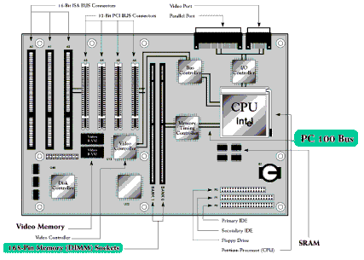
Figure 17
Layout of Motherboard and Busses

Slide 53
Storage Devices
Floppy Drive – 1.44 MB (now largely obsolete)
Hard Drive (see Figures 18 through 22):
Optical Drives:
  CD Drives (becoming largely obsolete because most DVD drives can also read CDs):
    CD+-R Drive – Can read 650 MB CD-ROM disk and play audio CDs.
    CD-RW Drives – 650 MB – Backup and Archive
  DVD Drives:
    DVD+-R Drive - Can read 4.7 GB DVD-ROM disks.
    DVD-RW – Backup and Archive – 4.7 GB

Slide 54
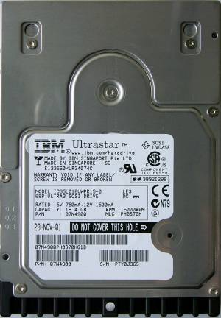
Figure 18
Hard Drive
(Top)

Slide 55
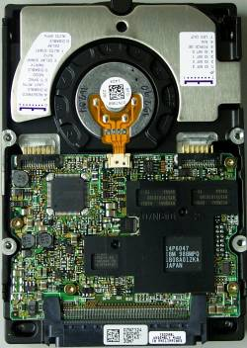
Figure 19
Hard Drive
(Bottom)

Slide 56
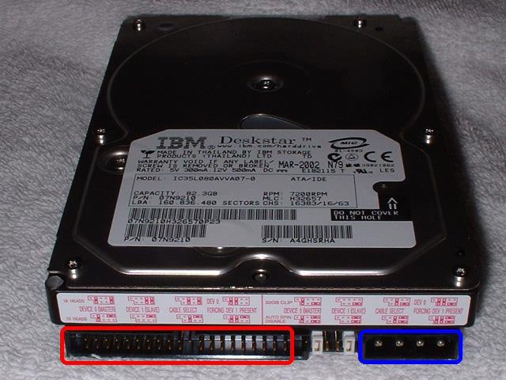
Figure 20
Hard Drive
(Rear Connectors & Jumper Pins)

Slide 57
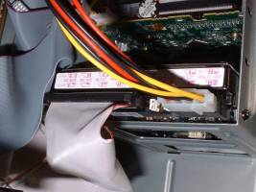
Figure 21
Data Cable and Power Cable
Connected to Hard Drive

Slide 58
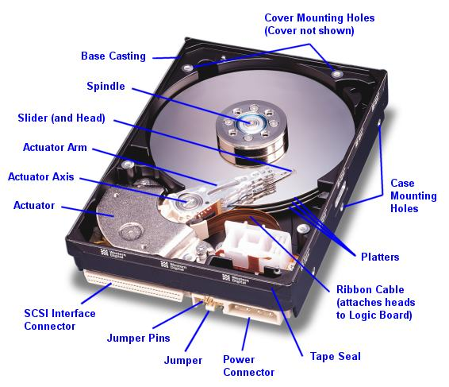
Figure 22
Hard Drive
(Cutaway View)

Slide 59
Storage Devices (continued)
Flash and jump drives
  Small portable pen or keychain size devices that store from 64 MB to 32 GB
  Completely electronic and plug into USB ports
  Ideal for transferring files between computers
  I view these as the ultimate storage media today for data on the go.
  Small portable pen or keychain size devices that store from 64 MB to 32 GB. Cost ranges after rebate from as low as $5-8 for a 2 GB drive, $8-$10 for a 4 GB drive, $18-20 for a 8 GB drive, $15 to $25 for a 16 GB drive, and $54 to $60 for a 32 GB drive.
Memory Cards:
  Compact Flash, SmartMedia, Memory Stick, Secure Digital, MultiMedia
  Depending upon the card, upwards of 16 Gigabytes of storage

Slide 60
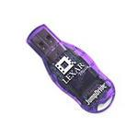


Flash and Jump Drives

Slide 61
Storage Devices (continued)
External Hard Drives and Portable Hard Drives (see Figures 23 and 24)
  Plug into USB or Firewire ports
  Enable users to:
    Easily and quickly back up internal hard drives
    Easily expand storage capacity without opening up a computer case
    Share data with other computers, such as home and office computers
  External hard drives are generally heavier, bulkier, and less shock resistant than portable hard drives. Portable hard drives are ruggedly built and pocket size, whereas external hard drives are not.
  External hard drives offer substantial greater storage capacities (upwards of two terabytes) than portable hard drives (generally 200 gigabytes or less)
  External hard drives usually require a power cord whereas portable hard drives generally get their power from a USB or Firewire port.

Slide 62
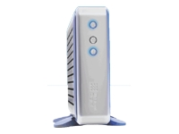
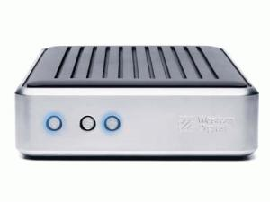
Figure 23
Western Digital
External Hard Drive

Slide 63
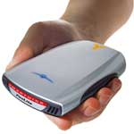
Figure 24
SmartDisk® FireLite
External Portable 60GB Hard Drive

Slide 64
Storage Devices (continued)
Removable Storage Devices (All are largely obsolete)
  Iomega Jazz Drive – Up to 2 GB
  Iomega ZIP Drive – Up to 750 MB
  LS-120 (SuperDisk) Drive – Up to 120 MB, but can also read a floppy disk.
Tape Drives
  QIC - obsolete
  Travan – TR-1, TR-2, …, TR-5, Travan-20 – Up to 40 GB (compressed data; uncompressed is about ½ of compressed)
  DAT drive – Up to 72 GB
    Drive prices range from slightly under $1,000 to about $1,500.
    DAT tape cartridges cost approximately $20 per cartridge

Slide 65
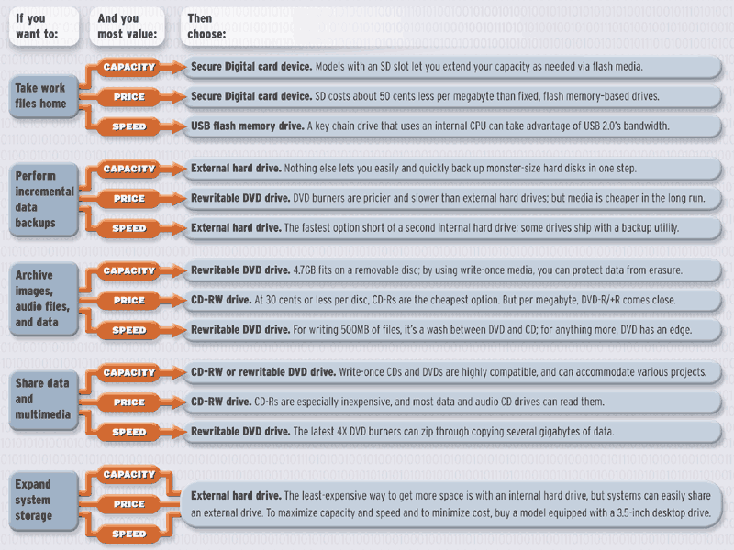
Figure 17
Type of Storage Devices

Slide 66
How do you make a PC faster? www.devx.com/amd/Article/26686
Traditionally, systems developers have focused on improving three aspects of a PC to improve performance: clock speed, I/O and memory bus speed, cache size, and data width.
The faster the microprocessor’s clock speed, the more processes can be handled each second; this represents a somewhat linear improvement—double the clock speed , and you double throughput, up to the limits of the I/O and memory bus, which can become bottlenecks. While clock speeds on new processors will continue to increase, and we'll also see continued improvements in bus speed and bus design.

Slide 67
How do you make a PC faster? www.devx.com/amd/Article/26686
System performance can also be improved through better caching mechanisms. Most microprocessors these days have a L2 cache as their primary on-chip caching mechanism; low-end processors have about 128K or 256K in their L2 cache, while higher-end systems have 1MB or 2MB L2 caches. While more cache is generally better, the improvement is definitely not linear: Doubling cache only adds a small amount to the overall chip performance, but raises the cost significantly. There is also a diminishing return, as there is not much benefit from exceeding 2MB L2 cache.

Slide 68
How do you make a PC faster? www.devx.com/amd/Article/26686
Traditionally, systems developers have focused on improving four aspects of a PC to improve performance:
  clock speed
  I/O and memory bus speed
  cache size
  data width of the processor
    The more bits a processor can manipulate at one time, the more powerful the performance of the CPU.
    For example, a 64-bit CPU is more powerful than a 32-bit CPU.
    Most of Intel’s and AMD CPUs are 64-bit processors.
    To take advantage of the increased performance of 64-bit processors, Microsoft developed a 64-bit version of Windows XP Professional and Windows Vista.

Slide 69
Now there is a fifth aspect of improving a PCs
Add more processors
  Many servers, some high-end desktops, and workstations use dual-core processors that incorporate two processors on a single chip.
  A dual-core processor or a quad-core processor system can give nearly twice or four times the performance of a single-CPU PC when running certain applications.
    The Pentium Quad-Core is a quad-core processor
    The Pentium Core 2 is a dual-core processor.
    The Athlon 64 X2 CPUs are AMD’s dual-core processors and the Ph.oenom is a quad-core processor.

Slide 70
Improving a PC’s Performance
Possible routes to improving PC’s performance include increasing:
  Processor clock speed,
  Data width,
  Number of processors,
  Cache size, and
  I/O and memory bus speed,
However, to take advantage of some of these performance enhancement routes, new operating systems and new applications had to be developed.

