Slide 1
Holy Family STEM
December 16, 2016

Slide 2
Agenda
Review of last week’s accomplishments
Rube Goldberg devices: automated
Trestles
3 weeks to get it done
Today’s focus

Slide 3
Accomplishments: Dec 2
Number of tennis balls: 4
Basic framework to open bible discovered
Motor selected
Ramps proved out on small scale

Slide 4
Automation
Rube Goldberg devices are automated
Per Rube Goldberg rules: no touching the machine after initial trigger
Each step in the machine must be automatic

Slide 5
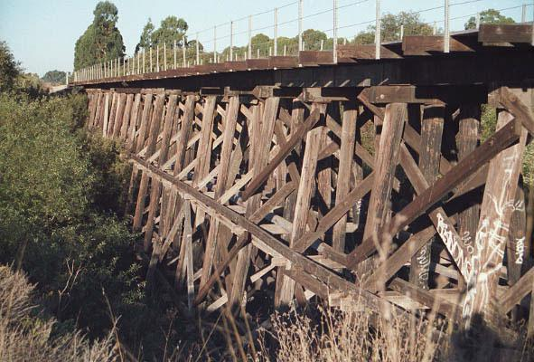
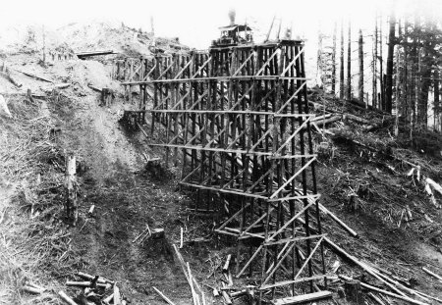
Trestles
What are they
We need them

Slide 6
Today’s Build
Team 1: Build trestle for ramp: 3 feet high
Team 2: Build container with tip mechanism
Team 3: Build container
Team 4: Build support to hold the page opener

Slide 7
Dec 16 Accomplishments
Team 1: Ramp at distance
Team 2: Great tower with triangle bracing
Team 3: Full ramp in process.
Team 4: Reduced the number of tennis balls needed

