Slide 1
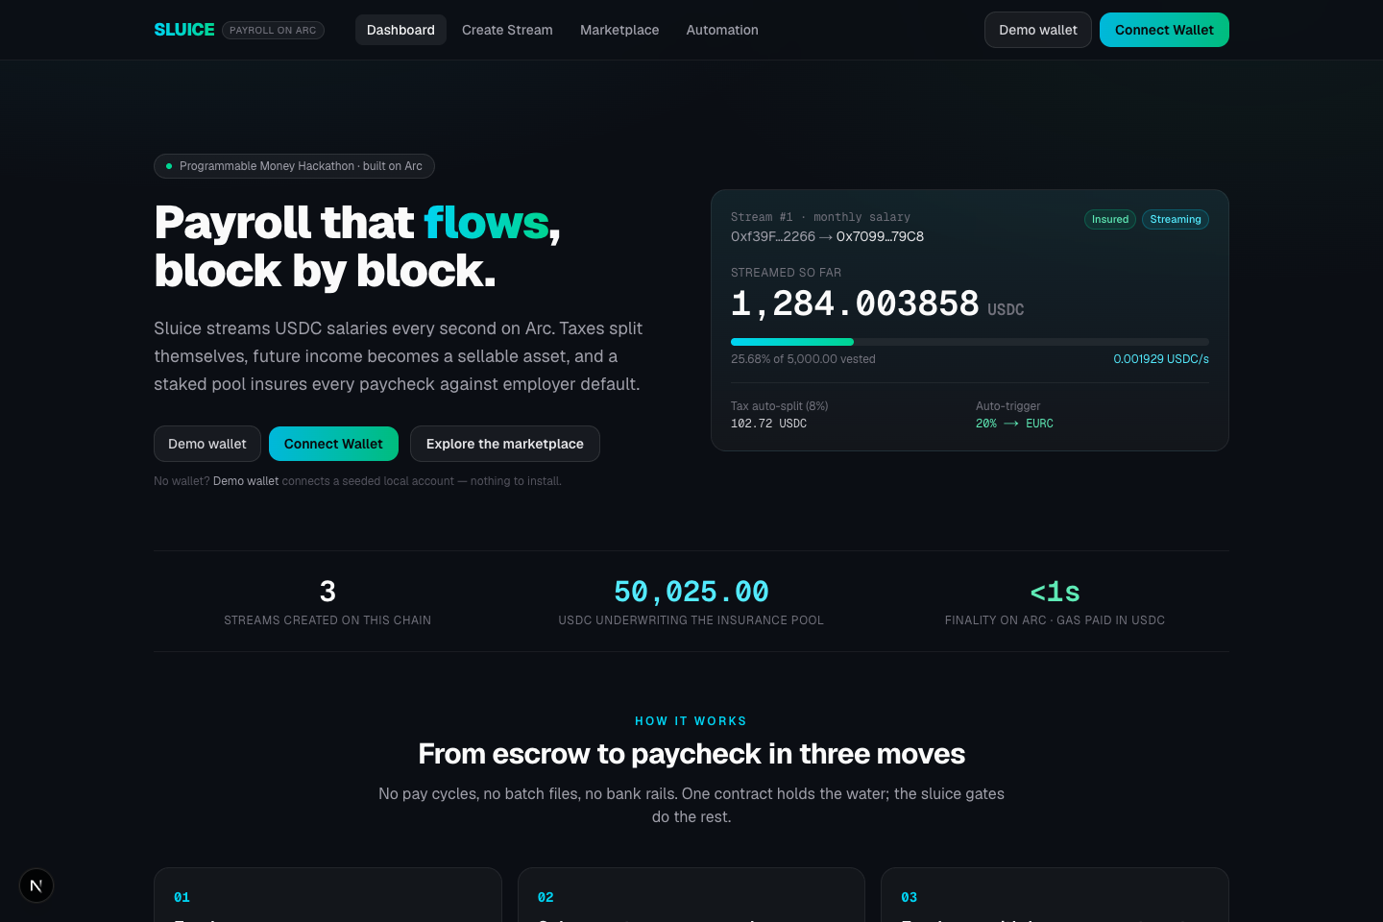
SLUICE
Payroll that flows,
block by block.
Streaming USDC salaries on Arc — tax splits itself, income becomes a liquid asset, and idle escrow earns yield across chains.
Programmable Money Hackathon · DeFi Track · github.com/mrnetwork0001/Sluice

Slide 2
THE PROBLEM
Payroll is a batch job from the 1970s
→ Workers deliver value every second — but get paid every 30 days
→ Between pay runs, employees are their employer's unsecured creditors
→ Tax withholding is manual back-office work, reconciled after the fact
→ Payroll escrow sits idle — the largest dead capital pool in any company
→ Future income is real value that workers cannot access or trade

Slide 3
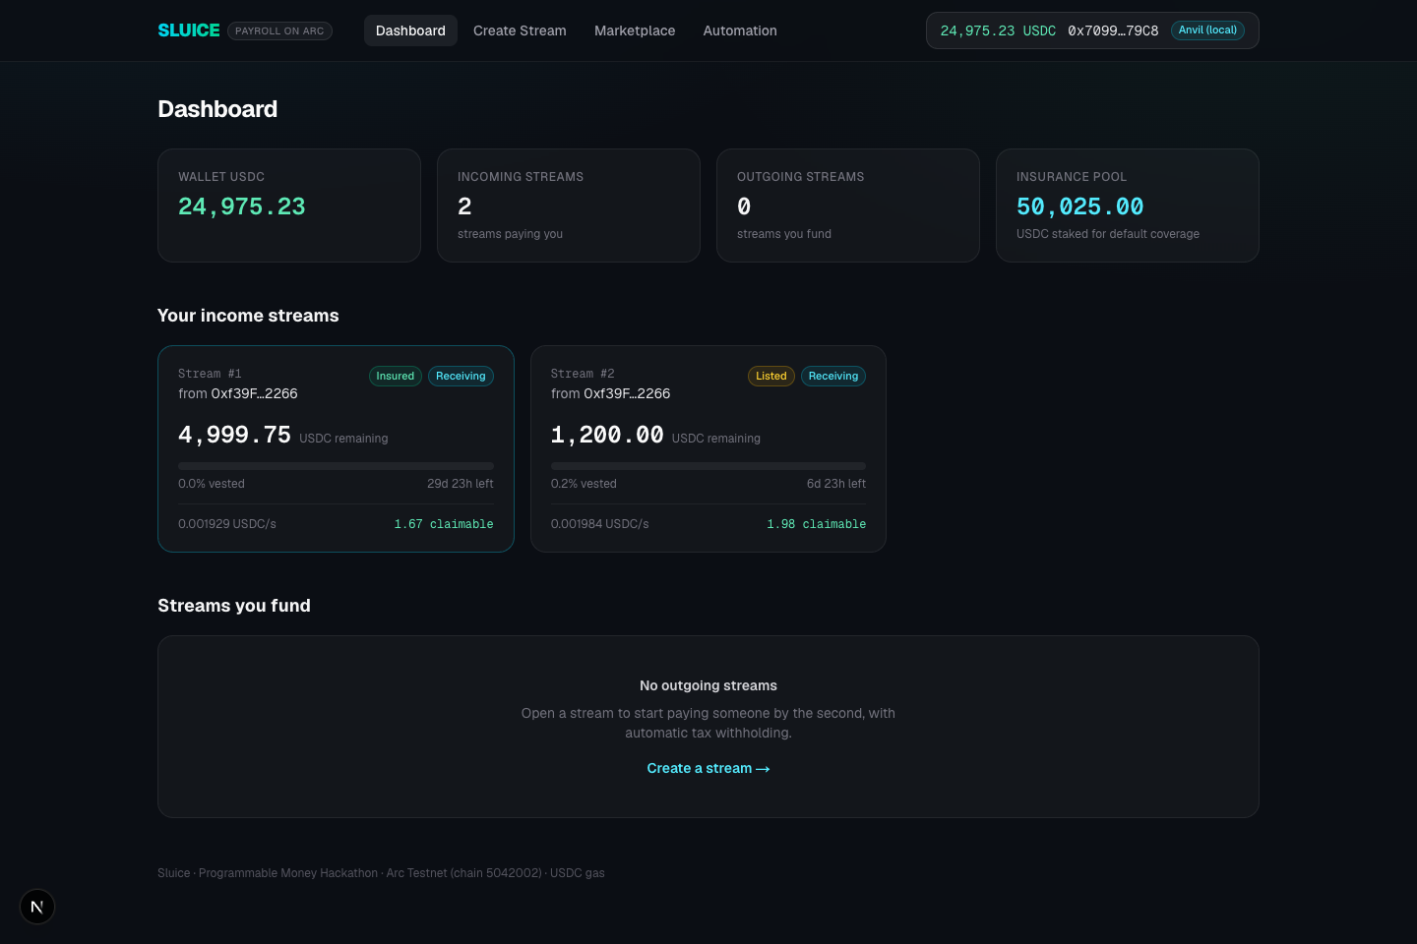
THE SOLUTION
Salary as programmable money
Employer escrows USDC once → salary vests every second on Arc
Tax splits itself — configured bps route to a tax vault on every withdrawal
Income is an asset — each stream is an ERC-3525 token: split, sell, borrow, insure
Escrow works — idle payroll routes to cross-chain yield, recalled on demand
Native rails — Arc L1: USDC gas, sub-second finality

Slide 4
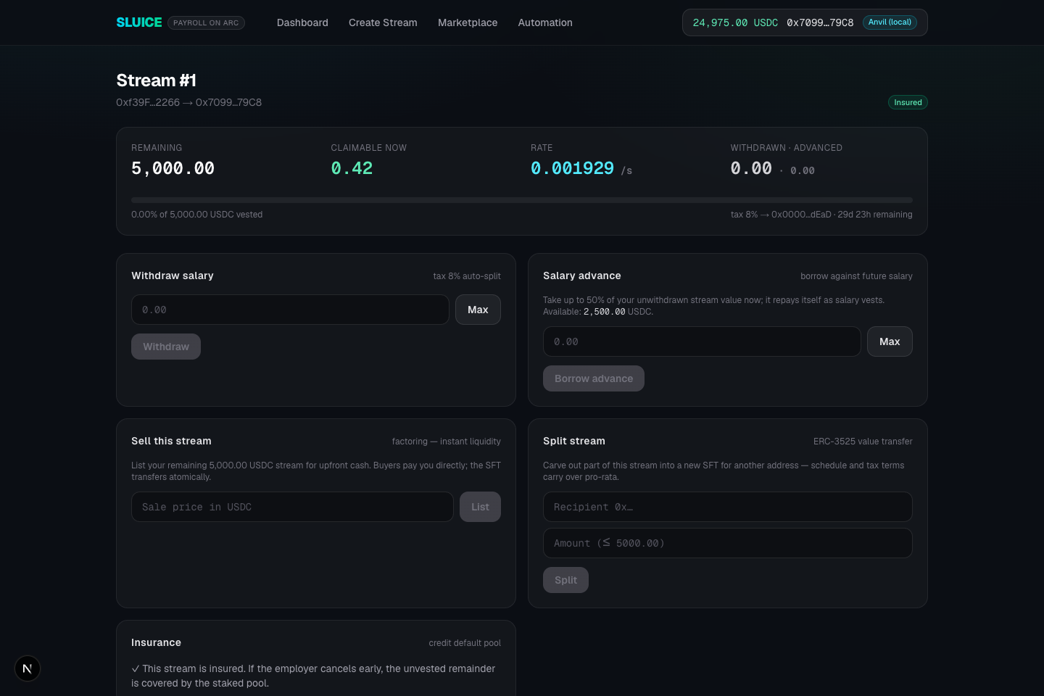
HOW IT WORKS
Three moves, one contract
01
Escrow once
Employer funds a stream: amount, duration, tax bps, tax vault
02
Vest per second
Employee holds an ERC-3525 SFT whose value = USDC left to stream
03
Withdraw — or automate
Tax routes itself; Swap Kit rules convert each paycheck

Slide 5
ERC-3525 STREAMS
Every salary is a semi-fungible token
Value = money — token value equals the remaining streamable USDC; the stream IS the asset
Split — carve part of your salary to another address; schedule carries pro-rata
Merge & transfer — same-schedule streams combine; whole streams change hands
Composable — standard rails, works with any protocol that speaks tokens
transferFrom(
streamId, to, value
) → new stream SFT

Slide 6
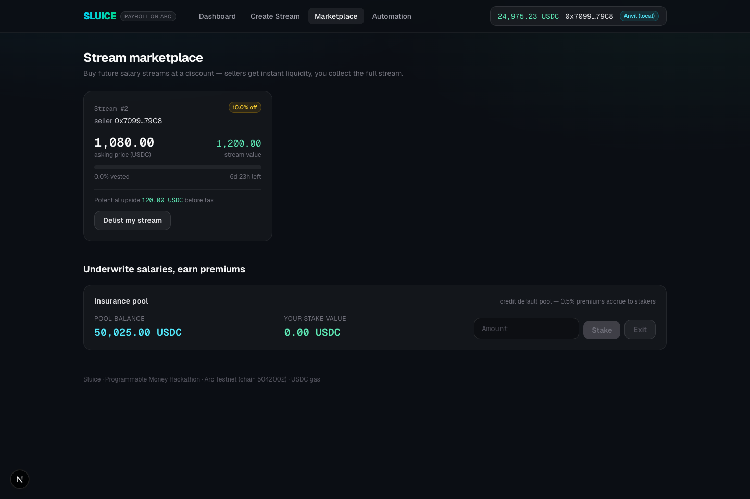
INSTANT LIQUIDITY
Need cash before payday?
P2P marketplace — list future income at a discount; an LP pays today and collects the full stream. SFT + payment settle atomically.
Salary advances — borrow up to 50% of unwithdrawn value. Zero interest, zero liquidations — the advance repays itself as salary vests.

Slide 7
SELF-INSURED SALARIES
A credit-default pool for payroll
0.5% once — employee pays a one-time premium; the stream is insured
Default covered — employer cancels early? The unvested remainder is claimable from the pool
Staker-underwritten — USDC stakers back the pool and earn every premium (share-based)
Live demo pool — 50,000+ USDC staked

Slide 8
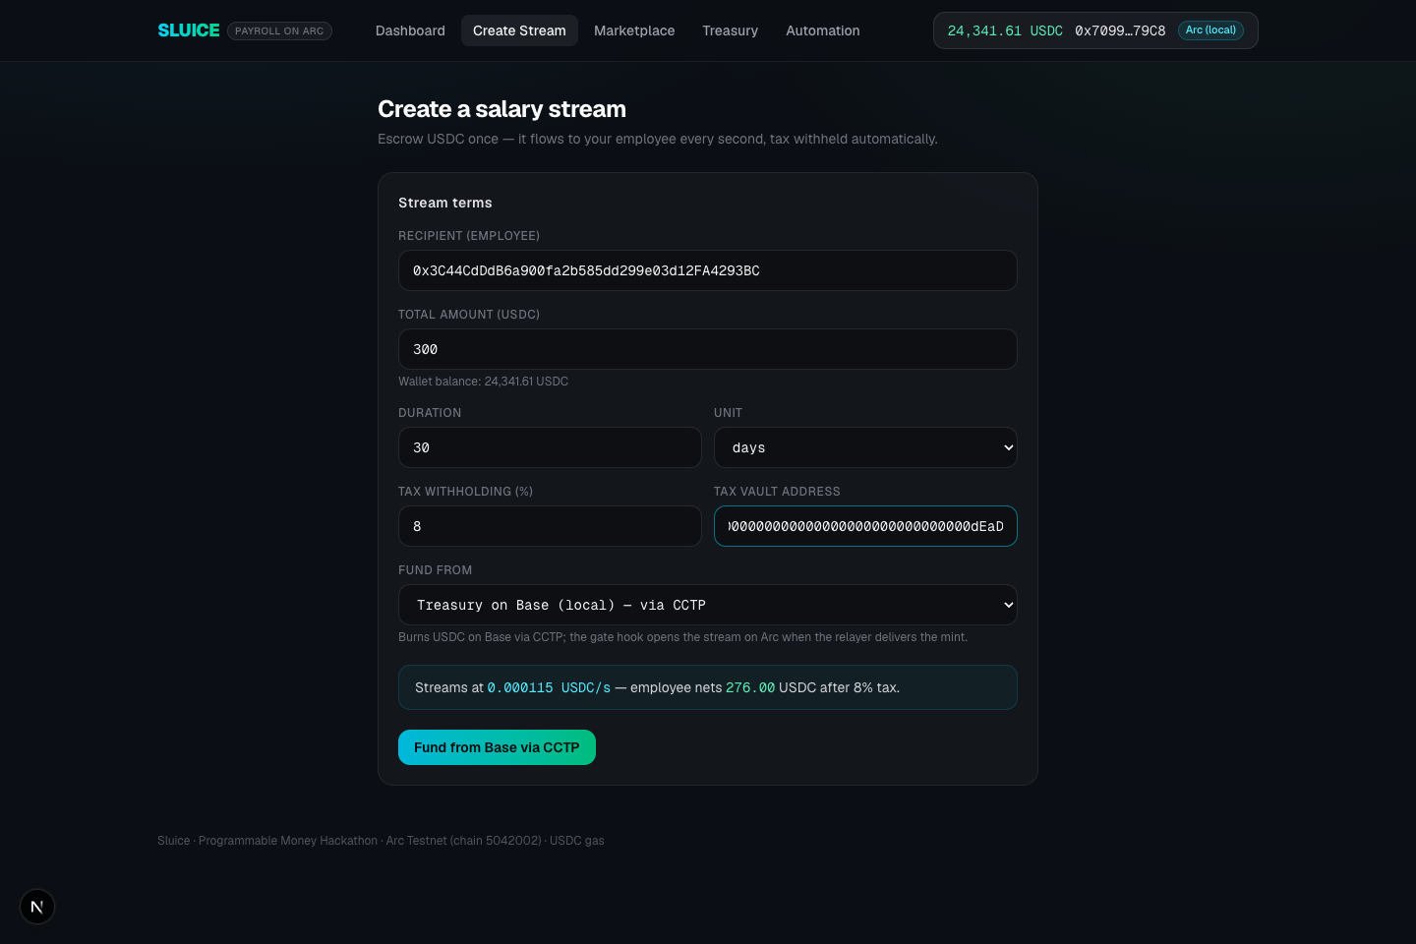
CHAIN-ABSTRACTED PAYROLL · CCTP
Arc settles. Every other chain is an on/off ramp.
Fund from any chain — one CCTP burn on Base opens a stream on Arc
Withdraw to any chain — net salary exits via CCTP; tax stays on Arc
Buy a stream from any chain — burn + hook settles the purchase atomically
Zero bridges in the UX — the word 'bridge' appears nowhere in the UI

Slide 9
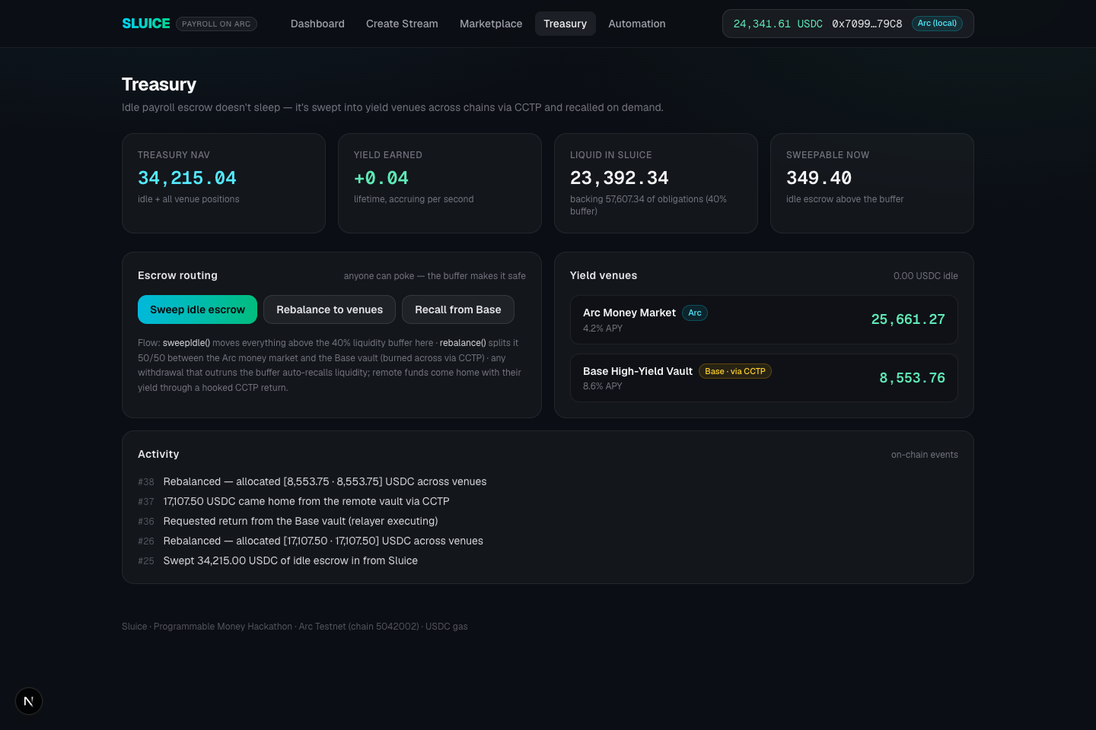
CROSS-CHAIN AUTO-YIELD TREASURY
Idle escrow earns — everywhere
Sweep — escrow above a 40% liquidity buffer moves to the treasury
Rebalance — Arc money market (4.2%) + Base vault (8.6%) via CCTP
Auto-recall — withdrawal outruns the buffer? Liquidity returns mid-transaction
Yield comes home — remote positions exit with earnings via a hooked return

Slide 10
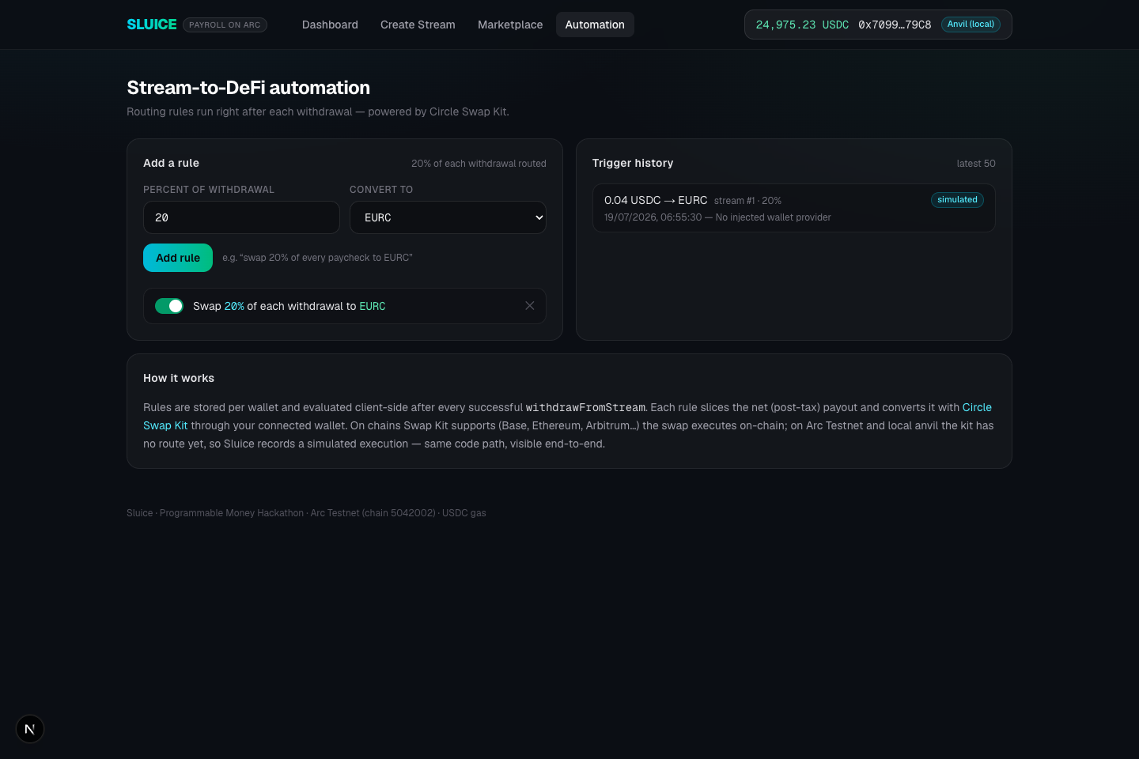
BUILT ON
Native to Arc + Circle
Arc L1 USDC gas · sub-second finality · chain 5042002
CCTP v2 pattern burn/mint + hooks power every cross-chain flow
Swap Kit per-paycheck auto-conversion (e.g. 20% → EURC)
App Kit / Bridge Kit integrated in the frontend, testnet-ready
ERC-3525 semi-fungible salary streams

Slide 11
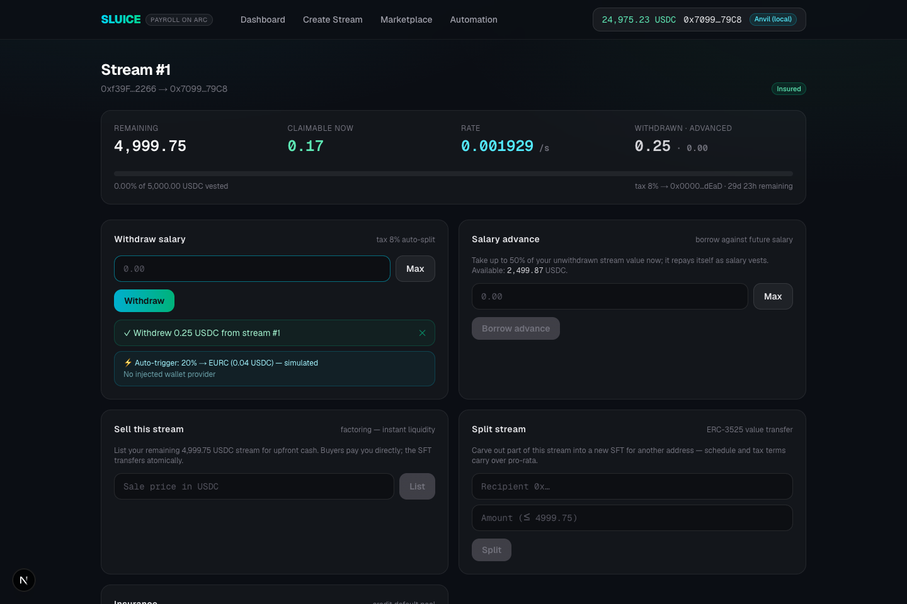
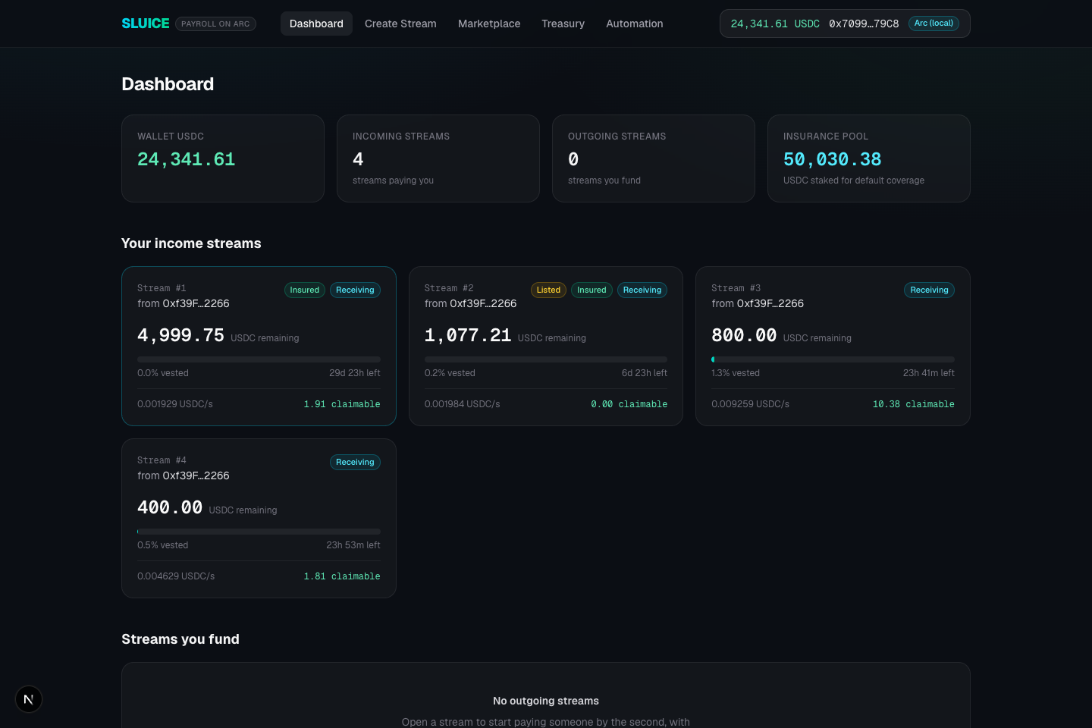
STATUS · IT WORKS TODAY
Not a mockup
✓ 26/26 Foundry tests — vesting math, SFT splits, marketplace, insurance, full cross-chain stack
✓ CI green on every commit
✓ Full frontend — dashboard, stream detail, marketplace, treasury, automation
✓ Every flow driven end-to-end in a real browser — a 0.25 USDC withdrawal arrived on Base as exactly 0.23, net of 8% tax
✓ One-command demo: ./dev.sh (twin chains + CCTP relayer + app)

Slide 12
ROADMAP
Next
Arc testnet deployment — script ready, USDC-gas native
Real CCTP domains — Circle Bridge Kit + Gateway unified balances
sluiceapp.xyz — public launch
Scale — employer dashboards, payroll batches, fiat off-ramp partners
github.com/mrnetwork0001/Sluice
Open the sluice.

