Slide 1
A PROPOSAL FOR TEL AVIV-YAFO MUNICIPALITY
The city already
built the places.
NestUp helps the families in them
find each other.
Municipal community pilot · 2026
Notes:
Open here. Don't rush this slide.
"Tel Aviv has spent decades building extraordinary public space for families.
Playgrounds, libraries, parks, community centres, story hours. The infrastructure
is world class.
What the city cannot build with concrete is the thing that makes a neighbourhood
feel like home — knowing the other parents in it.
That's the gap we'd like to close with you."
Set expectation: 15 minutes, then discussion. We're asking for a pilot, not funding.

Slide 2
You can live on a street with
four hundred families
and know none of them.
Notes:
Slow down. Let it sit for a beat before speaking.
"This is the part of city life nobody plans for. Density does not produce
community. You can be surrounded and still be alone."
Do not add statistics here. The line works because it is recognisable, and every
person in the room has either lived it or watched their children live it.

Slide 3
THE MOMENT IT MATTERS MOST
When you become
a parent, your city
gets smaller.
500m
Your world narrows to the distance you can push a pram. The people you used to see disappear into work and evenings. The park is full of people in exactly your situation — and none of you speak.
the pram radius
Notes:
"Ask any new parent how far they travel in a normal day. It's about 500 metres.
Inside that circle there are dozens of families on exactly the same schedule,
with exactly the same questions, at exactly the same playground. They are
strangers to each other — not because they want to be, but because there is no
natural way to meet."
This is the slide where the room starts nodding. Pause after it.

Slide 4
TODAY
Everything exists. Nothing connects.
WhatsApp groups
Facebook groups
Municipal listings
Word of mouth
Invite-only. You have to already
know someone to get in.
Noisy, city-wide, and rarely
about your street.
Excellent programmes that
parents never see.
Works beautifully — if you
already have a network.
Four channels. None of them designed for a parent standing in a park on a Tuesday morning.
Notes:
Walk left to right, one line each. Don't linger.
"None of these are bad products. They're just not built for this job.
The common failure is the same: they all assume you already have a network.
WhatsApp needs an inviter. Facebook needs you to find the right group.
Municipal listings assume you went looking. Word of mouth assumes you have
someone to hear it from.
The families who need community most — new arrivals, first-time parents, people
who just moved neighbourhood — are exactly the ones these channels fail."
If a Head of Community is present, this is where they will agree out loud.

Slide 5
Parents don't need
more information.
They need each other.
Notes:
The pivot of the deck. Say it plainly and stop.
"Every city instinct is to publish more — another listing, another portal,
another newsletter. But the shortage was never information.
A parent doesn't want a directory of story hours. They want to know that Dana
from two streets away will be at the one on Tuesday."

Slide 6
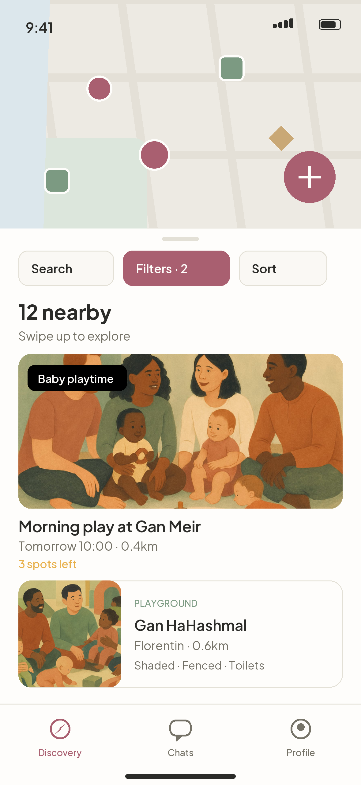
NESTUP
One map of
your neighbourhood.
Activities other parents are hosting. Places the city has verified. Events the municipality already runs. In one view, sorted by how close they are to you right now.
Activities — created by parents
Places — verified, family-ready
Events — from the city
Notes:
First look at the product. Hold it up, literally, if you have a device.
"This is the whole idea in one screen. One map. Three kinds of thing on it.
Round markers are activities a parent created. Squares are places the city has
verified as family-ready. Diamonds are municipal events.
A parent doesn't have to know which category they want. They just look at what's
near them."
Note the mixed list below the map — an activity and a place, side by side.
That's deliberate. Real life isn't organised into tabs.

Slide 7
WHAT'S ON THE MAP
Three layers of a neighbourhood.
Activities
Places
Events
A parent decides to be at the
playground at ten and says so.
Others join.
Verified, family-ready public
space — shade, fencing, toilets,
stroller access.
Story hours, workshops and
programmes the municipality
already runs.
21 categories
Created by residents
44 verified in Tel Aviv
Curated, not crowdsourced
From municipal sources
Now with people attached
The city supplies two of these three layers already.
Notes:
"Three layers, and here's the part that matters for this conversation:
The municipality already supplies two of them.
You have the places — 44 of them are already verified and live in the product for
Tel Aviv. You run the events. What's been missing is the third layer: the parents
themselves, and a reason for them to show up at the same time.
NestUp doesn't replace anything the city does. It's the connective tissue between
what you already provide and the families who should be using it."

Slide 8
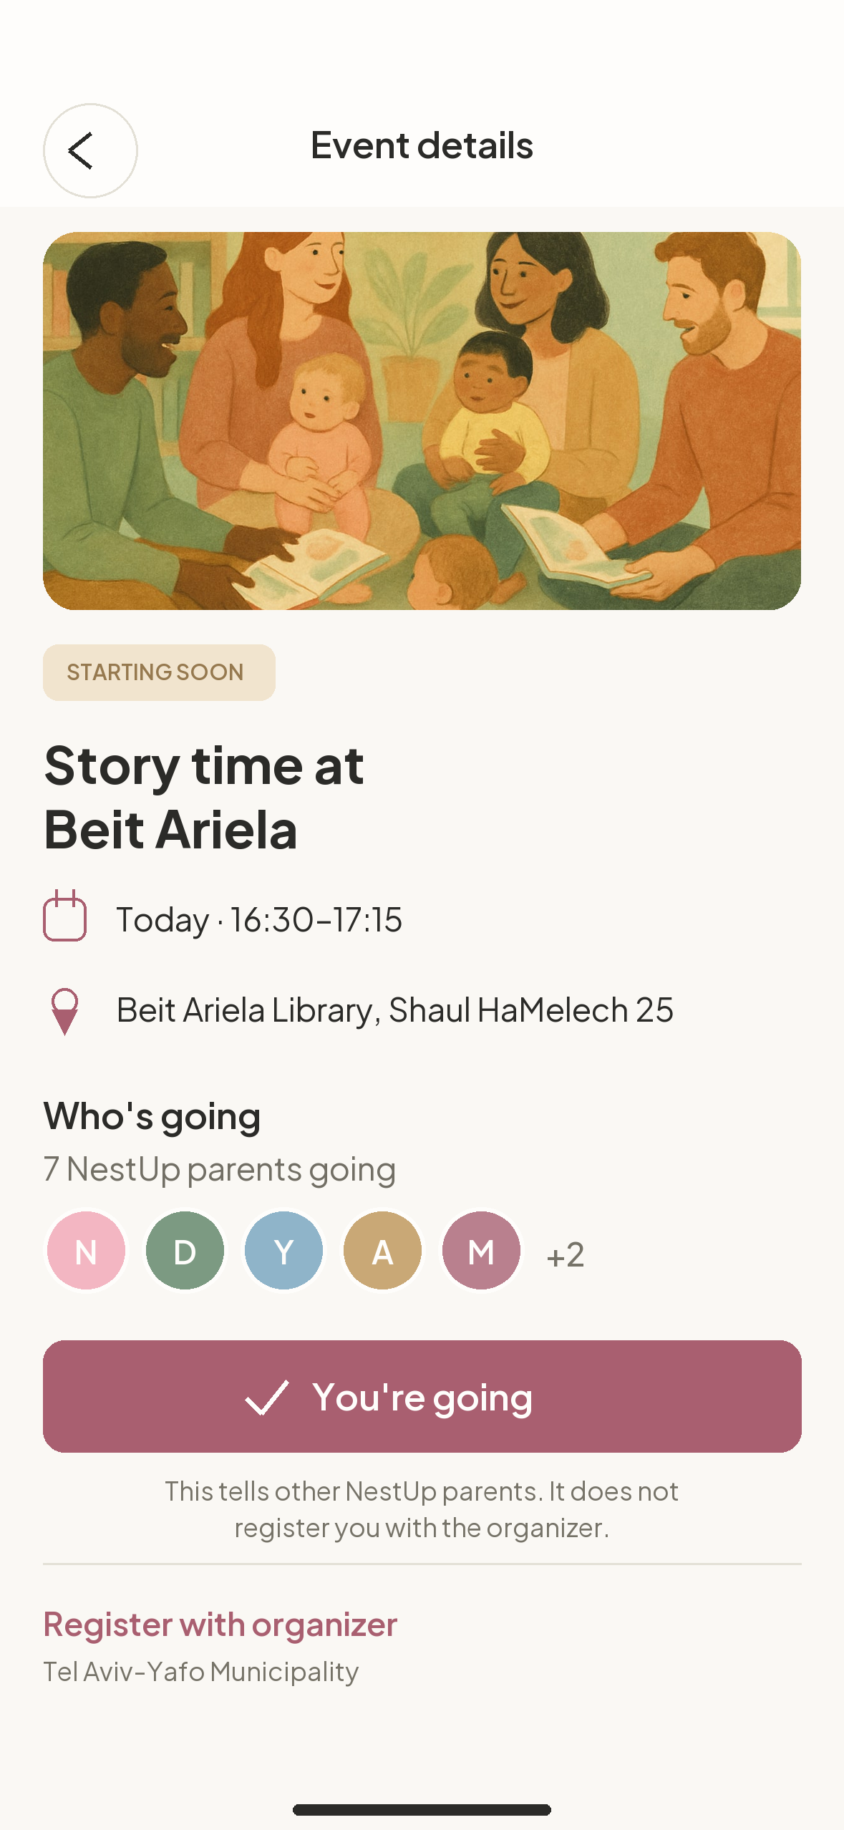
WHERE THE CITY ALREADY WINS
A great programme
with eight people in it
is still a great programme.
Municipal story hours, workshops and family programmes are genuinely good. The hard part was never the programming — it's that a parent has no reason to believe anyone else will be there.
Attendance is a community problem, not a marketing problem.
Notes:
"This is a real municipal event — a story hour at Beit Ariela — inside NestUp.
Look at what's been added. Not a better description. Not a nicer photo.
Seven other parents who said they're going.
That single line changes the decision. 'Should I take my toddler across town to a
library event?' is a hard question. 'Should I go to the thing seven other parents
from my area are going to?' is an easy one."
Point at the disclaimer under the button — this is important and we'll come back
to it on the trust slide. NestUp attendance is never presented as registration
with the city.

Slide 9
THE MECHANIC
One tap turns a listing into a gathering.
01
02
03
04
A city event appears
A parent says "I'm going"
Others see people, not text
They meet in physical space
Pulled from municipal sources into the same map as everything else.
Visible to other NestUp parents. Never sent to the organiser as a registration.
"7 NestUp parents going" — the strongest reason to attend anything.
The value lands in the park, the library, the community centre. Not in the app.
Success is measured in the park, not in screen time. We are not trying to keep anyone in the app.
Notes:
Four beats, quickly.
Land hard on step four and the green bar.
"I want to be explicit about something, because it matters to a municipality.
We are not building an engagement product. We do not want your residents spending
more time on their phones. Every mechanic in NestUp is designed to end with people
in physical public space — the space you already paid for.
If our usage numbers went up while park attendance stayed flat, we would consider
the pilot a failure."

Slide 10
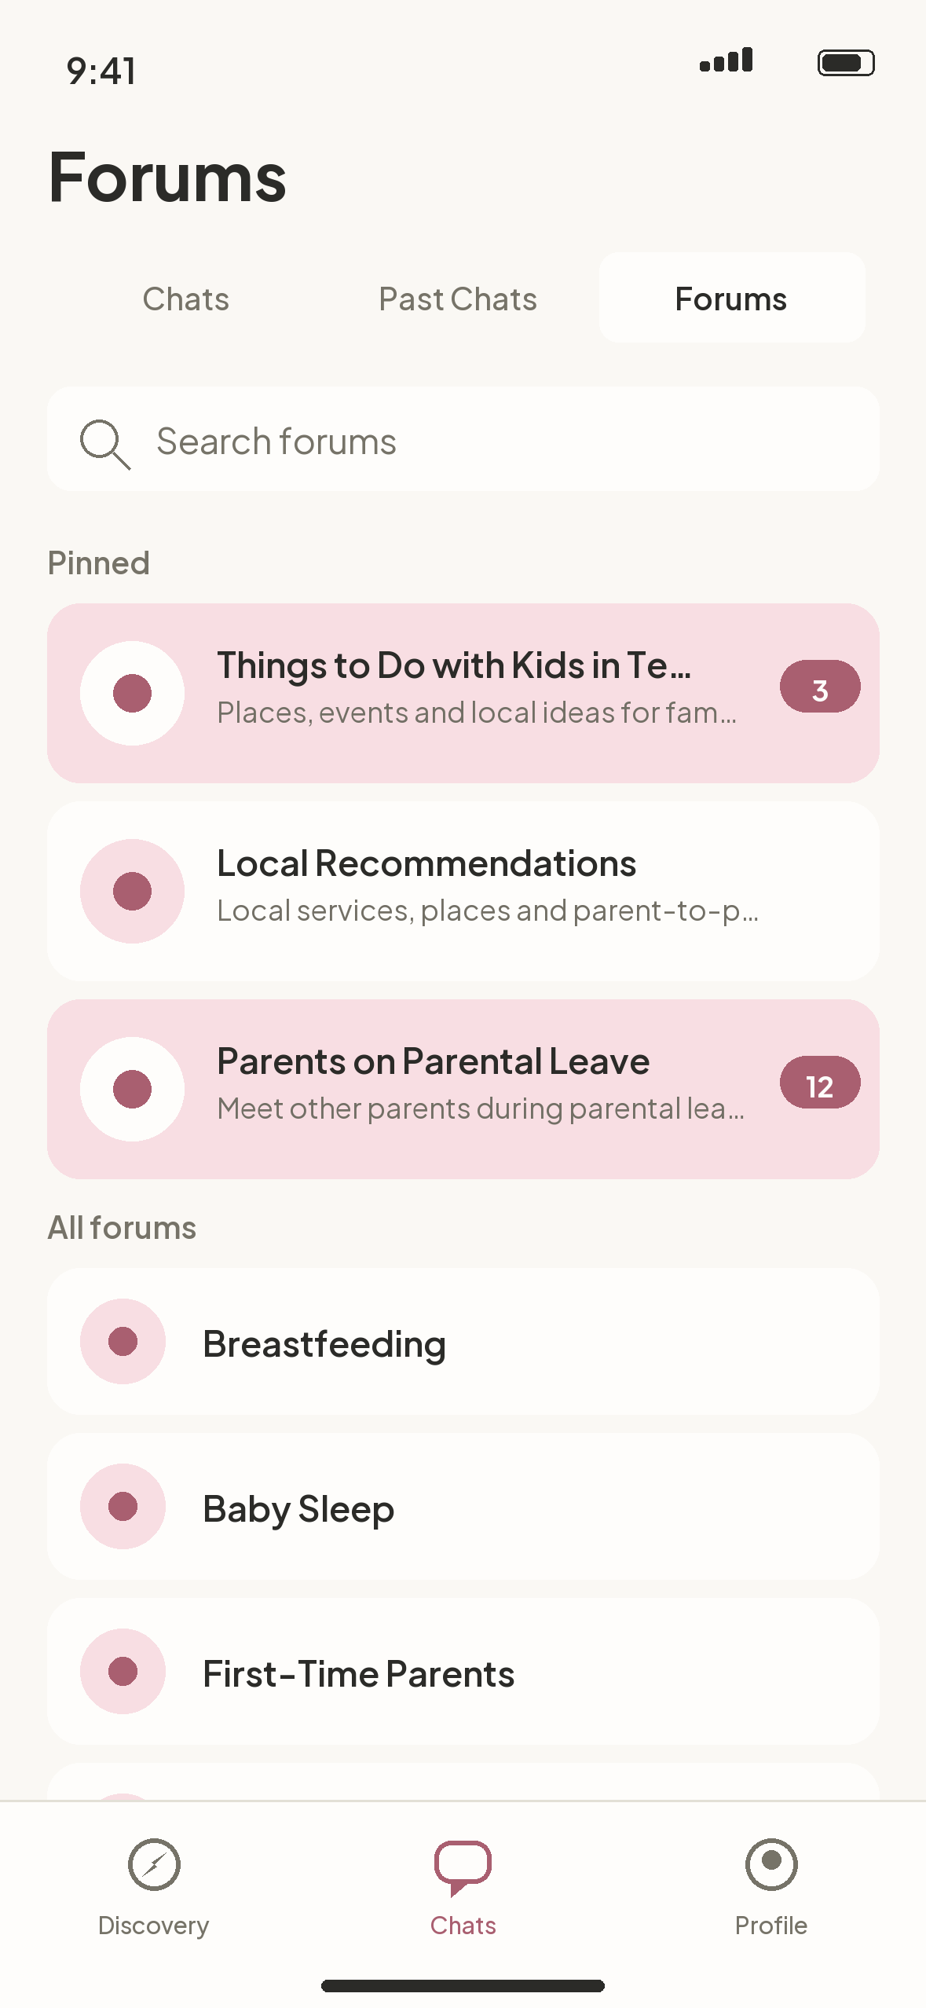
BETWEEN THE MEETUPS
Community isn't
only an event.
Twelve curated community spaces run continuously — sleep, feeding, development, daycare, local recommendations. Always there between the meetups, in Hebrew and English.
Baby Sleep
Breastfeeding
First-Time Parents
Daycare & Preschools
Local Recommendations
Parental Leave
Notes:
"A meetup is a moment. A community is what happens between moments.
Twelve forums, curated by us, not user-generated — which means no empty rooms, no
duplicates, no moderation crisis on day one. A parent awake at 3am with a sleep
question has somewhere to go, and it's full of people from their own city.
All of it works in Hebrew and English, right-to-left included."
If asked why users can't create forums: deliberate for the pilot. Twelve good
rooms beat two hundred empty ones, and it keeps moderation tractable.

Slide 11
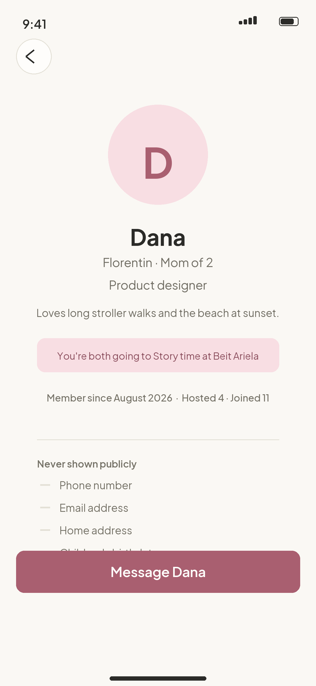
TRUST
Built for parents,
so built carefully.
A public profile shows enough to feel safe meeting someone, and nothing more.
SHOWN
NEVER SHOWN
First name and photo
Phone number
General area — never an address
Email address
Mom / Dad / Parent, self-selected
Home address or coordinates
Number of children, not their names
Children's birthdates
Notes:
Do not skip this slide with a municipal audience. It is the one that gets you
past legal.
"Parent safety shaped the data model, not the marketing.
Children's exact birthdates never leave the database — ages are coarsened before
they're sent to a device. Exact coordinates are never public. Parent role is
self-selected; we never infer it from a name or a photo.
There are no ratings, no trust scores, no verification badges pretending to be
something they aren't. We'd rather show less and be honest about it."
If asked about identity verification: deliberately deferred. We didn't want to
ship a badge that implies a guarantee we can't make.

Slide 12
THE MUNICIPAL CASE
Four things a city gets.
Isolation
Utilisation
Belonging
Insight
Parental isolation is a wellbeing issue the city already cares about — and one it currently has no instrument for.
Better attendance at programmes and public spaces the city has already paid to build and run.
Residents who know their neighbours stay longer, participate more, and ask more of their neighbourhood.
Anonymised, aggregated signal about where families actually gather — and where provision is thin.
None of these require the city to build or maintain software.
Notes:
This is the slide the CEO and Head of Innovation are waiting for. Slow down.
Isolation — you have mental-health and family-wellbeing objectives already. This
is a lever for them that costs almost nothing.
Utilisation — you've built the parks and you fund the programmes. Attendance is
the return on that investment, and it is currently left to chance.
Belonging — the strongest predictor of whether a family stays in a neighbourhood
is whether they know anyone in it.
Insight — and be careful here — aggregated and anonymised. Where families gather,
where they don't, which areas have thin provision. Never individual movement data.
We will put that in writing.
Then the closing line: the city doesn't build or run anything.

Slide 13
FIT
A layer, not a replacement.
The city provides
Public space · Verified places · Family programmes · Events calendar
↓
NestUp provides
Discovery · Attendance · Community · Local trust
↓
Families get
Somewhere to go · Someone to go with · A neighbourhood that feels known
No procurement of software. No integration burden. No new system for staff to run.
Notes:
"I want to be precise about what we are and aren't asking for.
We are not asking the city to buy, build, host or operate software. There's no new
system for your teams to learn and no data migration.
The city keeps doing exactly what it does today. We sit on top and make it findable
and social."
If the Head of Innovation asks about integration: the events layer already ingests
municipal event data. Deeper integration is possible but is explicitly not required
for the pilot.

Slide 14
THE ASK
One neighbourhood. Six months.
MONTH 1
MONTHS 2–3
MONTHS 4–5
MONTH 6
Baseline
Seed
Grow
Review
Choose one neighbourhood. Agree success measures and capture a starting baseline with the city's own data.
Onboard families through existing municipal touchpoints — tipot chalav, libraries, community centres.
Municipal events flow into the product. Parents host their own activities. Forums find their rhythm.
Joint review against the agreed measures. Decide together whether to extend, expand or stop.
One neighbourhood is deliberate. A pilot that can't fail teaches nothing.
Notes:
"We're asking for one neighbourhood, not the city. Six months, not a year.
Month one is the most important and the one people skip: we establish a baseline
together, using your data, before we've done anything. Otherwise in month six
we'll both be guessing.
Month six has a real stop option in it. If the measures don't move, we'd rather
you end it than renew out of politeness."
Suggested first neighbourhood: somewhere with strong existing family provision and
a dense young-family population. Florentin, Neve Tzedek, or Old North. Ask them
which they'd choose — it's a good way to get them designing the pilot with you.

Slide 15
ACCOUNTABILITY
How we'll know if it worked.
MEASURE
SOURCE
STARTING POINT
Attendance at municipal family events
City's own attendance records
Baseline set in month 1
Parent-initiated gatherings per month
In-product, reported monthly
Zero at start, by definition
Repeat participation
Share of parents attending more than once
Baseline set in month 1
Self-reported local connection
Short survey at month 1 and month 6
Baseline set in month 1
Reach into underserved areas
Distribution of activity across the neighbourhood
Mapped in month 1
We deliberately have no numbers to show you yet. Every baseline is set with the city, in month one.
Notes:
Be direct about the bottom bar. It will earn you more credibility than a slide of
invented projections would.
"You'll notice there are no impressive numbers on this slide.
That's on purpose. We could have put a forecast up. But any figure we produced
today about Tel Aviv parents would be a guess dressed as evidence, and you'd be
right not to trust it.
Every one of these baselines gets set in month one, with your data, before we
start. Then we're both measuring the same thing."
If pushed for projections: offer to model them jointly once the baseline exists.
Do not invent a number in the room.

Slide 16
WHY HERE
Why Tel Aviv should be first.
01
02
03
04
Density
Provision
Appetite
Readiness
Neighbourhoods dense enough that a 500-metre radius contains a real community.
The public space and family programming already exist and are genuinely good.
A municipality with a track record of testing new things before anyone else.
The product is live, in Hebrew and English, with 44 Tel Aviv places already verified.
The first city to do this gets to shape what it becomes.
Notes:
"Four reasons, and the last one is the practical one: this isn't a concept.
The product is built and running. Hebrew and English, right-to-left. Forty-four
Tel Aviv places already verified and live. It's on TestFlight today.
We're not asking you to fund development. We're asking you to be the first city to
point it at a real neighbourhood."
Then the closing line — first-mover framing works well with an innovation team.

Slide 17
WHAT WE NEED
Four things. None of them money.
1
A neighbourhood
One area, chosen with you, to run the pilot in.
2
Introductions
Access to existing family touchpoints — tipot chalav, libraries, community centres.
3
Event data
The family-facing events you already publish, so they appear where parents are looking.
4
A partner
One person inside the municipality who owns this with us for six months.
We bring the product, the team and the cost.
Notes:
"Four asks, and I want to be clear that none of them is a budget line.
A neighbourhood. Introductions to the places parents already go. The event data
you already publish. And one person who owns this with us — that's the one that
actually determines whether a pilot works.
We bring the product, the team and the cost."
Then stop talking. Let them respond.

Slide 18
Cities are built
from buildings.
Communities are built
from Tuesday mornings.
NestUp · nestup.app
Notes:
Final slide. Don't add anything to it.
"Tel Aviv already built the buildings. The parks, the libraries, the community
centres — they're there, they're good, and they're often half empty on a Tuesday
morning while a hundred parents sit alone within walking distance of them.
We'd like to help you fill them. One neighbourhood, six months, and an honest
measurement at the end."
Then: "What would you need to see to say yes?"
That question, not a summary, is how you end.

