Slide 1
Advanced Scientific Calculator
Developed by Nishchay Anand
Intern at NextHikes

Slide 2
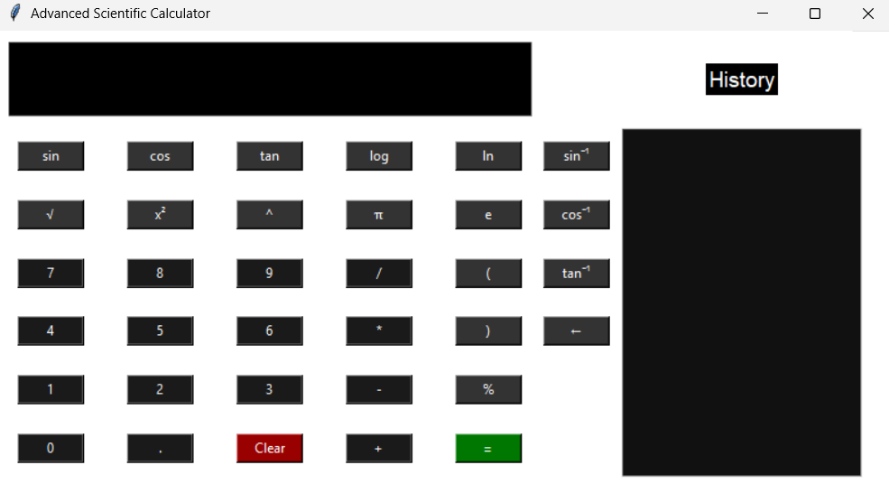
USP of the Calculator
Full scientific mode with advanced math functions
Inverse trigonometric operations
History panel for previous calculations
Keyboard input support
Custom white theme

Slide 3
Libraries Used
Tkinter – GUI design
Math – Scientific computations

Slide 4
Challenges Faced
Keyboard key mapping
Handling scientific expressions
UI layout management
Memory functions
Error handling

Slide 5
References
Python Documentation
StackOverflow
GeeksForGeeks
NextHikes Guidance
ChatGPT Assistance

Slide 6
Thank You

