Slide 1

Digital Signatures

Slide 2

Electronic Record
Very easy to make copies
Very fast distribution
Easy archiving and retrieval
Copies are as good as original
Easily modifiable
Environmental Friendly
Because of 4 & 5 together, these lack authenticity

Slide 3

Why Digital Signatures?
To provide Authenticity, Integrity and Non -repudiation to electronic documents
To use the Internet as the safe and secure medium for e-Governance and e-Commerce
Notes:
One cd rom=one tree

Slide 4
What is Digital Signature?
A digital signature is an electronic signature that can be used to authenticate the identity of the sender of a message or the signer of a document, and possibly to ensure that the original content of the message or document that has been sent is unchanged.
Digital signatures are easily transportable, cannot be imitated by someone else, and can be automatically time-stamped. The ability to ensure that the original signed message arrived means that the sender can not easily repudiate it later.
The originator of a message uses a signing key (Private Key) to sign the message and send the message and its digital signature to a recipient
The recipient uses a verification key (Public Key) to verify the origin of the message and that it has not been tampered with while in transit

Slide 5
Digital signatures employ a type of Asymmetric Cryptography. The Scheme typically consists of three Algorithms
A key generation algorithm that selects a private key uniformly at random from a set of possible private keys. The algorithm outputs the private key and a corresponding public key.
A signing algorithm that, given a message and a private key, produces a signature.
A signature verifying algorithm that, given a message, public key and a signature, either accepts or rejects the message's claim to authenticity
Hash value of a message when encrypted with the private key of a person is his digital signature on that e-Document

Slide 6

Digital Signatures
Each individual generates his own key pair
[Public key known to everyone
&
Private key only to the owner]
Private Key – Used for making Digital Signature
Public Key – Used to verify the Digital Signature

Slide 7
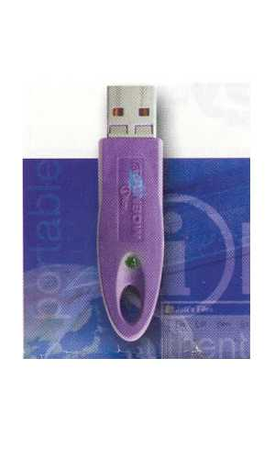
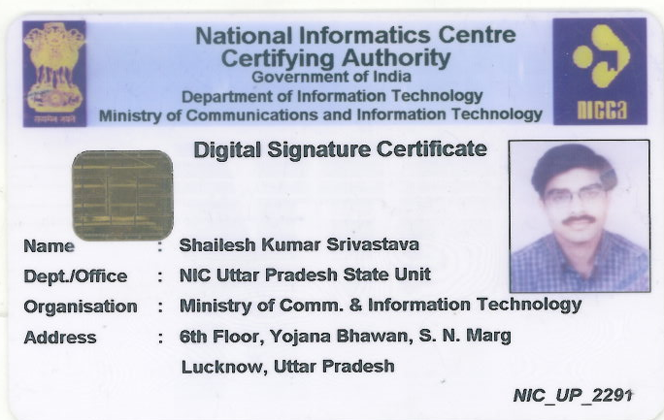
Hardware Tokens
Smart Card
iKey

Slide 8

Smart Cards
The Private key is generated in the crypto module residing in the smart card.
The key is kept in the memory of the smart card.
The key is highly secured as it doesn’t leave the card, the message digest is sent inside the card for signing, and the signatures leave the card.
The card gives mobility to the key and signing can be done on any system (Having smart card reader).

Slide 9
iKeys or USB Tokens
They are similar to smart cards in functionality as
  Key is generated inside the token.
  Key is highly secured as it doesn’t leave the token.
  Highly portable.
  Machine Independent.
iKEY is one of the most commonly used token as it doesn’t need a special reader and can be connected to the system using USB port.

Slide 10


Private Key Protection
The Private key generated is to be protected and kept secret. The responsibility of the secrecy of the key lies with the owner.
The key is secured using
  PIN Protected soft token
  Smart Cards
  Hardware Tokens

Slide 11

Digital Signatures
I agree
efcc61c1c03db8d8ea8569545c073c814a0ed755
My place of birth is at Gwalior.
fe1188eecd44ee23e13c4b6655edc8cd5cdb6f25
I am 62 years old.
0e6d7d56c4520756f59235b6ae981cdb5f9820a0
I am an Engineer.
ea0ae29b3b2c20fc018aaca45c3746a057b893e7
I am a Engineer.
01f1d8abd9c2e6130870842055d97d315dff1ea3
These are digital signatures of same person on different documents
Digital Signatures are numbers
Same Length – 40 digits
They are document content dependent

Slide 12

Paper Signatures V/s Digital Signatures
Parameter | Paper | Electronic
Authenticity | May be forged | Can not be copied
Integrity | Signature independent of the document | Signature depends on the contents of the document
Non-repudiation | Handwriting expert needed Error prone | Any computer user Error free
V/s

Slide 13

Role of Controller (CCA)
Controller of Certifying Authorities as the “Root” Authority certifies the technologies, infrastructure and practices of all the Certifying Authorities licensed to issue Digital Signature Certificates

Slide 14
Seven CAs have been licensed by CCA
Safescrypt
National Informatics Center (NIC), Government of India
Institute for Development & Research in Banking Technology (IDRBT) – A Spciety of Reserve Bank of India
Tata Consultancy Services (TCS)
MTNL Trustline
GNFC (Gujarat Narmada Fertilizer Corporation)
E-MudhraCA

Slide 15
How To Get & Use Digital Signature

Slide 16
Application Request
Go to NIC/CA Website
Download DSC Request Form
Fill-in the Form
Sign the Form at Required Place
Get the Form Countersigned and Verified from HOD along with his/her Official Stamp
Enclose Identification Proof
Enclose Fee (if required) in Form of Bank Draft
Send to NIC/CA Office

Slide 17
Issuance of Digital Signatures
Send your completed form to CA Office or Agent Office.
When your case is processed a Membership ID and Password is Issued and send to the email ID mentioned in Application Form.
A Digital Signature in USB Token or Smart Card will be couriered to you.

Slide 18
Prevention From Misuse
Don’t Hand over your DSC Media USB/Card to any one
Don’t tell your PIN to anyone
Document Digitally Signed carries same legal status as manually signing as per the IT Act

Slide 19

Thank You

