Slide 1
Capstone: Find the best neighborhood in Toronto to open a Restaurant Supply Store
Applied Data Science Capstone
IBM Data Science Professional Certificate

Slide 2
Introduction:
The idea is use neighborhood characteristics to determine which neighborhood should I consult my clients to run a new restaurant.

Slide 3
Data:
You can follow along in my Capstone Notebook located here:
https://github.com/dcrouch1/Peer-graded-Assignment-Capstone-Project---The-Battle-of-Neighborhoods-Week-2-/blob/master/Daves_Capstone.ipynb
Data Wrangling
A lot of hard work went into creating the working data set.
I had to combine the following disparate data sources. The order of events went like this
1. Load all the Data from all the various sources.
1.1 Toronto neighborhoods broken down by postal code
https://en.wikipedia.org/wiki/List_of_postal_codes_of_Canada:_M
Here I used BeautifulSoup to scrape the wiki page to extract a working list of Toronto Neighborhoods sorted by postal code.
1.1.1 Load Toronto geospatial coordinates and merge to Toronto Postal Code Data
http://cocl.us/Geospatial_data
Next, I joined geo spatial to the Toronto Data.
1.2 Toronto neighborhoods populations broken down by postal code
https://www12.statcan.gc.ca/census-recensement/2016/dp-pd/hlt-fst/pd-pl/Tables/File.cfm?T=1201&SR=1&RPP=9999&PR=0&CMA=0&CSD=0&S=22&O=A&Lang=Eng&OFT=CSV
Use Pandas to grab the csv
1.2.1 Merge Toronto Neighbourhood populations data with Toronto Postal Code data
Next, I joined population data to the Toronto Data.
1.3 Toronto neighborhoods average after tax income broken down by postal code
Here we must manually download these from Stats Canada and load them.
https://www12.statcan.gc.ca/census-recensement/2016/dp-pd/prof/search-recherche/change-geo.cfm?Lang=E&Geo1=FSA
1.3.1 Merge Toronto Neighbourhood income data with Toronto Postal Code data
Next, I joined income data to the Toronto Data.
At this time I also saved a copy of the data set as my friend had asked for it in his list of requirements.

Slide 4
Methodology:
Choice of Algorithms
I chose K-Means Clustering.
https://towardsdatascience.com/clustering-algorithms-for-customer-segmentation-af637c6830ac
A backgrounder on K-Means clustering
“K-means clustering is an iterative clustering algorithm where the number of clusters K is predetermined and the algorithm iteratively assigns each data
point to one of the K clusters based on the feature similarity.”
* Key Observation: And for my project feature similarity means restaurant similarity in Neighborhoods *

Slide 5
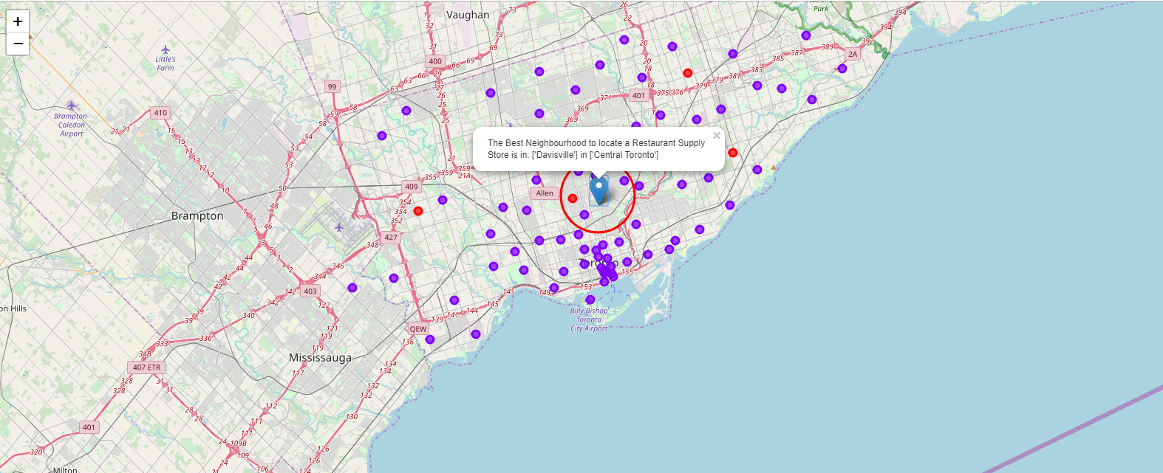
Results:
4.1 Plot the clusters on a Map of the Toronto and Super Impose the best location of a Store

Slide 6
Discussion:
5.1 Explaining the results
As we built our list of neighborhoods with Restaurant venues exclusively we discovered most neighborhoods were similar and the greatest concentration of restaurants was in Central Toronto and downtown Toronto. This might seem obvious but it would also appear that these are some of the most affluent neighborhoods in Toronto so there appears to be correlation. By Locating in the general vicinity of the Exact location my friend could be geographically centered in this cluster and poised to service his restaurant customer base with greatest efficiency.
When we built our our K-Means dataset we used Silhouette analysis to tell us there was a lot of similarity between neighborhoods and the most common restaurants contained with in. Really there was only 2 types of cluster or neighborhoods in greater Toronto. The vast majority of those were in 1 cluster. So Toronto restaurants might be many but they are very homogeneously located near the center of Toronto.
Of the 103 Toronto Neighborhoods gathered only 55.3% or 57 Neighborhoods are above the median after-tax income. 37.8% or 39 Neighborhoods are below he median after-tax income. 6.7% or 7 neighborhoods did not register as it appears their populations are too low. It appears that the greatest concentration of affluence is near central Toronto. We decided to keep all neighborhoods in the dataset regardless of income of population as the majority were close enough.

Slide 7
Conclusion:
I feel confident with the recommendation I have given my friend as it is backed up with demonstrated data analysis. While nothing can ever be 100% certain he will certainly be better informed than he was prior to asking for my help.
Much more inference can be obtained with more work. A potential side business for my friend might be assisting new restaurant owners where they might locate a new restaurant, who their competition is and who their clientele might be.

