Slide 1

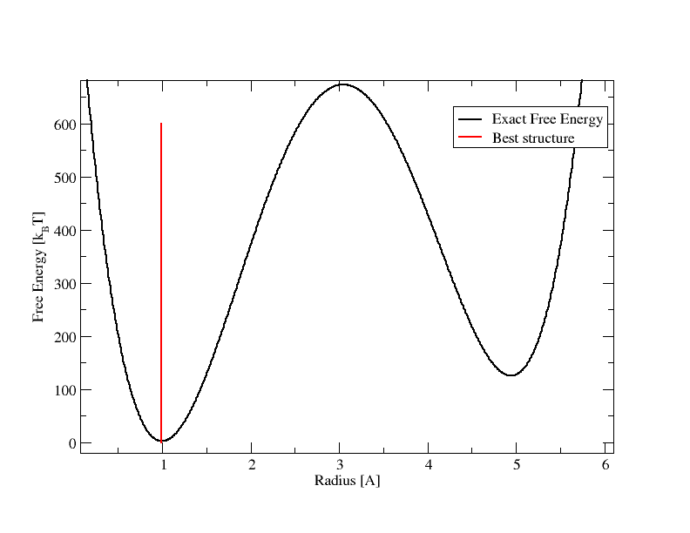
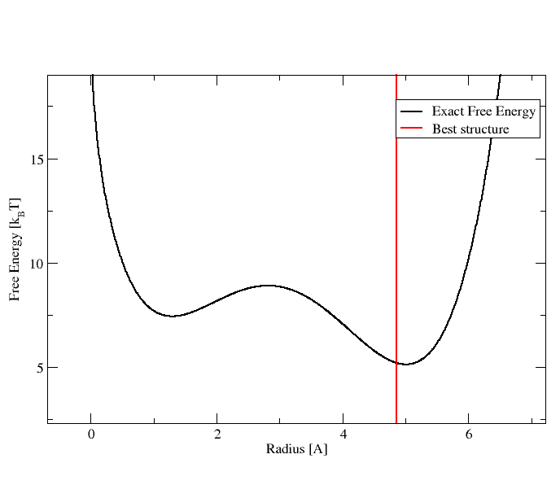
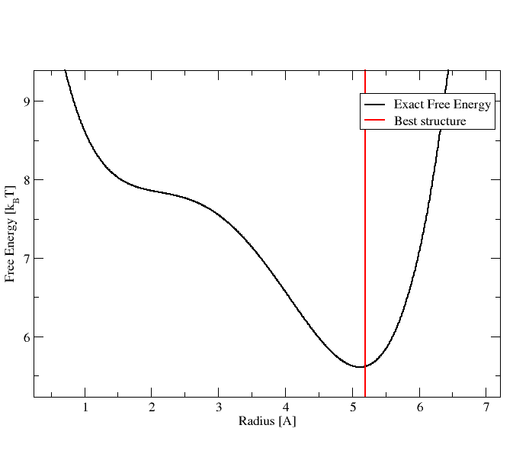

Tribal GA Toy System Tests
$E\left(r\right)=20∗{(\left(r−1\right)}^{2}$* ${(r−5)}^{2}+{0.2(r−1)}^{2})$
T = 0.5 k_{B} * K
T = 100.5 k_{B} * K
T = 300.5 k_{B} * K

