Slide 1
Strategic Energy Shield (SES)
Powering the Next Century of Civilization
Spencer O'Brien | spencer@nocturnalsecurity.io

Slide 2
The Problem
• Fossil fuel dependency persists
• Solar & wind are weather- and terrain-dependent
• AI & HPC power demand rising exponentially

Slide 3
The Vision
• SES: A space-based solar array
• Collects energy in orbit, beams it to Earth and Mars
• Uninterrupted global power delivery

Slide 4
The Solution
• Massive modular solar structure
• Wireless power transmission
• Robotics + human orbit teams assemble it in stages

Slide 5
Why Now
• SpaceX and others have reduced launch costs
• Climate urgency + AI energy boom
• U.S. needs strategic energy advantage

Slide 6
Technology
• 4,178 km² orbital array
• Modular thruster positioning
• Laser/microwave power beaming

Slide 7
Business Model
• Private energy contracts
• Licensing to allies
• Long-term energy-as-a-service (EaaS) deals

Slide 8
Market & Competition
• $2T+ U.S. energy market
• No full-orbit competitors
• Unique national strategic value

Slide 9
Progress & IP
• Provisional patent filed April 2025
• Self-funded MVP underway
• Outreach to early investors and partners

Slide 10
Funding Ask
$1.5M pre-seed capital to complete orbital simulation, engineering modeling, and final patent

Slide 11
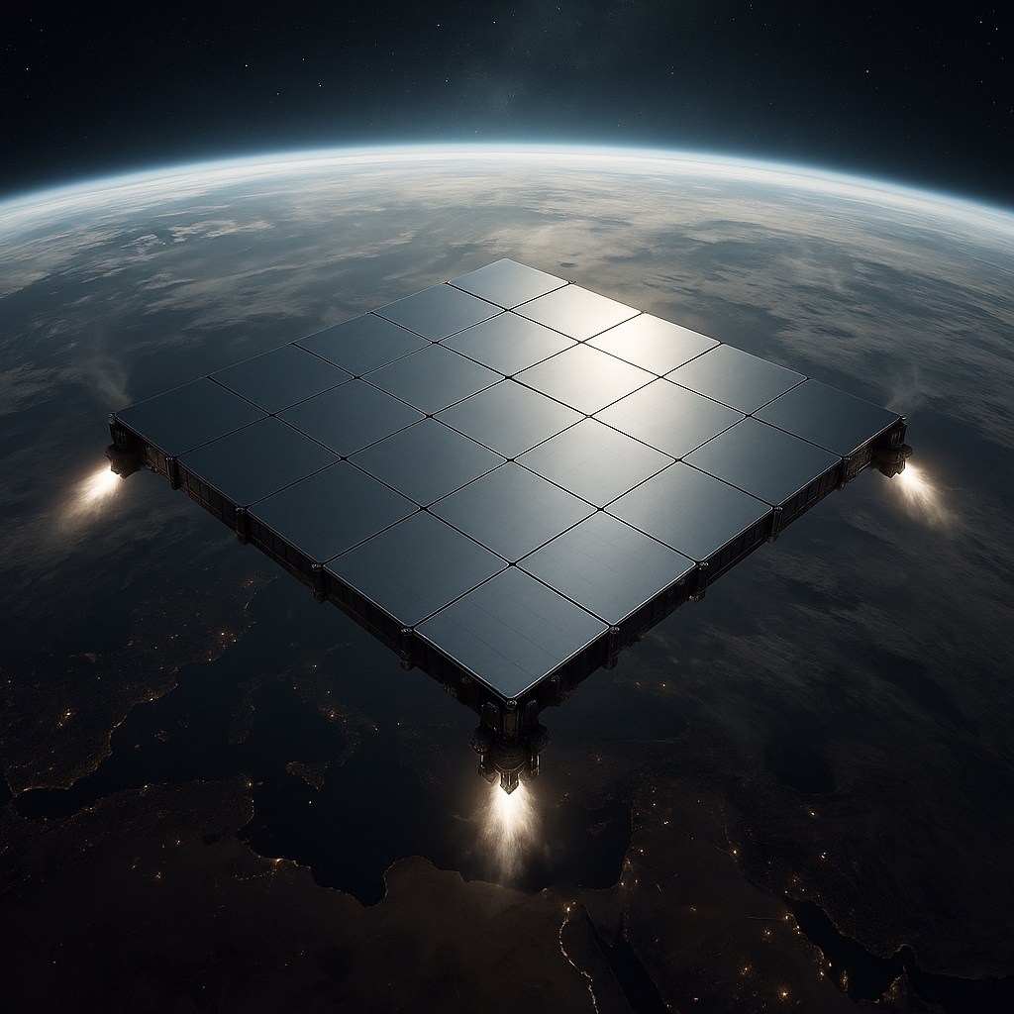
Aerial Concept Drawing

Slide 12
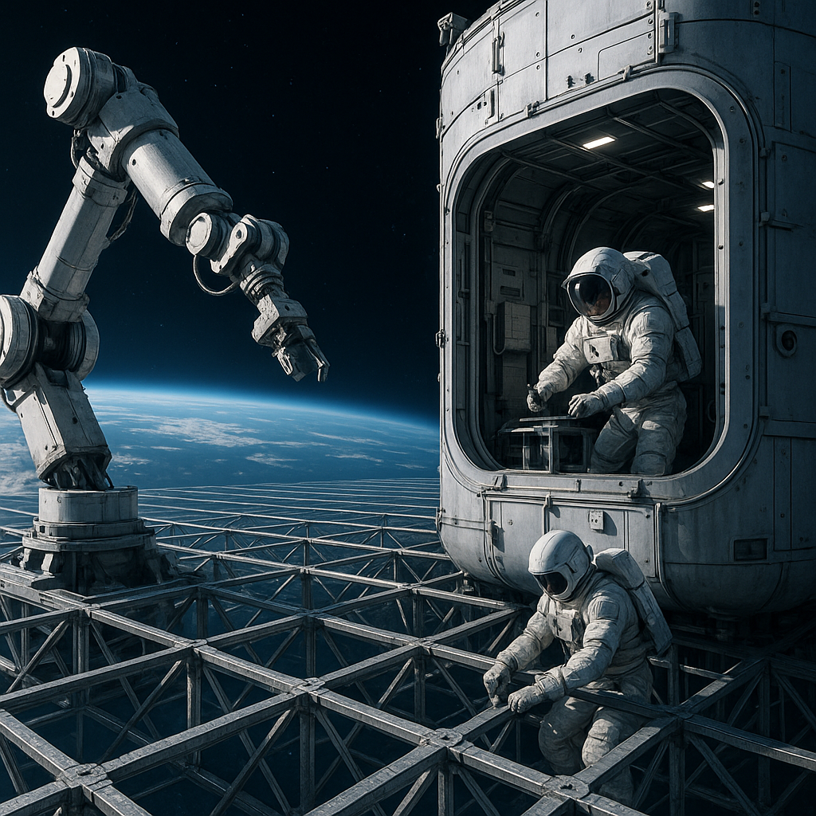
Assembly Bay

Slide 13
Contact
Spencer O'Brien
Founder, Nocturnal Security
spencer@nocturnalsecurity.io
www.nocturnalsecurity.io
linkedin.com/in/spencer-o-brien

