Slide 1
Kubernetes and AAD Workload Identity
Marius Rochon

Slide 2
Issue
Control application access to APIs

Slide 3
Authentication and authorization
Authentication
Who are you?
Authorization
Is this allowed?
Resource
Do/give something
Requires
Requires
Critical: protection of a secret/unique material
Critical: consistent control surface
Critical: secure validation

Slide 4
Two scenarios
Cluster as consumer
Cluster as resource

Slide 5
Cluster as consumer
Use existing control surface (Azure AD) when available
Use OAuth2
Protect token signing keys/secrets
Deployment agnostic (AKS or not)

Slide 6
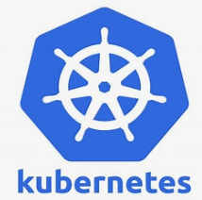
K8s workflow identity
3. OIDC .well-known and jwks
AAD
Cluster
2. OAuth2 Client Creds
w/ k8s token as assertion
Client app
4. AAD application
access token
1. API Token

Slide 7
Basic process
Cluster
Enable OIDC metadata discovery
Get cluster OIDC .well-known url
Pod/deployment
Create a service account
Assign it to a pod
Configure pod to have access to service account’s k8s API token
AAD
Register client as application
Configure federated identity for the app
Assign required API permissions

Slide 8
Cluster
AKS
Requires aks-preview and WorkloadIdentity enabled
Az aks create … --enable-oidc-issuer
Get issuer uri: az aks show –n… --query "oidcIssuerProfile.issuerUrl"
Minikube? – is it possible?
Other, common k8s implementations?

Slide 9
Deployment
apiVersion: v1
kind: ServiceAccount
metadata:
name: client.app1
---
apiVersion: apps/v1
kind: Deployment
metadata:
…
spec:
…
spec:
containers:
- name: api-client
…
volumeMounts:
- name: token-vol
mountPath: "/service-account"
readOnly: true
serviceAccountName: client.app1
volumes:
- name: token-vol
projected:
sources:
- serviceAccountToken:
audience: "api://AzureADTokenExchange"
expirationSeconds: 3600
path: token
Associate a service account to pod
Associate a service account to pod
Provide token to app code
Configure token

Slide 10
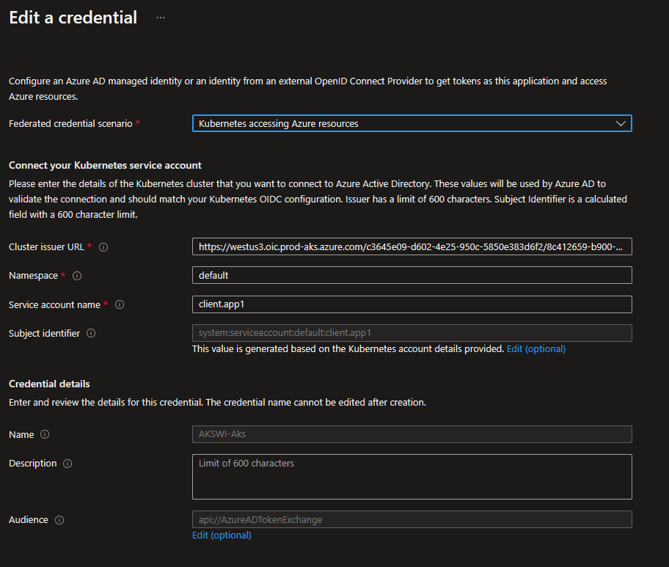
AAD

Slide 11
Application code
string k8sToken = String.Empty;
try
{
using (var sr = new StreamReader("/service-account/token"))
{
k8sToken = await sr.ReadToEndAsync();
}
} catch(Exception ex)
{
_logger.LogError(ex.Message);
}
if(!string.IsNullOrEmpty(k8sToken))
{
var msal = ConfidentialClientApplicationBuilder
.Create(_clientId)
.WithAuthority($"https://login.microsoftonline.com/{_tenantId}/")
.WithClientAssertion(k8sToken)
.Build();
try
{
var tokens = await msal.AcquireTokenForClient(new string[] { api://xyz/.default" }).ExecuteAsync();
// Call your API with tokens.AccessToken in Authorization header
}
catch (MsalServiceException ex)
{
_logger.LogError(ex.Message);
}
}
Notes:
Alternative is to not use MSAL but just an http POST to AAD /token endpoint but MSAL gives you token caching as well.

Slide 12
Demo
AKS cluster create script
Deployment yaml
AAD configuration
Code
Executing web app

Slide 13
Benefits
Native K8s APIs, any cloud, both Windows and Linux
Access control remains in AAD
[Protection of secrets - secrets never leave their source]
OAuth2 standard
Notes:
Removes the scale and performance issues that existed for identity assignment
Supports Kubernetes clusters hosted in any cloud or on-premises
Supports both Linux and Windows workloads
Removes the need for Custom Resource Definitions and pods that intercept Instance Metadata Service (IMDS) traffic
Avoids the complication and error-prone installation steps such as cluster role assignment from the previous iteration.

Slide 14
Issues
“Removes the scale and performance issues that existed for identity assignment” – what does sit mean?
Webhook vs volume mount?
Installing azwi on Windows?
Enabling OIDC discovery on other k8s implementations
Rotating signing key
AKS default: 6 months
AAD cache: 1h
Manual rotation?

Slide 15
Resources
Kubernetes and AAD Workload Identity
AAD Workload Identity (Preview)
Setup
Sample
My sample
Deployment with self-managed clusters

