Slide 1
PowerApp/LogicApp Connector Development
Marius Rochon

Slide 2
Connectors
Proxy to variety of APIs for use in graphical logic designers:
Power Automate
Power Apps
Logic Apps
Hides and augments http connection logic
Authentication/authorization
Payload/response formatting

Slide 3
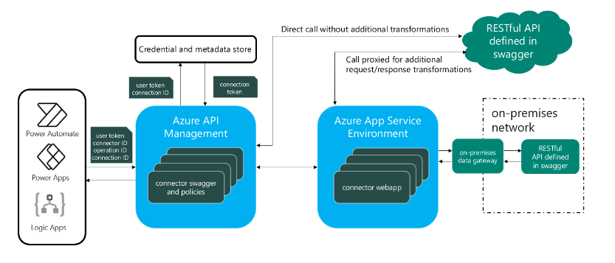
Architecture

Slide 4
Connector components
Design artifacts
Name
Icon
Parameters
Actions
Triggers (not supported in Power Apps canvas apps)
Polling
Listening
Procedural code (optional, preview)
Notes:
Power Platform connectors overview | Microsoft Learn

Slide 5
Definition components
Declarative
Input/output data types
Operations
Http verb
Input/output format
Procedural (preview)
C#
Call pipeline with access to declared parameters
Operates on current request and can modify returned response

Slide 6
Development
PowerApps-based,Logic App-based
General
Auth type (none, basic, API Key, OAuth2 – user based)
Actions/operations
Procedural code
Test
OpenID 2.0 (with some extensions, e.g. design time visibility)
Json (automatically converted to yaml in portal)
Hand-coded
Exported from API or Postman collection
Testing: do not use Test above, include in ‘real’ flow

Slide 7
Deployment
Portal (see above)
Platform Connectors Tools (paconn)

Slide 8
Resources
Documentation
Connectors source repo
Weekly Office Hours with pg

