Slide 1
Detection of ARP Spoofing
CSCI 651 FCN
Rushabh
Mayur

Slide 2
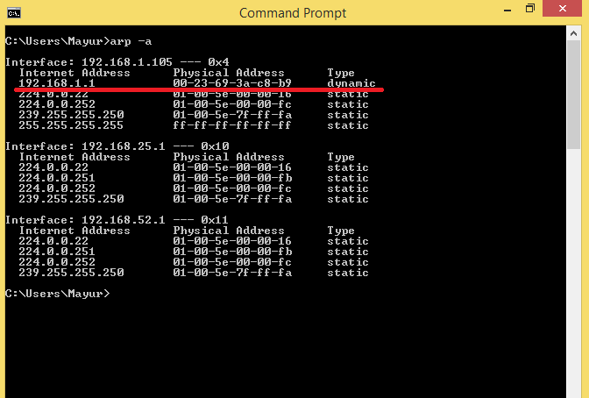
ARP ?
IP to MAC translation
Stateless
ARP reply & Gratuitous ARP packet

Slide 3
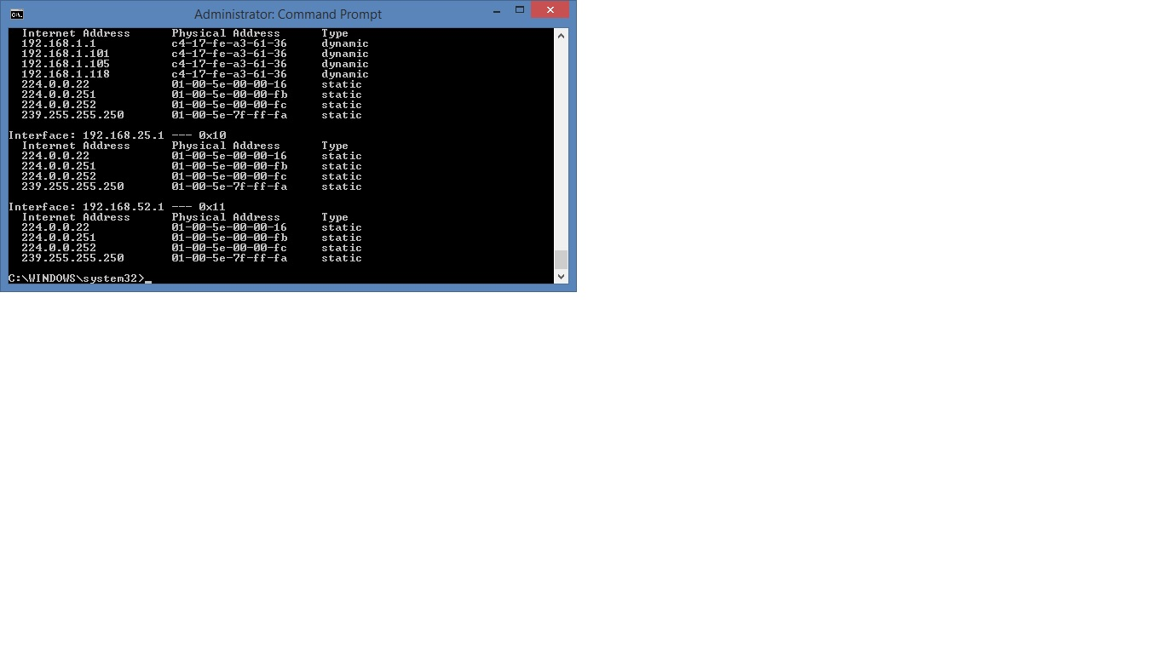

Slide 4
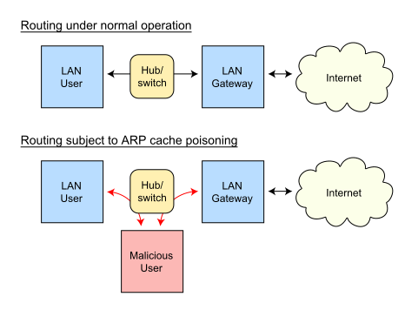
What ? Why ?

Slide 5
Better than
S-ARP
Static MAC entries
Passive detection

Slide 6
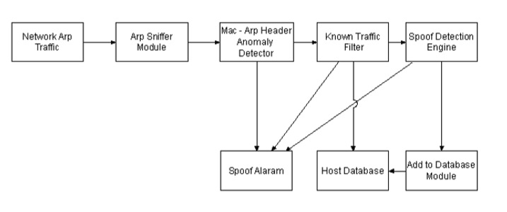
Approach
Active Detection Framework

Slide 7
Implementation
Active detection framework in Java
Jpcap for sniffing network packets
ARPPacket, TCPPacket, EthernetPacket
Etternet to spoof ARP

Slide 8
Milestones
Listening / Sending ARP packets
Generating spoofed packets
Implementation of detection framework
Testing framework against spoofing
GUI (if time permits)

Slide 9
DEMO

Slide 10
References
Detecting ARP Spooﬁng: An Active Technique Vivek Ramachandran , Cisco Systems, Inc., Bangalore India and Sukumar Nandi, Indian Institute of Technology, Guwahati, Assam, India
http://tools.ietf.org/html/rfc826
http://en.wikipedia.org/wiki/Address_Resolution_Protocol
http://jnetpcap.com/docs/javadocs/jnetpcap-1.4/index.html
http://www.java-forums.org/new-java/63347-read-arp-cache.html

Slide 11
धन्यवाद!
Thank You!

