Slide 1
Patient Check-In Process
Front Desk Training

Slide 2
Four Stages of Check-In
Greet the patient
Verify identity and insurance
Update the chart
Direct the patient to the waiting area

Slide 3
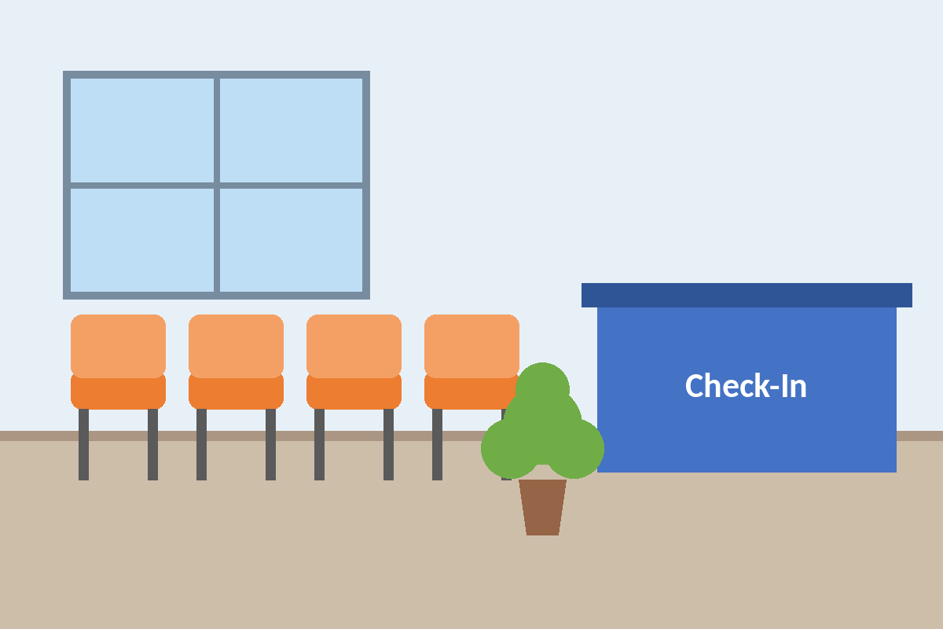
Where Patients Wait
Kiosks

