Slide 1
Organigrama
Singularity Software

Slide 2
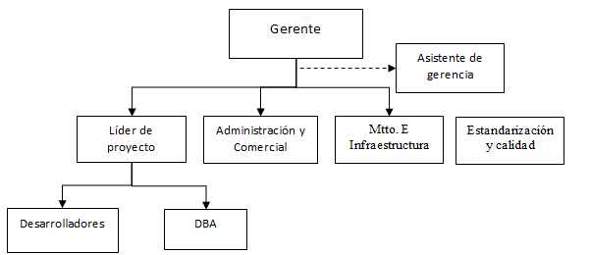
Organigrama

