Slide 1
Digging Around in the
ARCOS Dataset
Michael Rogove
Megana Lakshmi Padmanabhan
Kevin Hederman

Slide 2
Outline
How We Started
What We Found
Where We Ended

Slide 3
How We Started

Slide 4
Original Objective
Our original intent was to look for a correlation in the ARCOS Dataset between:
opioid distribution by geography and
overdose deaths in that vicinity

Slide 5
Original Objective
Our original intent was to look for a correlation in the ARCOS Dataset between:
opioid distribution by geography and
overdose deaths in that vicinity
We wanted to determine if there was a correlation between opioid shipments to an area and an increase in overdose deaths in that area after a certain time period.

Slide 6
Strategies
New Hampshire was chosen to as our region of focus to:
Reduce the problem space
Provide proof-of-concept

Slide 7
Strategies
New Hampshire was chosen to as our region of focus to:
Reduce the problem space
Provide proof-of-concept
Why New Hampshire?
In the hard-hit New England region
Potentially unexplored data
Fewer geographic variables
zip codes / counties

Slide 8


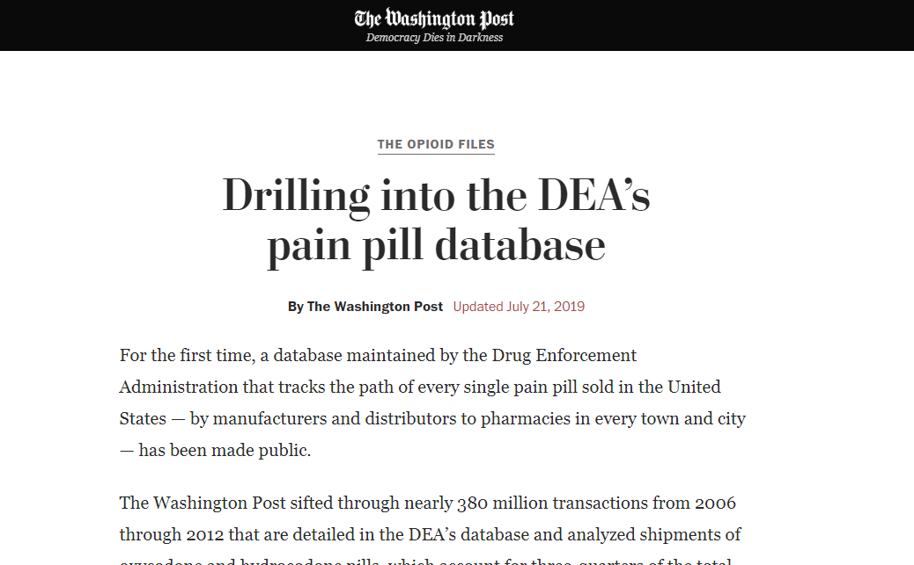

Datasets
ARCOS Dataset from the Washington Post
“Automation of Reports and Consolidated Orders System”
Tracks orders from manufacturers to individual pharmacies
Data from 2006 - 2012
Contains 178,598,027 entries
Approximately 75 GB

Slide 9
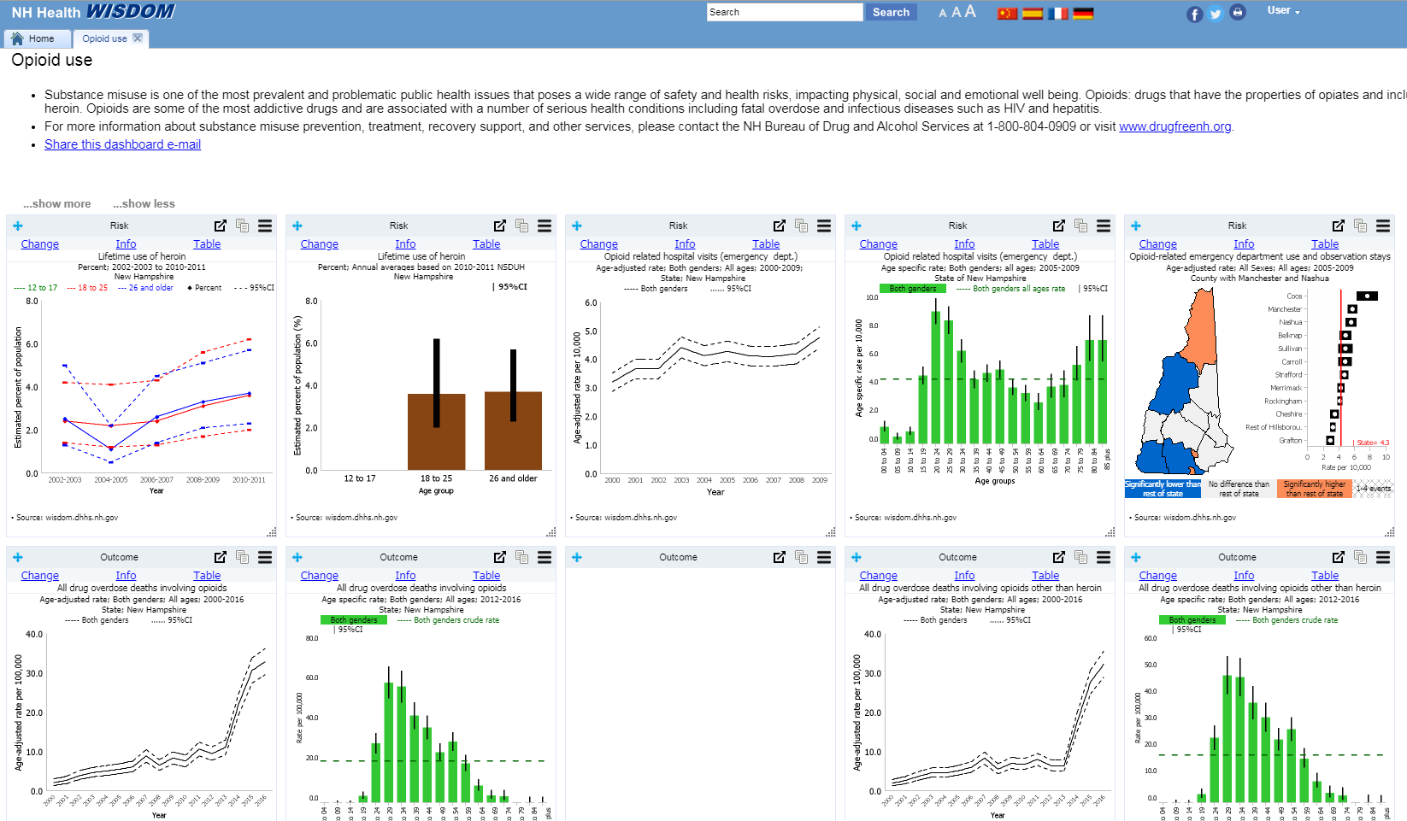
Datasets
NH Health WISDOM
Notes:
Our initial review of existing data sources turned up lots of .gov resources. This is the “WISDOM” portal. Pretty informative, if clunky.
Deaths spiked in the period after the observation, and largely from synthetic opioids (fentanyl introduction)
This led us away from performing the correlation analysis, since the spread of prescription medications might foretell those death trends rather than directly cause them.

Slide 10
Original Plan Overview
ARCOS
PySpark
NH ARCOS
Joined Data
Examine
NH OD Deaths

Slide 11
Original Plan Overview
ARCOS
PySpark
NH ARCOS
Joined Data
Examine
NH OD Deaths
Joined Data:
Destination / quantity / time of shipments
Time of opioid overdose deaths
Notes:
(this was the plan, but then…)

Slide 12
What We Found

Slide 13
New Tools
During our research, we found new toolsets, including the ARCOS API.
Published by the Washington Post
Provides focused tools to drill into data
Operates in R
Notes:
These changed our approach.

Slide 14
New Tools
During our research, we found new toolsets, including the ARCOS API.
Published by the Washington Post
Provides focused tools to drill into data
Operates in R
Live Demo
Notes:
See: “R_output_2019_12_6” or “RScriptAPIProj”/similar name.
Use Anaconda Navigator → environment that has R → Open Notebook.
We used the ARCOS API, which is intended for use by researchers, journalists, etc., to reframe our questions.

Slide 15
Primary Tools
Google Cloud Platform
General operating environment
PySpark
Vehicle to manipulate data
Various Python Libraries
Toolsets to manipulate the data

Slide 16
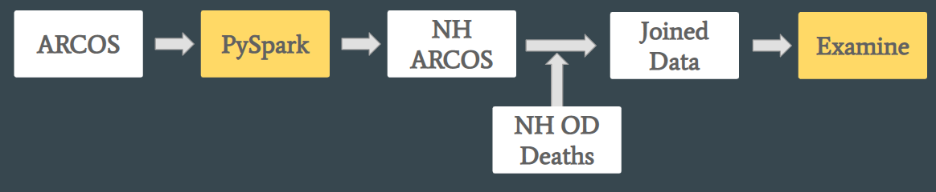
New Approach
With new direction, we wanted to dig deeper using a big data toolset.
Compressed ARCOS database downloaded to Google Cloud Platform; unzipped on a GCP VM.
Data hosted on GCP Bucket storage.
Computation run on GCP Dataproc.
PySpark Jupter Notebook.
Notes:
1+2- We used a similar approach to HW1 - a beefy VM, with a large persistent disk mounted. GCP provides a good walkthrough for mounting the disk. Then used gsutil to copy to Bucket.
3- Covered in the PySpark Jupyter Notebook

Slide 17
New Approach
With new direction, we wanted to dig deeper using a big data toolset.
Compressed ARCOS database downloaded to Google Cloud Platform; unzipped on a GCP VM.
Data hosted on GCP Bucket storage.
Computation run on GCP Dataproc.
PySpark Jupter Notebook.
Live(?) Demo
Notes:
See: “PySpark_Output_2019_12_10.pdf” or OpioidProjectNotebook.ipynb
1+2- We used a similar approach to HW1 - a beefy VM, with a large persistent disk mounted. GCP provides a good walkthrough for mounting the disk. Then used gsutil to copy to Bucket.
3- Covered in the PySpark Jupyter Notebook

Slide 18
The compressed ARCOS database was downloaded into Google Cloud Platform and unzipped on a virtual machine.
This unzipped data was loaded into PySpark for manipulation and evaluation.

Slide 19
We ran into an issue identifying a reliable set of data for NH overdose deaths.
Research indicated that overdose deaths spiked after the period of data we were examining (2006 - 2012)
Further, most opioid deaths ended up being the result of synthetic opioids (e.g. fentanyl), rather than prescription drugs
Notes:
Now that we have interesting county-level output, let’s revisit the original plan...
I touched on this in the .gov sources slide notes, a few slides earlier. Essentially, deaths spiked after this period, from synthetic opioids like fentanyl, rather than prescription drugs. This could be the confluence of the incredible potency of fentanyl combined with a decrease in prescriptions after ~2012 from new regulations.

Slide 20
New Tools
The ARCOS API illustrated the effectiveness of using GIS visualization.
We decided to explore the incorporation of additional GIS tools into our analysis.
QGIS is a free and open-source Geographic Information System, that supports viewing, editing and analyzing geospatial data.
This tool is used to analyze and represent the retrieved opioid consumption data and the SVI data geographically.

Slide 21
New Data
Additional consultations provided insight into previously unknown datasets:
The CDC has huge, publicly available datasets on the “Social Determinants of Health” based on nationwide census data
One such dataset is the “Social Vulnerability Index”

Slide 22
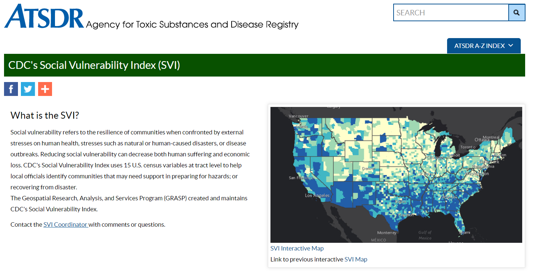

Slide 23
Social Vulnerability Index
The Social Vulnerability Index (SVI) is a data-backed ranking developed by the CDC to determine a rating of “Social Vulnerability”
Used by the CDC to identify areas that might be particularly sensitive to hazardous events
The SVI ranks each tract on 15 social factors, including poverty, lack of vehicle access, and crowded housing, and groups them into four related themes.

Slide 24
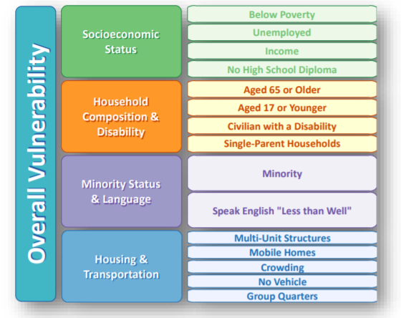
Social Vulnerability Index

Slide 25
New Objective
Following our initial examinations, we modified our objective to map opioid distribution to SVI data from the CDC.
We wanted to highlight any correlation between opioid shipments to an area and social determinants of public health within that community.

Slide 26
Updated Overview
ARCOS
PySpark
NH ARCOS
Joined Data
Examine
NH SVI Data
Isolated New Hampshire SVI Data:
% of population below poverty line
% of population unemployed
% of population with a disability
Per capita income

Slide 27
Where We Ended

Slide 28
Findings

Slide 29
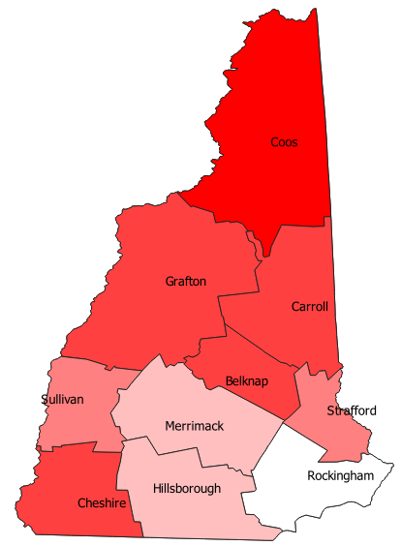
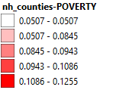
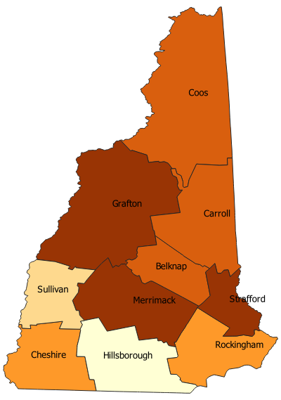
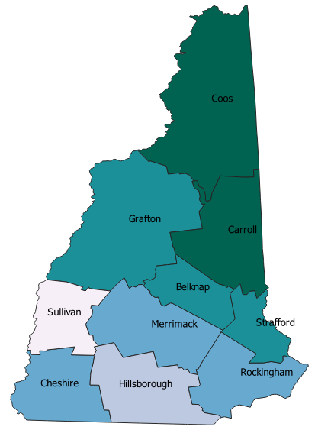
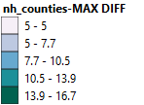
Maps showing the SVI Index Data

Slide 30
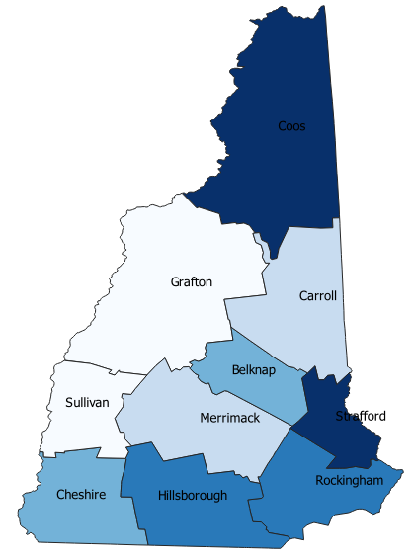
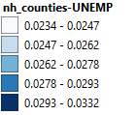
Maps showing the SVI Index Data

Slide 31
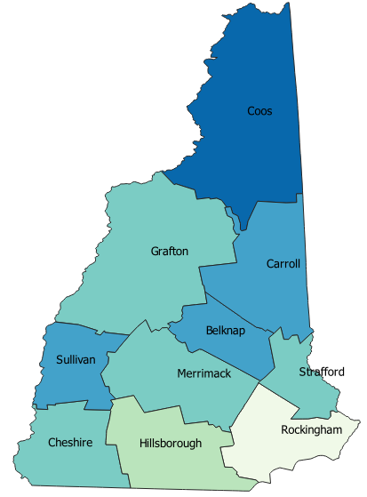
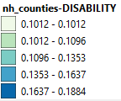
Maps showing the SVI Index Data

Slide 32
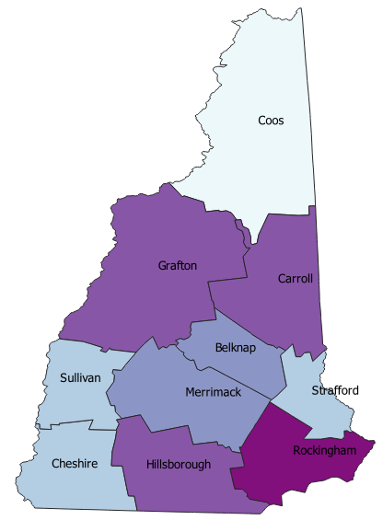
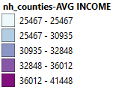
Maps showing the SVI Index Data

Slide 33
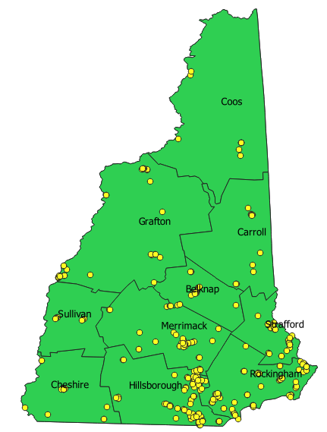
Pharmacies in New Hampshire
Notes:
Comments for future work - incorporating pill volume into the pharmacy dots - like a heatmap

Slide 34
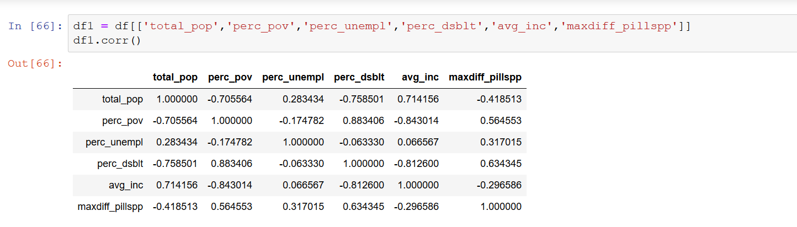
Findings
Notes:
(and largest positive correlation makes sense - disabilities sometimes include chronic pain, and opioids were over-prescribed as part of chronic pain management)
These results stored in county_summary python notebook.

Slide 35
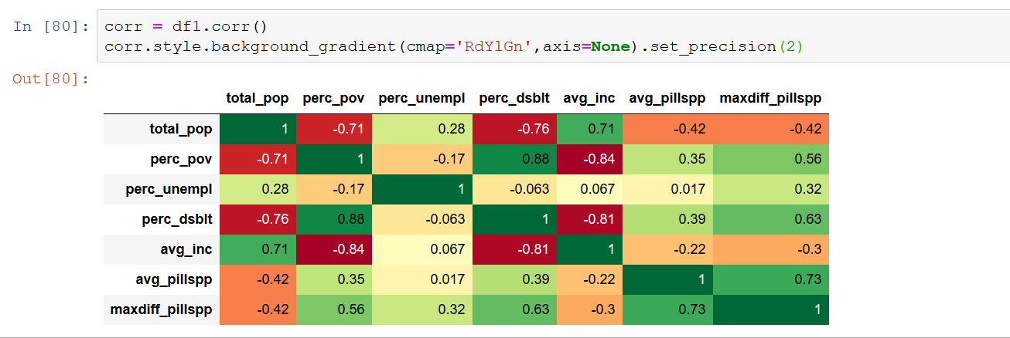
Findings
Notes:
(and largest positive correlation makes sense - disabilities sometimes include chronic pain, and opioids were over-prescribed as part of chronic pain management)
These results stored in county_summary python notebook.

Slide 36
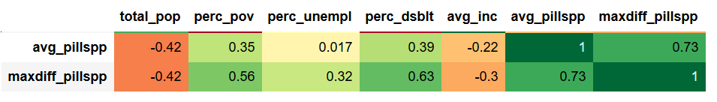
Findings
Largest positive correlation - % with a Disability and Increase in Pills/Person (by County)
Large positive correlation - % Below Poverty Line and Increase in Pills/Person (by County)
Negative correlations with Average Income and both opioid measures
Notes:
(and largest positive correlation makes sense - disabilities sometimes include chronic pain, and opioids were over-prescribed as part of chronic pain management)
These results stored in county_summary python notebook.

Slide 37
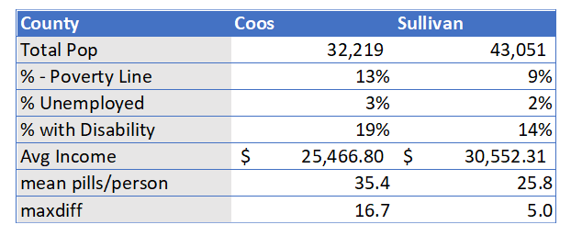
Findings
Notes:
Interesting comparison between the counties that experienced the largest and smallest change in Rx pills/person.
What else could be going on here? Public health initiatives? Distribution of pharmacies?

Slide 38
Big Picture
We realized in retrospect that we effectively navigated 2 useful processes:
ARCOS
Focused Analysis
Local Opioid Picture
WaPo Tools
PySpark
Public Health Correlation

Slide 39
Further Exploration
The Social Vulnerability Index (SVI) data exists for every census tract in the country - this analysis could be applied everywhere
Interesting findings during the deep dives on local data - these could provide a framework for potential local interests, including local investigative reporting.
PySpark allows us to go beyond the pre-filtered data provided by the ARCOS API.

Slide 40
The Social Vulnerability Index (SVI) data exists for every census tract in the country - this analysis could be applied everywhere
Interesting findings during the deep dives on local data - these could provide a framework for potential local interests, including local investigative reporting.
PySpark allows us to go beyond the pre-filtered data provided by the ARCOS API.

Slide 41
Q&A
Thank you!

