Slide 1

RV Institute of Technology and Management
Department of Computer/Information Science and Engineering
JP Nagar, Kothanur, Bengaluru - 560076
18CSL58: DBMS LABORATORY WITH MINI PROJECT
Project Title
Presentation
Presented by:
Student Name (USN)
Department
Batch
Under the Guidance of:
Guide Name
Designation Affiliation

Slide 2
Agenda
Abstract
Introduction
Aim and Objectives
Methodology
ER Diagram
Schema Diagram
Data Flow Diagram
Implementation
Instances
User Interfaces
SQL Queries processing the data
Results and Conclusion
Demonstration of the Project
References

Slide 3
Abstract
Brief description of the project work.

Slide 4
Introduction
Bullets points
Introduction about project

Slide 5
Aim and Objectives
List the Problem Statement
List the Objectives

Slide 6
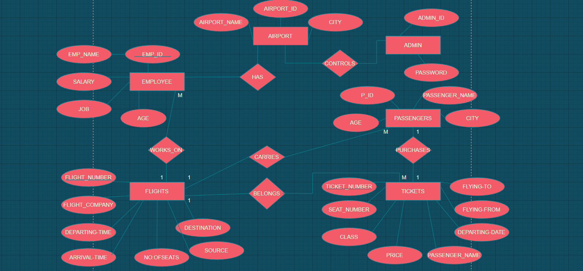
Methodology
ER Diagram (Sample is shown below)

Slide 7
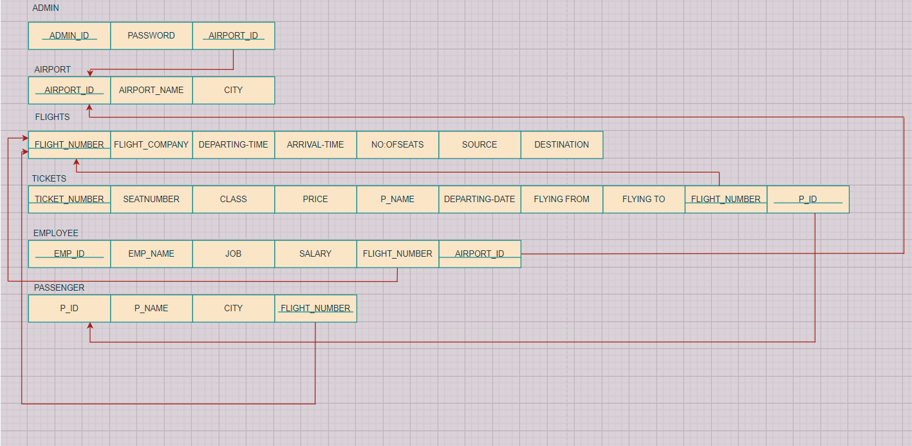
Schema Diagram (Sample is shown below)

Slide 8
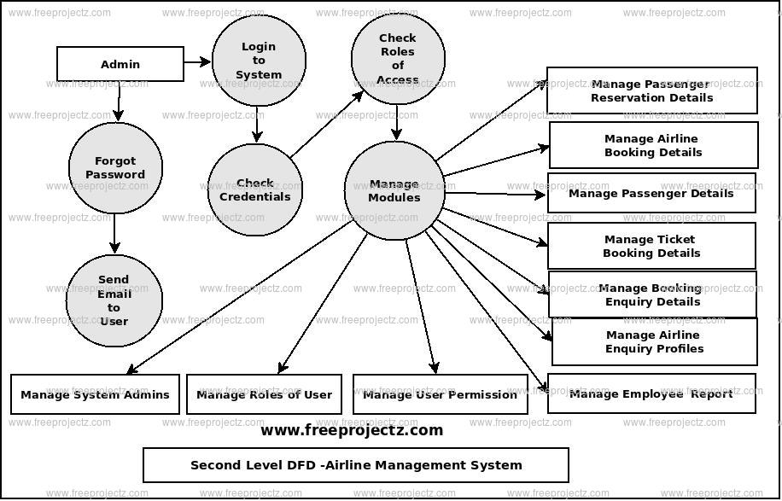
Data Flow Diagram (Sample is shown below)

Slide 9
Implementation
Instances
User Interfaces
SQL Queries processing the data

Slide 10
Results
Display the Screenshots

Slide 11
Conclusion
Add the conclusion in short

Slide 12
Demonstration of the Project
You should demonstrate the entire project

Slide 13
References
Basic Format:
Books:
[1] J. K. Author, “Title of chapter in the book,” in Title of His Published Book, xth ed. City of
Publisher, Country if not USA: Abbrev. of Publisher, year, ch. x, sec. x, pp. xxx–xxx.
Example:
[1] R. L. Myer, “Parametric oscillators and nonlinear materials,” in Nonlinear Optics, vol. 4, P. G. Harper and B . S. Wherret, Eds. San Francisco, CA: Academic, 1977, pp. 47-160.
Papers Presented at Conferences
[1] J. K. Author, “Title of paper,” presented at the Unabbrev. Name of Conf., City of Conf.,
Abbrev. State, year.
Example:
[2] J. G. Kreifeldt, “An analysis of surface-detected EMG as an amplitude-modulated noise,”
Presented at the 1989 Int. Conf. Medicine and Biological Engineering, Chicago, IL.
Journal
[1] Author Name, “Title of paper,” Name of the journal, vol, year, pp.xxx-xxx.
Example:
[1] Devid, Insulation “design to combat pollution problem”, Proc of IEEE, PAS, Vol 71, Aug
1981, pp 1901-1907.

Slide 14
Thank You

