Slide 1
MP1 ECE 471 Fall 2024
Zach Larson (zlarson2), Máximo Rojas (mgr9), Matthew Paul (mjpaul3)

Slide 2
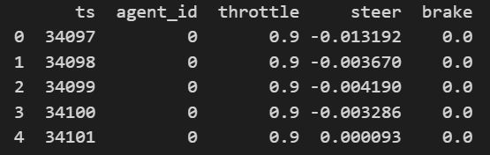
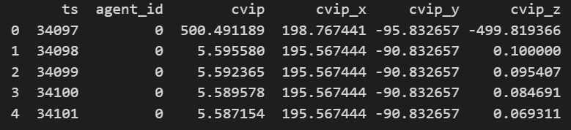
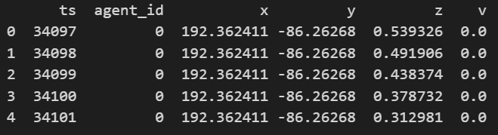
Task 1
Clear night: _ctl.csv
From the simulation with Carla, our team obtained data for 6 EV driving scenarios with different weather conditions. For each scenario, the data was split into 3 different files and consisted of the following features:
Timestamp (ts)
ID of the AV (agent_ID)
Acceleration of the AV (throttle)
Direction of the AV (steer)
Braking of the AV (brake)
Distance of AV to NPC Actor (cvip)
Horizontal location of AV (x)
Moving direction of AV (y)
Speed of AV along y-axis (v)
Clear night: _cvip.csv
Clear night: _traj.csv

Slide 3
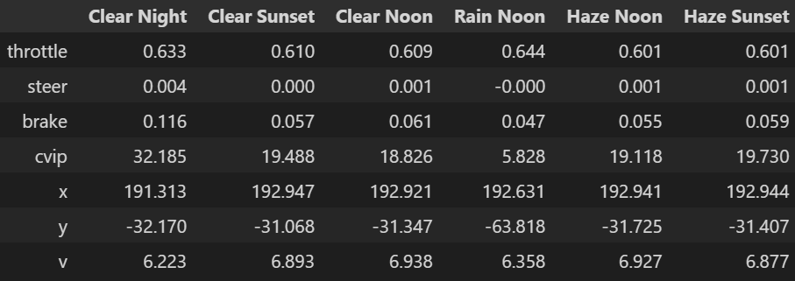
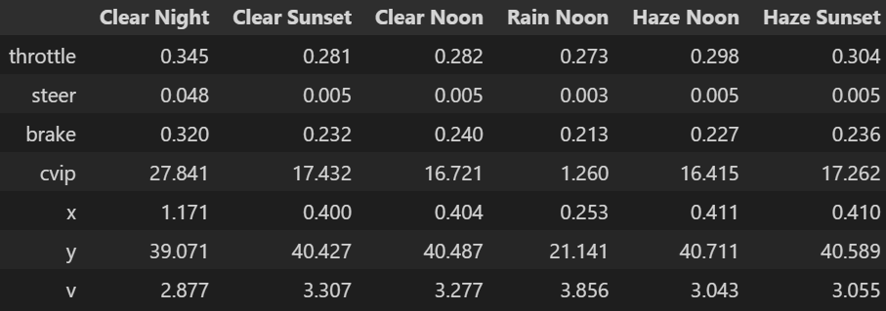
Task 1
Means Table
Scene Durations
Clear Night: 838 ms
Clear Sunset: 756 ms
Clear Noon: 750 ms
Rain Noon: 400 ms
Haze Noon: 751 ms
Haze Sunset: 757 ms
Standard Deviations Table

Slide 4
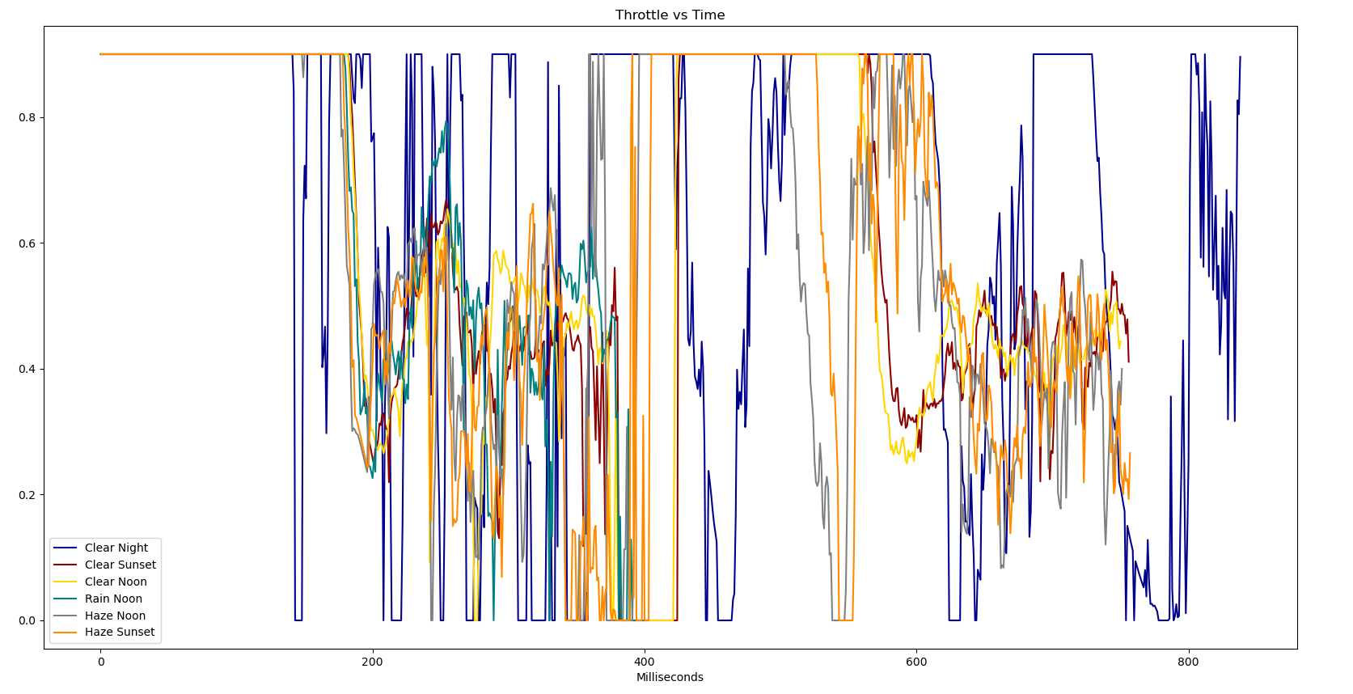
Task 1
Campaign Result Visualization

Slide 5
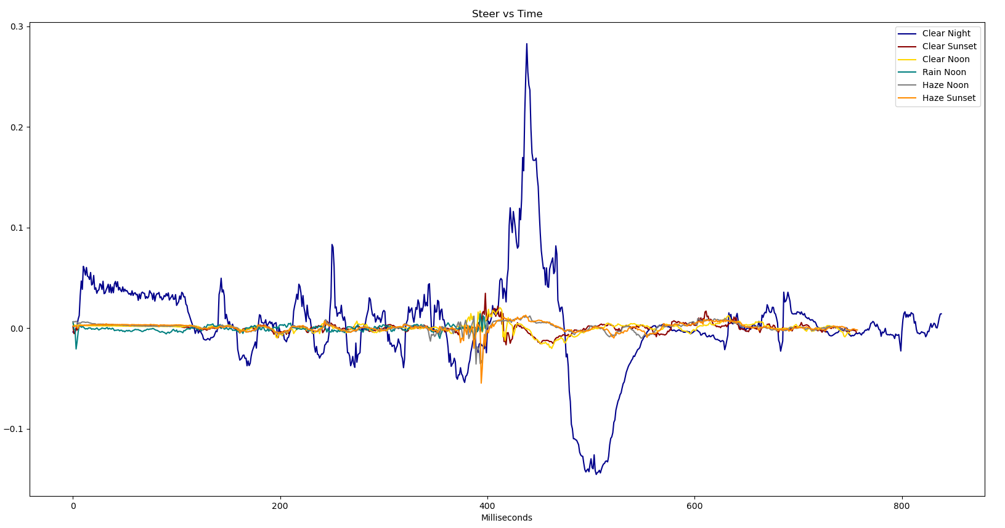
Task 1
Campaign Result Visualization

Slide 6
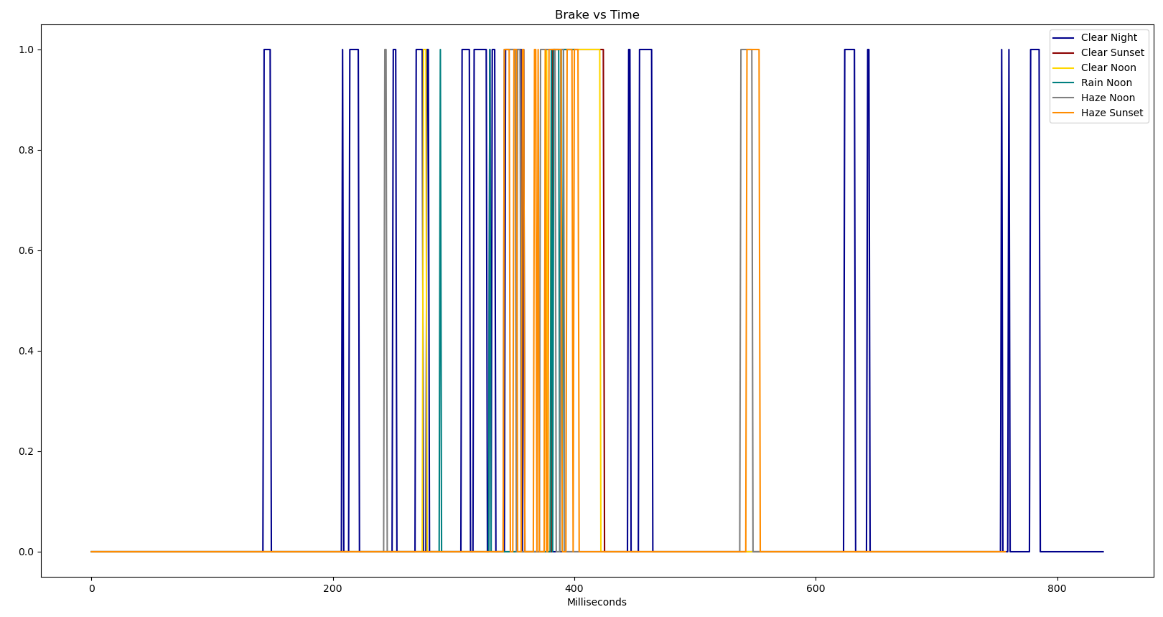
Task 1
Campaign Result Visualization

Slide 7
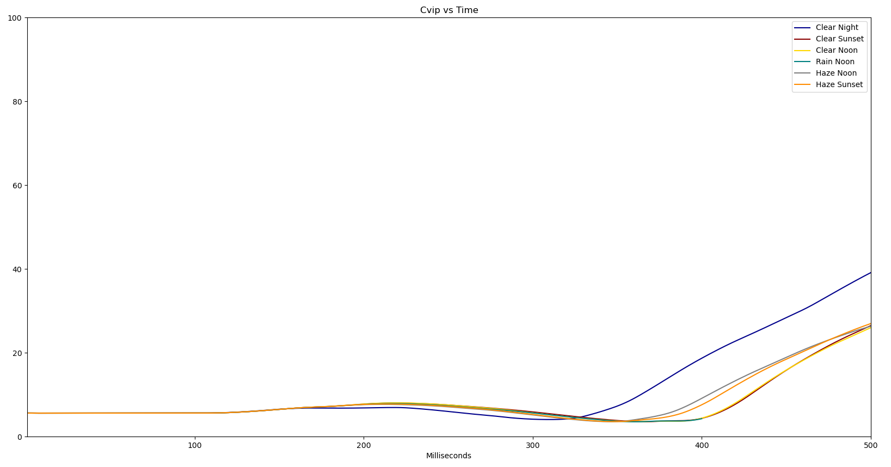
Task 1
Campaign Result Visualization

Slide 8
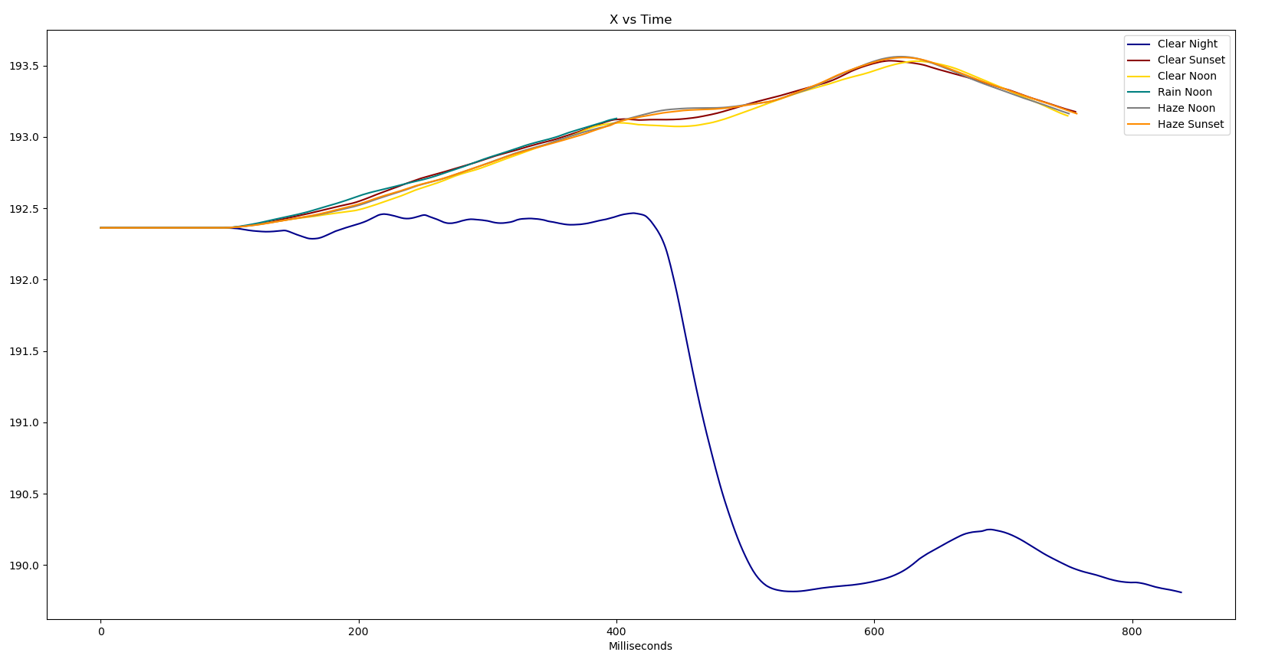
Task 1
Campaign Result Visualization

Slide 9
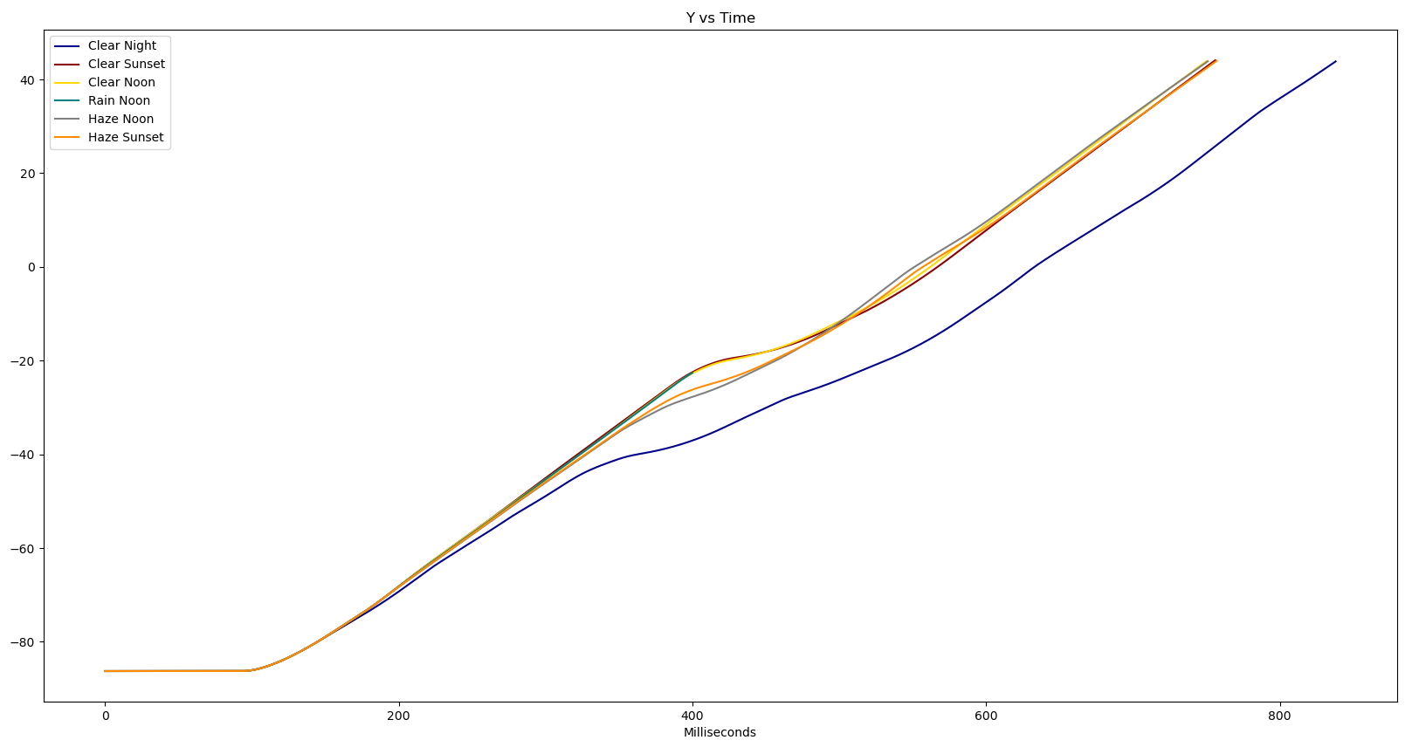
Task 1
Campaign Result Visualization

Slide 10
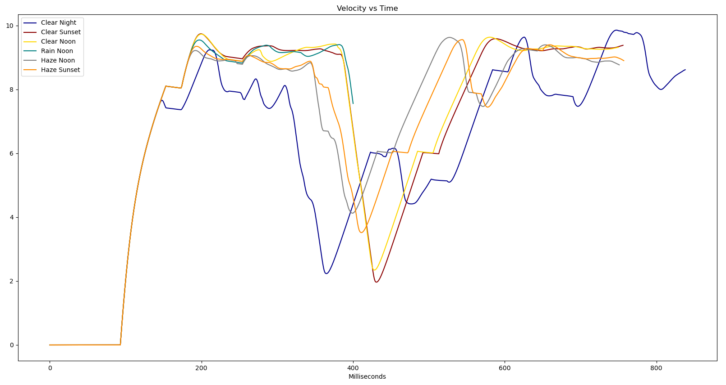
Task 1
Campaign Result Visualization

Slide 11
Task 1
Experience and Intuition: How should crashing affect car motion?
throttle: would expect to be negative, as velocity slows
velocity: would expect to drop
steer: direction may or may not change
brake: may or may not change depending on the abruptness of the crash. Would expect a slight change in general
x, y, cvip: would be hard to compare against non accident data
Based on the throttle, steering, and change in x-location in the clear night scenario, our group predicts a crash in that condition. No other EV in each of the different scenarios appears to have such volatile driving characteristics as compared to in this scenario.

Slide 12
Task 2
Q1: The probability of accident is 1/6.
Our data includes 6 simulations in distinct weather conditions. There was only one recorded crash, which took place in the rain-noon simulation. Therefore, without knowing the weather conditions, the probability of a crash in any given condition would be 1/6.

Slide 13
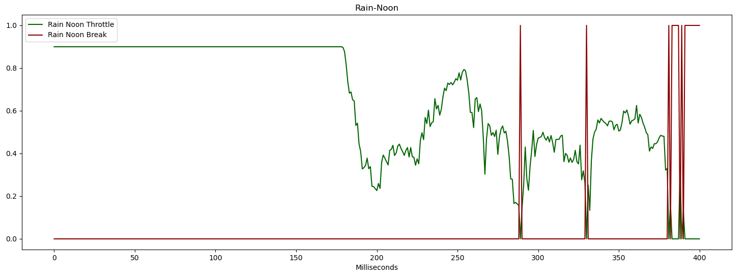
The crash occurred in the rain-noon weather condition, which does not match the prediction from Task 1. It took place slightly after 400 milliseconds into the simulation. The graphs give no obvious insight into why the crash occurred exactly at that time. Some minor observations from the plots include the following:
Insufficient breaking: the graph reveals that the vehicle did not break consistently during the time right before the crash. Additionally, it began breaking later than in the other cases. This lines up with what we viewed in the simulation through Carla.
Throttle: From the throttle vs time graph, we can see the vehicle accelerating immediately preceding the crash.
Cvip: The EV remained consistently close to the risky NPC actor throughout the duration of the simulation.
Task 2

Slide 14
Task 2
There was one other weather condition in which the EV displayed atypical behavior. As mentioned previously, this was the clear night scenario. Some of the atypical behavior included:
Consistently lower speeds
Lane change
Jittery steering, even before lane change
Throttle usage very jumpy, typically either fully on or fully off
Maintained maximum distance from NPC actor
We believe many of these observations are due to EV nighttime programmed behavior probably being more risk-adverse and aware of surroundings.

Slide 15
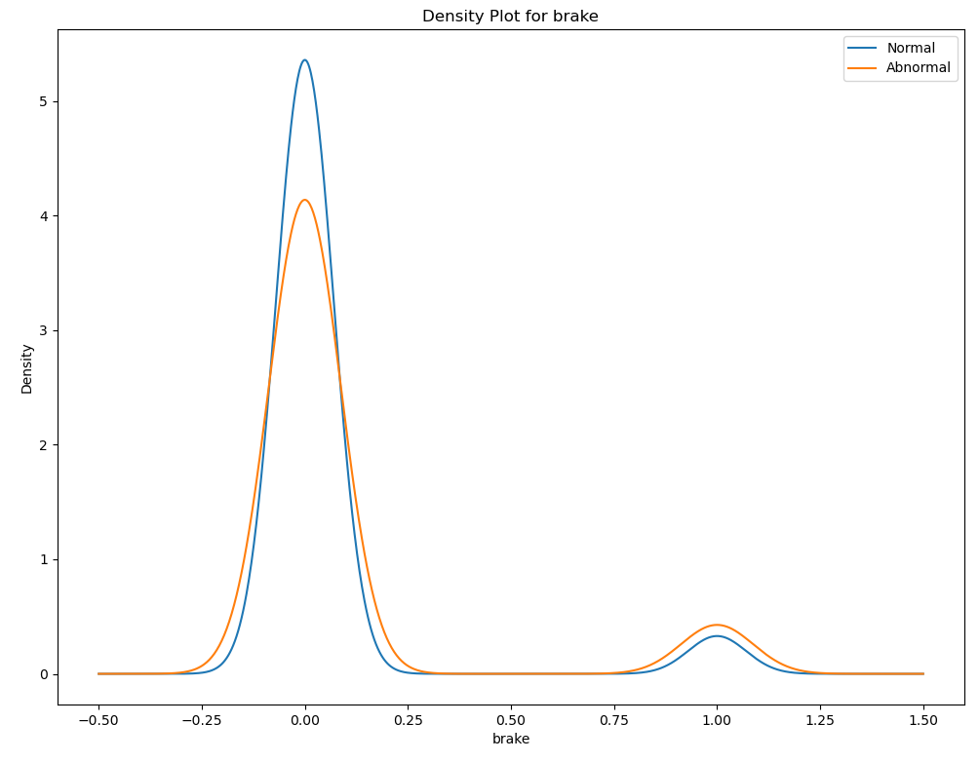
Task 2
Distribution of the Features: Normal vs Abnormal

Slide 16
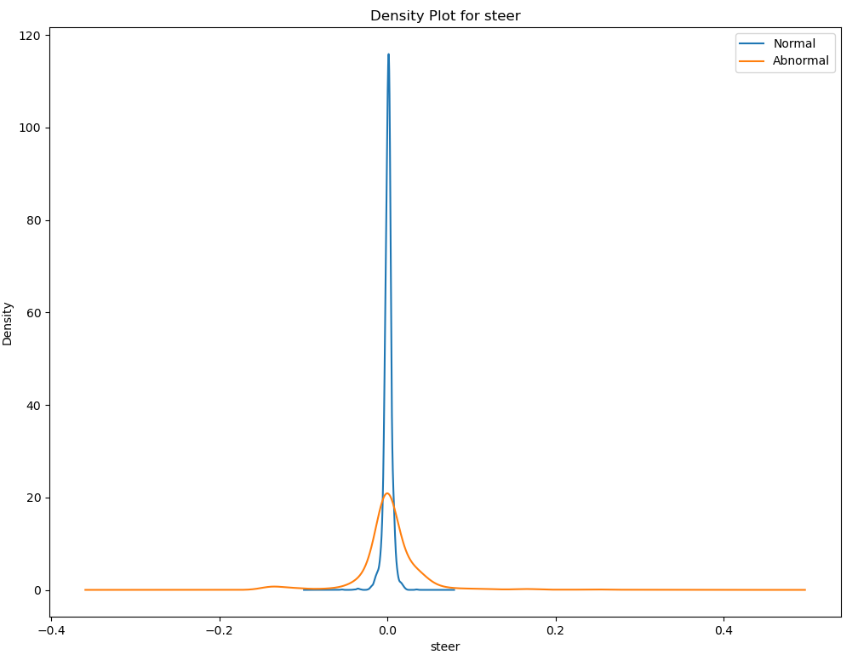
Task 2
Distribution of the Features: Normal vs Abnormal

Slide 17
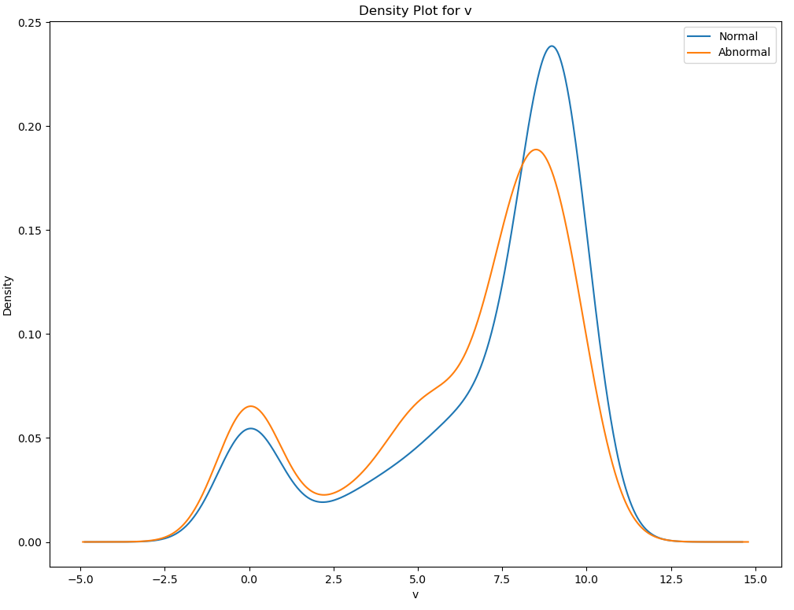
Task 2
Distribution of the Features: Normal vs Abnormal

Slide 18
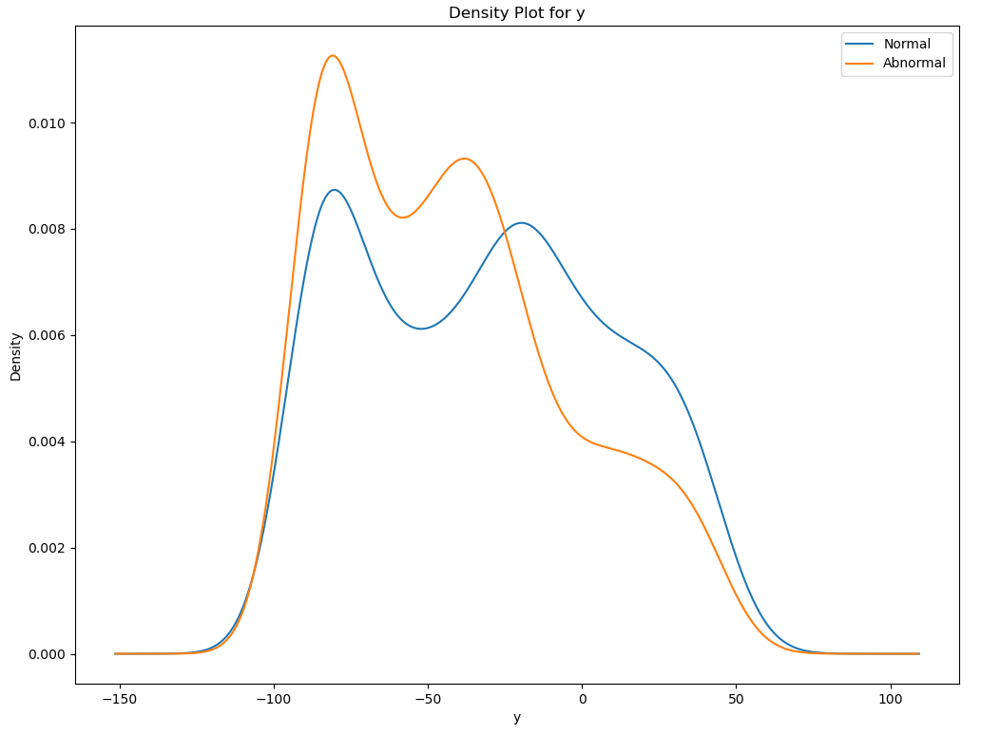
Task 2
Distribution of the Features: Normal vs Abnormal

Slide 19
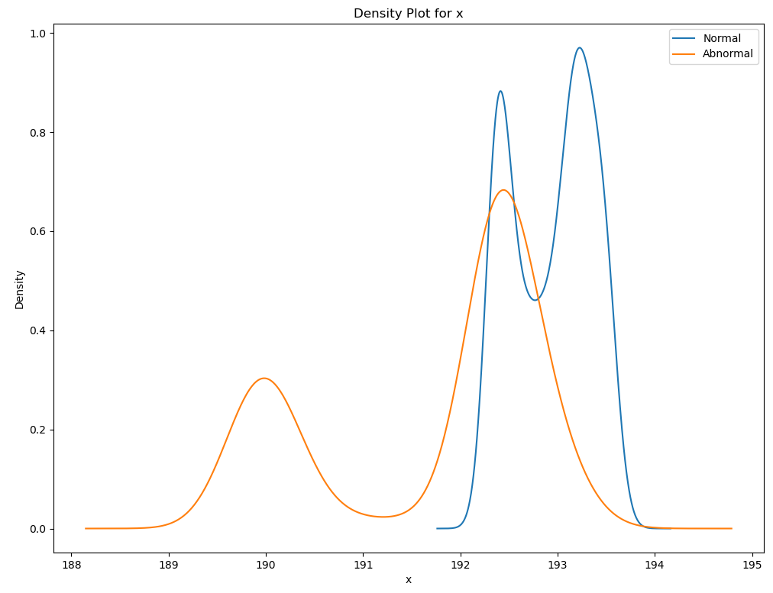
Task 2
Distribution of the Features: Normal vs Abnormal

Slide 20
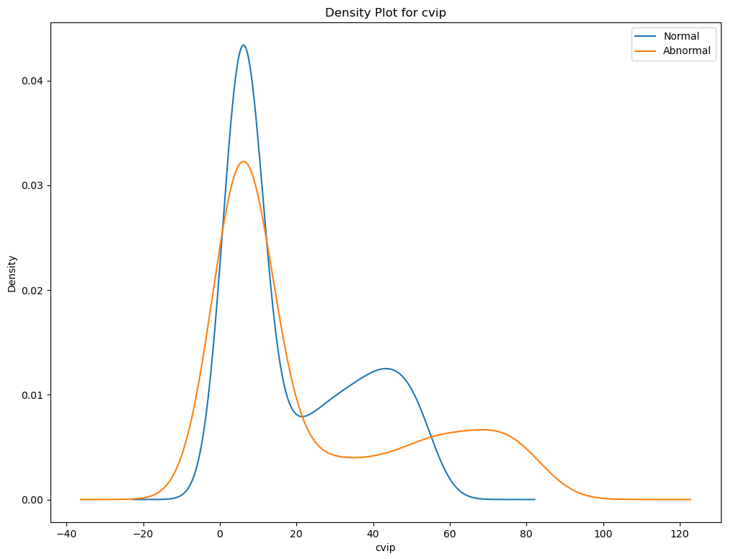
Task 2
Distribution of the Features: Normal vs Abnormal

Slide 21
Task 2
Q4.b: Use 2-sample t-test to test on the ‘steer’ values of abnormal runs vs normal runs.
State the null and alternative hypotheses
H0:
H1:
Perform the test and calculate test statistics
Assume a significance level of 0.05, what is your conclusion
Q4.c: Does the testing result contradict your observation on the ”steer” feature in part 4.a? Why?

Slide 22
Task 2
Q5: Some of the features are better indicators of abnormal AV behavior, can you identify them?
By looking at the distribution plots of the features in Task 2.4, explain your choice of indicators.
For the fields you identified as good accident indicators above, are they related (Calculate the Pearson correlation coefficient between each pair of the indicators to justify your answer)? If so, how does that affect the predicting power of using one indicator versus using all of them?

Slide 23
Task 2
Q6: Suppose we want to use hypothesis testing to test whether the field you choose from Task2.5 is indeed a good indicator of abnormal AV behavior, using the Kolmogorov–Smirnov two-sample test.
Construct the null and the alternative hypothesis and state them below
H0:
H1:
Perform the KS two-sample test and calculate its statistics.
Assume a significance level of 0.05, what is your conclusion?
Repeat the same test on a feature that you did not select as an indicator of abnormal behavior in Task 2.5, what is your conclusion?
What are the major differences between the KS test and the t-test?

Slide 24
Task 2
Q7: Keeping in mind that this experiment is executed over a period of time, what assumption did you make when using the KS two-sample test on the distributions in Task2.6? Are you able to come up with one situation where this assumption fails?

Slide 25
Task 2
Q8: The dynamic-time-wrapper (DTW) is a method to compare two time-series data (such as the control and the trajectory data collected in our simulation). Use the DTW package in python (dtaidistance · PyPI), and apply the DTW distance on the two time-series dataset (using steering data of clear-noon as a reference): (1) steering data of clear-night and (2) steering data of clear-sunset. What can you say about the DTW distance for (1) and (2) with respect to the reference?

