Slide 1
Great Wood Hexcrawl — Reference Deck
For PPT Copilot: maps, mechanics, POIs, creatures, encounter tables
Stonetop Campaign — GM Reference
Hex size: 2 hours edge-to-edge
Style inspiration: Hot Springs Island

Slide 2
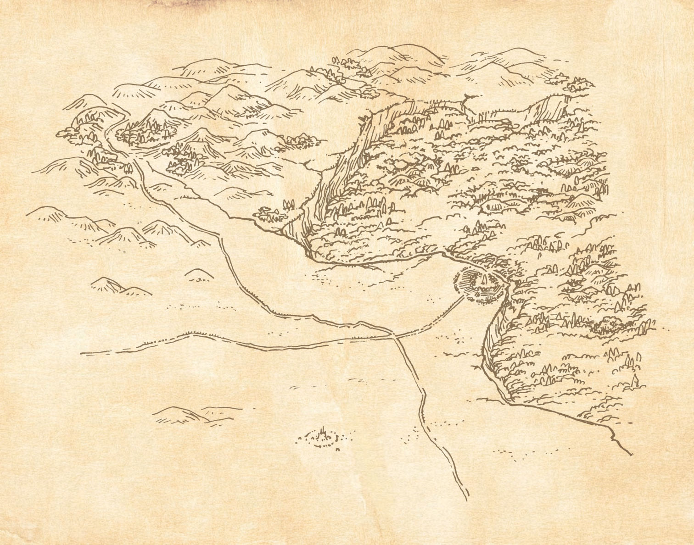
Vicinity Map (Stonetop)

Slide 3
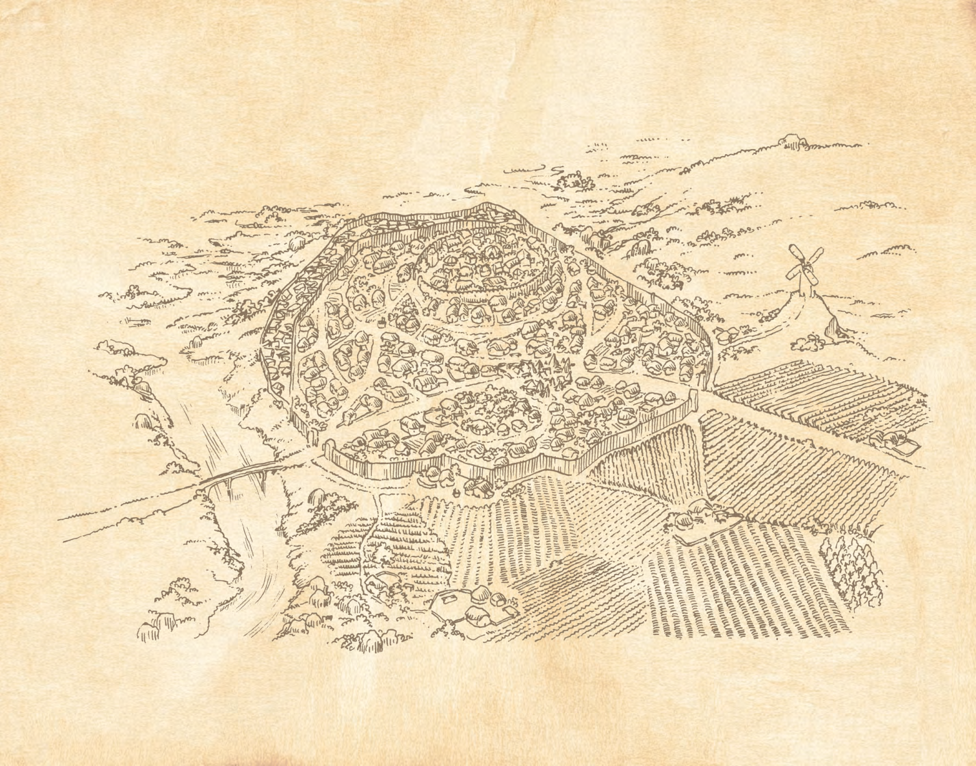
Great Wood Area Map

Slide 4
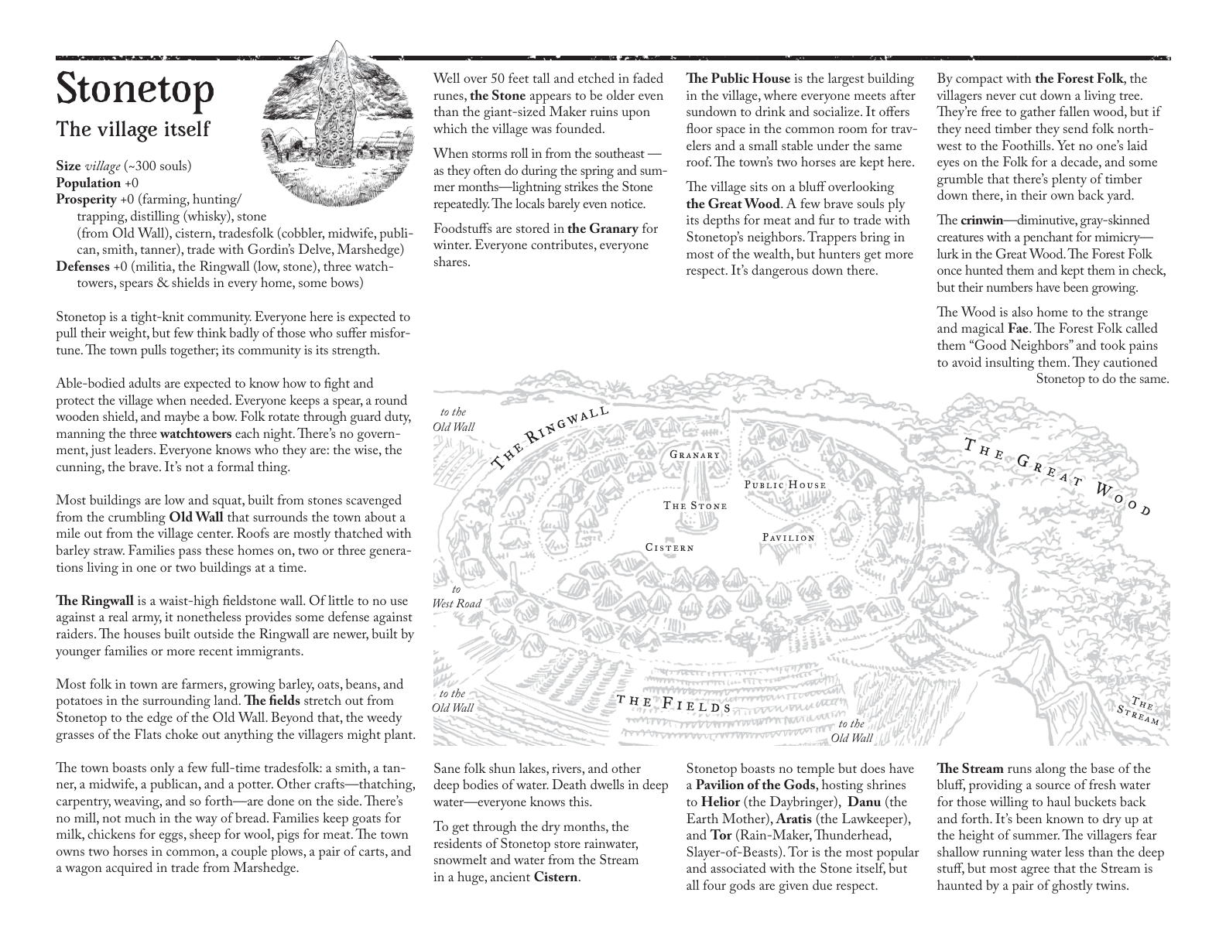
Stonetop Village Map

Slide 5
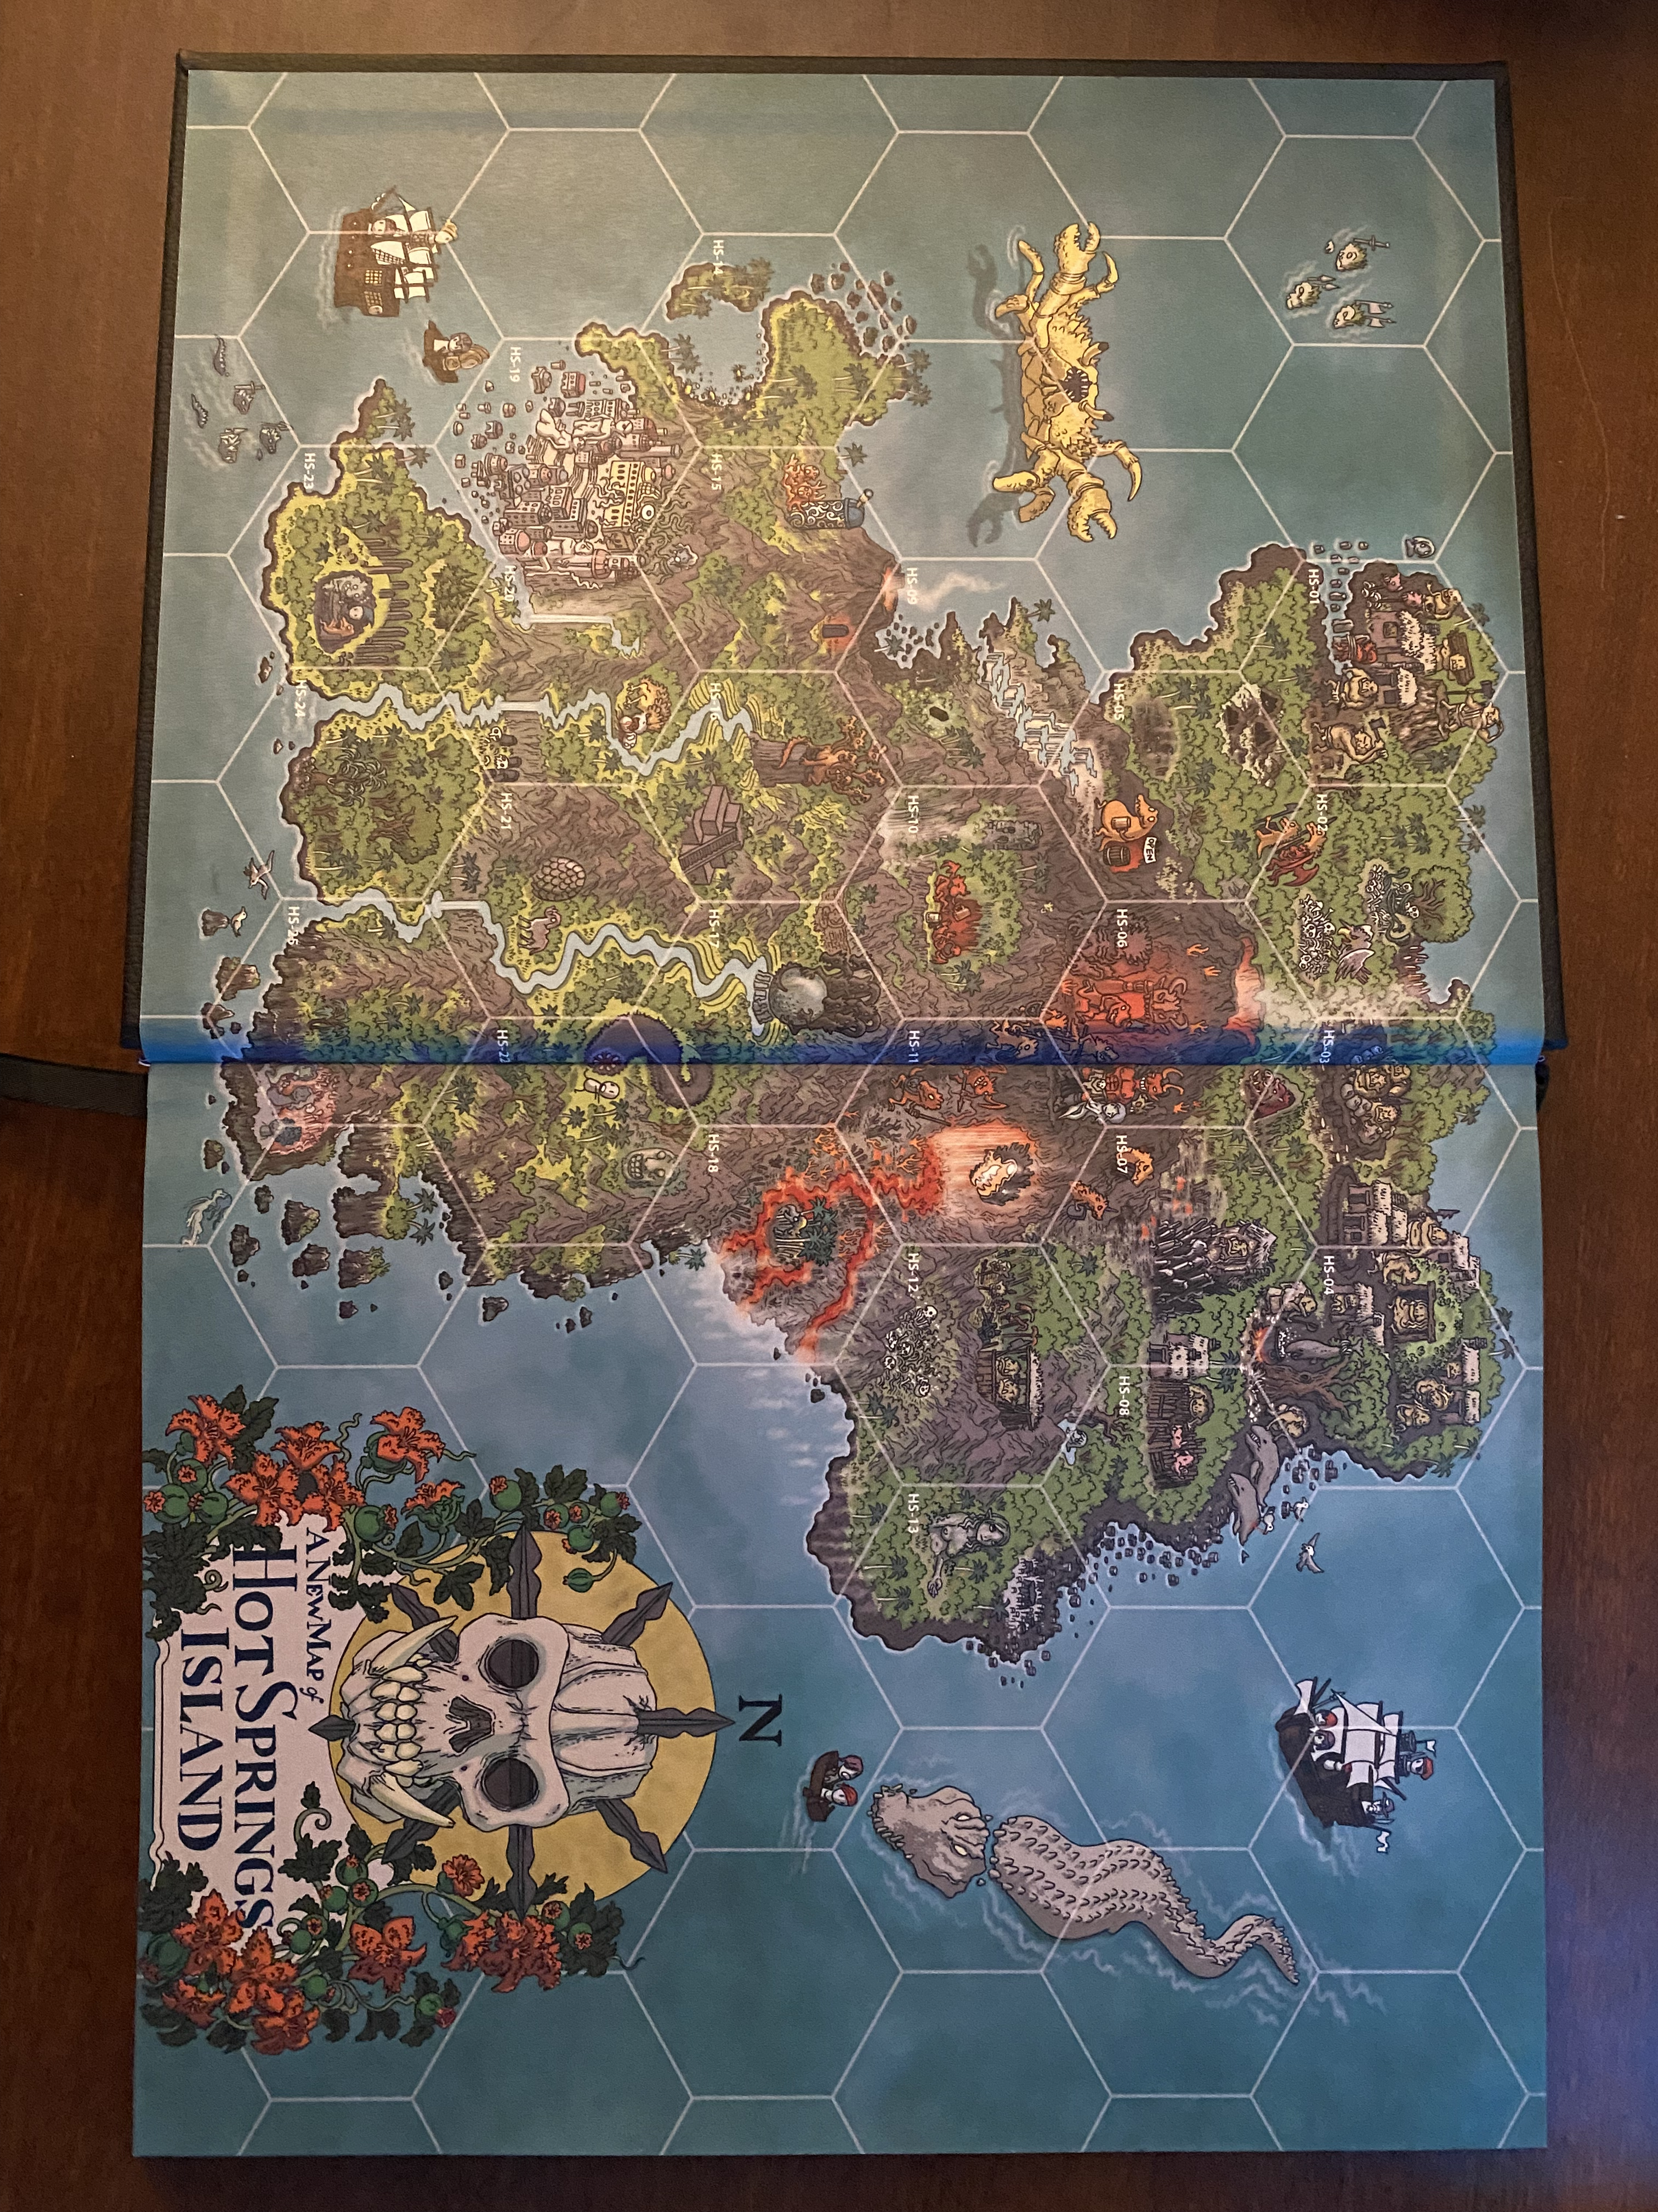
INSPIRATION: Hot Springs Island Map

Slide 6
Mechanic Reconciliation: HSI + Stonetop
HSI Mechanic | Stonetop Mechanic | Our Resolution
WATCH (4hr) = 1 action | Legs of travel (narrative) | Use 2-HOUR HEXES as time unit. Travel 1 hex = 1 watch (2hr). GM frames narratively per Stonetop.
Explore hex (1 watch) | Present a discovery (GM move) | Exploring = spending 2hr. Roll discovery table or reveal POI. Narrate as Stonetop exploration move.
Travel to adjacent (1 watch) | Leg of travel | Moving 1 hex = 2hr. Stonetop legs = hex-to-hex.
Investigate a POI (1 watch) | Seek Insight / Know Things | HSI investigate = Stonetop player moves. Keep dice.
Encounter tables (3d6) | Dangers/Discoveries (Die of Fate) | Create tables per terrain type with Stonetop creatures + perilous rules.
Poker chips (6/day) | Supplies (uses/day) | Use chips to track watches. 12 chips = 24hr. ~5-6 for action before camp.
N/A | Chart a Course | KEEP. PCs Chart a Course before entering wood.
N/A | Forage (2d6+WIS) | KEEP. Foraging = 1 watch (2hr, half-speed).
N/A | Make Camp | KEEP. Costs 1 watch min. GM asks per rules.
N/A | Struggle as One | KEEP. Difficult terrain hexes or forced marches.
N/A | Keep Company | KEEP. Camp or uneventful watches.
THE DARK (hidden info) | GM notes/threats | Adopt THE DARK format per POI.

Slide 7
Travel Time Calibration (2-Hour Hexes)
From Stonetop Book I examples:
• Stonetop to Stream: "a few minutes" = same hex edge
• Stream to first notable Wood: ~1 hour = half a hex
• Following a trail: 4-5 hours per leg = 2-3 hexes
• Hunters venture "a day or two" max = 6-12 hexes deep
• Swyn lair (example): ~1.5-2 days = 9-12 hexes from town
• Vor Svetelik: deep in Wood = 10+ hexes
CONCLUSION: 2-hour hexes fit perfectly.
• Near wood (logging site, Red Grove) = 2-4 hexes from edge
• Mid-depth (threats) = 4-7 hexes from edge
• Deep wood (Vor Svetelik) = 8+ hexes, multi-day
Daily budget: 5-6 hexes pure travel (10-12 hrs).
With exploration + Forage + Camp = ~3-4 hexes progress/day.

Slide 8
Known/Established Points of Interest
POI | Source | Hex Range | Map Visible? | Notes
The Stream | Book II p.396 | Edge (row 1) | YES | Boundary. First landmark.
The Logging Site | Session 1 | 2-3 hexes in | YES (stumps) | Axel felled trees. Spirit site.
The Maw | Book II p.281 | 1-2 hexes | YES (cave) | Cave, bones, strange noises.
Red Groves | Book II p.314 | 3-4 hexes | YES (red trees) | Blood-red trees. Sacred/dangerous.
Vor Svetelik | Book II p.468 | 10+ hexes | NO | Green Lord ruins. Multi-session.
Golden Oak | Book II p.186 | Fae paths | NO | Only via waystone. Not on grid.
Fay Markers | Canon | 1-2 hexes | YES (stones) | Contract boundary stones.
Old Crinwin Nest | Book I ex. | 5-7 hexes | NO | Torn apart nest.
Makers Ruin | Book I ex. | 7-9 hexes | NO | Buried. Forest Folk glyphs.

Slide 9
POIs To Create (from Book II)
POI Concept | Source | Visible? | Description
Crinwin Nest (active) | GW dangers | NO | Giant wasp-hive in canopy. Spiders nearby.
Fae Waystone | Fae/Waystones | YES | Standing stone. Portal to Fae paths.
Forest Folk Ruins | Forest Folk | NO | Overgrown dwelling. Glyphs. Artifacts.
Dool Tree Copse | GW dangers | NO | Bound spirits in sick trees. Pale Hunter avoids.
Hagr Domain | GW p.208 | YES | Obsessively stacked logs. Evil eye creature.
Green Lord Barrow | GW/Vor Svet. | NO | Burial mound. Swyn lair or sealed artifacts.
Gylglyd Vine Grove | GW p.207 | YES | Beautiful clearing. Euphoric. Bones under.
Nailadd Web Canopy | GW p.208 | NO | Giant spider territory. Paralytic venom.
Sacred Spirit Clearing | Spirits | NO | Spirit of the wild. Primal, territorial.
Corrupted Hollow | Things Below | YES | Dead vegetation ring. Corruption seeps.
Freed Spirit Trees | Campaign | YES | More felled trees. More spirits freed?
Pale Hunter Crossing | Pale Hunter | NO | Trail on certain nights. Silver hoof-prints.

Slide 10
Great Wood Terrain Table (Book II p.202)
Roll 1d12 for hex terrain type:
1 — Pond, wetland, or lake
2 — Creek, stream, or river
3 — Rocky outcropping, cave(s)
4-5 — Clearing, meadow, sparse trees
6-7 — Dense thicket
8-9 — Swath of one type of tree
10 — Briars, thorns, nettles
11 — Slope, hill, ridge, ravine
12 — Single, notable tree
Roll 1d6 for size/scope/intensity.
Each hex: PRIMARY terrain + 1-2 secondary features.

Slide 11
Great Wood Discovery Table (Book II p.203)
DISCOVERIES (1d6):
1 — Terrain change + roll again
2 — Insight into a threat (tracks, signs)
3 — Game (see below)
4 — Useful or valuable flora
5 — Crinwin, Fae, or spirit (curious/indifferent)
6 — Point of interest (see below)
GAME (1d6):
1-3 — Harmless: deer, fowl, rabbits
4-5 — Big, dangerous if provoked: boars, wisents, tal gerdwyr
6 — Deadly: cave bears, ceirwmawr, raselbaedd
POINTS OF INTEREST (1d6):
1 — Corrupted by Things Below or Fomoraij
2 — Haunted by death and the undying
3 — Traces of Forest Folk
4 — Sacred to spirits of the wild
5 — Fae domain or waystone
6 — Ruin or artifact of the Green Lords
If 10+ years old, likely marked by Forest Folk glyphs.

Slide 12
Great Wood Creatures — Part 1
BOAR — Group, gluttonous. HP 10, Armor 0. gore d8 (hand, messy, 1p). Protect territory.
• Relentlessly charge • Eat anything • Ignore pain
BUTCHERBIRD — Horde, tiny, organized. HP 1, Armor 1. peck d6-2 (hand, messy, 2p). Feast on meat.
• Grab+stab • Scent blood from miles • Own blood = repellent
CAVE BEAR — Solitary, large, cautious. HP 16, Armor 1. d10+4 (hand, close, forceful, messy, 1p). Fill belly.
• Rend/maul/crush • Surprising speed • Sniff food/trouble
CEIRWMAWR — Solitary, large, terrifying, fearless. HP 16, Armor 0. hoof d10+1, antlers d10+3 (reach, forceful). No disrespect.
• Toss aside • Ignore harm • Only Pale Hunter hunts them
COUGAR — Solitary, stealthy, cautious, athletic. HP 12, Armor 0. bite d10 (hand, grabby). Catch unawares.
• Silent position • Pounce+drag • Waits for stragglers

Slide 13
Great Wood Creatures — Part 2
CWISARFF (tree adder) — Solitary, small, stealthy. HP 10, Armor 0. venom d10 (close). Defend spot.
• Wait to spring • Quick bite • Debility + cant heal until treated
CYNDDARAIG (rage drake) — Solitary, large, terrifying, fearless. HP 20, Armor 2. teeth d10+3 (3p, advantage). Dominate.
• Roar+quills • Bite limb off • Primal fury • ~6 in entire Wood. Offering may calm.
FEATHERED DRAKE — Group, stealthy, organized. HP 6, Armor 1. crest d8+2, talons d8+2 (1p). Spring on unwary.
• Burst from brush • Bash to ground • Rend • Follow for days. Feathers Value 3.
GYLGLYD VINES — Damage d6 (hand, grabby). Lure prey.
• Ensnare senses • Euphoric scents • Slowly entwine • Bones under. Musk counters.
NAILADD (spider) — Group, cunning, stealthy. HP 6, Armor 2. venom d8 (hand). Capture+consume.
• Leap+prone • Paralytic venom • Drag to canopy • Hound-sized. Venom Value 1.

Slide 14
Great Wood Creatures — Part 3
HAGR — Solitary, large, terrifying. HP 16, Armor 1. hands d10+3, trunk d10+5, thrown d10+3. Shape environment.
• Evil eye (fear) • Pluck weightlessly • Stack obsessively • Tantrums
RASELBAEDD (iron boar) — Solitary, large. HP 20, Armor 4. gore d10+5 (3p). Hold a grudge.
• Rip apart • Never backs off • Recovers mortal wounds • Weapons <=2dmg shatter • Fears fire
TAL GERDWYR — Group, huge. HP 14, Armor 2. trample d8+5, tail d8+5 (area). Get annoyed.
• Bellow • Smash barriers • Reach very high • Deep forest only
WISENT — Group, large, cautious. HP 10, Armor 0. d8+3 (forceful). Protect herd.
• Shield young • Stampede • Leap surprising heights • Herds of 20
WOLF — Group, organized, cautious. HP 6, Armor 0. bite d8 (grabby). Weakest prey.
• Follow for miles • Surround/flank • Crush bone

Slide 15
The Pale Hunter (Book II)
Solitary, large, athletic, cunning, magical, terrifying, tireless
HP 26; Armor 4 (resilience)
Damage: silver spear d12+3 w/adv; antlers d12+5 w/adv; grapple d10+3 w/adv
Special: mist, grapple undead spirits, keen senses, uncanny reflexes
Instinct: hunt worthy prey
MOVES: Feat of prowess • Disperse into mist • Summon spear • Call hounds • Claim soul
GHOSTLY HOUNDS — Horde, spirit, terrifying. HP 10, Armor 1. bite d6 w/adv.
Only harmed by salt or while biting. Manifest from mist. Call pack + Hunter.
BEHAVIOR: Hunts certain nights. Values worthy prey. Especially hunts UNDEAD.
Won't follow into: dool trees, glyph sites, red groves, waystones, caves, corrupted sites.
CAMPAIGN HOOK: The freed tree-spirits are undead — he may come hunting them!

Slide 16
Great Wood — Seasonal Impressions
ALWAYS: Massive trunks bigger than houses. Pale sky through canopy. Bending/creaking/rustling.
Skittering in distance. Sense of smallness, swallowed by something ancient and vast.
SPRING: Mud, rotting leaves. Drip of snowmelt/rain/mist. Pale buds (blue, yellow, violet). Birdsong.
SUMMER: Brilliant green. Insects buzzing, birds chirping. Oppressive heat and humidity.
AUTUMN: Aflame with reds and golds. Crunch of needles. Long shadows. Sharp cold damp air.
WINTER: Frosty stillness. Shocking white snow. Trees like boney fingers. Chirp of finches.
TERRAIN: Hilly, rugged, small streams, ponds. Mixed deciduous/evergreen.
Varies: tight trees + thick brush (barely walk) OR massive old-growth with sparse open space.

Slide 17
Campaign Threats in the Great Wood
THE BROKEN CONTRACT (Active 🔴 — Stage 2/5)
━━━━━━━━━━━━━━━━━━━━━━━━━━━
Trees BIND undead spirits. Fay contract protects trees from disturbance.
Axel felled trees → spirits freed → one attacked Cefin's party.
Party defeated one spirit at logging site (Session 1).
GRIM PORTENTS:
1. ☑ Axel fells sacred trees
2. ☑ Freed spirit possesses Cefin
3. ☐ More spirits freed from additional felled trees
4. ☐ Fay retribution — forest turns hostile
5. ☐ Impending doom (TBD)
MISSING: Dilwen + 3 hunters, Axel
OPEN: How many trees felled? How many spirits free? Fay retribution? Rebind possible?

Slide 18
Hex Grid Design Notes
TARGET: ~25-30 hexes (like HSI’s 25)
LAYOUT (working estimate):
• Row 1 (forest edge): 5-6 hexes — Stream, bluff, Maw
• Row 2-3 (near wood): 6-7 each — logging site, markers, Red Grove
• Row 4-5 (mid wood): 5-6 each — deeper threats, crinwin
• Row 6+ (deep wood): 3-4 — trails toward Vor Svetelik
NUMBERING: GW-01, GW-02, etc.
POI DENSITY: 2-3 per hex (one on entry, others need Explore)
VISIBILITY FLAGS:
• VISIBLE = on player-facing map
• HIDDEN = discoverable through exploration only
• SECRET = in THE DARK, needs specific action
NEXT: Mockup with cropped vicinity map + hex overlay to test fit.

Slide 19
Vor Svetelik — Deep Wood Goal
Green Lords’ "Great White City." Learning center turned war-ground turned blight.
Deep in Great Wood. Multi-session expedition.
FEATURES: Surface ruins, undercity, battlefields, sealed wards, corrupted growths, undead, relics.
CREATURES:
• Nemurvojak — Horde, construct, undead. HP 11, Armor 4 (0 vs bronze). Spears d6 w/adv. Shuns light.
• Plasmic Horror — Solitary, large, amorphous. HP 19, Armor 2. Pseudopod d10+3, engulf d10+5. Child-like mind.
SITES: Conservatory, Menagerie, Great Library, Necropolis, Hallow Tree.
Beyond immediate hexcrawl scope but serves as long-term goal.
Place hints and glyph-trails in mid-wood hexes pointing toward it.

