Slide 1
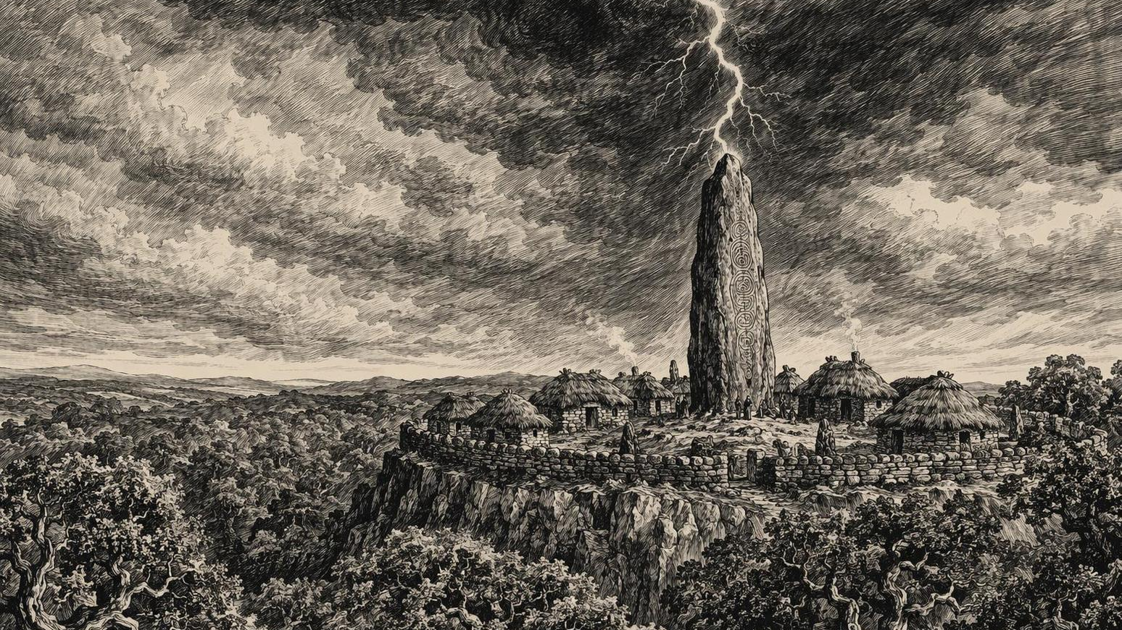
STONETOP
Session Zero — Campaign Kickoff

Slide 2
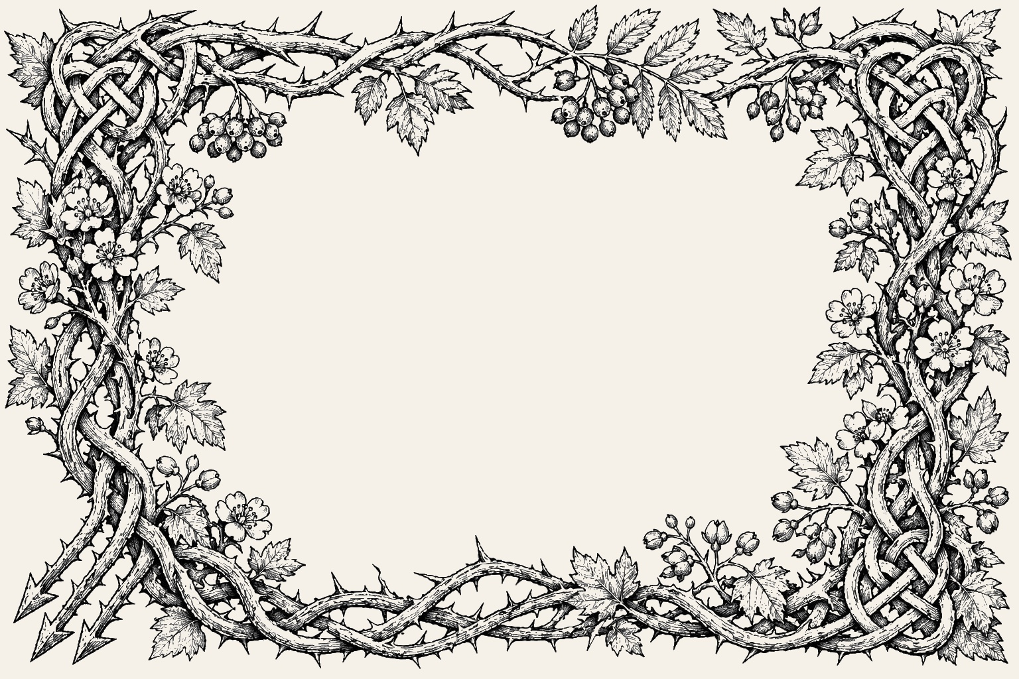
Content Safety Survey Results
Exclude (not even referred to): Sexual Violence, Incest
Viel (fade to black/offscreen): Sexual Content, Harm to Children, Substance abuse, Childbirth
I would like no players to be pro-fascist or pro destruction of society. I think it's fine for NPCs but in today's time I want to punch Nazis not try to redeem them or work with them.

Slide 3
Safety Tool
Type "X" in the meeting chat at any time — no explanation needed. When someone posts X:
1. GM immediately pauses the scene
2. No questions asked — we rewind, skip, or fade to black
3. If you're not comfortable posting publicly, DM the GM privately and I'll pause without identifying who called it
4. Can also be used after a session: "Hey, that scene last week — X that for going forward"
The rule: Anyone can X anything, anytime, for any reason. No justification required. No discussion about why. We just move on.

Slide 4
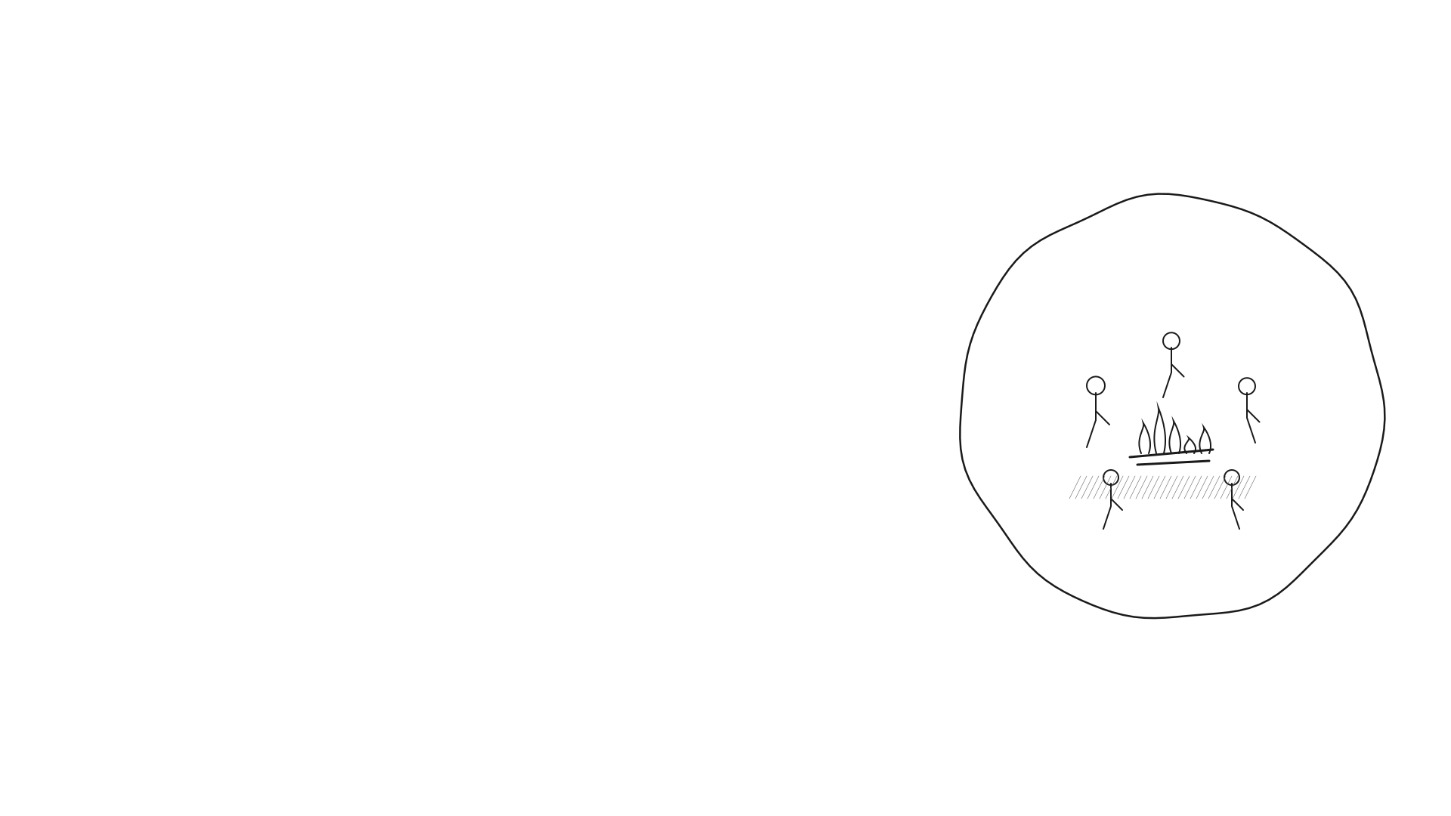
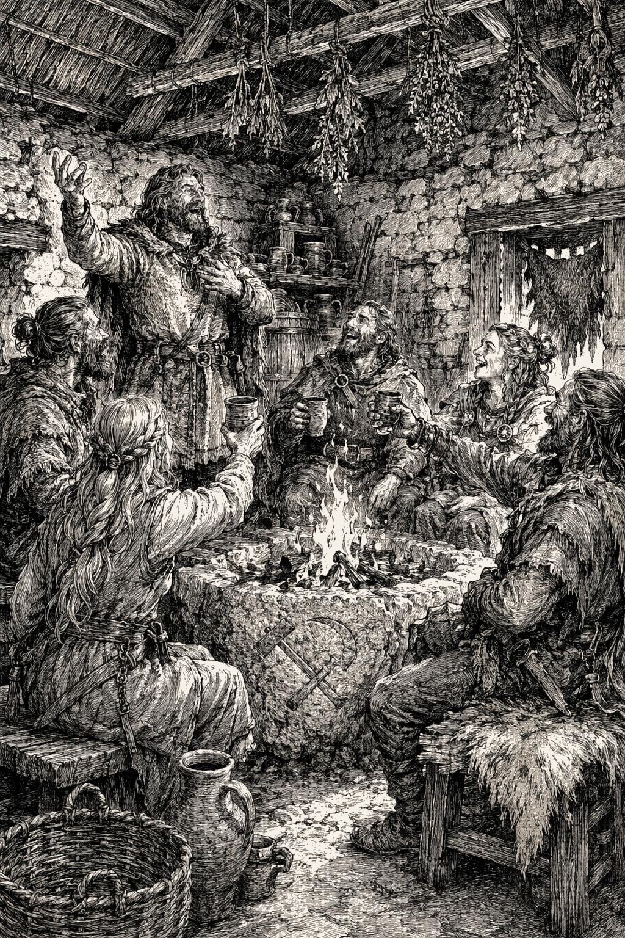
What Are We Excited For?
Building out this world together, seeing how the characters learn and grow
I am most excited for the community building and the communal struggle to survive and thrive. I want to see the players struggle with hard moral choices where failure, even when the intent was genuinely good, results in tangible consequences for the PC, PCs, and even the Stonetop community. I also am excited about the passage of time and the possibility of PCs dying a peaceful death in bed surrounded by loved ones as they pass the torch to a new PC that fits the fiction.
Interacting with a world that values other gameplay pillars beyond exclusively tactical combat and number-goes-up progression
Bookkeeping!
Why Play Stonetop:
“Because here, in the real world, our communities are often fractured, broken, disconnected. Because maybe you want to imagine a community that works, one that pulls together and struggles together and looks out for its own. Because play is practice, and practice is how you change yourself, how you change your world.”

Slide 5
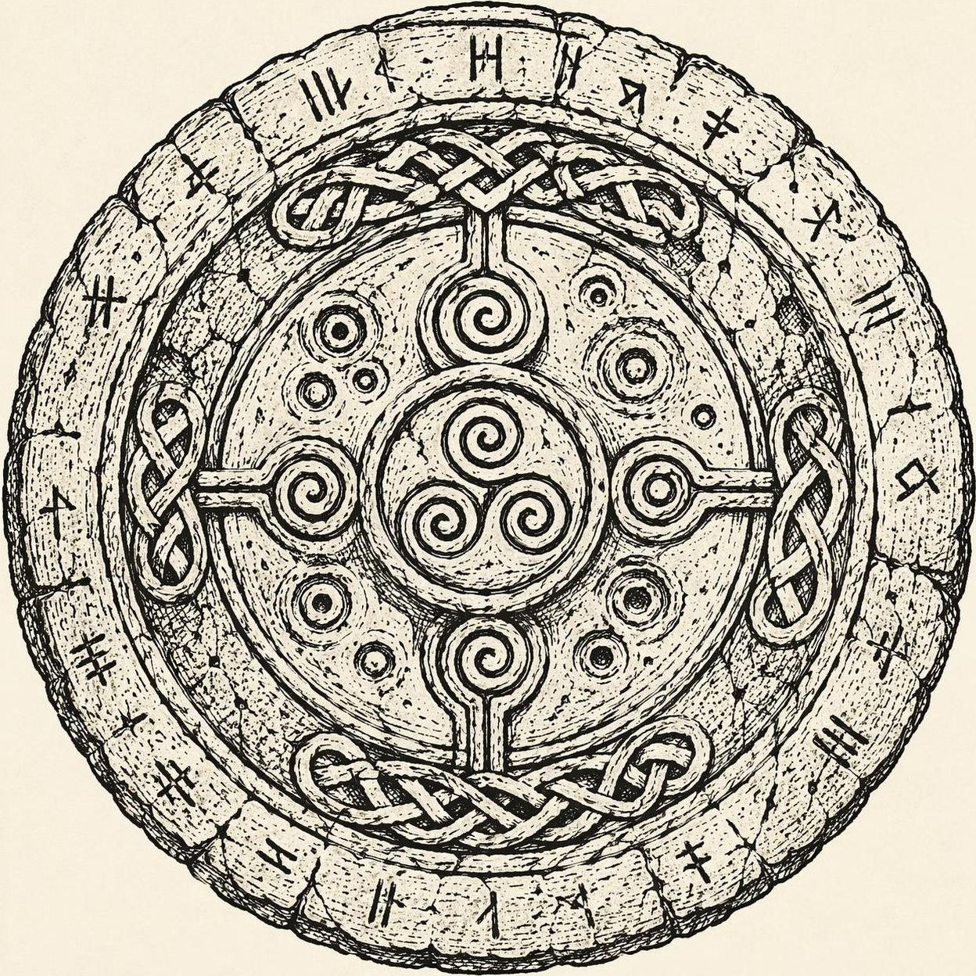
Player Principles
Begin and end with the fiction. Tell us how you do what you do, what it looks like.
Have goals and pursue them. Don’t just react to threats that the GM presents.
Be bold, take risks. If you don’t act like a hero, who will?
Embrace difficulty, setback, and failure. Show us how your character deals with it.
Participate in worldbuilding. Answer the GM’s questions with color and life.
Build on what others have said. Let yourself be inspired by your fellow players

Slide 6
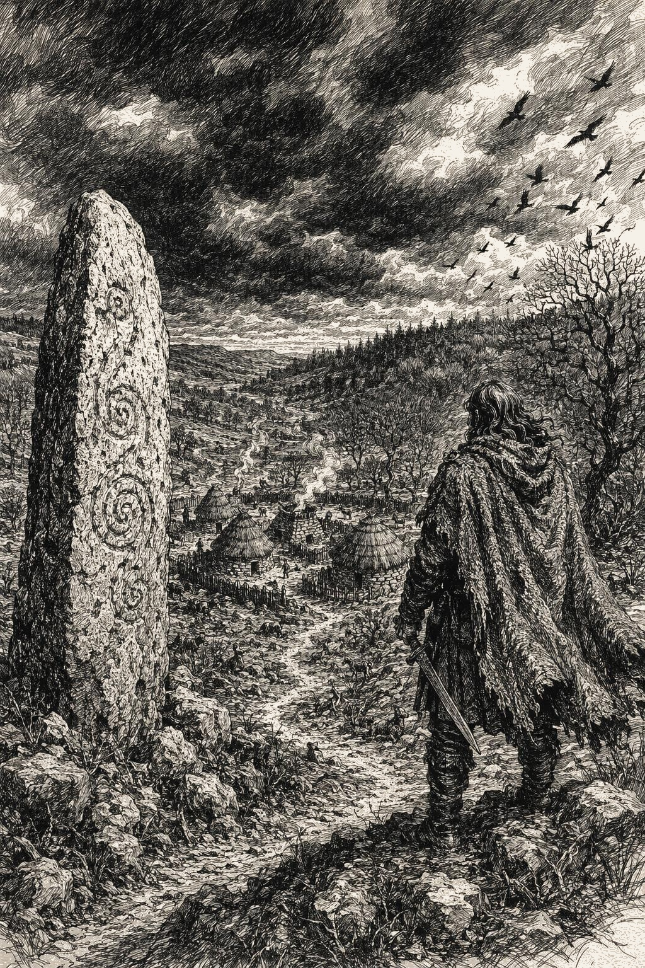
Expectations
We will play to find out, the story is emergent
Resources are sparse, there are no lords, folks expect you to contribute and not endanger them
Combat is deadly. 90% chance someone is going to die/retire/become something worse in the first 10 sessions
Magic exists but is borrowed from greater powers. Mastery comes in knowing how to beseech them and what to offer in return. In a land on the brink, most don’t have much to offer: making magic rare, scrutinized and distrusted
The world moves on its own, other actors will pursue their own goals and potentially achieve them unless you interrupt them
Winter is coming, expect threats to keep you under pressure BUT when you overcome – expect spoils and the license to leverage them creatively
Forget about game mechanics, set your own goals and if it fits in the fiction - we will build a path to progress them.

Slide 7
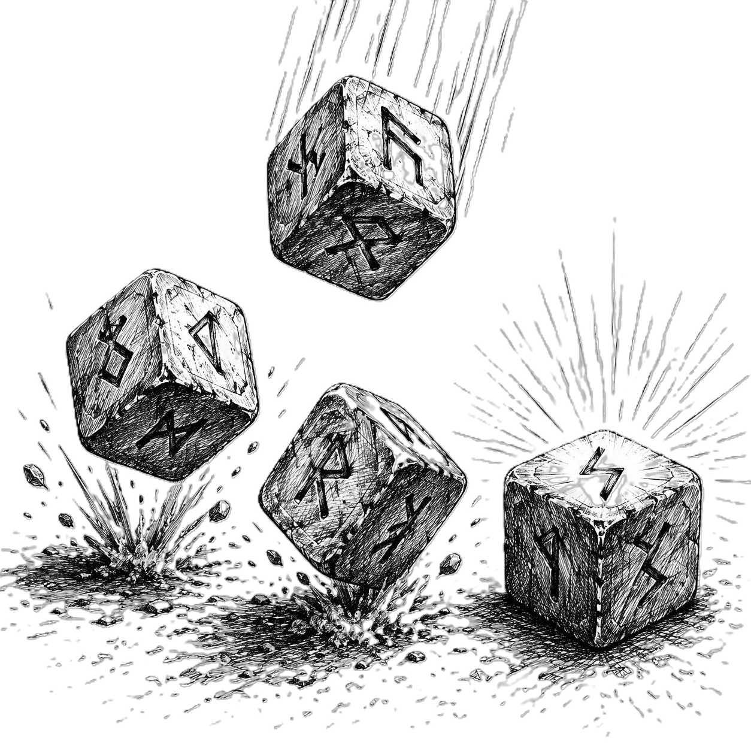
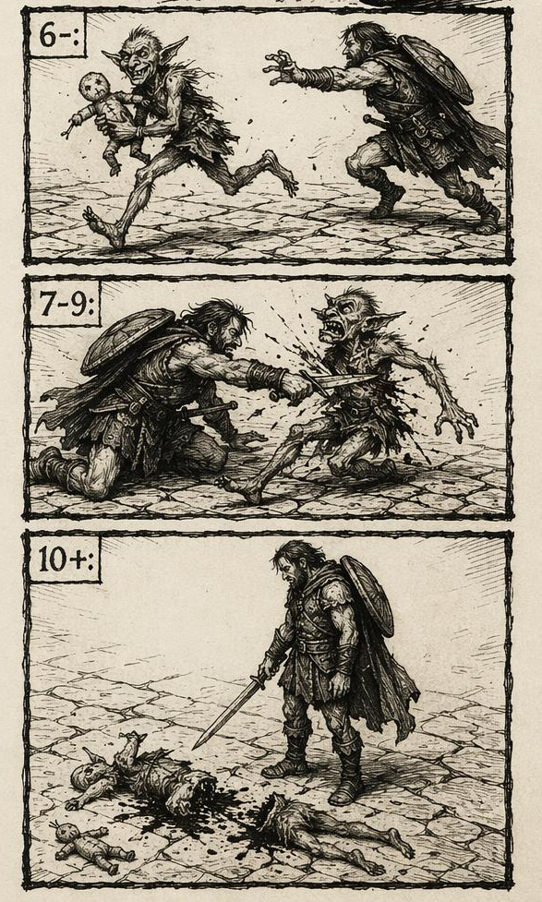
Conflict Resolution
Roll 2d6 + Stat Modifier (-1 to +3)
Miss — mark XP! The GM makes a move. NOT just “you failed.” Something bad happens — possibly worse than failure. The fiction moves forward dangerously.
Success with Complications — you succeed, but there’s a cost, a hard choice, or a consequence. This is where the best fiction happens.
How This Changes Everything:
• The GM almost never rolls dice
• Monsters don’t take turns — their actions ARE the consequences of your rolls
• On 10+, the enemy can’t touch you. On 7–9, it gets a piece of you. On 6−, it acts before/despite you
• Every roll moves the story forward — no wasted turns
• Fiction first: describe what you do, then we see if it triggers a move
Full success, you get what you wanted
Advantage: 3d6 keep best 2 | Disadvantage: 3d6 keep worst 2 | They cancel out

Slide 8
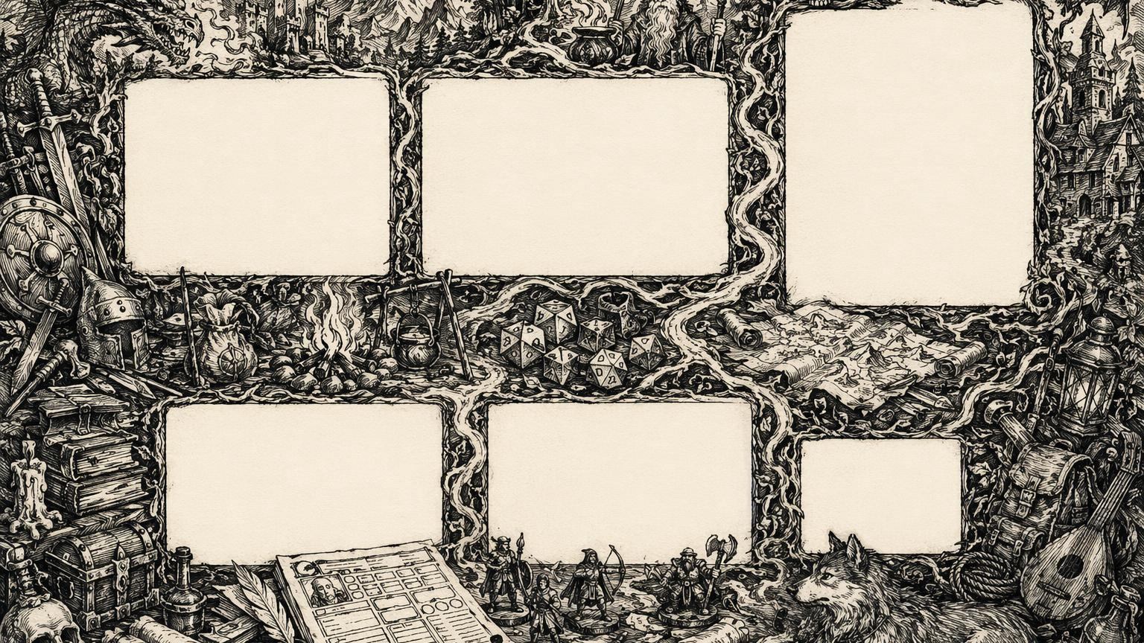
Homefront
• Bolster
• Convalesce
• Deploy
• Level Up
• Make a Plan
• Meet with Disaster
• Muster
• Pull Together
• Seasons Change
• Trade & Barter
Basic
• Chart a Course
• Outfit
• Requisition
• Have What You Need
• Recover
• Struggle as One
• Keep Company
• Make Camp
• Return Triumphant
• Aid
• Clash
• Defend
• Defy Danger
• Interfere
• Know Things
• Let Fly
• Persuade
• Seek Insight
Expedition
Playbook
Special
• Unique to each class
• Gained at creation
• More on level-up
• See your playbook sheet
• Advantage/Disadv.
• Burn Brightly
• End of Session
• Death’s Door
Follower
• Order Followers
• Strengthen Bond

Slide 9
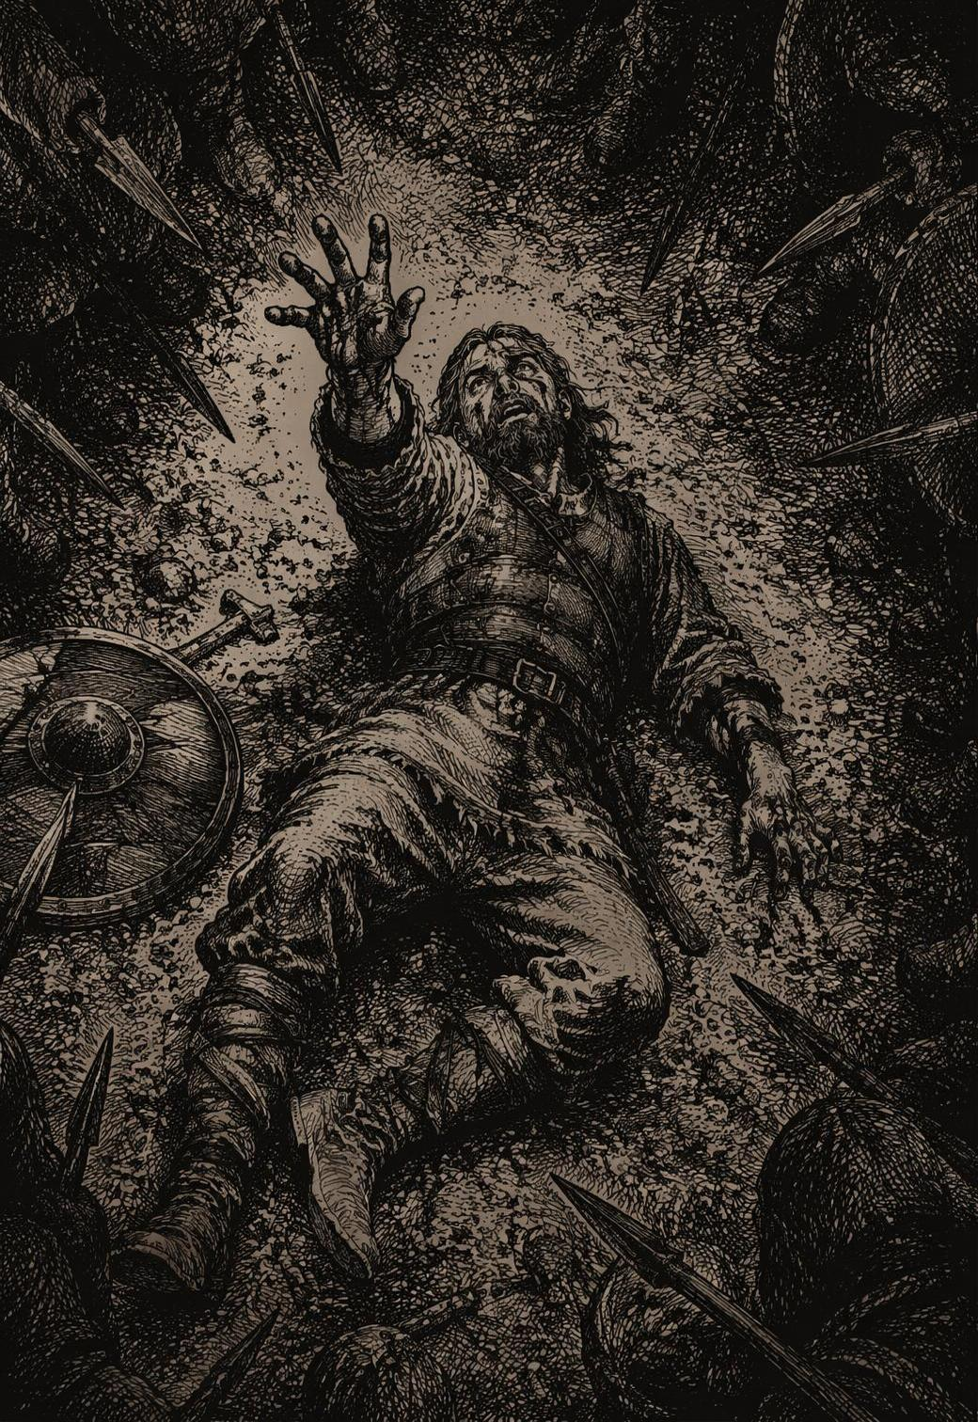
Mechanics
Fictional Positioning
• You can’t do it if the fiction doesn’t support it
• Gear & preparation open options, not just bonuses
Armor & Damage
• Armor subtracts from incoming damage before you lose HP
• Armor doesn’t stack — use the highest value (0–1 typical, 2 tough, 3 max at start)
• +Armor DOES stack on top (shields, Defend, some abilities)
• Damage is your playbook die, not your weapon — the weapon is just a tool
Hold
• Some moves grant hold — spend 1-for-1 on listed options
• Lost when the situation changes
HP & Death
• Hit 0 HP → Death’s Door move (not instant death)
• Healing is slow and scarce — no potions, no short rests
• Damage is scary at every level
Debilities
• Conditions giving disadvantage on a specific stat
• Last until you Convalesce during downtime
Ammo & Uses
• Deplete on specific triggers, not per shot/use

Slide 10
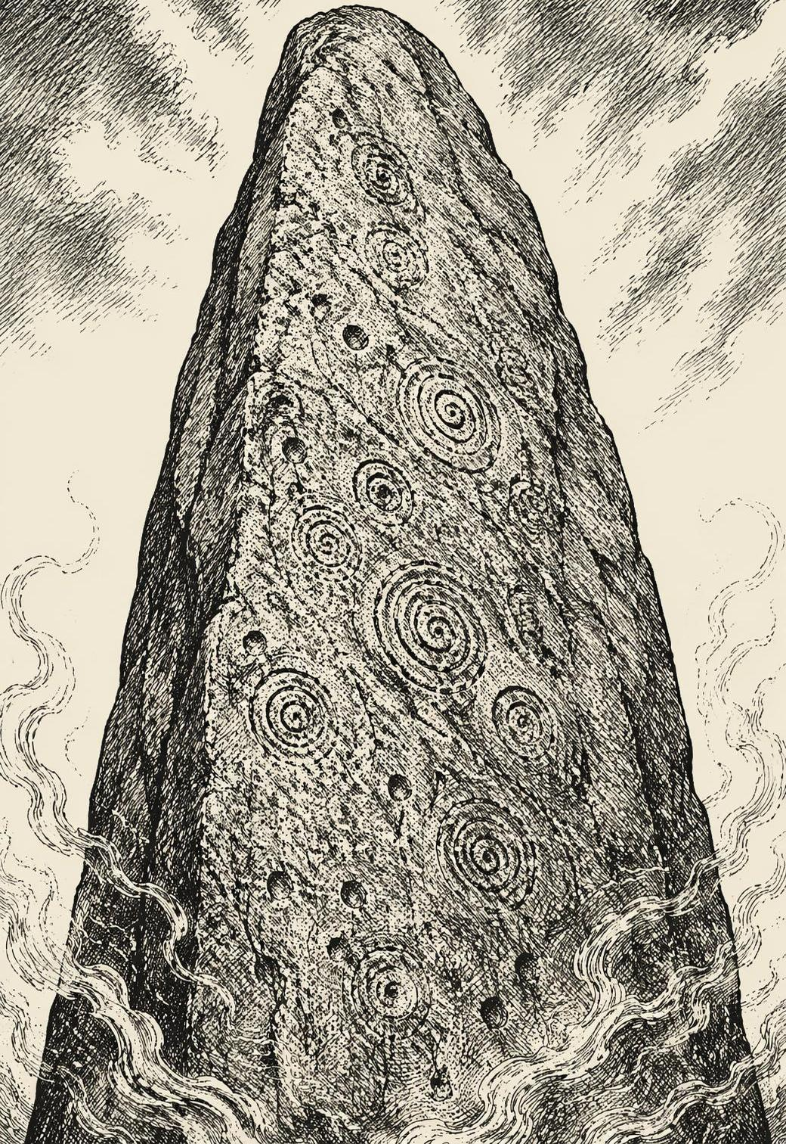
XP & Leveling
Sources of XP:
• Roll a 6- (miss) on any move — mark XP
• Another PC Persuades you (on 7+) and you comply — mark XP
• End of Session move (whole group):
✦ Did you demonstrate or struggle with your instinct? → XP
✦ Did a relationship with a PC/NPC/group change? → XP
✦ Did we learn more about the world or its history? → everyone XP
✦ Did we defeat a threat to Stonetop? → everyone XP
✦ Did we improve standing with neighbors? → everyone XP
✦ Did we make lasting improvement to Stonetop? → everyone XP
Level Up: when XP ≥ 6 + (2 × current level)
Subtract that amount, gain a level, pick a new move.
Burn Brightly: Spend 2 XP after any roll to add +1 (if you have enough to level).
Level | 1→2 | 2→3 | 3→4
Cost | 8 | 10 | 12

Slide 11

Our Party
Player | Playbook | Background | God | Domain
David | The Judge | Missionary | Aratis, the Lawkeeper | Law, order, civilization
Danny | The Seeker | Antiquarian | — | Studies arcana, not gods?
James | The Blessed | TBD | Danu, the Earth Mother | Earth, nature, fertility
Kari | The Would-Be Hero | TBD | — | Mortal grit, no divine patron?
Dan | The Lightbearer | Auspicious Birth | Helior, the Daybringer | Light, sun, truth

Slide 12
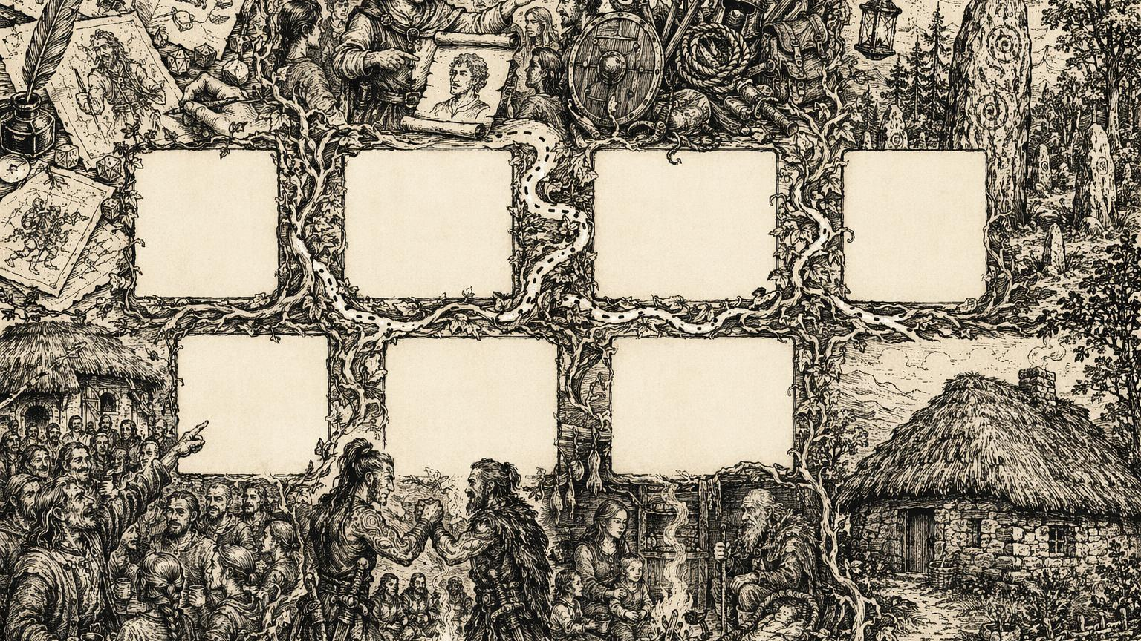
Create Characters
Choose background, stats, gear, instinct, appearance, origin, name
p.21–28 | ~20 min
Turn 1: Vital Info
Name, pronouns, background, origin, appearance. GM asks background Qs
p.28–29 | ~15 min
Turn 2: Possessions
Special gear, how you contribute to the village beyond the fields
p.29 | ~10 min
Turn 3: Worldbuilding
Define your god, your arcana, your fears and anger
p.29–30 | ~15 min
Turns 4–5: NPC Links
Name NPCs. Who loves you? Who do you owe? Who doubts you?
p.30 | ~15 min
Turns 6–7: PC Links
Ask fellow PCs questions. Build bonds between characters
p.30–31 | ~10 min
Family and Life
Married? Kids? Parents alive? Quick family tree
p.31 | ~5 min
Turn 8: Homes
Add each PC home to the steading map
p.31 | ~5 min

Slide 13
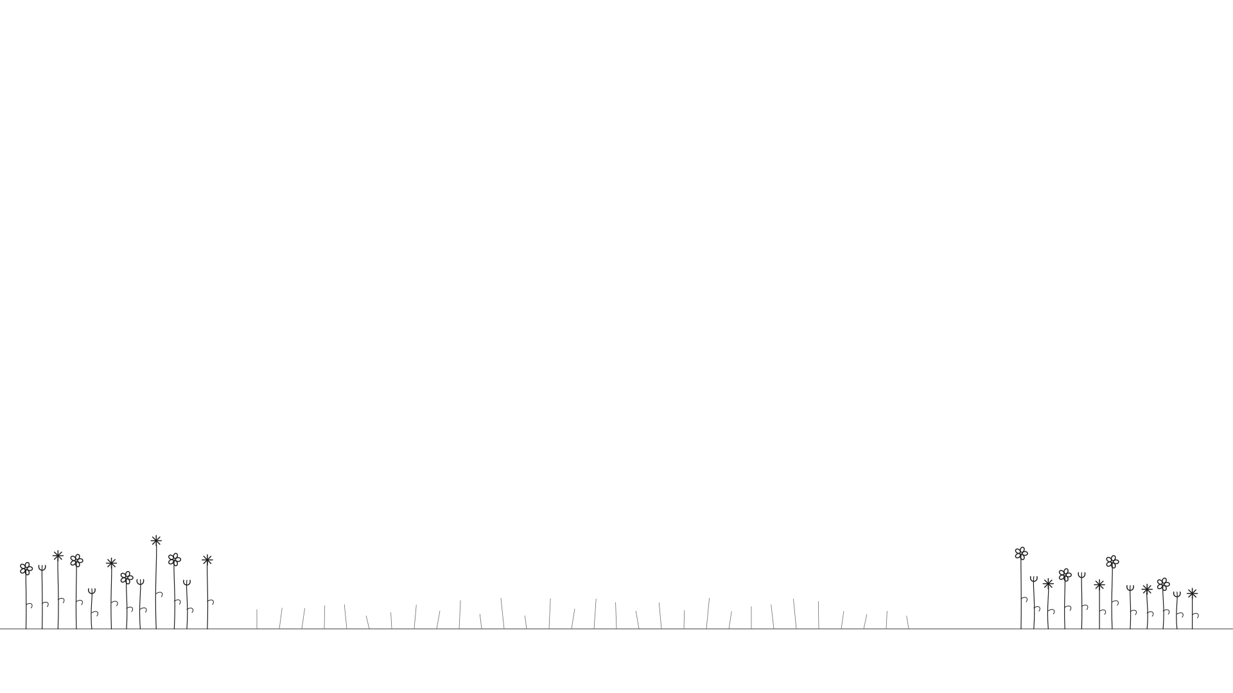
Let Spring Burst Forth!
Roll +Fortunes (2d6+1)

Slide 14

Value & Coins (Appendix)
Value | Worth roughly... | Coin equivalent
0 | A favor, common item, a few days labor | Purse of coppers / 1 silver
1 | Season of unskilled labor, unit of trade goods | Handful of silvers
2 | Year of unskilled labor, cartload of goods, 1 Surplus | Purse of silvers / 1 gold
3 | Year of skilled labor, a good horse | Handful of golds
4 | A dozen horses, a “priceless” item | Purse of golds
Coins: individual → handful (~10) → purse (~100)
1 silver ≈ 100 coppers | 1 gold ≈ 100 silvers
Stonetop runs on barter, favors, and honor — coins are for outsiders.

Slide 15
Tags
Range |  | Weapon/Item
hand | Tight quarters | area | Hits everything nearby
close | 1-2 steps | forceful | Knocks people around
reach | 3-4 steps | messy | Rips things apart
near | ~30 steps | awkward | Unwieldy, gets stuck
far | 100+ steps | reload | Takes time to reset
 |  | slow | Useless in a fight
Mechanical
n armor | Subtract n from damage | fragile | Easy to break
+1 armor | Stacks on base | crude | Prone to wear out
n piercing | Ignore n armor | warm | Keeps you warm

Slide 16
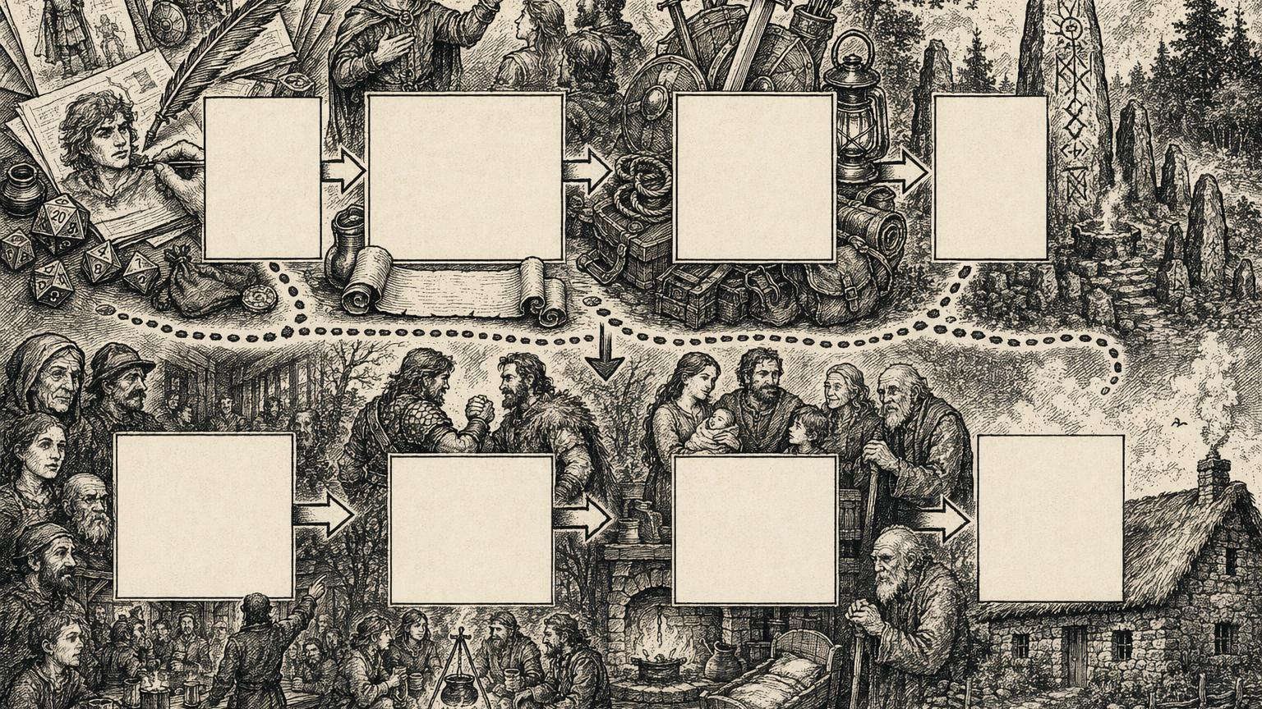

Slide 17
