Slide 1

Lab Book 1.0. Waveguides
Student:

Slide 2
Instructions General
SCRIPTS
From GitHub →
Fork the repo: cccanvas-upv/pic-upv-lab1
Clone the repo using VSCode
Run the Jupyter Notebook:
WAVEGUIDES_Student.ipynb
W (width)
W (width)
Core
Core
h_core
h
(height)
Cladding
Cladding
Slab
h_slab
deep waveguide
shallow waveguide

Slide 3
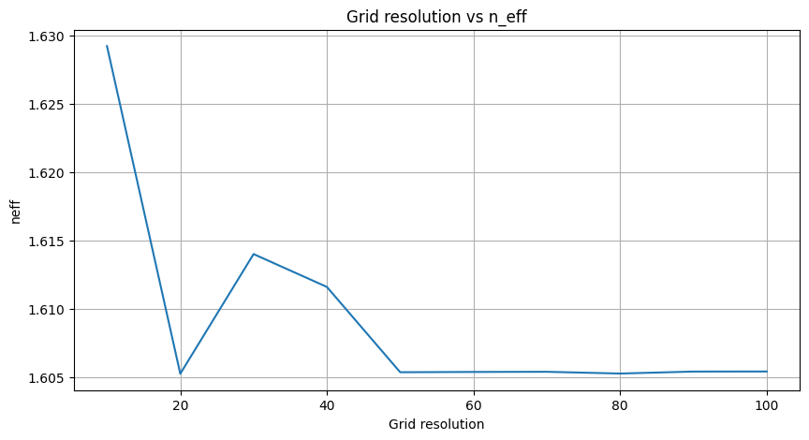
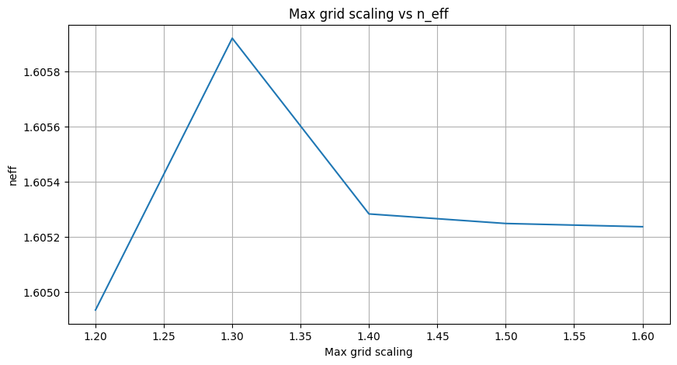
Learning outcome #1 – Convergence tests DE waveguide, w = 1.2 µm, neff_TE0, wvl 1.55 µm.
deep waveguide
Paste neff_TE0 vs grid_resolution plot here
deep waveguide
Paste neff_TE0 vs max_grid_scaling plot here
In the first plot, we observe that from a grid resolution of 50 onward, the value converges and stabilizes around n_eff = 1.605. We could use 50 as grid resolution value. However, we can also notice that the value at grid_resolution = 20 is very close to the converged value. For this reason, it would be preferable to use 20 as grid resolution, since it reduces computational cost.
In the second plot, simulated with grid_resolution = 20, we observe that the effective index converges around n_eff = 1.605 from a value of max_grid_scaling = 1.5 onward.
Overall, an appropriate configuration is grid_resolution = 20 and max_grid_scaling = 1.5 in order to obtain a stable effective index with a reasonable simulation time.

Slide 4
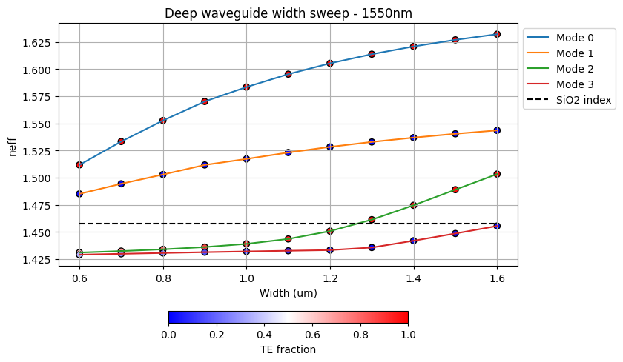
Learning outcome #2 – Width dependence Width 0.6 - 1.6 µm (step 0.1 µm) – Wavelength 1.55 µm
deep waveguide
Paste plot here
The plot shows that the effective index of all guided modes increases as the waveguide width grows. The fundamental TE mode (Mode 0) exhibits the highest sensitivity to width variations (it interacts with the side walls). As the width increases, Mode 2 becomes guided. If a higher width were simulated, Mode 3 would also be guided. Moreover, the slopes of Mode 2 and 3 also increase with width.

Slide 5
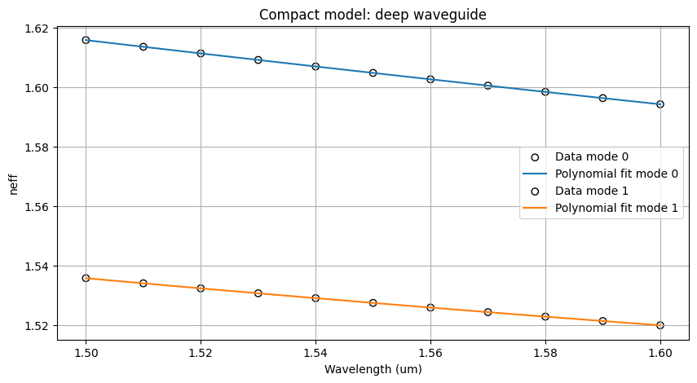
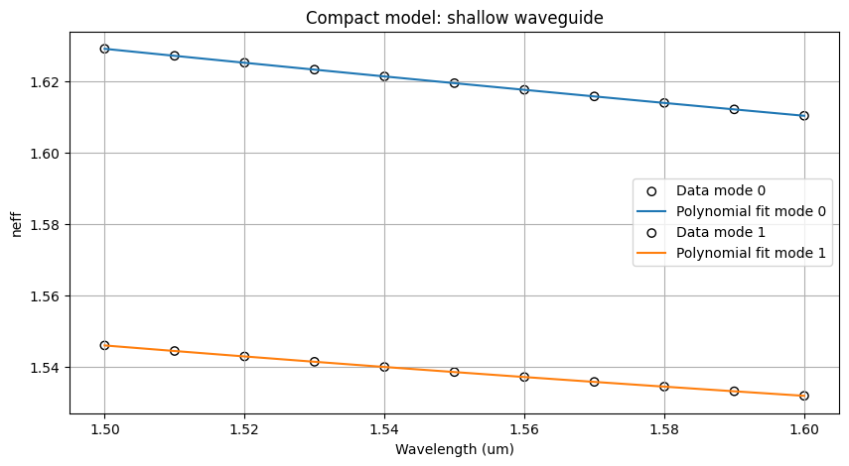

Learning outcome #3 – Waveguide compact model Let’s model the waveguide using a second order polynomial: $$n_{eff}\left(λ\right)=n_{1}+n_{2}\left(λ−λ_{0}\right)+n_{3}{\left(λ−λ_{0}\right)}^{2}$$
deep waveguide
neff_TE0 vs $λ$ with the second-degree polynomial fit
& neff_TM0 vs $λ$ with the second-degree polynomial fit
shallow waveguide
neff_TE0 vs $λ$ with the second-degree polynomial fit
& neff_TM0 vs $λ$ with the second-degree polynomial fit
slab: 150nm
Find the second-degree polynomial coefficients and relate them with the group index and the dispersion parameter. $\left\{\begin{aligned}n_{eff}=n_{1} \\ n_{g}=n_{1}−n_{2}λ_{0} \\ D=−\frac{2λ_{0}n_{3}}{c}\left[\frac{s^{2}}{m}\right]\end{aligned}\right.$
Comment on the results found for the TE0 and TM0 for both deep and shallow waveguides.

Slide 6
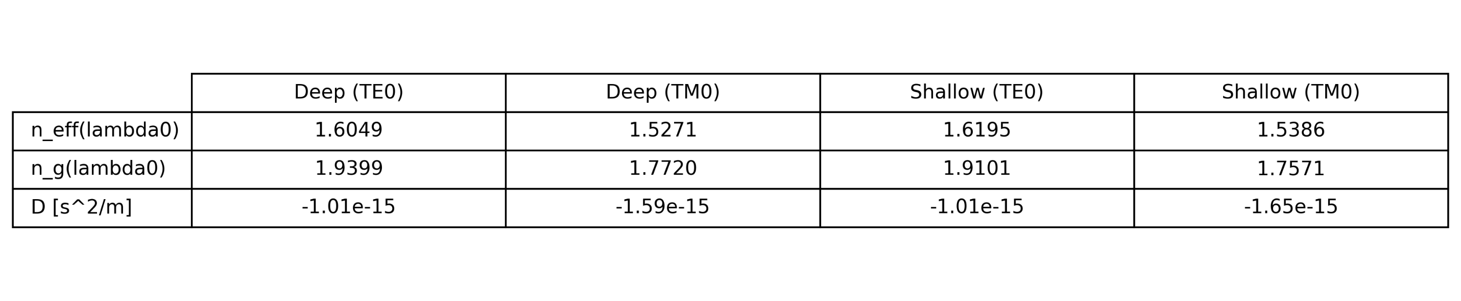
Learning outcome #3 – Waveguide compact model
As it can be seen in the table below, the shallow waveguide yields higher effective índices for both TE0 and TM0 due to the presence of the slab. In contrast, the deep waveguide shows larger group índices also for both TE0 and TM0, which indicates larger confinement inside the SiN core.
Both structures show negative values of dispersion but the shallow waveguide displays more negative values. Specifically, for TM0.

Slide 7
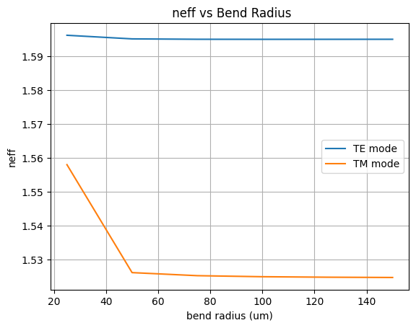
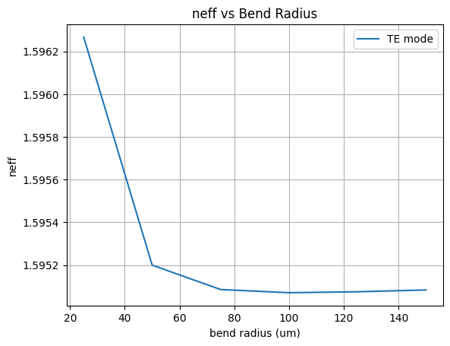
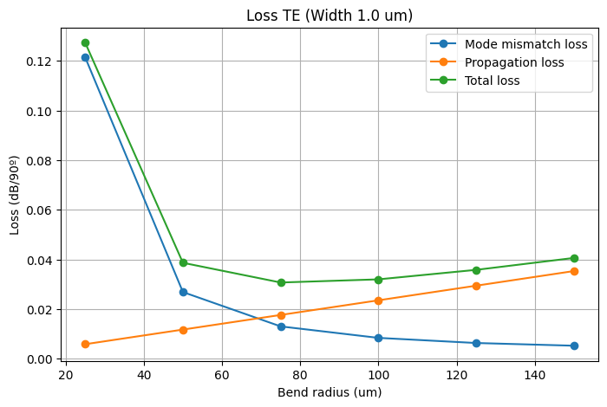
Learning outcome #4 – Bend waveguide radius vs. loss – deep
Safe radius: 50

Slide 8
Learning outcome #4 – Bend waveguide radius vs. loss – deep
The three plots show how bend radius influences modal confinement. At small radii, the mode is pushed outward, and its shape becomes noticeably distorted; this increases leakage into the cladding and reduces confinement. This behaviour can be observed in the plots for small radii in both TE and TM, where the effective index drops significantly. However, it is easy to notice that the TM mode has a more significant drop in the effective index value.
As the radius increases, the mode regains a stable profile. Above 50 µm, both modes settle into nearly constant effective index values, although the TE₀ mode remains much more stable across the entire range.
The loss curve follows the same physical tendency: tight bends correspond to high mismatch losses, which decrease rapidly as the waveguide curvature relaxes. The minimum of the loss curve appears at 75 µm. Since this radius also coincides with the region where the effective indices stop changing, we can state that the safe radius is: 75 µm.

Slide 9
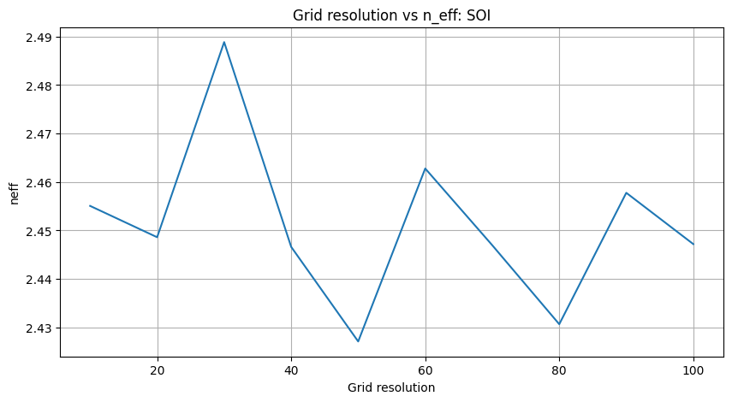
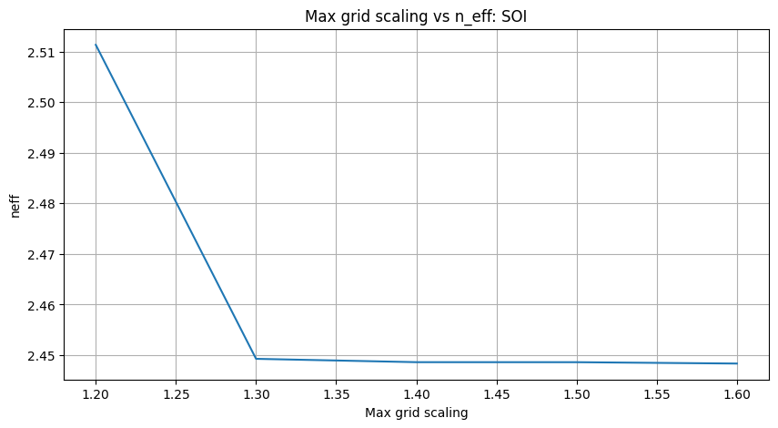
EXTRA (SOI) : Learning outcome #1 – Convergence tests
For the SOI case, the effective index lies around 2.45–2.49 but the grid‑resolution sweep shows pronounced oscillations with no convergence; unlike SiN, where n_eff = 1.605 stabilized from grid resolution = 50 (and 20 was an acceptable compromise). For SOI no tested grid value can be selected so a finer or adaptive mesh is required before trusting the result. The max‑grid‑scaling stabilizes around 1.3 around n_eff = 2.45. Compared with SiN, SOI yields a higher absolute n_eff and a much stronger sensitivity to grid resolution.

Slide 10
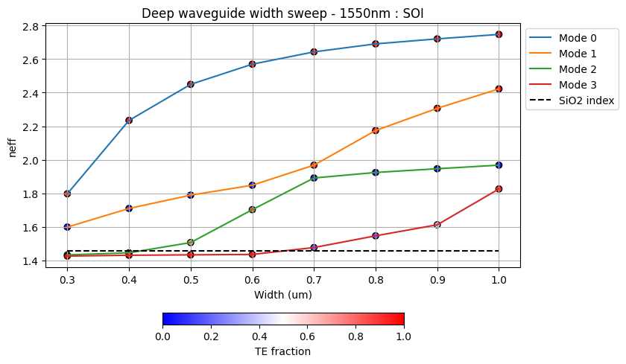
EXTRA (SOI) : Learning outcome #2 – Width dependence
Compared to the SiN case, the SOI width sweeps show the same tendency: every mode increases its effective index as width grows. However, the transition from cut-off to guided for higher order modes is more abrupt. As in SiN, the fundamental TE mode remains the most sensitive to width.

Slide 11
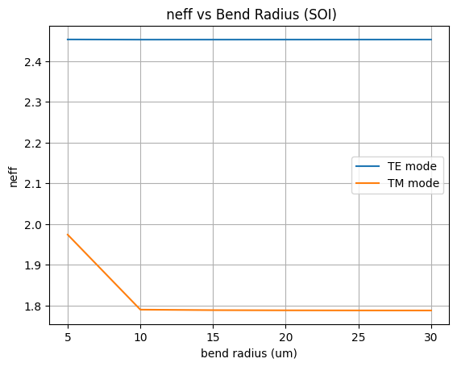
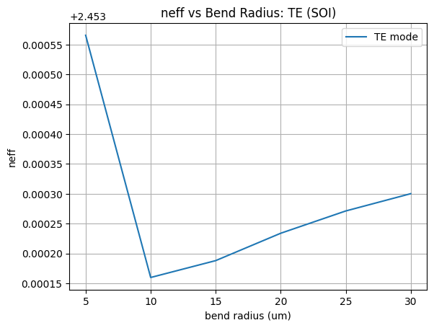
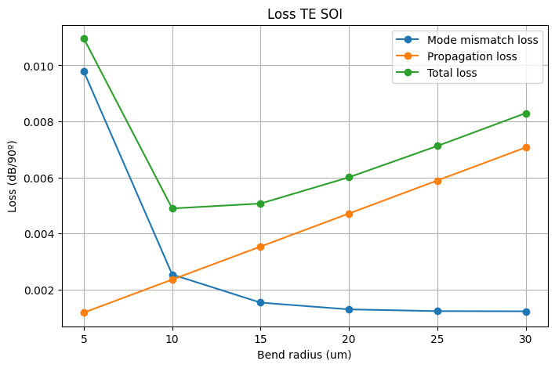
EXTRA (SOI) : Learning outcome #4 – Bend waveguide radius vs. loss – deep
Safe bend radius for SOI:
10 µm
In SOI the loss minimum appears near 10 µm, while in SiN it only stabilizes near 75 µm, reflecting how much more compact SOI bends can be.

Slide 12

Thank you

