Slide 1

Lab Book 2.0. Couplers
Student: María Romero García

Slide 2
Instructions General
SCRIPTS
From GitHub →
Fork the repo: https://github.com/cccanvas-upv/pic-upv-lab2.git
Clone the repo using VSCode
Run the Jupyter Notebook:
COUPLERS_Student.ipynb
Cross-Sections to be studied:
w (width)
w (width)
h
(height)
Core
Core
h
(height)
MMI Body
g
(gap)
Cladding
Cladding
Directional coupler (DC)
Multimode Interference (MMI) coupler

Slide 3
Directional coupler

Slide 4
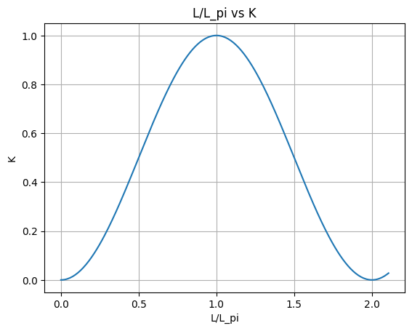
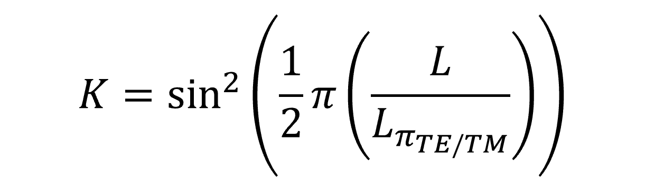
Learning outcome #1 – Directional coupler length and coupling coefficient Wavelength 1.5 µm – width 1.2 µm – gap 0.6 µm
The plot shows the evolution of the coupling coefficient as a function of the normalized propagation length. The results exhibit the expected periodic behaviour of a directional coupler.
When the propagation length reaches the beat length, the coupling coefficient attains its maximum value (K=1), indicating that the optical power has been completely transferred from the input waveguide to the adjacent one.
The coupling coefficient reaches K=0,5 when the propagation length is half of the beating length, which corresponds to equal power distribution between both waveguides (50:50 splitter). Therefore, the beating length defines the distance required for full energy transfer, while half of the beating length determines the length to achieve equal power splitting.

Slide 5
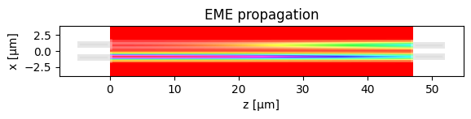
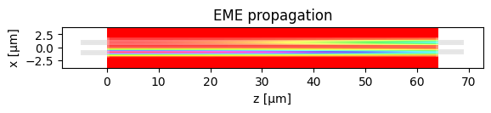
Learning outcome #2 – 2x2 Directional Coupler
Parameters: | Width = 0,6 um
MMI length (L_pi/2) | 47.0137 um
Total power IN coupled | 0.9688
Total OUT power | 0.9583
Excess loss [dB] | 0.1851
Power over outputs | ['0.4791', '0.4791']
Ratio over outputs | ['0.5000', '0.5000']
Parameters: | Width = 0,7 um
MMI length (L_pi/2) | 64.0328 um
Total power IN coupled | 0.9841
Total OUT power | 0.9737
Excess loss [dB] | 0.1157
Power over outputs | ['0.4869', '0.4868']
Ratio over outputs | ['0.5000', '0.5000']

Slide 6
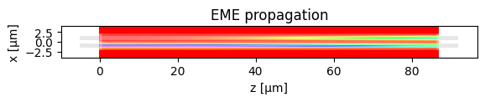
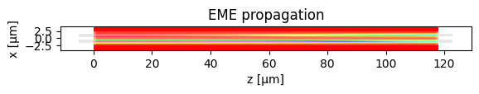
Learning outcome #2 – 2x2 Directional Coupler
Parameters: | Width = 0,8 um
MMI length (L_pi/2) | 86.9819 um
Total power IN coupled | 0.9882
Total OUT power | 0.9778
Excess loss [dB] | 0.0976
Power over outputs | ['0.4888', '0.4890']
Ratio over outputs | ['0.4999', '0.5001']
Parameters: | Width = 0,9 um
MMI length (L_pi/2) | 117.8870 um
Total power IN coupled | 0.9832
Total OUT power | 0.9728
Excess loss [dB] | 0.1198
Power over outputs | ['0.4863', '0.4865']
Ratio over outputs | ['0.4999', '0.5001']

Slide 7
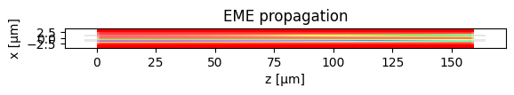
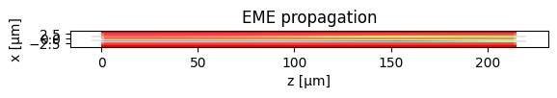
Learning outcome #2 – 2x2 Directional Coupler
Parameters: | Width = 1 um
MMI length (L_pi/2) | 159.4421 um
Total power IN coupled | 0.9663
Total OUT power | 0.9560
Excess loss [dB] | 0.1955
Power over outputs | ['0.4778', '0.4782']
Ratio over outputs | ['0.4998', '0.5002']
Parameters: | Width = 1,1 um
MMI length (L_pi/2) | 215.2738 um
Total power IN coupled | 0.9360
Total OUT power | 0.9258
Excess loss [dB] | 0.3351
Power over outputs | ['0.4628', '0.4629']
Ratio over outputs | ['0.4999', '0.5001']

Slide 8


Learning outcome #2 – 2x2 Directional Coupler
Parameters: | Width = 1,2 um
MMI length (L_pi/2) | 290.2147 um
Total power IN coupled | 0.8916
Total OUT power | 0.8818
Excess loss [dB] | 0.5464
Power over outputs | ['0.4407', '0.4410']
Ratio over outputs | ['0.4998', '0.5002']
Parameters: | Width = 1,3 um
MMI length (L_pi/2) | 390.6951 um
Total power IN coupled | 0.8474
Total OUT power | 0.8380
Excess loss [dB] | 0.7677
Power over outputs | ['0.4189', '0.4191']
Ratio over outputs | ['0.4999', '0.5001']

Slide 9


Learning outcome #2 – 2x2 Directional Coupler
Parameters: | Width = 1,4 um
MMI length | 525.2393 um
Total power IN coupled | 0.7870
Total OUT power | 0.7782
Excess loss [dB] | 1.0893
Power over outputs | ['0.3889', '0.3893']
Ratio over outputs | ['0.4997', '0.5003']
Parameters: | Width = 1,5 um
MMI length (L_pi/2) | 705.3304 um
Total power IN coupled | 0.7299
Total OUT power | 0.7217
Excess loss [dB] | 1.4167
Power over outputs | ['0.3607', '0.3609']
Ratio over outputs | ['0.4999', '0.5001']

Slide 10

Learning outcome #2 – 2x2 Directional Coupler
Parameters: | Width = 1,6 um
MMI length (L_pi/2) | 946.2337 um
Total power IN coupled | 0.6724
Total OUT power | 0.6648
Excess loss [dB] | 1.7729
Power over outputs | ['0.3327', '0.3321']
Ratio over outputs | ['0.5004', '0.4996']
The results confirm the expected behavior of the 2×2 directional coupler as the waveguide width varies. Since the device length is set to half of the beat length, the structure consistently operates as a 3 dB splitter. The output ratios remain very close to 0.5/0.5 in all cases, confirming accurate and stable power division. The variation of other parameters with width will be discussed in the following slide.

Slide 11
Learning outcome #2 – 2x2 Directional Coupler
The simulations also show that the length required to achieve equal power splitting increases strongly with waveguide width, from about 47 µm at 0.6 µm to 946 um at 1.6 um. This means that the beat length becomes progressively larger, and therefore the coupler must be longer to preserve the same splitting condition.
The loss results reveal an optimum around 0.8 um, where the excess loss is minimum, about 0.097 dB, and the transmitted power is highest. For larger widths, the device becomes much longer, and the accumulated losses increase, reducing the output power.
Overall, widths around 0.7–0.9 µm, especially 0.8 µm, provide the best balance between compactness, low loss, and balanced power splitting.

Slide 12
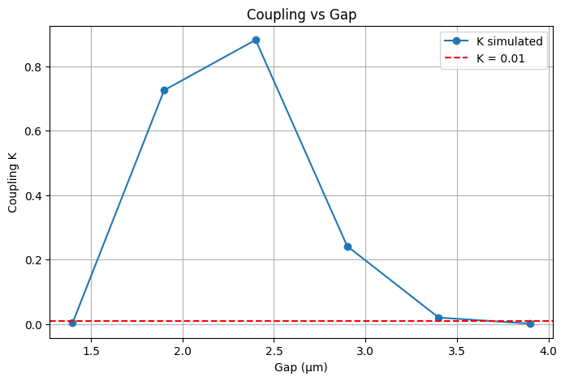
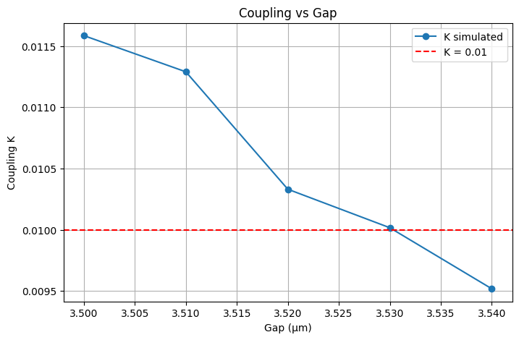
Learning outcome #3 – Parallel uncoupled waveguides
The first plot shows two clearly different regimes. For small gaps, the coupling exhibits the expected oscillatory behavior of the full expression for K at fixed propagation length. In this region, the beat length is small, so the sine-squared dependence remains visible. As the gap increases, the beat length becomes much larger and the coupler progressively enters the weak-coupling regime, where K decreases smoothly toward the design limit.
It must be taken into account that at the oscillatory region we could find some local minima that fall below the design threshold. However, relying on those minima would be problematic because small fabrication variations in the gap would easily shift the operating point to a nearby maximum, leading to significant coupling again.
This first sweep is therefore useful to identify the transition region and to localize the gap interval where the uncoupled condition is reached. A second, finer sweep is then carried out around that point in order to determine the minimum design gap more accurately. From this refinement, the minimum gap satisfying K ≤ 0.01 is found to be approximately 3.54 µm.
The result is also consistent with the theoretical estimate. The target beat length obtained analytically is 156817.09 µm, while the simulated value at the selected gap is 160745.90 µm.

Slide 13
Multimode Interferometer (MMI) Coupler

Slide 14
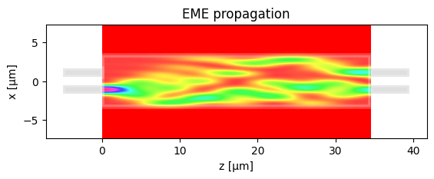
Learning outcome #4 – 4.1 2x2 Multimode Interference Coupler
The MMI operates close to the expected 3 dB splitting condition. The output powers are approximately 0.467 and 0.440, which indicates an almost balanced 50:50 power division.
The simulated device length is about 34.5 µm, which corresponds approximately to Lpi/2, with Lpi around 69 µm. This agrees with the self-imaging principle of multimode interference, where two symmetric images of the input field appear at roughly half the beat length.
The coupled input power is about 0.96 while the total output power is around 0.907, giving an excess loss of about 0.42 dB. These losses are too large if we think of a chip where we would have many MMI’s concatenated for a given application, since losses would grow extremely fast.
Compared with a directional coupler, which transfers energy through evanescent coupling, the MMI relies on multimode interference inside a widened region. This mechanism allows similar power splitting with a compact device and generally provides better tolerance to fabrication variations since it does not depend on maintaining a very precise gap along the structure.
Parameters:
MMI length | 34,548 um
MMI length increment | 0
IO wg width | 1
IO wg width increment | 0
Total power IN coupled | 0.9604
Total OUT power | 0.9075
Excess loss [dB] | 0.4217
Power over outputs | ['0.4675', '0.4399']
Ratio over outputs | ['0.4675', '0.4399']

Slide 15

Learning outcome #4.2 – 2x2 Multimode Interference Coupler - Optimization
To improve the power balance and reduce excess loss, a manual optimization of the MMI geometry was performed by slightly adjusting the device length and the position of the I/O waveguides. The MMI length was shortened by 0.5 µm and a small transverse shift of the ports (dy = 0.05 µm) was introduced, while keeping the I/O waveguide width at 1 µm.
Shortening the device and slightly shifting the ports improves the alignment between the self-image and the output waveguides.
The optimized configuration shows a balanced power division with output powers of 0.463 and 0.440, corresponding to a ratio of about 0.506 and 0.494. The coupled input power is about 0.957 and the total output power is 0.9149, resulting in an excess loss of 0.3861 dB. The EME propagation profile also shows better overlap between the self-imaging pattern and the output ports, confirming that small geometric adjustments can improve the efficiency of the MMI splitter. However, loss is still too high.
Parameters:
MMI length | 34,518 um
MMI length increment | -0,5
IO wg width | 1
IO wg width increment | 0
Total power IN coupled | 0.957
Total OUT power | 0.9149
Excess loss [dB] | 0.3861
Power over outputs | ['0.4631', '0.4399']
Ratio over outputs | [‘0.5062', ‘0.4938']
dy | 0,05

Slide 16
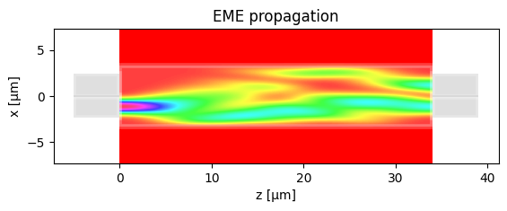
Learning outcome #4.3 – 2x2 Multimode Interference Coupler – Optimization (II)
IO wg width increment | Excess los [dB] | Ratio over outputs
1,2 um | 0,0018 | ['0.5132', '0.4868']
1,4 um | -0,0075 | ['0.5138', '0.4862']
1,5 um | -0.0114 | ['0.5140', '0.4860']
1,6 um | -0.0186 | ['0.5140', '0.4860']
1,7 | -0,026 | ['0.5140', '0.4860']
In this stage the width of the input and output waveguides was increased while keeping the optimized MMI length, port displacement and multimode width fixed. The aim was to improve the modal matching between the access waveguides and the multimode region and therefore reduce the device losses.
The results show that the excess loss remains extremely small for all tested widths. For an I/O width of 1.2 µm the loss is about 0.0018 dB, and it gradually decreases to around −0.026 dB for 1.7 µm. These slightly negative values do not represent physical gain, since the MMI is a passive device. They are caused by small numerical errors related to the EME method.
The output power ratio remains very stable across the sweep, with values close to 0.514 and 0.486. This indicates that increasing the I/O waveguide width mainly improves the coupling efficiency while preserving the symmetry of the splitter and maintaining an almost ideal 50:50 power division.

Slide 17
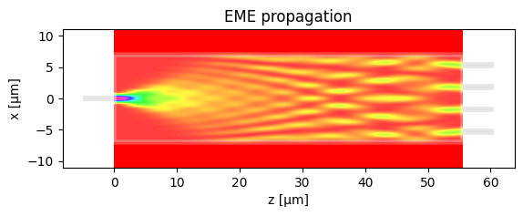
Learning outcome #5 – 1x4 Multimode Interference Coupler
The MMI operates close to the expected 1×4 splitting condition. The output powers are approximately 0.217, 0.206, 0.206 and 0.217, corresponding to normalized ratios of about 0.257, 0.243, 0.243 and 0.257. This indicates an almost uniform power distribution among the four outputs, as expected for a symmetric 1×4 MMI splitter.
The simulated device length is about 55.5 µm, which corresponds to the position where the self-imaging pattern forms four replicas of the input field across the multimode region. The EME propagation profile clearly shows the progressive formation of these four images along the device, consistent with the multimode interference mechanism.
The coupled input power is about 0.963 while the total output power is around 0.846, resulting in an excess loss of approximately 0.73 dB. Not acceptable losses.
Parameters:
MMI length | 55.5273 um
MMI length increment | 0
IO wg width | 1
IO wg width increment | 0
Total power IN coupled | 0.9627
Total OUT power | 0.8456
Excess loss [dB] | 0.7283
Power over outputs | ['0.2172', '0.2055', '0.2055', '0.2174']
Ratio over outputs | ['0.2569', '0.2431', '0.2431', '0.2570']
dy | 0

Slide 18
Learning outcome #5 – 1x4 Multimode Interference Coupler
To improve the power balance and reduce excess loss, a manual optimization of the MMI geometry was performed. In this case the MMI length was shortened by 1.3 µm and a small port displacement of dy = 0.1 µm was introduced, while keeping the I/O waveguide width at 1 µm.
The optimized configuration shows a more uniform power distribution, with output powers of about 0.232, 0.225, 0.225 and 0.232, corresponding to ratios of approximately 0.254, 0.246, 0.246 and 0.254. The coupled input power is about 0.963 and the total output power increases to about 0.914, reducing the excess loss to around 0.39 dB.
The EME propagation profile also shows a clearer overlap between the self-images and the output ports.
Parameters:
MMI length | 55.5273 um
MMI length increment | -1,3
IO wg width | 1
IO wg width increment | 0
Total power IN coupled | 0.9627
Total OUT power | 0.9136
Excess loss [dB] | 0.3926
Power over outputs | ['0.2320', '0.2247', '0.2247', '0.2322']
Ratio over outputs | ['0.2539', '0.2460', '0.2460', '0.2541']
dy | 0,1

Slide 19
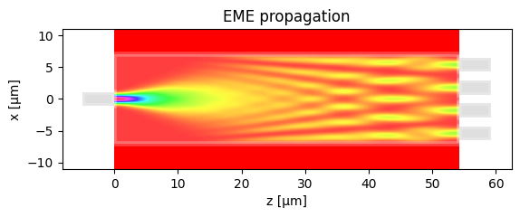
Learning outcome #5 – 1x4 Multimode Interference Coupler
IO wg width increment | Excess los [dB] | Ratio over outputs
0,6 um | 0.1081 | ['0.2528', '0.2471', '0.2471', '0.2530']
0,8 um | 0.0588 | ['0.2518', '0.2481', '0.2481', '0.2520']
1 um | 0.0274 | ['0.2506', '0.2493', '0.2493', '0.2508']
1,2 um | 0.0166 | ['0.2494', '0.2505', '0.2505', '0.2496']
In this stage the width of the input and output waveguides was increased while keeping the optimized MMI length, port displacement and multimode width fixed.
The results show a clear reduction in excess loss as the I/O width increases. The loss decreases from about 0.108 dB for a width of 0.6 µm to around 0.0166 dB for 1.2 µm.
The power distribution among the four outputs remains very stable during the sweep. The output ratios stay close to 0.25 for each port. The EME propagation profile also shows a smooth formation of the four self-images and good alignment with the output ports.

Slide 20

Thank you

