Slide 1

Lab Book 3. Interferometers I – MZI
Student: María Romero García

Slide 2




Instructions General
SOFTWARE
Python notebook supplied by instructors
SCRIPTS
From Poliformat → download the 030_INTERFEROMETERS_v2025_Student_UPDATE2.ipynb
https://github.com/cccanvas-upv/pic-upv-lab3.git
COMPONENT to be studied: Mach-Zendher Interferometer (MZI)
$β_{u}$, $L_{u}$
In2
Out2
$$k_{a}$$
$$k_{b}$$
In1
Out1
$β_{d}$, $L_{d}$

Slide 3

ASSESSMENT #1 – Recap from theory – MZI configurations
Provide one example of implementation for each one of the configurations studied during MZI lecture:
1. Balanced configuration
2. Unbalanced configuration:
2.1. Phase difference
2.2. Delay imbalance
Compute also some examples with $α≠0$ and $γ≠0$
Document all your results (neff, alpha, gamma, transfer function plots, etc.) and comment on the obtained results (in terms of FSR, amplitude, losses, etc.).

Slide 4
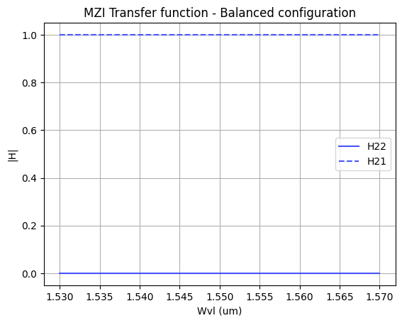
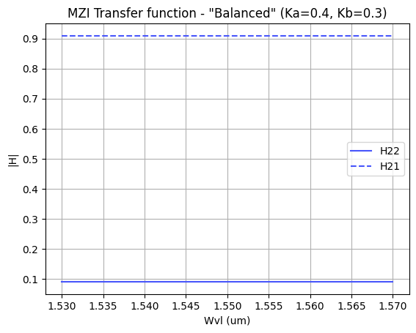
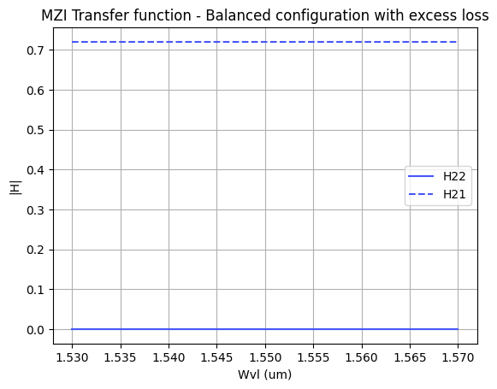
1. Balanced configuration
As we can observe in the first plot, the transfer function of a balanced MZI is flat and does not show any spectral periodicity because there is no wavelength-dependent phase difference between arms. The unity level in H21 and the near-zero level in H22 reflect ideal constructive and destructive interference.
If the coupling ratio deviates from a 50:50 split, the amplitudes in the two paths become unbalanced. As a result, the extinction ratio degrades as shown in the second plot: the constructive port drops below 1 and the destructive plot rises below zero.
As shown in the third plot, introducing excess loss reduces the absolute amplitude. We observe a drop to 0.7 in the constructive port while the destructive port remains at 0.

Slide 5
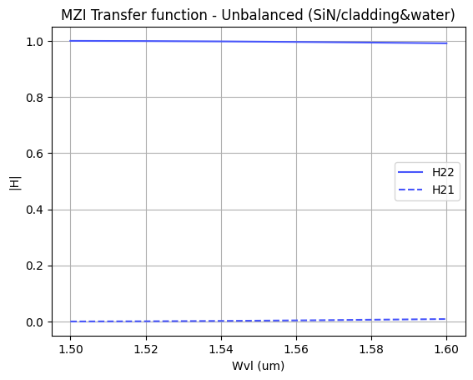
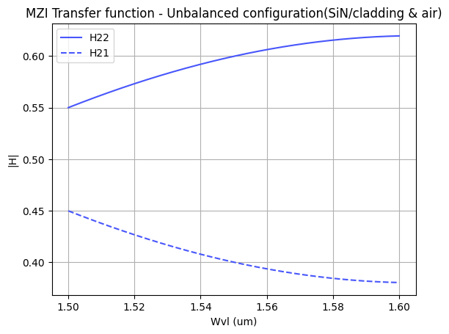
1. Unbalanced configuration: phase difference
The phase difference in both simulations is introduced by changing the refractive index in one of the MZI arms, which modifies the propagation constant.
When the refractive index contrast is very small, as in the case of the first plot, the phase difference roughly changes with wavelength, and the expected sinusoidal transfer function of the MZI is not visible. We can observe a minimal curvature for higher wavelengths, but the transfer function appears practically flat: the MZI behaves like a tunable power coupler rather than a wavelength filter.
For the case of the second plot, the index difference is significantly larger than in the previous example. This increases the mismatch in propagation constants and causes the phase to vary more noticeably with wavelength. The outputs follow a sinusoidal and complementary trend because the coupler recombines two equal‑amplitude waves with relative phase. This sinusoidal behaviour is slow (phase/2) because phase grows extremely slowly with wavelength.

Slide 6
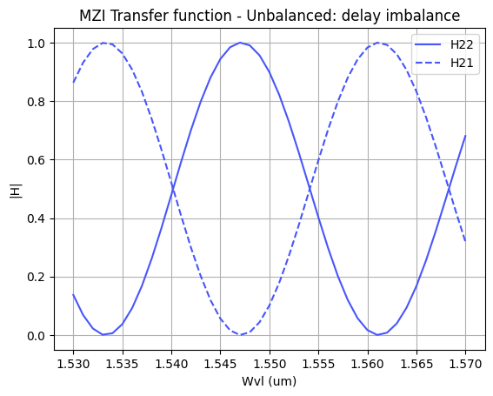
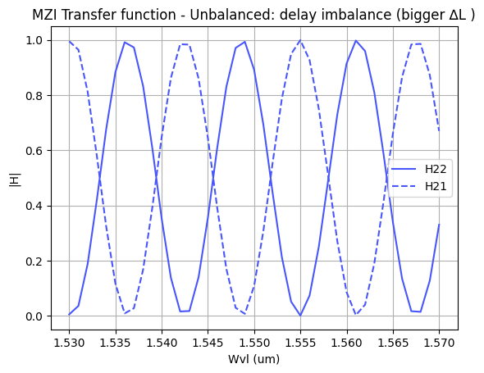
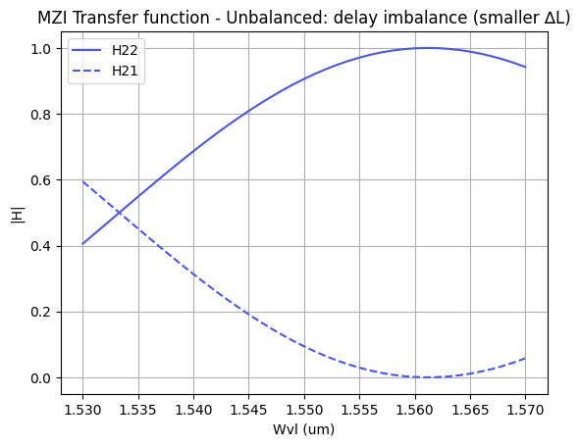
1. Unbalanced configuration: delay imbalance
The phase difference in these simulations is introduced by varying the length of the MZI arms: ΔL ≠ 0.
As we can observe in the second plot, comparing it with the first plot, increasing the path-length difference reduces the Free Spectral Range (FSR). On the contrary, as shown in the third plot, decreasing ΔL increases the FSR. We notice that the FSR is inversely proportional to the path-length difference.
Although it is not clearly noticeable in the simulated graphics, dispersion causes the fringes to appear chirped because the propagation constant does not vary linearly with wavelength. The group index determines the spectral period because it describes how quickly the optical phase changes with wavelength due to dispersion. Spectral period is inversely proportional to the group index.

Slide 7
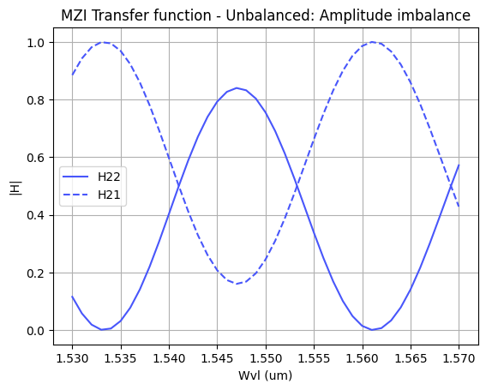
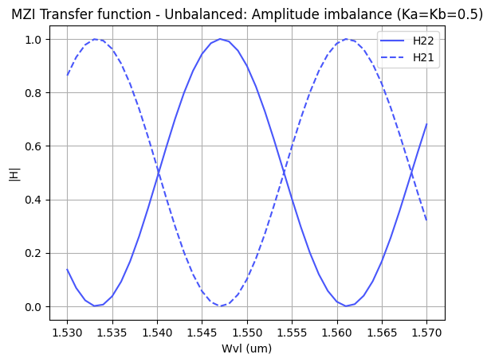
1. Unbalanced configuration: delay and amplitude imbalance
The phase difference in these simulations is introduced by varying the length of the MZI arms and modifying the coupling coefficients
If the couplers split the optical power unevenly (Ka ≠ Kb), the amplitudes of the fields propagating in the two arms become different. Even when the phase condition for constructive interference is satisfied, the fields do not add perfectly, which reduces the peak transmission as shown in the plot. This is, it reduces the extinction ratio.
In the lossless case, maximum rejection is obtained when the two paths have complementary amplitudes as shown ìn the second plot. This is Ka = 1 – Kb.
To compensate for propagation loss imbalance between the two arms, the input coupler must be made asymmetric so that more power is injected into the arm with higher loss and less into the arm with lower loss. In this way, after propagation, both fields reach the output with equal amplitudes, restoring optimal interference and maximizing the extinction ratio.

Slide 8
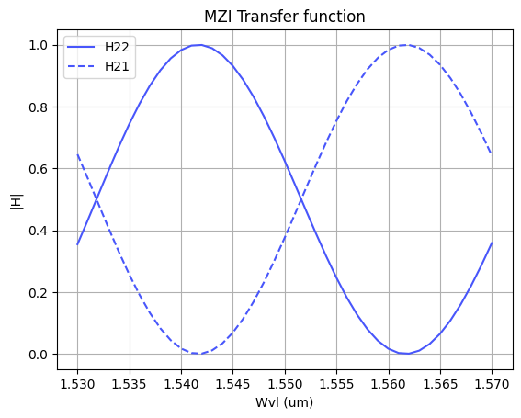


ASSESSMENT #2 – Recap from theory – Calculation of $ΔL$
Considering the n_{eff} values for the SOI cross-section, what would be the path difference ($ΔL= L_{u} −L_{d}$) needed to obtain a Free Spectral Range of 40 nm? Introduce the obtained value in the model to check the MZI response.
Hint: We assume 1550 nm as the central design wavelength ($λ_{0}=$1550 nm).
The required path difference to obtain a Free Spectral Range of 40 nm is obtained from the theoretical MZI expression using the group index (computed with np.gradient), resulting in $ΔL=13.99 um$.
As we can observe in the plot, the simulated MZI response shows the expected periodic behavior. Although the plotted wavelength range does not include two consecutive maxima, the graph shows a separation of about 20 nm between one maximum and the adjacent minimum, which corresponds to half of the FSR. Therefore, the complete FSR is confirmed to be approximately 40 nm.

Slide 9
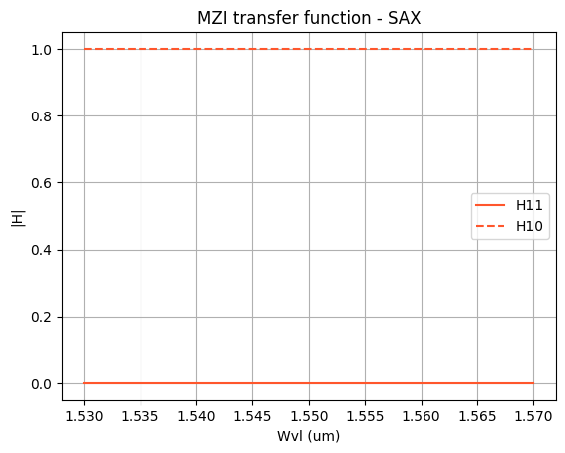
ASSESSMENT #3 – SAX implementation
Now, we are going to implement the design parameters in the MZI model developed in SAX and compare the response obtained with the one simulated by mathematical formulation.
After implementing the design in SAX, both plots show identical behavior. In both cases, one output remains close to 1 while the complementary output stays close to 0 over the whole wavelength range, which confirms the expected behavior for the balanced configuration.
The comparison validates that the SAX model has been correctly defined and that the individual components are properly connected. It must be noted that SAX uses port numbering (0,1) so its port 1 corresponds to port 2 in the analytical model.

Slide 10
Extra assessments
Assessment 4. Design an MZI for filtering at a specific wavelength. Calculate and adjust the arm lengths to configure the MZI to have a maximum transmission at 1550 nm.
Assessment 5. Let's see how the response of the MZI varies with the effective index. Vary the effective index of one of the arms and analyze how the spectrum shifts. To do this, you can use the data provided in the .txt files entitled ‘SiN’. Can you give an example of an application where this configuration is used?
Advanced level assessment. Explore how cascading two MZIs affects the transmission spectrum. To do so, design a system in which two MZIs are cascaded. Simulate and observe the spectrum, explaining how the transmission peaks behave.
Document all your results

Slide 11


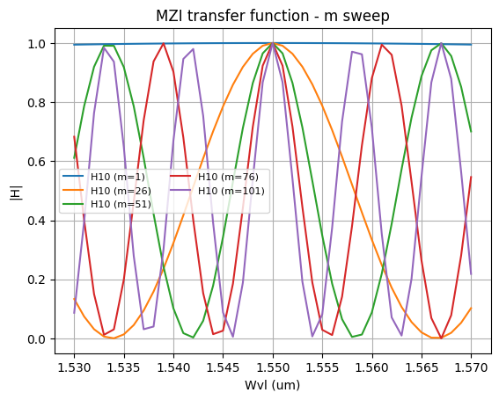
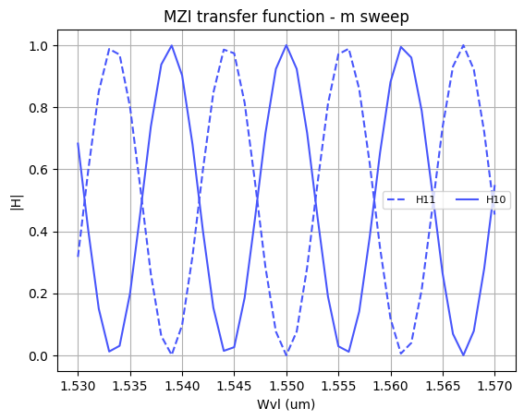
EXTRA ASSESSMENTS: ASSESSMENT 4
To achieve constructive interference at $λ_{0}=1550$nm, the arm length difference must satisfy the MZI phase condition:
A parametric sweep over m was performed to analyze its impact on the spectral response and to identify a suitable configuration for filtering. As observed in the plot, low values of m result in an excessively large FSR, which is not appropriate for practical filtering applications. Increasing m leads to finer spectral selectivity. For this reason, m=76 is selected to design a filter with the following response:

Slide 12
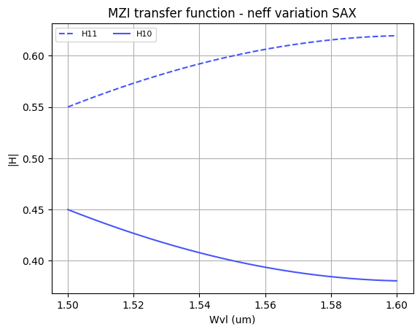
EXTRA ASSESSMENTS: ASSESSMENT 5
Varying the effective index in one arm modifies its propagation constant, introducing a phase mismatch that shifts the interference condition of the MZI. As observed in the SAX result, this leads to a gradual redistribution of power between the outputs. This behavior is consistent with the analytical results. (second plot)
An example of application is tunable MZI-based filters or optical modulators, where the effective index of one arm is controlled to shift the transmission spectrum and select or modulate specific wavelengths.

Slide 13

Thank you

