Slide 1
Ch12 Exercise Midterm Review Exercises
As usual, please ignore problem numbers and other oddly bulleted items ☺

Slide 3
Customer: 1data,1 processing
Remote request

Slide 5
Remote request

Slide 7
A and B are in different database location, so
Distributed request

Slide 8
Because product contain PROD_A and prod_B>>> Distributed

Slide 9
Begin work, commit work indicate that this is a procedural
SQL, but still can finished with one processing because two inserts
Are all located in location B
Product an customer DB are associated, since product
has two parts So there are multiple database
Distributed transaction

Slide 12
Because first insertion is located in location A, while the
Second insertion is located in location B, totally I have two requests,>>>
Transaction
Since database is also splitted into two location>>> distributed transaction

Slide 16
This question is asking what DBMS does:
Number 2 is like run Query

Slide 18
Homo: all the sites have the same DBMS
Heter: all the site have different DBMS, like one has SQL, one has orcale

Slide 21
The protocol is basically saying the transaction keeps doing , until the transaction forgot to
Commit and then it will rollback and undo the entire process

Slide 22
If One site didn’t commit, rollback
Do is like commit, undo is like rollback, redo is like committed later

Slide 23
Distributed databse
State

Slide 32
Distributed request because we need to
Gather all the information together for the
headquarter

Slide 33
Transitional dependcies:
Ven_code>>ven_name
Partical dependcit:
Inv_num>> sale date
(date go through as in_num increase)
PROD_LABEL=
PRO_DESCR
Particial depend:
Prod_num>>pro_price,pro_label, vendor code, vendor name
Inv_num, prod_num>>>>
Use ivv_num,prod_num to be the primary
Key to determine other factors

Slide 34
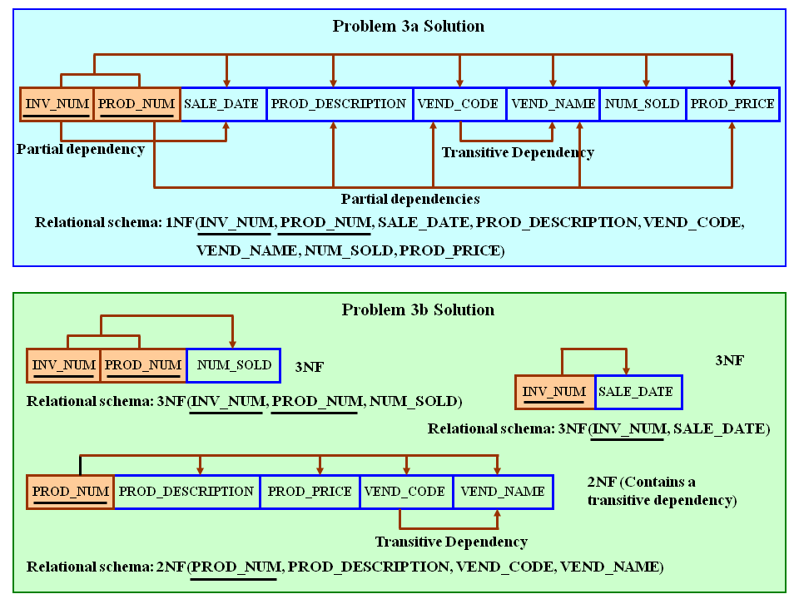
Figure P6.3a The Dependency Diagrams for Problems 3a and 3b

Slide 35
Remove all transitive dependencies, write the relational schema, and draw the new dependency diagrams. Also identify the normal forms for each table structure you created.
To illustrate the effect of Problem 3's complete decomposition, we have shown Problem 3a's dependency diagram again in Figure P6.3c.
Figure P6.3c The Dependency Diagram for Problem 3c
1NF
2NF

Slide 36
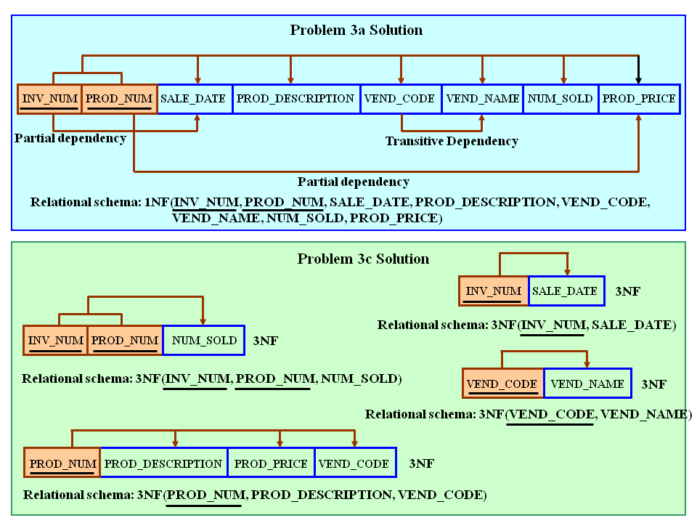
Remove all transitive dependencies, write the relational schema, and draw the new dependency diagrams. Also identify the normal forms for each table structure you created.
To illustrate the effect of Problem 3's complete decomposition, we have shown Problem 3a's dependency diagram again in Figure P6.3c.
Figure P6.3c The Dependency Diagram for Problem 3c
3NF

Slide 38
發票

