Slide 1


C# In the browser with Bridge.NET!
Mike Rosack
mike@rosacksoftwaresolutions.com
@mike_rosack
https://github.com/mrosack/presentations/tree/master/bridge.net

Slide 2
C# in the browser? What’s the point?
Web development in general is moving towards dynamic frontends
Javascript is really powerful for it’s ability to run on both the frontend and the backend
Can’t trust clients, so need the same/equivalent code in both places anyway
OK, but if I like C#, what do I do?
Sometime hopefully soon: WebAssembly/Blazor (but you can’t bet your job on it yet)
What to do now?

Slide 3
Bridge.Net
Transpiler, not a Compiler
Creates an equivalent Javascript version of your C# code
Runs on a Javascript reimplementation of most of the .NET BCL
Transpile Business Logic and call from existing Javascript
Works with any project type or framework
Write all front end script in Javascript
Works much better for traditional web apps than SPAs
Newer SPA frameworks have issues:
React works, but JSX isn’t available
Angular just doesn’t work

Slide 4
You’re writing Javascript in C#
Leaky abstraction for writing client side logic – you’ll do best if you already understand client side programming in Javascript
Most business logic can be transpiled as is – the abstraction doesn’t leak if the business logic doesn’t know about a browser
Don’t have access to .NET libraries in Nuget, but you could theoretically transpile them
One major exception is JSON.Net, which has a Bridge implementation
You DO have access to Javascript libraries in Nuget…

Slide 5
Interfacing with JS Ecosystem: Retyped
Sister project to Bridge.Net
Uses Typescript type definition files (d.ts) to create Nuget packages for interop

Slide 6


Use Cases
 | Traditional Web Site | SPA
Transpile Business Logic
Write all Client Side Logic in Bridge

Slide 7
Use Case: Client Side Scripting (MVC)
PRO: Use everything you love about .NET (Linq, decimals, sane OOP)
CON: Leaky abstraction – still need to know browser idioms, frameworks

Slide 8
DEMO
MVC APP WITH CLIENT SIDE BRIDGE SCRIPTING

Slide 9
Gotchas: Performance
Fast
Slow
Simple logic that can be translated directly to Javascript (int/float/double math/simple regexes)
Linq is generally fairly quick as long as you’re doing simple comparisons
.Net types that don’t translate to Javascript (decimal math)
Boxing/unboxing between Bridge and Javascript Types (Nullables especially)

Slide 10
DEMO
Performance TESTS

Slide 11
Other Gotchas
Things that seem equivalent aren’t always equivalent (bridge array/javascript array)
Reflection
Enough reflection works that you can be caught off guard when it doesn’t
Only thing I’ve come across is memberwise clone
Integration with module bundlers can be a pain because Bridge wasn’t intended to be used this way: https://github.com/bridgedotnet/Bridge/issues/3097

Slide 12
Still not convinced? A Case Study.
Greatland Corp: Business tax filing service (1099/w-2)
Traditionally a .Net shop
Complicated business logic for form rules
Immediate validation on client side preferred
Had issues in the past duplicating client and server side validations

Slide 13
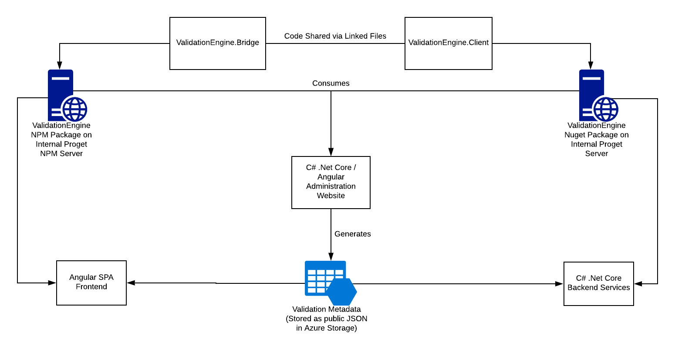
Solution: Bridge.NET
Common “Validation Engine” written in C#
Transpiled to Javascript using Bridge
Runs inside Angular SPA allowing real-time form calculations/validations
Forms are edited in editor by non-developers with real time preview
Forms are published as JSON metadata

Slide 14
Use Case: SPA with Transpiled Business Logic
PRO: Business logic is equivalent without any extra work
CON: Interop between Javascript and transpiled code can be nasty, especially with generics

Slide 15
DEMO
Angular spa with transpiled business logic

Slide 16
Dragons: Full Client Side Scripting (SPA)
PRO: Same as MVC – it’s .NET!
CON: Depending on the framework you’re using, you may be missing out on additional functionality provided by framework build processes (JSX in react)

Slide 17
DEMO
RETYPED REACT DEMO
https://github.com/Retyped/Demos/tree/master/ReactDemo

Slide 18
Thanks for Listening!
Mike Rosack
mike@rosacksoftwaresolutions.com
@mike_rosack
https://github.com/mrosack/presentations/tree/master/bridge.net

