Slide 1


C# In the browser with Bridge.NET!
Mike Rosack
mike@rosacksoftwaresolutions.com
@mike_rosack
https://github.com/mrosack/presentations/tree/master/bridge.net

Slide 2
C# in the browser? What’s the point?
Web development in general is moving towards dynamic frontends
Javascript is really powerful for it’s ability to run on both the frontend and the backend
Can’t trust clients, so need the same/equivalent code in both places anyway
OK, but if I like C#, what do I do?
Sometime hopefully soon: WebAssembly/Blazor (but you can’t bet your job on it yet)
What to do now?

Slide 3
Bridge.Net
Transpiler, not a Compiler
Can plug into both traditional MVC-style websites and SPA frameworks like Angular/React
Allows client side Javascript to be written in .NET
Allows business logic to be translated into Javascript instead of writing twice

Slide 4
Still not convinced? A Case Study.
Greatland Corp: Business tax filing service (1099/w-2)
Traditionally a .Net shop
Complicated business logic for form rules
Immediate validation on client side preferred
Had issues in the past duplicating client and server side validations

Slide 5
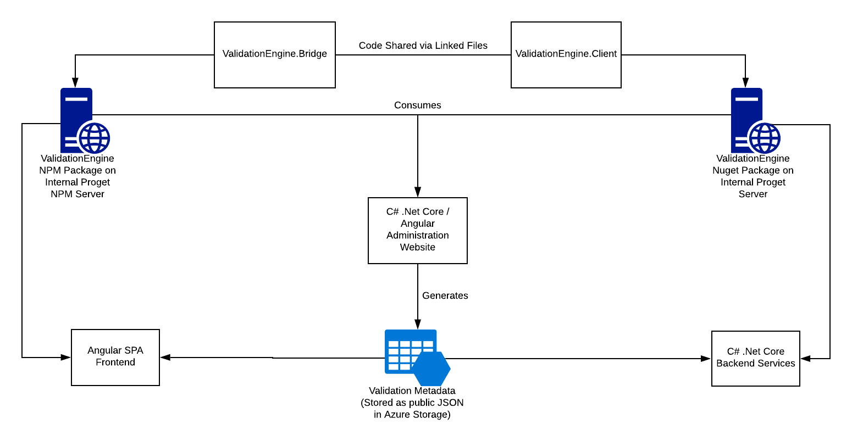
Solution: Bridge.NET
Common “Validation Engine” written in C#
Transpiled to Javascript using Bridge
Runs inside Angular SPA allowing real-time form calculations/validations
Forms are edited in editor by non-developers with real time preview
Forms are published as JSON metadata

Slide 6
Gotchas
Performance
Where code translates closer to 1-1 performance will be better
.NET specific functionality works but can be slow (decimals, extended regex functionality)
Things that seem equivalent aren’t always equivalent (bridge array/javascript array)
Reflection
Enough reflection works that you can be caught off guard when it doesn’t
Integration with module bundlers can be a pain because Bridge wasn’t intended to be used this way: https://github.com/Azure/monaco-kusto/issues/22

Slide 7
Interfacing with JS Ecosystem: Retyped
Sister project to Bridge.Net
Uses Typescript type definition files (d.ts) to create Nuget packages for interop

Slide 8
Use Case: Transpiling Business Logic
PRO: Business logic is equivalent without any extra work
CON: Interop between Javascript and transpiled code can be nasty, especially with generics

Slide 9
DEMO
Angular spa with transpiled business logic

Slide 10
Use Case: Client Side Scripting (MVC)
PRO: Use everything you love about .NET (Linq, decimals, sane OOP)
CON: Leaky abstraction – still need to know browser idioms, frameworks

Slide 11
DEMO
MVC APP WITH CLIENT SIDE BRIDGE SCRIPTING

Slide 12
Use Case: Client Side Scripting (SPA)
PRO: Same as MVC – it’s .NET!
CON: Depending on the framework you’re using, you may be missing out on additional functionality provided by framework build processes (JSX in react)

Slide 13
DEMO
RETYPED REACT DEMO
https://github.com/Retyped/Demos/tree/master/ReactDemo

Slide 14
Thanks for Listening!
Mike Rosack
mike@rosacksoftwaresolutions.com
@mike_rosack
https://github.com/mrosack/presentations/tree/master/bridge.net

