Slide 1

C# In the browser with Bridge.NET!
Mike Rosack
mike@rosacksoftwaresolutions.com
@mike_rosack
github.com/mrosack/presentations/master/bridge.net

Slide 2
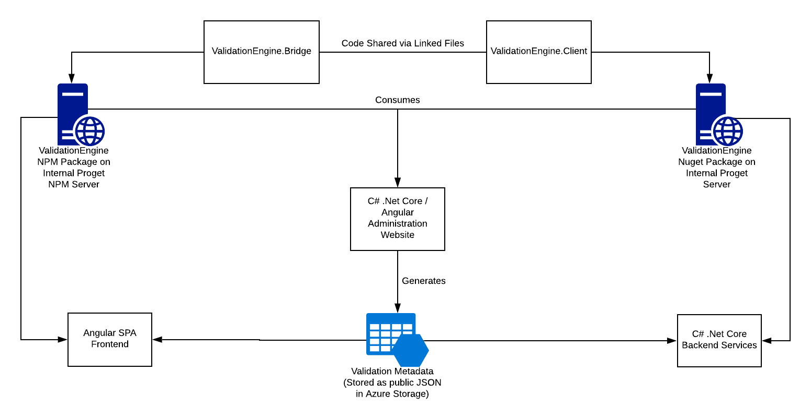
Greatland Form Engine Architecture

