Slide 1
NCAA March Madness Bracket Predictive Analytics
Farshad Miraftab, Matthew Rosendin, Nabeel Saleem

Slide 2
Agenda
GOAL: Correctly predict the true NCAA tournament bracket for 2017 (and future years)
Tournament Overview
Descriptive Analytics
Dataset
Data Cleanup
Feature Description and Selection
Method Overview
Classification Algorithms
Simulation
Classification Algorithm Results
Simulation Results

Slide 3
Tournament Overview
Nabeel to review
Annual college basketball tournament
The ‘top’ 64 teams are admitted to the tournament
Single game elimination (a total of 63 matches are played concluding the champions)
32 + 16 + 8 + 4 + 2 + Final = 6
There are 2⁶³ ways of selecting a bracket (~9.2 quintillion ways – impossible!)

Slide 4
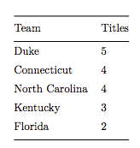
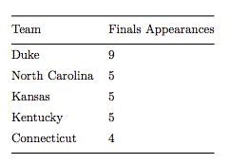
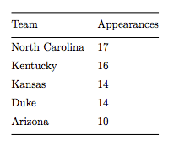
Descriptive Analytics
Most Titles
Most Finals Appearances
Most Final Four Appearances

Slide 5
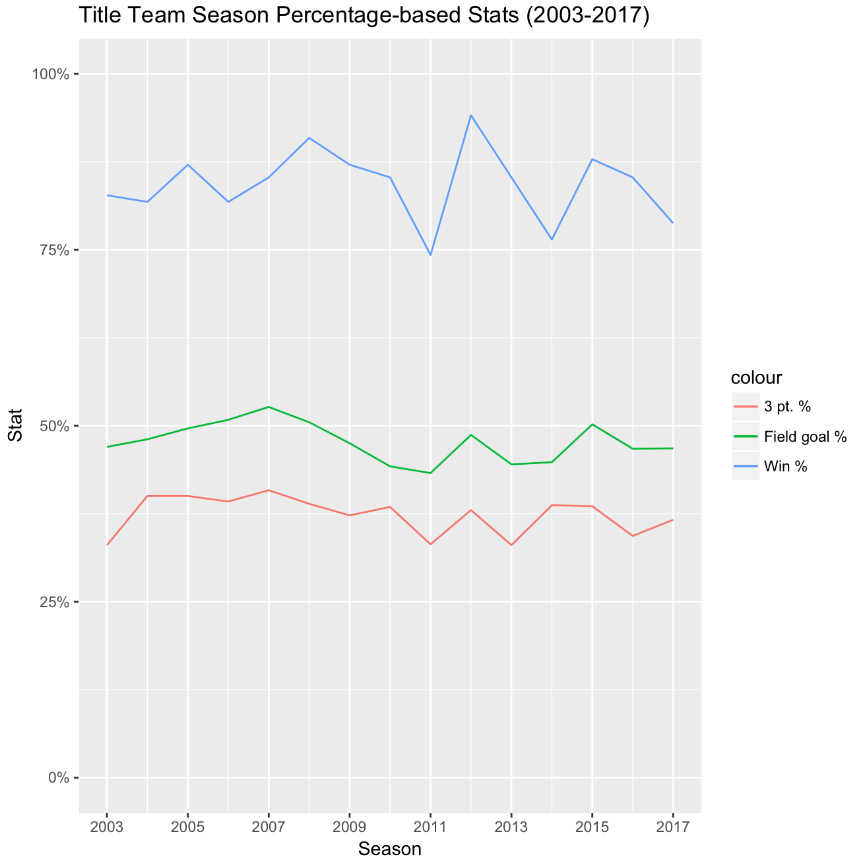

Slide 6
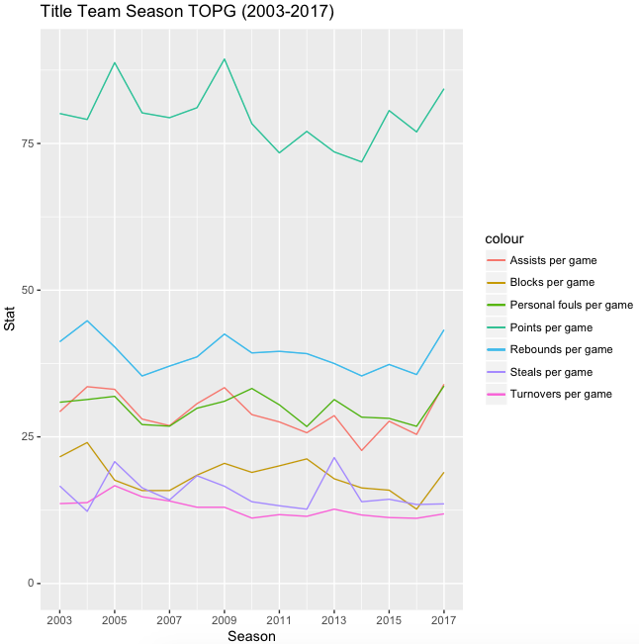

Slide 7
Data Sets
Team to add
Table 1 – Teams.csv (365x2)
A list of all NCAA teams
Table 2 – RegularSeasonDetailedResults.csv (76,000x34)
Historical season matches dating back to 2003
Winning and Losing team stats (points, assists, blocks, fouls etc.)
Data manipulation required to iterate through each team to aggregate season stats by team by season
Table 3 – School Ratings link (5307x12)
Additional season stats (MOV, SRS, SOS, DSRS, OSRS)
Table 4 – TourneyCompactResults.csv (2114x8)
All tournament matches along with outcome since 1985
Table 5 – TourneySeeds.csv (2151x3)
The seeds of teams that were admitted to tournament forever season

Slide 8
Method Overview – Classification Algorithms
Farshad to expand on these thoughts
Random Forest
Logistic Regression
Logistic Regression with Regularization
CART
Support Vector Machine
Linear Kernel
Radial Kernel
Accuracy for each model
Cross validation visuals for RF, Logistic regression regularization, CART, and SVM
ROC curve for all models except SVM

Slide 9
Method Overview – Simulation

Slide 10
Results – Classification Algorithms

Slide 11
Results – Simulation

