Slide 1

NCAA March Madness Analytics
Farshad Miraftab
Matthew Rosendin
Nabeel Saleem

Slide 2
Agenda
Context & Goal
Descriptive Analysis
Data Preparation and Manipulation
Model Results & Comparisons
Monte Carlo Simulation
Impact & Opportunities for Improvement

Slide 3
Context
Each year, the greatest tournament in college sports takes place in what is known as March Madness
Excluding the first four at large teams, 64 total teams are entered
Millions participate every year in hope of beating others in predicting the best bracket
There are 2⁶³ different ways to fill a bracket
Odds are 1 in 9.2 Quintillion!!!

Slide 4
Goal
What
Predict the outcome of the 63 games of the 2017 tournament, in hope of placing our bracket in the top 25 percentile on ESPN’s Annual Tourney Challenge
How
Step 1: Predict probabilities of outcome for all pairwise matchups
Step 2: Perform a simulation using the probabilities to account
Why
Predict a perfect bracket next year and make a $1B off Warren Buffet

Slide 5
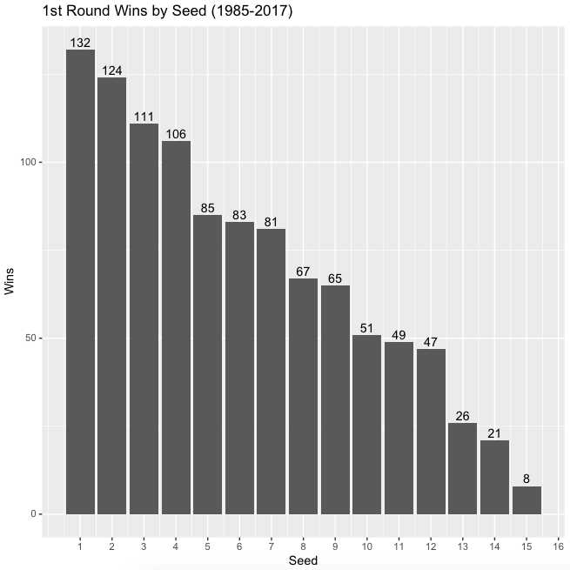
Descriptive Analysis

Slide 6
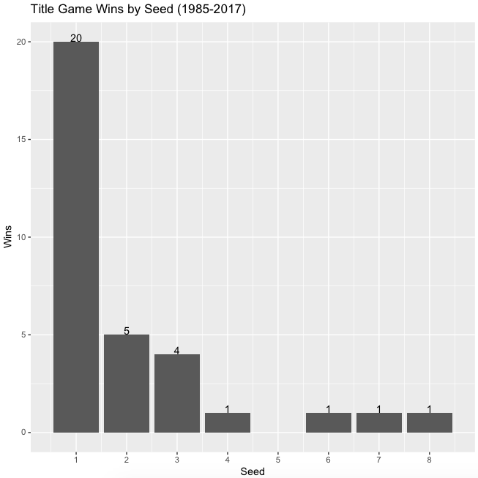
Descriptive Analysis (Cont’d)

Slide 7
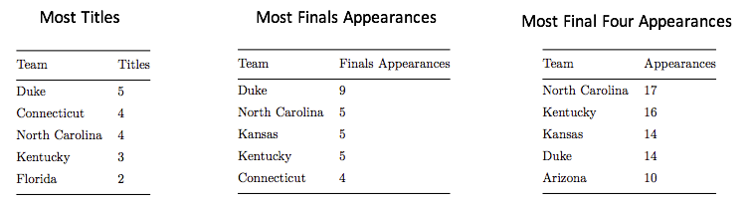
Descriptive Analysis (Cont’d)
The first time 64 teams were introduced was in 1985
(1985-2017)

Slide 8
Data Sources & Manipulation
Table 1:
Teams.csv (365x2)
A list of all NCAA D1 Men’s team
Table 3:
School Ratings link
(5307x12)
Team Season Ratings (e.g., SRS)
Table 2:
RegularSeasonDetailedResults.csv (76kx34)
All season matches from 2003 to present.
Stats for both winning and losing teams (e.g. assists).
Aggregate games into season stats.
Table 4:
TourneyCompactResults.csv (2114x8)
All tournament matches along with outcomes since 1985
Table 5:
TourneySeeds.csv (2151x3)
The seeds of teams that were selected.

Slide 9
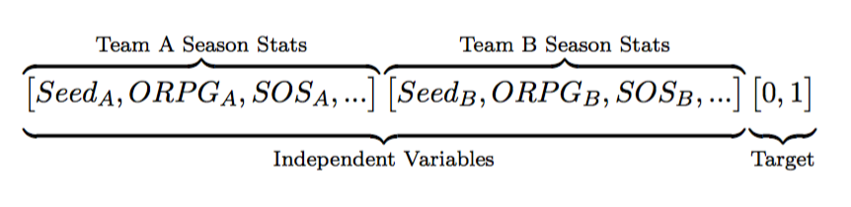
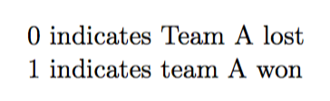
Features Selected
After iterating through various combination of features, we settled on a total of 18 features.
Features: Seeds, APG, BPG, SPG, ORPG, FGP, MOV, SOS, SRS.

Slide 10
Features Selected
After iterating through various combination of features, we settled on a total of 18 features.
Features: Seeds, APG, BPG, SPG, ORPG, FGP, MOV, SOS, SRS.

Slide 11
Classification Techniques
Logistic Regression
Logistic Regression with Regularization
Random Forest
CART
Support Vector Machine – Linear Kernel
Support Vector Machine – Radial Kernel

Slide 12
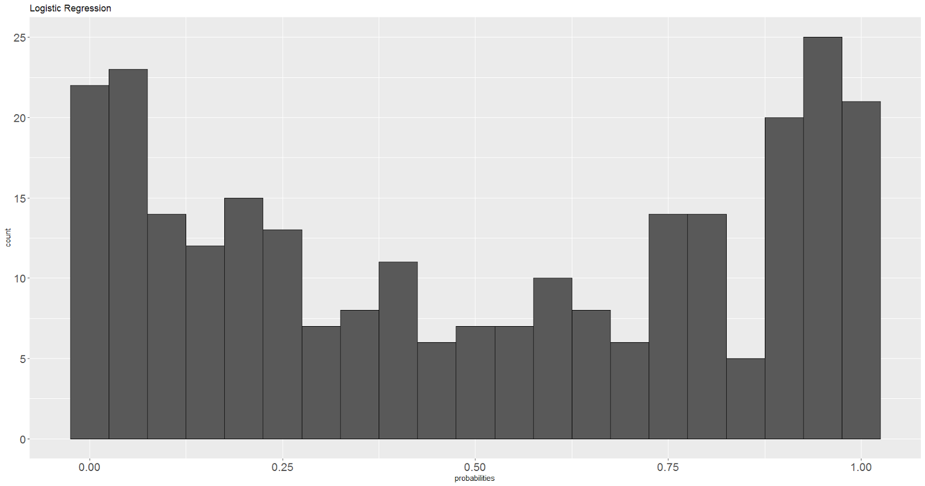
Logistic Regression Results
Accuracy | FPR | TPR
84.3% | 15.6% | 84.2%

Slide 13
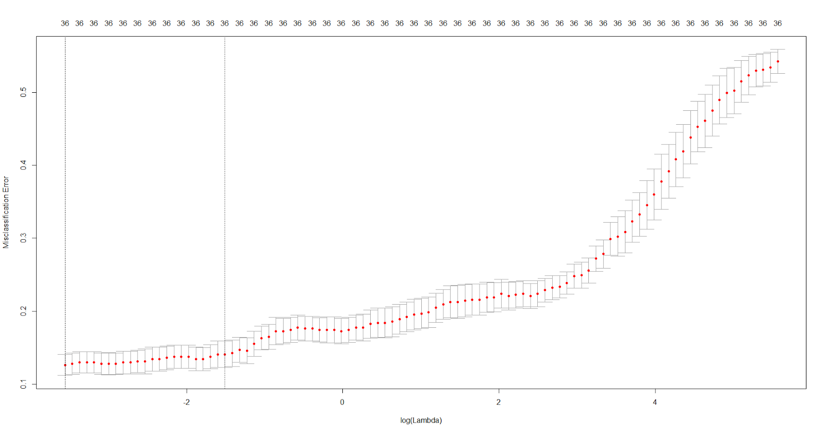
Logistic Regression - Regularization Results

Slide 14
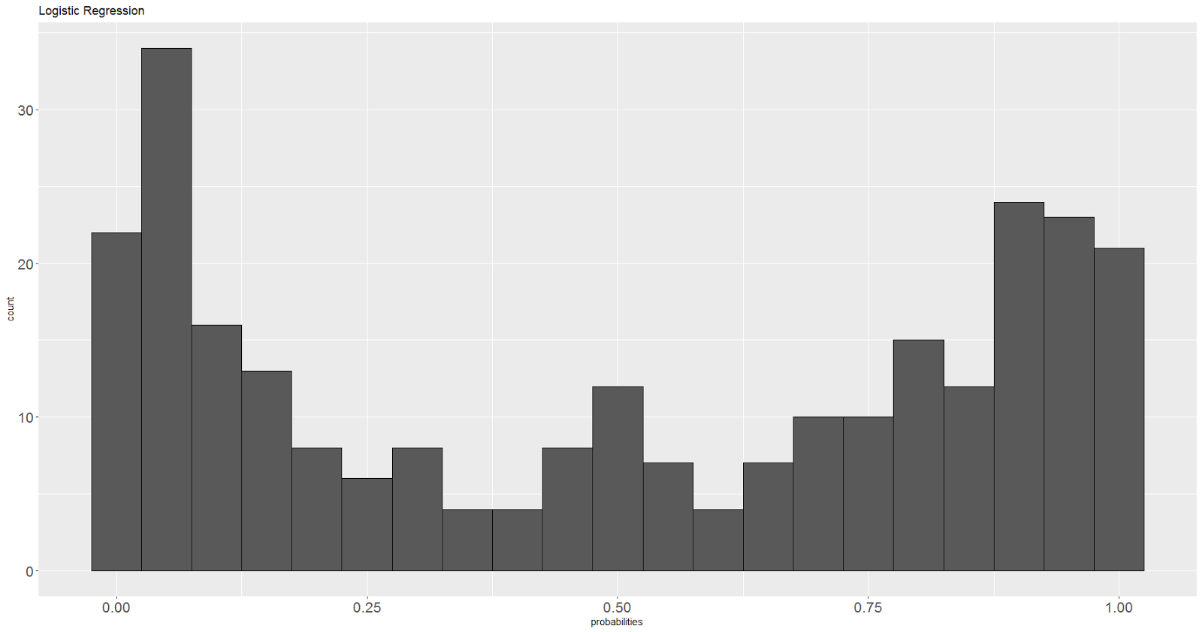
Logistic Regression - Regularization Results
Accuracy | FPR | TPR
86.9% | 15.6% | 89.5%

Slide 15
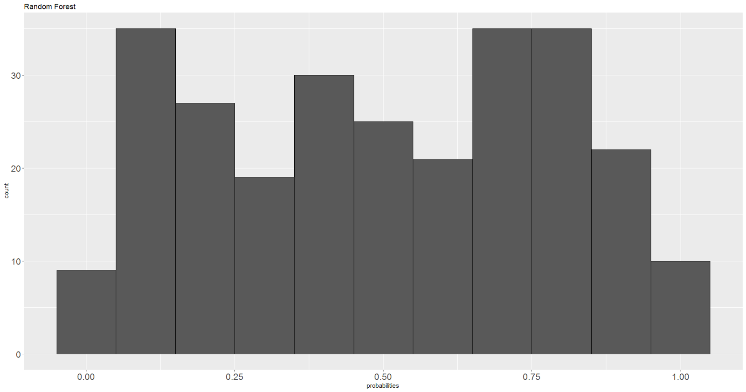
Random Forest Results
Accuracy | FPR | TPR | Mtry
82.5% | 17.0% | 82.0% | 6

Slide 16
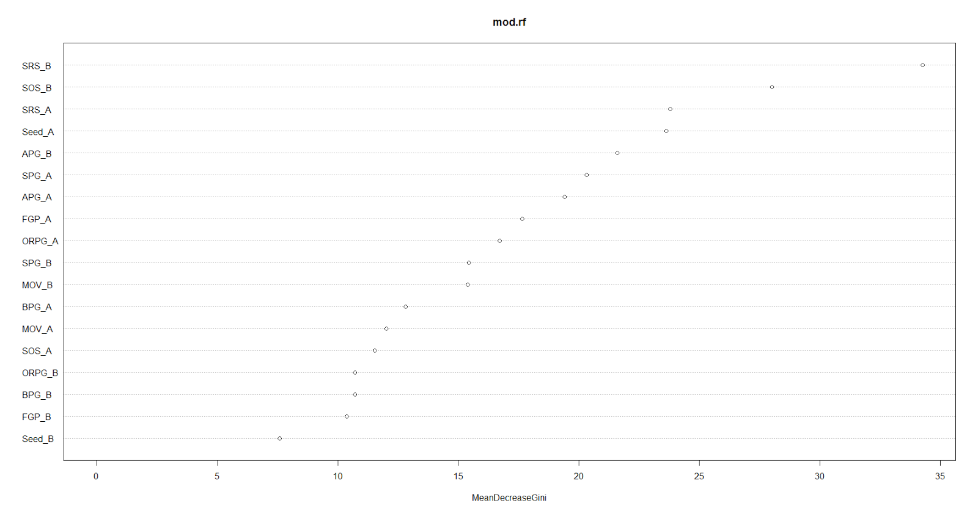
Random Forest – ‘Important’ Features

Slide 17
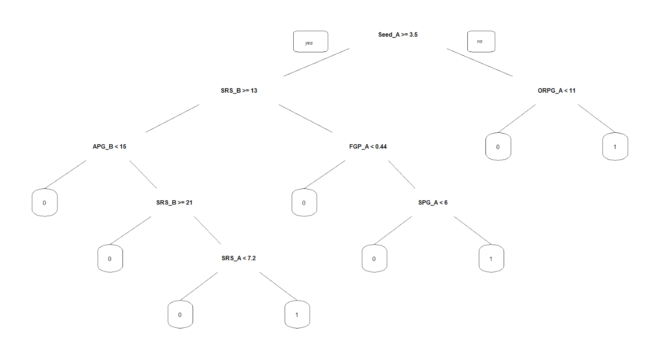
CART Results
Accuracy | FPR | TPR | Cp
73.1% | 30.4% | 76.7% | .02

Slide 18
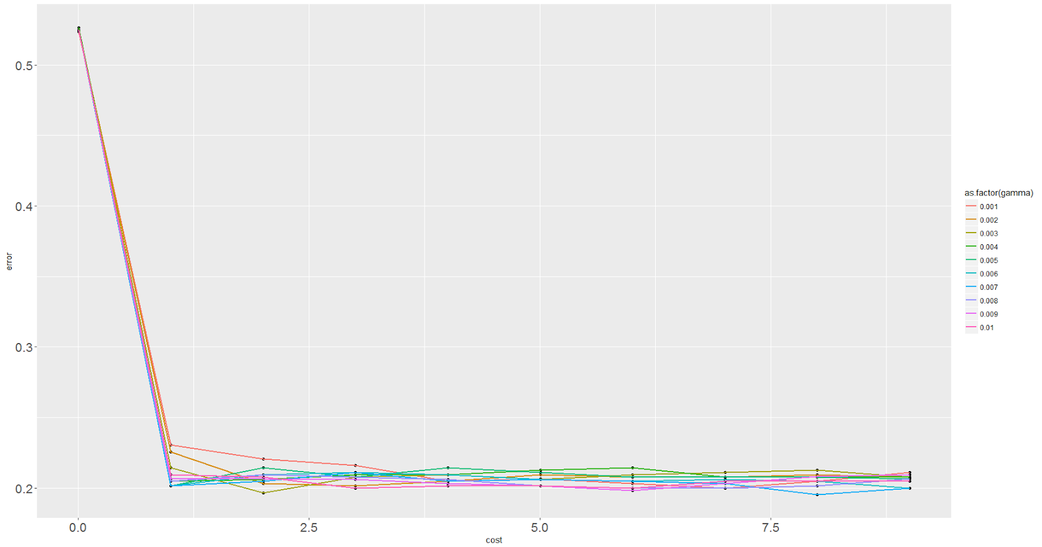
Support Vector Machines
Kernel | Accuracy | FPR | TPR | Cost Value
Linear | 83.6% | 18.5% | 82.7% | 1
Radial | 82.1% | 14.1% | 81.2% | .19

Slide 19
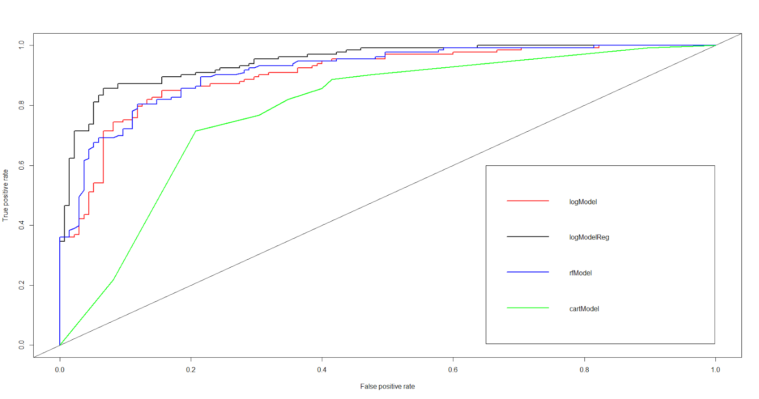
Summary of Models
Model | Accuracy | AUC | FPR | TPR
Logistic Regression | 84.3% | 90.3% | 15.6% | 84.2%
Logistic Regression - Regularization | 86.9% | 94.7% | 15.6% | 89.5%
Random Forest | 82.5% | 91.4% | 17.0% | 82%
CART | 73.1% | 78.7% | 30.4% | 76.7%
SVM – Linear Kernel | 83.6% | N/A | 14.5% | 81.2%
SVM – Radial Kernel | 82.1% | N/A | 18.5% | 82.7%

Slide 20
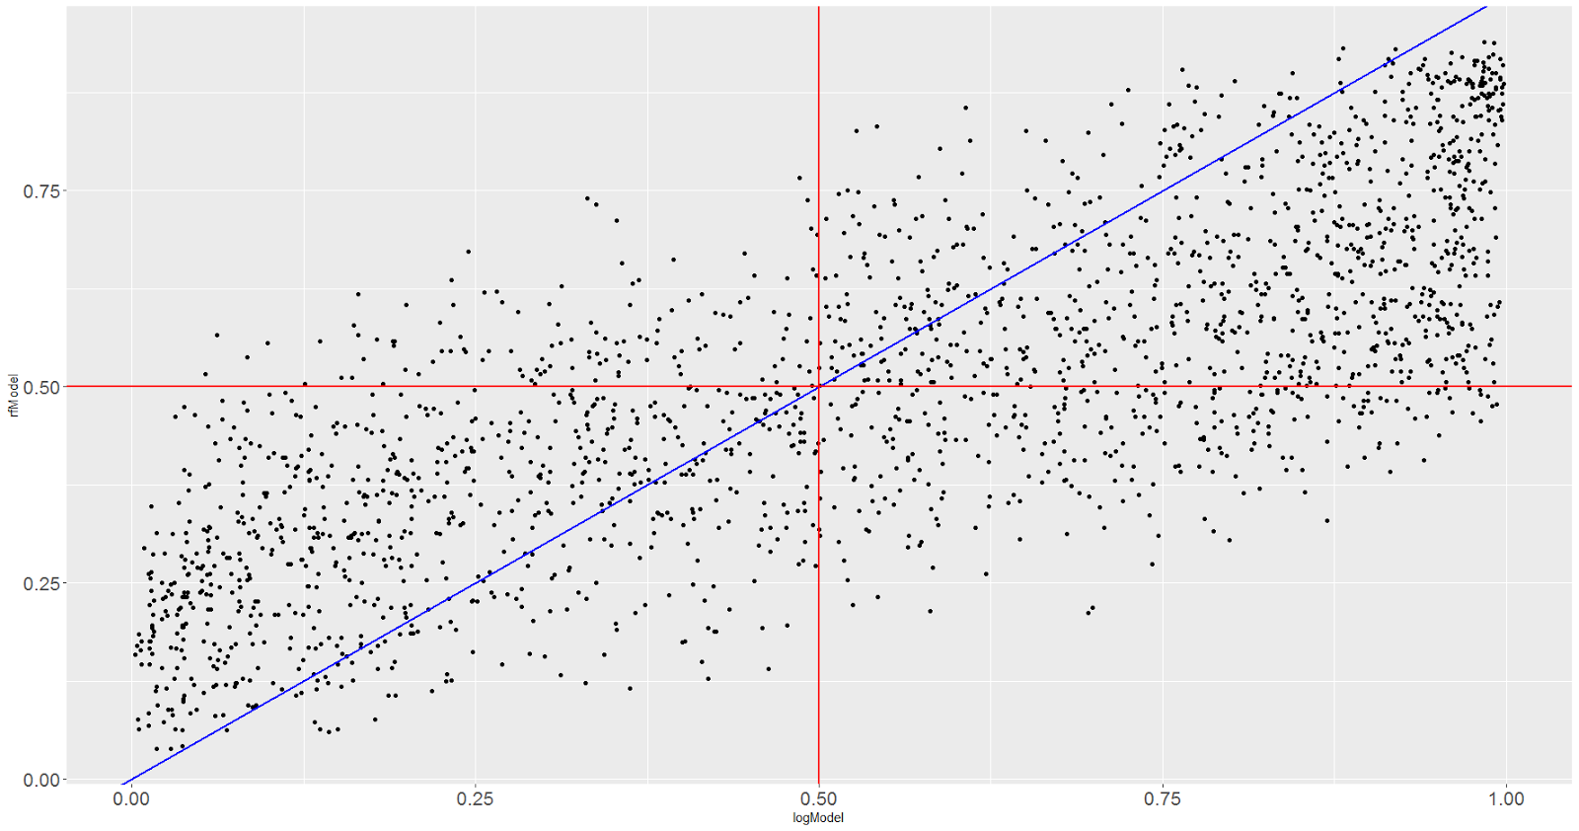
Logistic Regression vs. Random Forest

Slide 21
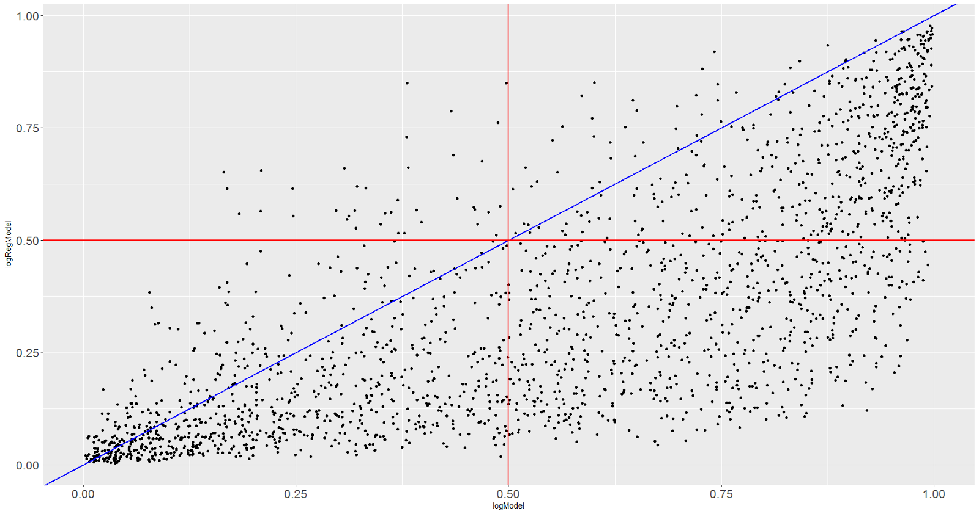
Logistic Regression - Reg vs. Random Forest

Slide 22
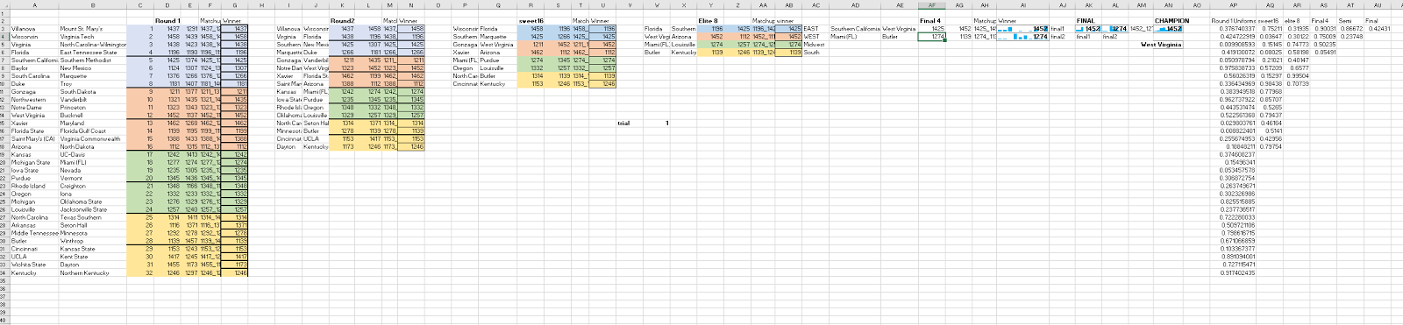
Simulating 2017 Bracket
Major Benefits
Accounts for uncertainty in prediction for a given match.
Ability to ‘evaluate’ thousands of potential brackets and identify sensitivities.
Logistic Regression probabilities used for simulation
5,000 trials performed in excel

Slide 23
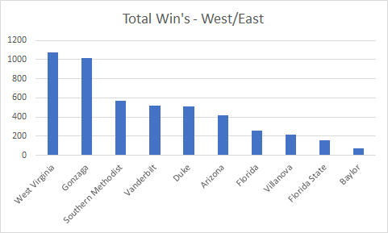
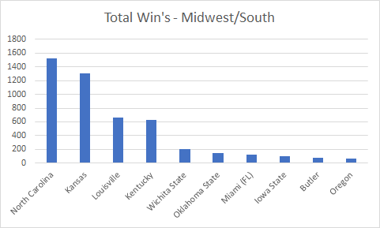
Simulation Results
81.9 percentile
42/63 total picks correct

Slide 24
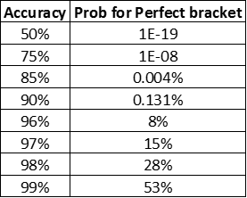
Impact and Opportunities for Improvement
Feature engineering and selection
Increased granularity in features (e.g., player stats)
Observe team trends throughout season (e.g., momentum going into tournament)
Ensemble models to alleviate ‘conflicting’ probabilities
Note: Even with very accurate model, chances of predicting a perfect bracket are terrible

