Slide 1
Transport Economics and Appraisal
Matt Routley, Director, Research & Planning Analytics, Metrolinx

Slide 2
Introduction

Slide 3
Questions for You
Quantifying the costs and benefits of a project is important when planning it?
Projects can be consistently evaluated and ranked?
Project selection should be based only on quantifiable metrics?
All benefits can be quantified?

Slide 4
The need for appraisal
There is no shortage of promising ideas for transit
Every year new infrastructure, services, and policies are proposed to expand and improve transit
How can decision makers choose which investments to make?

Slide 5
Business Cases as a tool for appraisal

Slide 6
Business Cases
A Business Case is a comprehensive collection of evidence and analysis that sets out the rationale for why an investment should be implemented to solve a problem or address an opportunity
Business cases provide evidence to decision-makers, stakeholders, and the public as a crucial part of transparent and evidence-based decision making processes
They are used throughout any proposed investment’s lifecycle, including planning, delivery, management, and performance monitoring

Slide 7
Four cases of appraisal
Strategic Case
Determines the strategic value of addressing a problem or opportunity with proposed options
Options are evaluated against strategic objectives that link the problem/opportunity to regional goals and other - policies
Determines the strategic value of addressing a problem or opportunity with proposed options
Economic Case
Assesses the economic costs and benefits of the proposal to individuals and society as a whole, and spans the entire - period covered by the investment
Uses standard economic analysis to detail benefits and costs in economic terms
Establishes ‘what the benefit to society’ is in economic terms
Financial Case
Assesses the affordability of the proposal, its funding arrangements and technical accounting issues and financial - value for money
Focuses on capital and resource requirements, including taxation issues directly related to the intervention and - indirectly resulting from the intervention. The financial case is concerned with the impact upon budgetary totals.
Establishes ‘how much the project will cost’ in financial terms
Deliverability and Operations Case
Provides evidence on the overall viability of one or more options for addressing the problem/opportunity
May consider procurement strategies, deliverability risks, operating plans and risks, or organizational risks
Establishes ‘what is required to deliver and operate’ the project
Examples of business cases
Metrolinx publishes many of its business cases at http://www.metrolinx.com/en/regionalplanning/projectevaluation/benefitscases/benefits_case_analyses.aspx
The four chapters

Slide 8
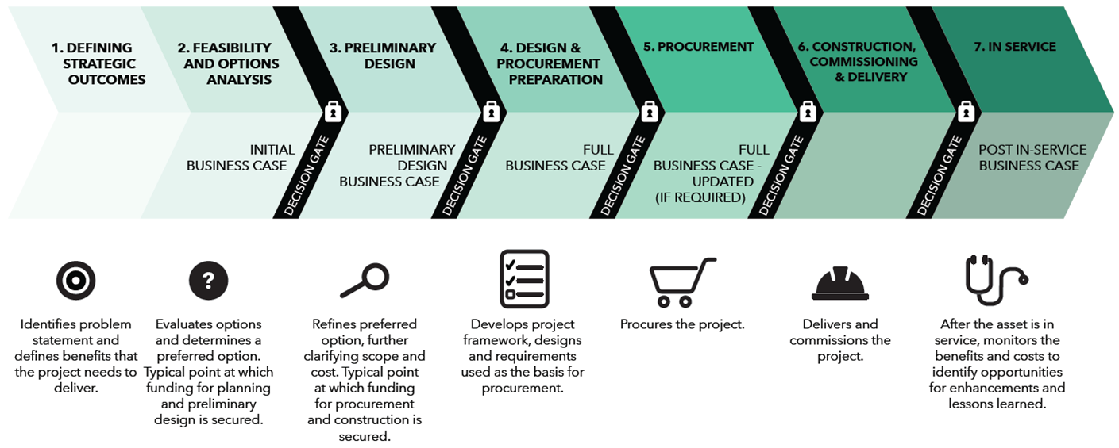
Business cases used throughout the project lifecycle
Notes:
Initial Business Case
Compares project options and selects a preferred option for further refinement and design.
This business case is typically used to secure Provincial funding for planning and preliminary design.
Preliminary Design Business Case
Takes the recommended option of the Initial Business Case and reviews different approaches to refine and optimize it, further clarifying scope and cost.
This business case is typically used to secure Provincial funding for procurement and construction.
Full Business Case
Confirms a specific option (including benefits realization, financing, and delivery plans) for procurement.
Post-implementation Business Case
Reviews the actual costs and performance of the investment after the asset has gone into service.
This business case provides lessons learned and opportunities to enhance the service being provided.

Slide 9
Analytical principles

Slide 10
Strategic analysis

Slide 11
Economic analysis

Slide 12
Financial analysis

Slide 13
Deliverability and operations analysis
https://www.andrewheiss.com/blog/2017/09/15/create-supply-and-demand-economics-curves-with-ggplot2/

